Slide 1
Data-Driven Decisions:
A New Resource for Understanding Early Childhood Care and Education Supply and Demand
May 19, 2025

Slide 2
Highlights
Developed with support of William R. Kenan, Jr. Charitable Trust
Synthesized and integrated set of key Early Childhood Care and Education (ECCE) data
Available for all Virginia localities and Ready Regions
Unique data and features

Slide 3
One-stop for key ECCE indicators
Synthesized and integrated Early Childhood Care and Education (ECCE) data from variety of sources

Slide 4
One-stop for key ECCE indicators
Indicators allow users to explore:
Demand for ECCE services
Supply of ECCE
Key Outcomes

Slide 5
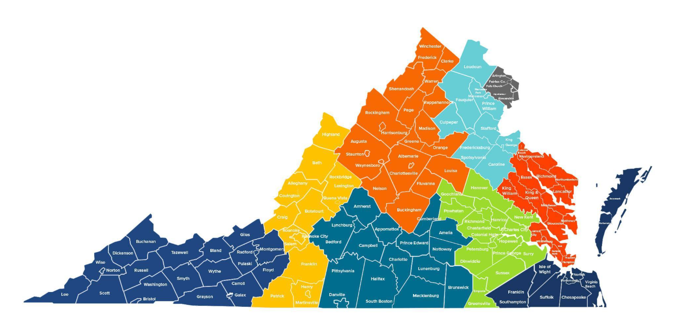
Locality-level data

Slide 6
Unique data & features
Complete picture of ECCE supply in one place
Locality-level Early Head Start/Head Start slots
Custom methodology to estimate children in families at or below 85% SMI
Price and affordability of ECCE services
On-demand analysis of any combination of localities and/or Ready Regions

Slide 7
Next Steps
ECCE data resources for legislative districts
Additional information on infant & toddler supply and demand
Neighborhood-level supply & demand resources to better support strategic local investments and supply-building

Slide 8
https://vecf.org/supply-and-demand-data/

Slide 9
Screenshots

Slide 11
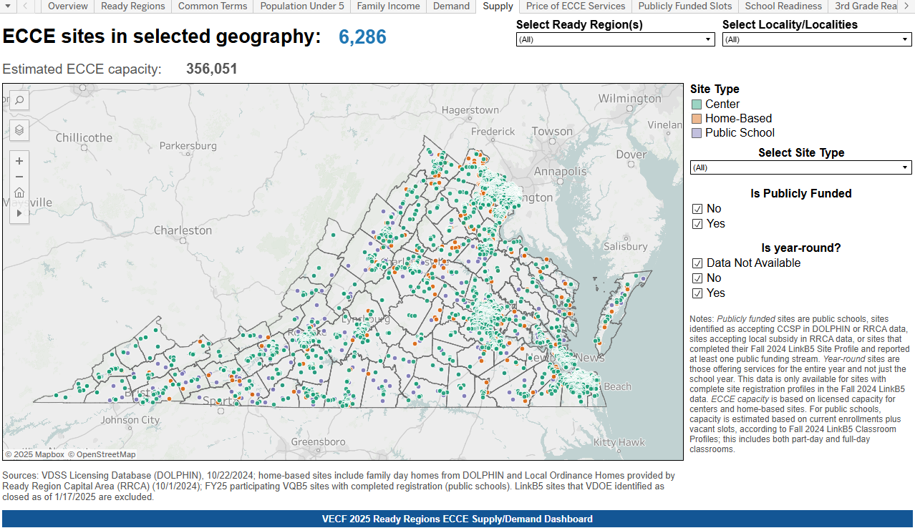

Slide 12
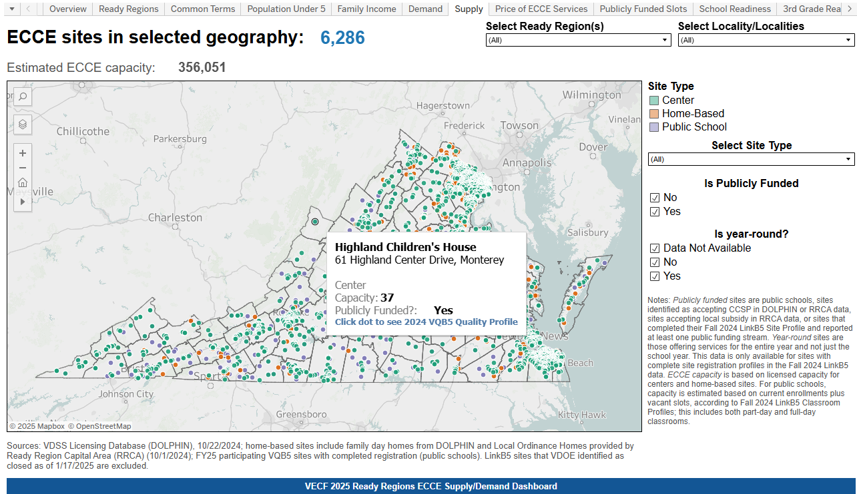

Slide 13
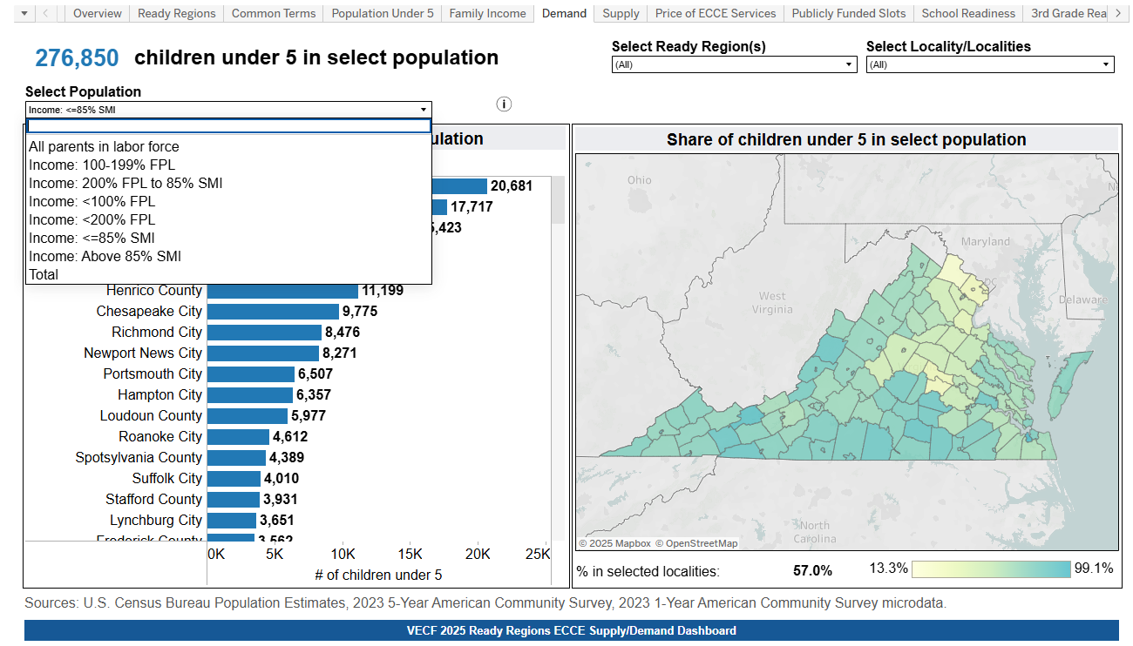

Slide 14
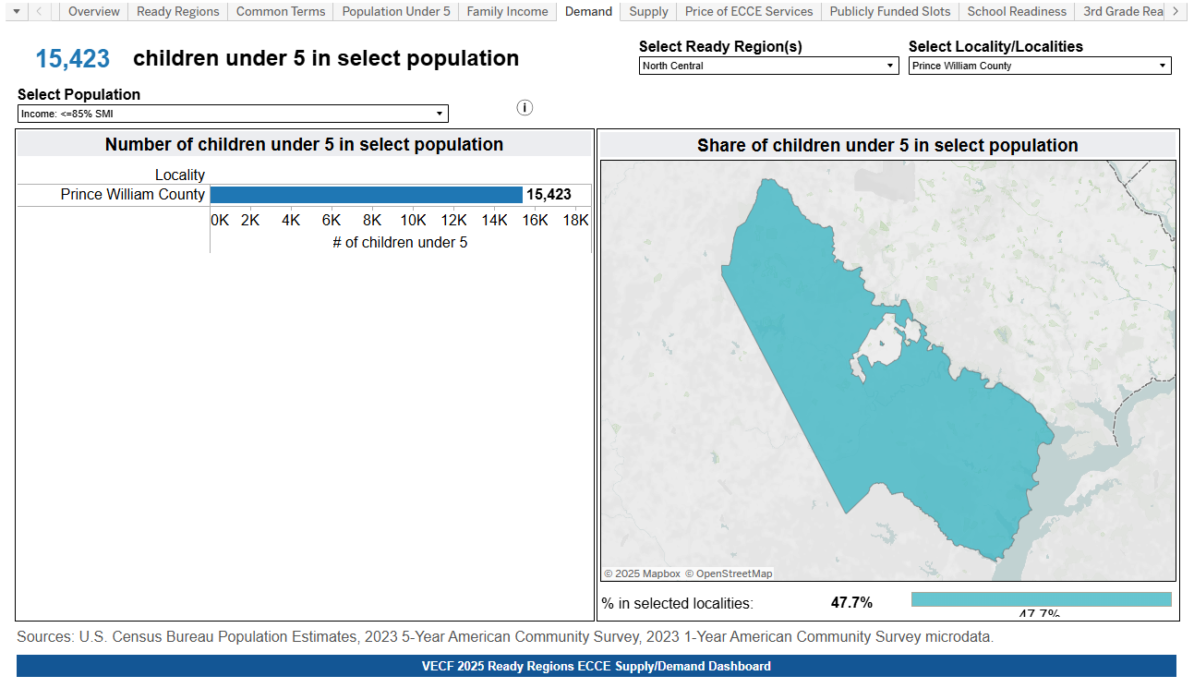

Slide 15
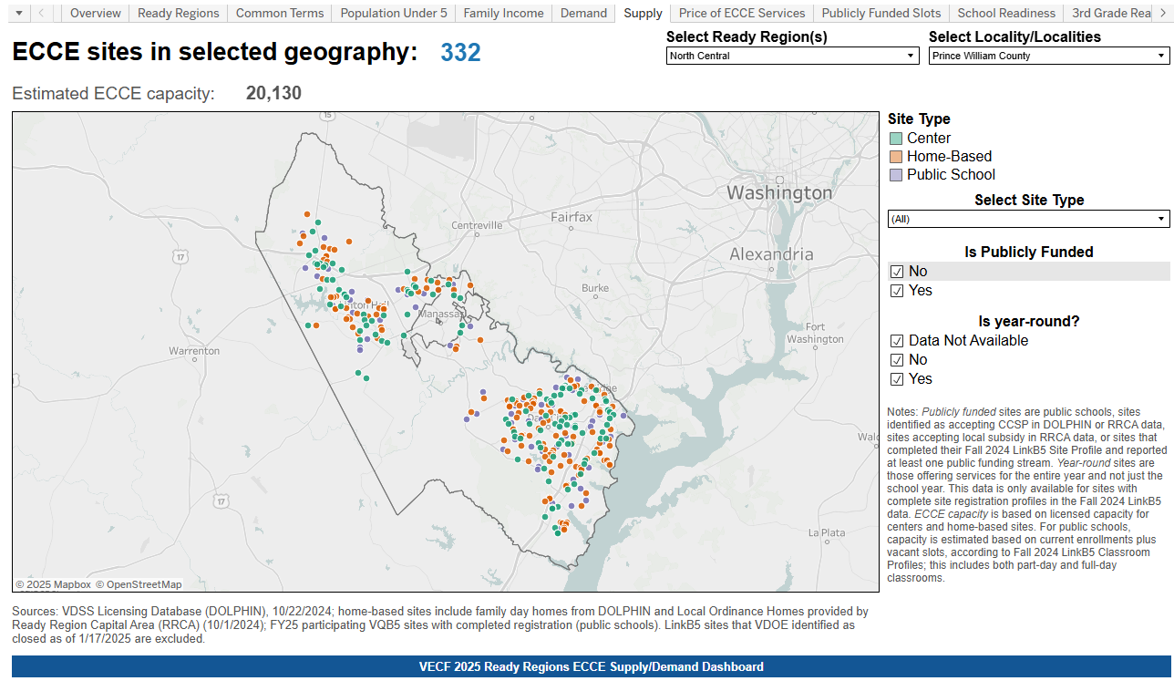

Slide 16
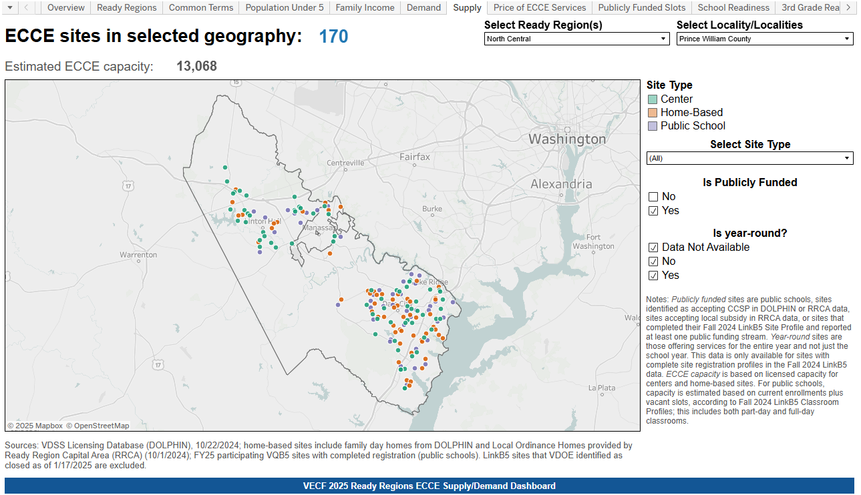

Slide 18
