Slide 1
Potential Topics for 2026 Legislative Session
Andrew Block, Megan Schaefer, Christine Schulman

Slide 2
REVIEW and preview
Review:
Review of April Meeting
Plan for Today
Reminder of what we can cover at August meeting
Preview:
Provide preliminary information on potential legislative topics for Commission consideration.
Ask for direction from Commission on potential drafting.
Notes:
List of sources from 1 Cohen's Handbook of Federal Indian Law § 9.03 (2025)
INTERNATIONAL LAW: "The United Nations Declaration on the Rights of Indigenous Peoples directs states to consult with Indigenous Peoples and to obtain their free, prior, and informed consent concerning some matters.162 These matters include the adoption and implementation of “legislative or administrative measures that may affect” Indigenous Peoples,163 the storage of hazardous materials on Indigenous lands,164 and the approval of projects that affect Indigenous lands, territories, and resources.165 These obligations are discussed in detail in Ch. 12, The Role of International Law." 1 Cohen's Handbook of Federal Indian Law § 9.03 (2025)

Slide 3
Intro
Conservation Easements
Indian Child Welfare Act (ICWA)
In-state tuition for tribal members.
Other discussion items.

Slide 4
Conservation and open space Easements

Slide 5
Conservation Easements: definitions
"Conservation easement" means a nonpossessory interest of a holder in real property, whether easement appurtenant or in gross, acquired through gift, purchase, devise, or bequest imposing limitations or affirmative obligations, the purposes of which include retaining or protecting natural or open-space values of real property, assuring its availability for agricultural, forestal, recreational, or open-space use, protecting natural resources, maintaining or enhancing air or water quality, or preserving the historical, architectural or archaeological aspects of real property.” Va. Code. Sec. 10.1-1009.
"Open-space easement" means a nonpossessory interest of a public body in real property, whether easement appurtenant or in gross, acquired through gift, purchase, devise, or bequest imposing limitations or affirmative obligations, the purposes of which include retaining or protecting natural or open-space values of real property, assuring its availability for agricultural, forestal, recreational, or open-space use, protecting natural resources, maintaining or enhancing air or water quality, or preserving the historical, architectural or archaeological aspects of real property. Va. Code. Sec. 10.1701.

Slide 6
Types of "conservation" Easements in VA
Open Space Easements
Governed by the Open Space Land Act (Va. Code. Sec. 10.1-1700 and following)
Held by "Public Bodies."
Conservation Easements
Governed by the Virginia Conservation Easement Act. (Va. Code. Sec. 10.1-1009 and following)
Held by private individuals/groups or, in some circumstances, by certain governmental bodies.
Easements are comparable in effect, and benefit, to landowner.
"

Slide 7
Current situation in VA
Tribes lack ability to hold any kind of conservation easement.
Tribes can partner with easement holders when they own/purchase land. For example:
Mattanock- Nansemond/Ducks Unlimited Easement Partnership
Cross Swamp - Nansemond/Ducks Unlimited Easement Partnership
Some tribal leaders/Commission members want tribes to be able to be easement holders
Opportunities to partner with, and offer benefits to, local landowners, or to protect their own property.

Slide 8
Basics of Open-Space Easements
Voluntary legal agreement between a landowner and a government agency or land trust –permanently limits future development on land.
Specific benefits of each easement depend on terms but preservation and access are often key priorities.
Easement is held by a public body.
Property owner receives a range of potential tax benefits:
Federal.
Local Property Valuation Reduction.
Tax credits.

Slide 9
Holders
"Public body" means any state agency having authority to acquire land for a public use, or any county or municipality, any park authority, any public recreational facilities authority, any soil and water conservation district, any community development authority. (Sec. 10.1-170o).
Currently, Tribes are not included as public bodies.

Slide 10
Basics of Conservation Easements
Exist to keep the land in its natural state, with the goal of allowing one's family to keep living/working there (EDIT).
Under Virginia law, private groups are holders of easements, unless unable to do so, in which case easement can transfer to gov’t agency.
Property owner receives a range of potential tax benefits.
Federal
Local Property Valuation Reduction.
Tax credits.

Slide 11
Conservation easement Holders
Holders can be " (a) charitable corporation, charitable association, or charitable trust which has been declared exempt from taxation pursuant to 26 U.S.C. § 501(c)(3) and the primary purposes or powers of which include: (i) retaining or protecting the natural or open-space values of real property; (ii) assuring the availability of real property for agricultural, forestal, recreational, or open-space use; (iii) protecting natural resources; (iv) maintaining or enhancing air or water quality; or (v) preserving the historic, architectural or archaeological aspects of real property.” (Sec. 10.1-1009)

Slide 12
Impact/benefit of tribes becoming “public bodies”
Tribes will be able to offer neighboring landowners tangible and measurable benefits for preserving their land, granting access to tribal members, and/or minimizing development.
Tribes can put their own land under easement (see 2013 AG Opinion) to further protect it and obtain tax benefits.
Tribes who are interested in becoming easement holders may need to develop legal/monitoring/maintenance capacity.

Slide 13
Policy Options
Maintain Status Quo
Include Tribes in Definition of “Holder” in Conservation Easement Act; and/or
Include Tribes in Definition of “Public Body” in Open-Space Easement Act.

Slide 14
Indian Child Welfare Act (ICWA)
25 U.S.C. §§ 1901-1963 (1988)

Slide 15
Research process
Reviewed Virginia State code, Virginia's Juvenile and Domestic Relations District Court Manual, and the Virginia Department of Social Services' (VDSS') Child and Family Services Manual for mentions of ICWA
Reviewed state court forms used for ICWA proceedings and consulted the BIA's guidelines on implementing ICWA
Examined other state approaches to ICWA incorporation.
Reached out to stakeholders to hear their perspectives on incorporating ICWA, including:
VDSS
Virginia Tribal Nations' leaders
Virginia Court Improvement Program administrators
Child welfare system advocates

Slide 16
WHAT IS ICWA?
A law that prioritizes placement of tribal children, who are the subject of child welfare proceedings, with tribal members.
Congress passed the law in response to the repeated and disparate government removal of tribal children from tribes and reservations.
Creates substantive and procedural protections against such removal of children.
When does it apply?
Child custody proceedings that involve a statutorily defined "Indian Child"
“Indian child": "any unmarried person who is under age eighteen and is either (a) a member of an Indian tribe or (b) is eligible for membership in an Indian tribe and is the biological child of a member of an Indian tribe" 25 U.S.C. § 1903(4).
Applicable to federally recognized tribes. 25 U.S.C. § 1903(8)
Notes:
Information from 1 Cohen's Handbook of Federal Indian Law § 15.02 (2025) (esp first bullet point)

Slide 17
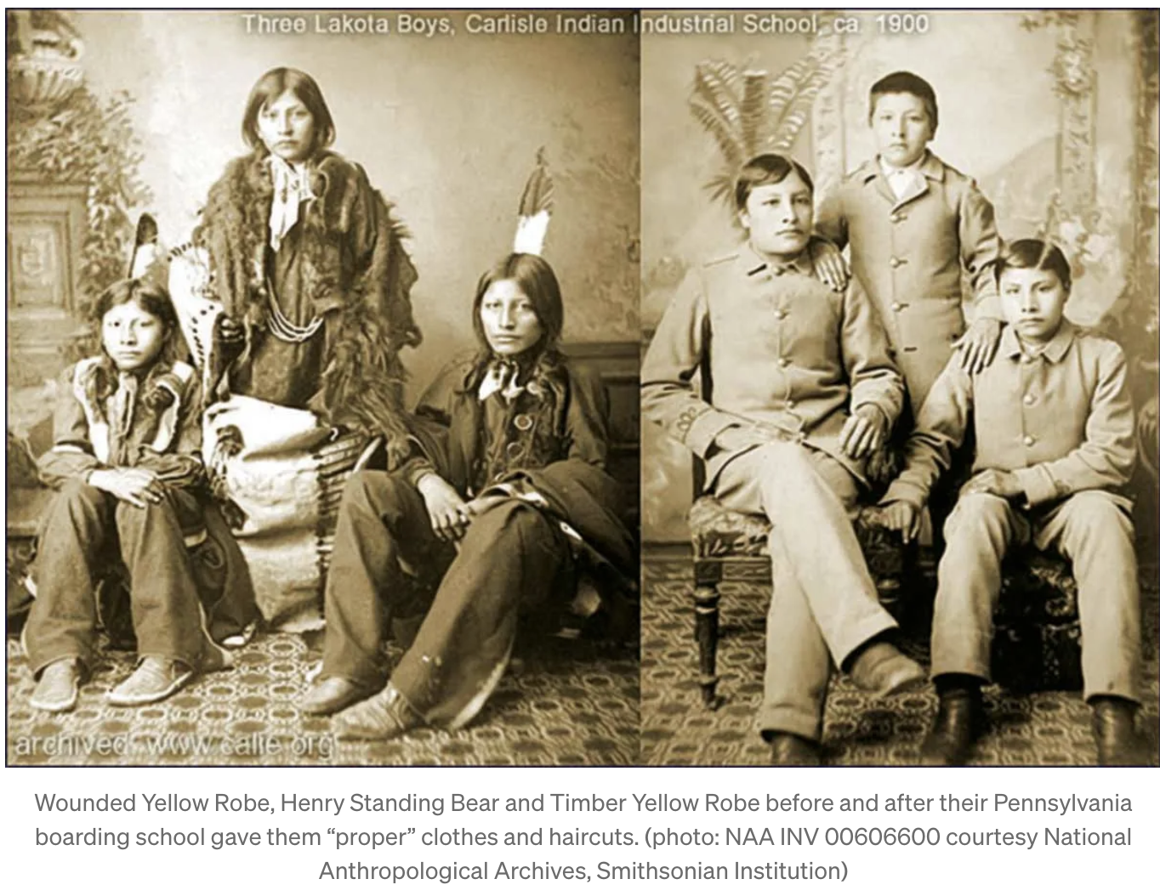
Historical background: Why was icwa passed?
Federal Boarding Schools (Late 19th Century)
1879 – Carlisle Indian Industrial School opened
Goal of "civilizing" American Indians by erasing tribal identity
"Kill the Indian in him, and save the man"
417 compulsory federal institutions established nationwide
Forced Assimilation
Meriam Report (1928)
Found the care for Indian children in boarding schools grossly inadequate (11)
Use of force - Abductions and captured runaways

Slide 18
Historical Background: Why was ICWA PASSED
The Indian Adoption Project (1958-1967)
Funded by the BIA and administered by the Child Welfare League of America
Aimed to place American Indian children, primarily from poor households, with "mainstream" American families
Coincided with shifting racial ideologies that led to an increased demand for Indian children by adoptive couples
Unjustified family separations without due process of law
Non-Indian social workers were "ignorant of Indian cultural values and social norms"
1969 and 1974 surveys revealed 25-35% of all Indian children were separated from their families. AAIA Report 1
Long-lasting adverse health and emotional effects

Slide 19
Emergence of icwa: Congressional findings
25 U.S.C. § 1901. Congressional Findings
Congress finds–– (3) that there is no resource more vital to the continued existence and integrity of Indian tribes than their children... (4) that an alarmingly high percentage of Indian families are broken up by the removal, often unwarranted, of their children...and that an alarmingly high percentage of such children are placed in non-Indian foster and adoptive homes and institutions; and (5) that the States...have often failed to recognize the essential tribal relations of Indian people and the cultural and social standards prevailing in Indian communities and families

Slide 20
ICWA’s Requirements apply to Fed. Recognized tribes
Tribal Courts have primary jurisdiction and are entitled to full faith and credit.
States have affirmative duty to identify tribal children.
States must notify parents and tribes when tribal children are in child welfare proceedings.
Tribes have right to intervene.
Proceedings involving tribal children require higher burdens of proof.
(“In absence of good cause to the contrary”) Strict placement preferences:
Family
Other members of Tribe
Other Indian Families
Notes:
Information from 1 Cohen's Handbook of Federal Indian Law § 15.03 (2025)
Also relied on: Report: Native American Children and Child Welfare Laws, National Conference of State Legislatures, https://www.ncsl.org/human-services/native-american-children-and-child-welfare-laws.

Slide 21
How do other states approach ICWA?
18 states have largely incorporated ICWA into state law. These include:
California, Colorado, Connecticut, Iowa, Maine, Michigan, Minnesota, Montana, Nebraska, Nevada, New Mexico, North Dakota, Oklahoma, Oregon, South Dakota, Washington , Wisconsin, Wyoming
13 states have provisions referring to ICWA in relevant places throughout state code :
Alabama, Alaska, Arizona, Delaware, Florida, Idaho, Kansas, Missouri, South Carolina, Tennessee, Vermont, Indiana, Louisiana

Slide 22
Is icwa constitutional?
In 2023, the Supreme Court affirmed ICWA’s constitutionality in Haaland v. Brackeen
Key takeaways:
ICWA is within the U.S. government's Article I, Section 8 Commerce Power
ICWA does not violate the Tenth Amendment's Anti-Commandeering Doctrine:
Provisions apply to state agencies and private actors equally
Congress has the authority to impose ancillary recordkeeping requirements on state courts
Equal Protection challenge did not have standing
ICWA is based on political, not racial, classifications

Slide 23
Application of ICWA in Virginia
Given the recency of Federal Recognition of Virginia’s tribes, Virginia is still playing catch-up.
The Juvenile and Domestic Relations Court code sections (Va. Code Sec. 16.1-228 and following) contain virtually no mention of ICWA.
Supreme Court of Virginia provides training, and has developed court forms, to share information about ICWA requirements.
ICWA cases in Virginia (according to DSS):
Infrequent, but accuracy of the numbers is subject to proper identification and tracking in the system
2016 – 18 total children
2024 – 37 total children

Slide 24
Application of icwa In va cont.
Virginia Department of Social Services:
Child and Family Service manual explains ICWA requirements
Agency has mandatory online training
ICWA liaison position who works with tribal members and leaders.
Obstacles:
Staffing – turnover rate is 43%
Tracking system – did not account for all American Indian children until recently.
Local implementation.
Advocates:
Concerns about implementation.

Slide 25
Policy Options
Maintain Status Quo (do nothing)
Modest approach:
Clarify identification, jurisdiction, and full faith and credit, in the juvenile code.
Include children of state recognized tribes.
Make explicit reference to federal code in the juvenile code
Substantial Incorporation.
Notes:
1 Cohen's Handbook of Federal Indian Law § 15.04 (2025) (procedural)
1 Cohen's Handbook of Federal Indian Law § 15.05 (2025) (substantive)
FOSTER PLACEMENT PREFERENCES: "(i)a member of the Indian child’s extended family;(ii)a foster home licensed, approved, or specified by the Indian child’s tribe; (iii)an Indian foster home licensed or approved by an authorized non-Indian licensing authority; or (iv)an institution for children approved by an Indian tribe or operated by an Indian organization which has a program suitable to meet the Indian child’s needs." 25 U.S.C. 1915(b)."
Also relied on: Report: Native American Children and Child Welfare Laws, National Conference of State Legislatures, https://www.ncsl.org/human-services/native-american-children-and-child-welfare-laws.
Appointment of counsel proceedings?
ACTIVE EFFORTS: "ICWA prohibits any foster care placement or termination of parental rights with respect to an Indian child unless the state court is satisfied that “active efforts have been made to provide remedial services and rehabilitative programs designed to prevent the breakup of the Indian family and that these efforts have proved unsuccessful.”13 The federal regulations define active efforts as “affirmative, active, thorough, and timely efforts intended primarily to maintain or reunite an Indian child with his or her family.”14 Such efforts must “be tailored to the facts and circumstances of the case,” “should be provided in a manner consistent with the prevailing social and cultural conditions and way of life of the Indian child’s Tribe” and “conducted in partnership” with the child and the child’s parents, extended family members, Indian custodians, and Tribe."
1 Cohen's Handbook of Federal Indian Law § 15.05 (2025)

Slide 26
In-State Tuition for Virginia's Out-of-state Tribal Members

Slide 27
Research process
Discussed with Tribal Leaders
Researched the history of Virginia Tribes displacement due to education policy.
Researched past Virginia Legislation
Researched initiatives by other states

Slide 28
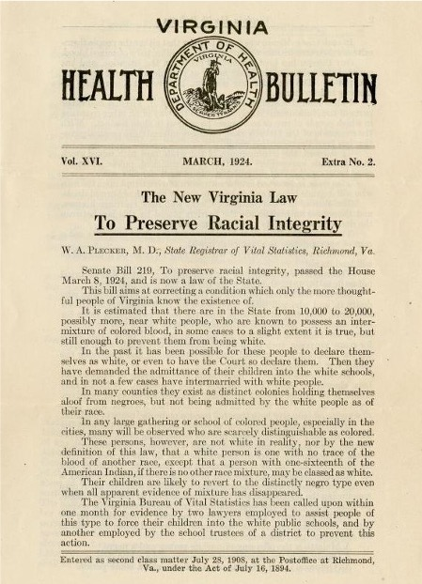
History of Tribal Education in VA
Racial Integrity Act of 1924
Recognized only two races and erased American Indian identity.
Indian Schools
Opportunities in other states:
Oklahoma
Pennsylvania
North Carolina
Va. Brown v. Board of Education Scholarship

Slide 29
Current Tribal Member Locations Outside of VA
Lack of educational opportunities was a direct cause for movement of VA Tribes
Schools in Philadelphia, Oklahoma, Kansas, North Carolina.
Upper Mattaponi - 685 enrolled citizens, 307 of whom live out of state (45%).
Philadelphia, Florida.

Slide 30
Current Landscape of VA In-State Tuition
In state tuition requirements:
An individual must demonstrate legal residence in Virginia with an intent to remain in Virginia indefinitely to establish domicile in Virginia. After meeting the requirements to establish domicile, a person must continue to be domiciled in Virginia for at least 12 months preceding the first day of classes.
In-state tuition is also granted tospecific categories of people, regardless of their domicile, such as:
Non-Virginia students that have worked in Virginia for over a year
Active-duty members mobilized or on temporary orders in VA
Any veteran or surviving spouse who resides in VA
Any non-Virginia student who established domicile before being called to active duty in the National Guard of another state
Any member of the foreign service office who resided in the Commonwealth for at least 90 days immediately prior to receiving a foreign service assignment
Any child of an active-duty member or veteran who claims Virginia as his home
Refugees who reside in the commonwealth
Any non-Virginia student who is currently present in the Commonwealth as a result of being a victim of human trafficking

Slide 31
Past Virginia Legislative Efforts
2022, House Bill No. 1120
Any non-Virginia student who is a member of a state-recognized or federally recognized American Indian tribe that is headquartered in the Commonwealth eligible for in-state tuition charges regardless of domicile.
Also included provisions for tuition waivers and annual offers for native students.
2008, House Bill No. 1373
Any person who is a member of a Native American tribe officially recognized by the Commonwealth is eligible for in-state tuition so long as such membership is verified.
Verification:
(i) a valid tribal identification card, (ii) confirmation of membership through a central tribal registry, (iii) a written statement of a tribal chief or council confirming membership, or (iv) certification of the enrolled member’s status from a tribal office.

Slide 32
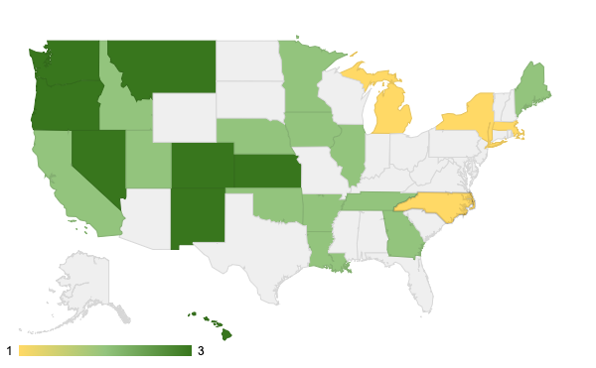
Other State's Approaches
Large collection of states address in-state tuition for members of tribes originating in the state.
Dark Green – State Policy
Light Green – School Board Policy
Yellow – Other forms of tuition aid provided for out-of-state tribal members.

Slide 33
State | Kansas | Utah | Nevada | Colorado | Washington | Oregon | New Mexico | Hawaii
Who is covered? | Specifically enumerated tribal nations currently located within Kansas, and tribal nations with historical connections to Kansas | Any American Indian who is enrolled on the tribal rolls of a tribe whose reservation or trust lands lie partly or wholly within Utah or whose border is at any point contiguous with the border of Utah | Members or descendants of an enrolled member of a federally recognized Native American tribe or nation, all or part of which is located within the boundaries of Nevada | In-state tuition for members of a federally recognized American Indian tribe with historical ties to Colorado, as designated by the Colorado commission of Indian affairs | American Indian students domiciled in Idaho, Montana, or Oregon, and who are part of a federally or state recognized tribe whose traditional and customary tribal boundaries included portions of the state of Washington, or whose tribe was granted reserved lands within the state of Washington. | Enrolled members of one of Oregon’s federally recognized tribes or from a tribe that has had traditional and customary tribal boundaries that included parts of the state of Oregon | Members of Indian nations, tribes and pueblos located wholly or partially in New Mexico. | Native Hawaiian race/ ethnicity/ ancestry/ descent
Benefit | Residency status for the purpose of paying in-state tuition | Classified as in-state for purposes of tuition | Fee waiver for registration costs. | In-state tuition classification | In-state Tuition | Offers in-state tuition | Waiver to be in-state for tuition purposes only | In-state Tuition

Slide 34
Policy Options
Tribal Status?
Federally recognized; or
Federal and state recognized
Connection to tribe?
Tribal Enrollment; or
Descendant
Tribal Connection to Virginia?
Tribes located/headquartered in VA (mirrors past legislative approach); or
Tribes with Historic Connection to VA
Benefit?
Residency classifications (past approach) to permit in-state tuition.
Scholarship or fee waiver

Slide 35
RECAP
Conservation Easements
ICWA
3. In-state tuition

Slide 36
Additional discussion items
Veto’ed legislative proposals ( HB2134 and SB949)
Medicaid Reimbursement

Slide 37
Future meeting research agenda?
Revisit ‘25 Legislation?
Consultation?
Jurisdiction?
Treaty incorporation – taxes; hunting and fishing.
Other

