Slide 1
Cannabis in the Commonwealth
The Cannabis Control Authority
& Current Cannabis Laws
7/9/25

Slide 2

Mission Statement
As an independent, political subdivision of the Commonwealth, the Cannabis Control Authority promotes public safety, advances public health, and protects communities in Virginia through effective medical cannabis oversight and balanced and inclusive cannabis regulation, policy, and education.

Slide 3
History of the CCA
2021
2022
2024
Established by General Assembly
First staff hired
Began regulating medical cannabis

Slide 4



CCA’s Roles
Regulator
Policy Advisor
Educator

Slide 5
Cannabis Laws in Virginia

Slide 6




What’s Legal?
Medical Cannabis
Limited Home Cultivation
Limited Possession
Limited Adult Sharing

Slide 7
Home Cultivation
Cultivation of up to 4 plants in primary private residence for those 21+
Plants must be properly labeled
Must not be visible from public areas
Must prevent access by minors

Slide 8
Limited Possession &
Adult Sharing
Possession for personal use at residence for adults 21+
Public possession up to 1 oz. for adults 21+
Adults 21+ can privately share up to 1 oz. of marijuana with other adults 21+ without compensation

Slide 9

Cannabis Tax
Medical cannabis exempt from sales and use tax
  § 58.1-609.10.
  23VAC10-210-940.
Taxes on retail sales of cannabis from 2024 & 2025 adult use legislation
  Total possible tax rate of 11.625 percent
    8% state
    2.5% local option
    1.125% for school funding

Slide 10

Hemp
Cannabis plants with less than .3% delta-9 THC by weight
Legal under federal law
Regulated by VDACS
  Products must have less than .3% total THC and no more than 2 mg THC or a cannabidiol (CBD) to THC ration of 25:1

Slide 11
What’s Illegal?
Possession
Consumption
Retail/Sales
Travel
  Of any amount with intent to distribute
  By anyone under 21
  Of any amount on school grounds or school buses
  Publicly of more than 1oz. of cannabis
  By anyone under 21
  Or sharing in public spaces
  (Landlords may prohibit tenants from growing or using cannabis on rental property)
  Retail sales outside of the medical cannabis program
  Giving cannabis in exchange of something else (e.g., a product or service)
  Home cultivation of more than 4 plants or for retail use
  Operating a vehicle while cannabis-impaired
  Consumption or possession of an open container of cannabis while operating a motor vehicle (applies to driver and passenger)
  Mailing, shipping, or traveling interstate with cannabis

Slide 12
Medical Cannabis Program

Slide 13
Overview
Licensed facilities dispense medical cannabis to individuals that meet basic qualifications and have been issued a written certification by a medical practitioner.

Slide 14



Patient Requirements
Meet basic qualifications
  Live in Virginia
  Valid government-issued ID
  Have condition that may benefit from the use of cannabis
Receive certification by licensed practitioner
  Eligible practitioners: doctors, physician assistants, advanced practice nurses
  Parents/legal guardians can get written certification on behalf of minor or vulnerable adult
  Must be renewed annually by licensed practitioner
Present certification at a licensed dispensary
  Bring written certification and valid government-issued ID
Notes:
Change to be less detailed

Slide 15
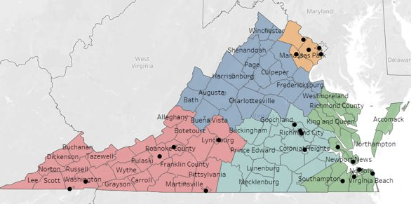
Program Overview
Virginia divided into 5 Health Service Areas (HSA)
Limit on number of facilities in each HSA:
  1 facility with cultivation, processing, and dispensing operations
  5 additional standalone dispensaries
  1 separate cultivation location
Currently 24 facilities (across all types)
Notes:
There are no limits on number of plants.

Slide 16
Patient Numbers
Unique patients:
  104,840 in 2024
  98,396 in 2023
Reported monthly spending:
  32% spent more than $300.
  25% spent $201-$300.
  24% spent $101-$200.
Notes:
From a recent patient survey. A detailed report is on our website.

Slide 17
Medical Cannabis Program Patient Satisfaction Survey (2024)
The CCA issued a medical cannabis patient survey to assess how the Virginia medical cannabis program (MCP) serves patients, parents or legal guardians of patients, and registered agents.
The MCP Satisfaction survey captured patterns of:
  Cannabis use
  Process of obtaining a written certification
  Purchase behaviors
  Dispensary experiences
  Overall satisfaction

Slide 18
The three most reported medical conditions were anxiety, depression, and chronic pain; 62% of survey respondents use medical cannabis for these conditions.
Q16. Please indicate which condition(s) you, the patient, use medical cannabis for. (N=722)

Slide 19
Seed-to-Sale Tracking
Seed-to-sale consists of an inventory control system that tracks the cultivation, processing, and sale of cannabis and cannabis-infused products
Virginia’s seed-to-sale system went live on July 1, 2025
Tracking increases available data leading to an increase in public health and safety by ensuring:
  No diversion of products to the illicit market
  No illicit products enter the regulated market

Slide 20
CCA Data & Educational Initiatives

Slide 21




Educational Initiatives
Data Collection
Educational Resources
Safe Driving Campaign
Partnerships & Outreach

Slide 22




Educational Resources
Cannabis laws in Virginia
Health Risks
Responsible Use
Available for bulk order!

Slide 23
Impaired Driving Survey (2024)
783 Virginia residents aged 16 or older with a driver’s license were surveyed.
Partnered with SSRS to manage data collection and process, clean and weigh the collected data.
Data were weighted to be representative of Virginia residents who are 16 and older and have a driver’s license.

Slide 24
Perceptions of Drivers
Almost one third (30%) of Virginia drivers believe those who consume marijuana are usually safer drivers. These perceptions are unchanged from 2022.
Q14. Which of the following statements comes closest to your view (even if neither is exactly right)? Base: Total Respondents (2022 n=783; 2024 n=783)

Slide 25
Perceived Danger Levels of Various Behaviors and Driving
More Virginia drivers continue to rate texting while driving, as well as driving after using illegal drugs or consuming alcohol, as extremely dangerous compared to driving after using marijuana.
Q11. How dangerous do you believe it is to (INSERT ITEM)? Base: Total Respondents (2022 n=783; 2024 n=783)
Notes:
2022 Extremely dangerous: 60% texting, 53% illegal drugs, 49% alcohol, 26% marijuana, 12% prescription drugs, 11% speed limit

Slide 26
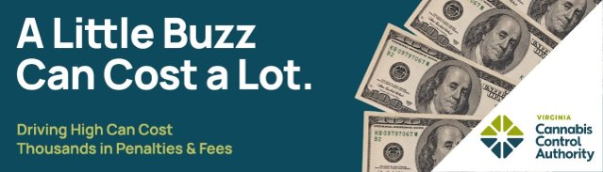

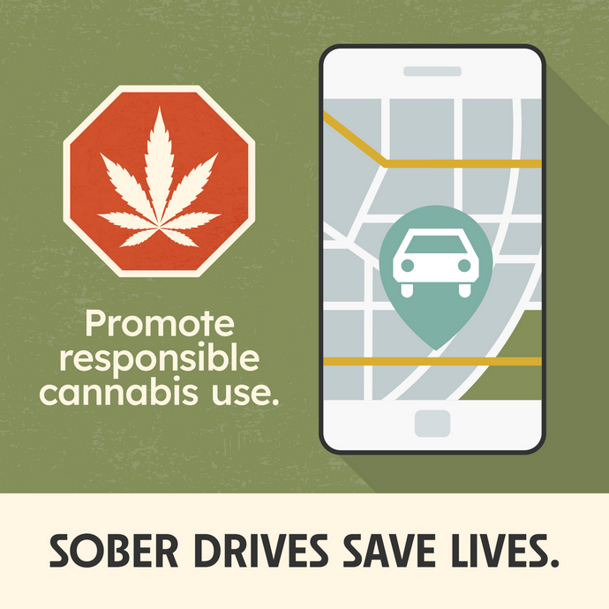
Safe Driving Campaign
Most recent campaign ran 2022-2024
Media platforms included:
  Digital / Online​, Billboards​
  TV, Radio, Streaming
  Social Media
  Partnership Toolkit
    Includes Spanish language
    Still available on our website!
RFP in progress to develop a new campaign in 2025

Slide 27

Partnerships and Outreach
Workgroups
Presentations
Resource development and distribution
Exhibit tables
Partner or support projects/initiatives

Slide 28






Connect with the CCA
Website: cca.virginia.gov
facebook.com/virginia.cca.gov
Email: info@cca.virginia.gov
Data requests: data@cca.virginia.gov
Jake’s email: jake.shuford@cca.virginia.gov
Linkedin.com/company/virginiacca
@virginia_cca
@virginia_cca
Full data reports available at cca.virginia.gov/reports.

Slide 29
Questions?

