Slide 1
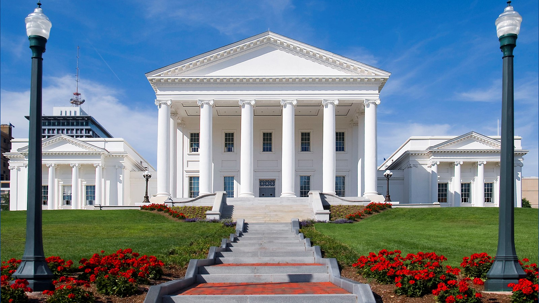

Cannabis in the Commonwealth
An Overview of the Background and Current Status of Marijuana Legalization in Virginia
Taylor Mey, Senior Attorney - General Laws (ABC/Cannabis)
Troy Hatcher, Attorney - Courts of Justice - Criminal
Stephen Kindermann, Lead Senior Attorney - Finance & Appropriations

Slide 2
Legislative History

Slide 3
Overview: Medical Cannabis
2015
  HB 1445 (Albo) /SB 1235 (Marsden) passed, which authorized licensed medical practitioners to provide written certification for the use of marijuana in the form of CBD oil or THC-A oil for treatment or to alleviate the symptoms of a patient's epilepsy.
    The bills provided an affirmative defense in a prosecution for the possession of marijuana if the marijuana was in the form of CBD oil or THC-A oil possessed pursuant to such valid written certification.
2016/2017
  SB 701 (Marsden) [passed with reenactment clause in 2016] and SB 1027 (Marsden) [passed in 2017] authorized a pharmaceutical processor, after obtaining a permit from the Board of Pharmacy and under the supervision of a licensed pharmacist, to manufacture and provide CBD oil and THC-A oil to be used for the treatment of epilepsy.
2018
  The Virginia Board of Pharmacy awarded the first five pharmaceutical processor licenses in September 2018.
  HB 1251 (Cline) and SB 726 (Dunnavant) passed, which allowed medical practitioners to issue a written certification for the use of CBD oil or THC-A oil for the treatment of any diagnosed condition or disease determined by the practitioner to benefit from such use. Patients required to register with the Board of Pharmacy.
Notes:
Virginia’s current medical cannabis program is a compilation of several incremental bills
spanning multiple years and legislative sessions.

Slide 4
Overview: Medical Cannabis
2020
  SB 976 (Marsden) allowed the five authorized pharmaceutical processors to establish five additional off-site cannabis dispensing facilities within each of their designated health service areas. Shifted from just CBD oil and THC-oil, to “cannabis oil.”
  SB 1015 (Marsden) switched possession of CBD oil or THC-A oil pursuant to valid written certification from affirmative defense to immunity from prosecution.
2021
  HB 2218 (Hayes) and SB 1333 (Lucas) permitted pharmaceutical processors to produce and distribute cannabis products other than just cannabis oil, such as botanical cannabis.
  HB 2312 (Herring) and SB 1406 (Ebbin and Lucas) [legalization of marijuana] contained an enactment clause that directed all regulations governing pharmaceutical processors be transferred from the Board of Pharmacy to the CCA by July 1, 2023. However, the 2021 bills did not contain the necessary Code changes to implement the switch of the medical cannabis program from the Board of Pharmacy to the CCA.
2022
  HB 933 (Robinson) and SB 671 (Dunnavant) passed which removed the Board of Pharmacy patient registration requirement for medical cannabis but maintained requirement that patients obtain written certification from a health care provider.
2023
  HB 1598 (Robinson) and SB 788 (Favola) moved oversight and administration of the medical cannabis program from the Board of Pharmacy to the Cannabis Control Authority, with a delayed effective date of January 1, 2024.

Slide 5
Overview: Hemp Products
2019
  HB 1839 (Marshall) passed, which conformed Virginia law to the provisions of the federal 2018 Farm Bill by amending the definitions of cannabidiol (CBD) oil, marijuana, and tetrahydrocannabinol (THC) to exclude industrial hemp in the possession of a registered person, hemp products, or an oil containing no more than 0.3% THC.
    The bill defined "industrial hemp" as any part of the plant Cannabis sativa that has a concentration of THC that is no greater than that allowed by federal law, and it defines "hemp product" as any finished product that is otherwise lawful and that contains industrial hemp.
    Under federal law, hemp is defined to include any cannabis plant, or derivative thereof, that contains not more than 0.3% concentration of delta-9 THC on a dry-weight basis.
2021
  HB 2078 (Marshall) made various additional updates to Virginia’s industrial hemp laws, including changes to exclude industrial hemp from certain criminal provisions.
2023
  HB 2294 (Kilgore) and SB 903 (Hanger) limited the amount of total THC (not just delta-9) that can be included in a hemp product or industrial hemp extract to 0.3 % and either two milligrams of total THC per package or an amount of CBD that is at least 25 times greater than the total THC per package. (among other things). Total THC includes delta-8, delta-9, etc.

Slide 6
Overview: Adult-Use of Cannabis
2020
  HB 972 (Herring) and SB 2 (Ebbin) passed; decriminalized simple possession of marijuana and transitioned the penalty from a misdemeanor to a $25 civil penalty.
  JLARC study: https://jlarc.virginia.gov/landing-2020-marijuana-legalization.asp
2021
  HB 2312 (Herring) and SB 1406 (Ebbin and Lucas) legalized possession of up to one ounce of marijuana and created the Virginia Cannabis Control Authority (among many other things). These bills, which were identical, contained a partial reenactment clause. Some of their provisions became law, but a majority of the provisions were subject to reenactment and thus would only become law if passed again by the 2022 GA, which did not happen. We will go into further detail about what passed and what did not later on in the presentation, but effectively possession of up to one ounce of marijuana is legal, but commercial adult-use sales are still illegal.

Slide 7
Overview: Recent Legislation
2024
  HB 698 (Krizek) and SB 448 (Rouse) established a framework for the creation of a retail marijuana market in the Commonwealth, to be administered by the Virginia Cannabis Control Authority. Passed the GA, but vetoed by the Governor.
2025
  HB 1989 (Askew) - Medical cannabis program; product labels and delivery. Passed the GA, but vetoed by the Governor.
  HB 2485 (Krizek) and SB 970 (Rouse) - almost identical to 2024 cannabis retail market bills - both passed GA, but vetoed by the Governor.
  HJ 497 (Krizek) establishing this Joint Commission passed.

Slide 8
Current Law

Slide 9
Current Law - Medical Cannabis
Medical Cannabis Program - Chapter 16 of Title 4.1 (4.1-1600 - 4.1-1606)
Virginia residents can use and purchase medical cannabis to treat or alleviate the symptoms of any diagnosed condition or disease with a written certification from their medical practitioner.
Can purchase cannabis products from a pharmaceutical processor or at a cannabis dispensing facility licensed by the CCA.
  Medical cannabis products can contain no more than 10 mg of THC per dose.
  No more than a 90-day supply may be dispensed
  No more than 4 oz of botanical cannabis for each 30 day period
Pharmaceutical processors cultivate, process, dispense, sell, and deliver medical cannabis products under one license.
There are five pharmaceutical processors in Virginia (one in each of the five HSA’s established by the Board of Health). Each pharmaceutical processor can have (i) up to five additional cannabis dispensing facilities for dispensing of cannabis products that have been cultivated and produced on the premises of permitted pharmaceutical processor and (ii) one authorized additional cultivation location.
Before dispensing any cannabis products, pharmaceutical processors are required to make a sample available from each batch of cannabis product for testing by an independent laboratory located in the Commonwealth (4.1-1602)
Advertising restrictions for medical cannabis - § 4.1-1603.3
  Can generally advertise, subject to restrictions.
  All advertising and marketing by pharmaceutical processors and cannabis dispensing facilities shall (i) accurately and legibly identify the pharmaceutical processor or cannabis dispensing facility responsible for its content, (ii) include a statement that cannabis products are for use by certified patients only, and (iii) comply with Board regulations.
  Further conditions on advertising in regulations (3VAC10-40-170, 3VAC10-40-190)

Slide 10
Current Law - Hemp Products
The Virginia Department of Agriculture and Consumer Services (VDACS) regulates hemp in the Commonwealth.
The Commissioner of VDACS issues registrations for growing, handling, or processing industrial hemp. See 3.2-4115
Any person selling at retail a hemp product intended for smoking, an edible hemp product, or certain substances intended for human consumption that are advertised or labeled as containing an industrial hemp-derived cannabinoid has to obtain a regulated hemp product retail facility registration through the VDACS. (3.2-4122)

Slide 11
Current Law - Hemp Products
When offered for retail sale, a hemp product may not exceed 0.3 percent total tetrahydrocannabinol (THC) and may not have more than two milligrams of total THC per package unless the product’s cannabidiol (CBD) to THC ratio is at least 25 parts CBD for every one part THC. (3.2-4112)
  “Total THC” means all of the THC in a product, including delta-8 THC, delta-9 THC, and other THC isomers. (3.2-4112)
There are certain product packaging, labeling, and testing requirements for hemp products intended for smoking, edible hemp product, and topical hemp products. (3.2-4123 & 3.2-4124)
Sale of hemp products intended for smoking to persons under 21 is prohibited (18.2-371.2) and persons under 21 years of age are prohibited from possessing such products (18.2-371.2:1).

Slide 12
Current Law - Adult-Use of Cannabis
Title 4.1, Subtitle II (Cannabis Control Act)
What is legal?
  Adults 21 years or older may possess marijuana in their private residence for personal use and up to 1 oz of marijuana on their person or in public. (4.1-1100)
  Adults 21 years or older can cultivate up to 4 marijuana plants at home for their personal use. (4.1-1101). Note: 4 plants per “household,” which includes all those living in the place of residence
    Plants must not be visible from a public way, must take precautions to prevent unauthorized access by persons younger than 21, plants must be tagged with name, ID number, and notation that its being grown for personal use
    Property owners and landlords may prohibit marijuana consumption or cultivation in rental housing agreements
  Adults 21 years or older can share up to 1 oz of marijuana with each other without exchanging anything of value. (4.1-1101.1)

Slide 13
Current Law - Adult-Use of Cannabis
What is prohibited?
  Sale or purchase of marijuana. (18.2-248.1) (outside of medical cannabis program)
  Growing more than four plants at home or manufacturing cannabis concentrate from home-cultivated cannabis (4.1-1101)
  Use of marijuana in a public place. (4.1-1108)
  Possess or consume marijuana on public school grounds during school hours or school activities. (4.1-1109)
  Driving under the influence of marijuana (18.2-266)
  Using or consuming marijuana while driving or while being a passenger (4.1-1107)
  Carrying cannabis while providing transportation services, like driving a cab or for Uber or Lyft (4.1-1112)
  Purchase, possession, and consumption of marijuana by a person under 21. (4.1-1105.1)
  Advertising restrictions (4.1-1401) & outdoor advertising restrictions (4.1-1402)

Slide 14
The 2025 Bills

Slide 15
HB 1989 (Askew) - Medical cannabis; labels and delivery
Passed by the GA, but vetoed by the Governor.
Changed the requirements for what is included on medical cannabis product labels depending on the type of product → edible cannabis product, topical cannabis product, or inhalable cannabis product.
Allowed a pharmaceutical processor or cannabis dispensing facility to dispense or deliver cannabis products in person to a patient or such patient's registered agent, parent, or legal guardian at any residence, including a temporary residence, or business. Specified certain places where cannabis products could not be delivered.
Defined “delivery agent” and clarified that pharmaceutical processor employees and delivery agents are subject to all relevant laws and regulations and that the CCA can suspend or revoke delivery privileges.

Slide 16
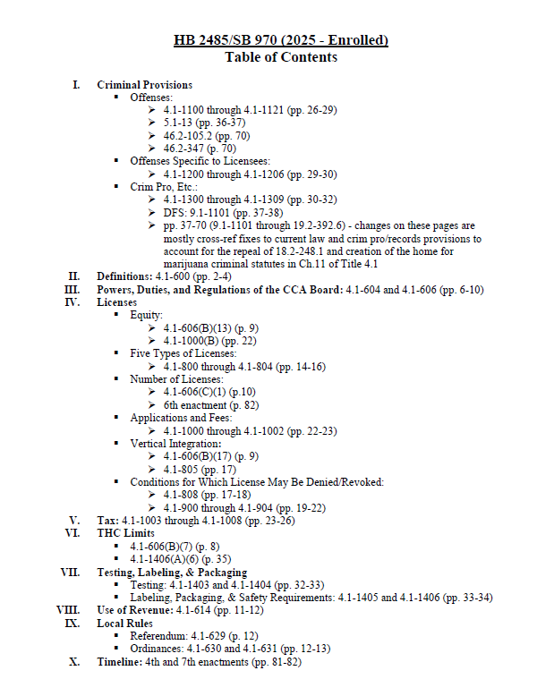

Slide 17
HB 2485/SB 970 - CCA Powers, Duties, and Regulations
The Virginia Cannabis Control Authority (CCA) was established in 2021 when the marijuana legalization bills passed. See 4.1-601.
The Board of Directors of the CCA is vested with control of the possession, sale, transportation, distribution, and delivery of marijuana and marijuana products in the Commonwealth.
Powers and duties of the Board laid out in 4.1-604 and regulations to be promulgated by the Board detailed in 4.1-606, both sections already in effect.
A few changes to those sections made in the bills, including:
  Changes related to social equity licenses → micro business licenses (discussed later in presentation)
  Maximum THC level permitted for marjiuana products changed from 5 mg to 10 mg per serving for edible marijuana products/equivalent amount for other marijuana products and from 50 mg to 100 mg per package for edible marijuana products/equivalent amount for other marijuana products
  Requiring the Board to issue a quarterly report that contains information about licenses issued, public education initiatives, community engagement initiatives, sales and tax revenue, programs funded by tax revenue, info related to micro businesses, and license denials and disciplinary actions taken
  Noting that regulations shall ensure marijuana establishment licenses are issued evenly among all areas of the Commonwealth

Slide 18
HB 2485/SB 970 - Criminal provisions
Criminal offenses
  § 4.1-1100 through 4.1-1121 (pp. 26-29)
  § 5.1-13 (p. 37)
  § 46.2-105.2 (pp. 71)
  § 46.2-347 (p. 71)
Offenses Specific to Licensees:
  § 4.1-1200 through 4.1-1206 (pp. 29-30)
Crim Pro, Etc.:
  § 4.1-1300 through 4.1-1309 (pp. 30-32)
  § DFS: 9.1-1101 (pp. 37-38)
  § pp. 37-70 (9.1-1101 through 19.2-392.6) - changes on these pages are mostly cross-ref fixes to current law and crim pro/records provisions to account for the repeal of 18.2-248.1 and creation of the home for marijuana criminal statutes in Ch.11 of Title 4.1

Slide 19
HB 2485/SB 970 - Criminal provisions
Criminal offenses
  Bill increases amount a person is able to possess on his person or in public from 1 oz to 2.5 oz. 4.1-1100
  Moves crimes for illegal cultivation, processing, and sale of marijuana to Title 4.1 and repeals current crime for sale/distribution of marijuana (18.2-248.1).
  Illegal cultivation or processing (4.1-1102)
  Illegal sale (4.1-1103)
  Illegal sale to or purchase/possession of marijuana by persons under 21 (4.1-1104/4.1-1105)
Lays out criminal offenses specific to licensees
Many of the criminal provisions line up with comparable alcohol sections

Slide 20
HB 2485/SB 970 - Testing, Labeling, and Packaging
Testing
  Board to establish a testing program (4.1-1403).
    Prior to selling or distributing marijuana or marijuana products to a consumer or another licensee, a licensee required to submit a sample for testing for contaminants to a licensed testing facility.
  Mandatory testing requirements (4.1-1404)
    Lays out specifics on what shall be included in the testing, recordkeeping of testing, and the process for when additional testing is required.
Labeling and packaging
  Certain information required to be on labeling (4.1-1405)
    ID of the type of marijuana, license numbers of licensees, net weight, information on all ingredients, servings, etc., instructions on usage, certain warning statements, universal symbol stamped or embossed, certificate of analysis, etc.
  Packaging requirements (4.1-1405)
    Prepackaged in child-resistant, tamper-evident, and resealable packaging that is opaque
    Cannot be packaged in a manner that appeals to persons younger than 21, in a way that obscures identifying information, be misleading, or depict or be in the shape of a human, animal, vehicle, or fruit, etc.
Other health and safety requirements for edible marijuana and other approved marijuana products (4.1-1406)
  Shall not contain more than 10 mg of THC per serving and not more than 100 mg of THC per package.

Slide 21
HB 2485/SB 970 - Licenses
Five types of licenses:
  Cultivation facility license (4.1-800)
    Tier I-indoor/outdoor - not more than 2,000 sq ft canopy
    Tier II-indoor/outdoor - not more than 10,000 sq ft canopy
    Tier III-indoor only - not more than 25,000 sq ft canopy
    Tier IV-indoor only - not more than 45,000 sq ft canopy
    Tier V-indoor only - not more than 70,000 sq ft canopy
    *Secure agriculture greenhouse considered indoor cultivation and is permitted as long as its surrounded by a privacy fence no less than 8 feet tall
  Processing facility license (4.1-801)
  Retail marijuana store license (4.1-802)
  Transporter license (4.1-803)
  Testing facility license (4.1-804)

Slide 22
HB 2485/SB 970 - Licenses
The Board may promulgate regulations that limit the number of licenses issued by type or class, but the number of licenses not to exceed (4.1-606):
  Retail marijuana stores: 350
  Processing facilities: 100
  Cultivation facilities: 125 total
    Tier I: 50
    Tier II: 50
    Tier III: 10
    Tier IV: 5
    Tier V: 10
  Testing facilities licenses: maximum set by Board regulations
Sixth enactment clause requires CCA to analyze whether any limits should be placed on the number of licenses and to analyze the canopy limits for cultivation facilities and report findings to the GA

Slide 23
HB 2485/SB 970 - Licenses
Limitations on multiple licenses awarded to one person (4.1-805)
  No more than five total licenses, not including a transporter license
  Cannot hold more than one tier V cultivation facility license
  No person who holds a cultivation facility license, processing facility license, transporter license, or retail marijuana store license can be issued or hold interest in a testing facility license
Reservations for licenses (4th enactment clause)
  Between September 1, 2025 and September 1, 2030, the CCA to reserve license slots for all permitted pharmaceutical processors and cannabis dispensing facilities and issue applicable licenses for any location for which such a permit has been issued, provided the applicable licensing requirements are met.
  Priority for tier IV and tier V cultivation facility licenses to be given to permitted pharmaceutical processors and no less than five registered industrial hemp processors or growers that completed such registration prior to January 1, 2021

Slide 24
HB 2485/SB 970 - Licenses
CCA Board has the power and duty to grant, suspend, restrict, revoke, or refuse to grant or renew any of the licenses
    Conditions under which the Board shall or may refuse to grant licenses (4.1-808)
      May refuse it reasonable cause to believe granting would be detrimental to the interest, morals, safety, or welfare of the public or be inconsistent with the provisions of the subtitle.
      “Shall refuse” conditions listed in subsection B of 4.1-808, including that:
        The applicant is under 21
        The applicant has been convicted of a felony or any crime involving moral turpitude within 7 years
        Place to be occupied doesn’t meet certain conditions
    Grounds for which the Board may suspend or revoke licenses that have been granted (4.1-900)
      Within previous 5 years, committed certain violations of the subtitle or regulations of the Board
      Has been convicted of a felony or any crime of moral turpitude
    Grounds for which Board shall suspend or revoke licenses that have been granted (4.1-902)
      Reasons related to illegal possession of a gambling device at a retail marijuana store
      Defrauded the Board
    Applications for licenses
      Board to promulgate regulations that establish an application process for licensure as a marijuana establishment in a way that prevents disparate impacts on historically economically disadvantaged communities (4.1-606(B)(5))
      Applications for any of the license types filed with the Board. Includes certain requirements for publication and notice, background investigations, and fees. (4.1-1000)
        In considering criminal history record information, the Board shall not disqualify an applicant because of a past conviction for a marijuana-related offense.

Slide 25
HB 2485/SB 970 - Licenses
License Fees
Established by Board in an amount sufficient to cover regulation (no amount specified in the bill)
12/24/36 month licenses; 5% premium for different license term
Note: Enactment 8 - 75% of marijuana establishment annual license fees deposited into Cannabis Equity Business Loan Fund in first year
“Micro business” license applicants:
What is a “micro business”?
  A business with at least 66% ownership AND direct control by person(s) who meet any of the following:
    (i) previously convicted of certain marijuana misdemeanors;
    (ii) parent/child/sibling/ spouse of a person previously convicted of those certain marijuana misdemeanors;
    (iii) resided for at least ⅗ past years in a historically economically disadvantaged community;
    (iv) attended a public elementary/ secondary school located in such a community;
    (v) received Pell Grant or attended college/ university for 2+ years where 30%+ of students Pell Grant eligible; OR
    (vi) is a veteran.
  Applicants prioritized based on the number of criteria categories met (need 1/6, but more categories, greater priority/ preference)
Micro business advantages:
  Preference in the licensing process
  Waiver for a percentage of application/ license fees for increased participation
  Waiver of certain requirements for proof of funds and premises possession/ control during licensing process
  May enter into cooperative agreements with other micro business licensees
  May lease space/ equipment and cultivate, manufacture, and sell marijuana/ products on premises of another licensee

Slide 26
HB 2485/SB 970 - Taxes and Revenue Distribution
State Taxes:
  8% marijuana tax
    On “marijuana”, “marijuana products”, and “marijuana paraphernalia”
    Exceptions:
      Sales between marijuana establishments
      Sales for treatment under the existing medical marijuana program
      Certain industrial hemp sales by a grower, processor, or handler
      Sales of a hemp product.
  Capped 1.125% state sales tax
  Business expense deductibility: Amends conformity provisions to allow Virginia taxpayers to claim income tax deductions for ordinary and necessary expenditures made in connection w/ carrying on a CCA licensed trade/ business (starting in TY25)

Slide 27
HB 2485/SB 970 - Taxes and Revenue Distribution
Local Option - 2.5%:
  2.5% optional, additional local tax
    Note - not up to, but equal to 2.5%
    Local tax is by ordinance, not referendum
    Irrevocable once imposed by a locality
    Any local tax revenue returned to the locality where it was collected.

Slide 28
HB 2485/SB 970 - Taxes and Revenue Distribution
Revenue Distribution:
  8% Marijuana Tax - “...net profits shall be appropriated” in the Budget Bill as follows:
    Until 7/1/2027 - keep current law:
      40% Pre-K programs for at-risk 3-4 year olds
      30% Cannabis Equity Reinvestment Fund
      25% Substance use disorder prevention and treatment programs
      5% Public health programs/ health awareness campaigns
    Effective 7/1/2027:
      10% Pre-K programs for at-risk 3-4 year olds
      60% Cannabis Equity Reinvestment Fund
      25% Substance use disorder prevention and treatment programs
      5% Public health programs/ health awareness campaigns
  1.125% state sales tax
    1% for public education based on school age population
    0.125% for state SOQ payments
      **Note dealer discount = -0.01%**
  2.5% optional local tax
    All revenues retained by locality

Slide 29
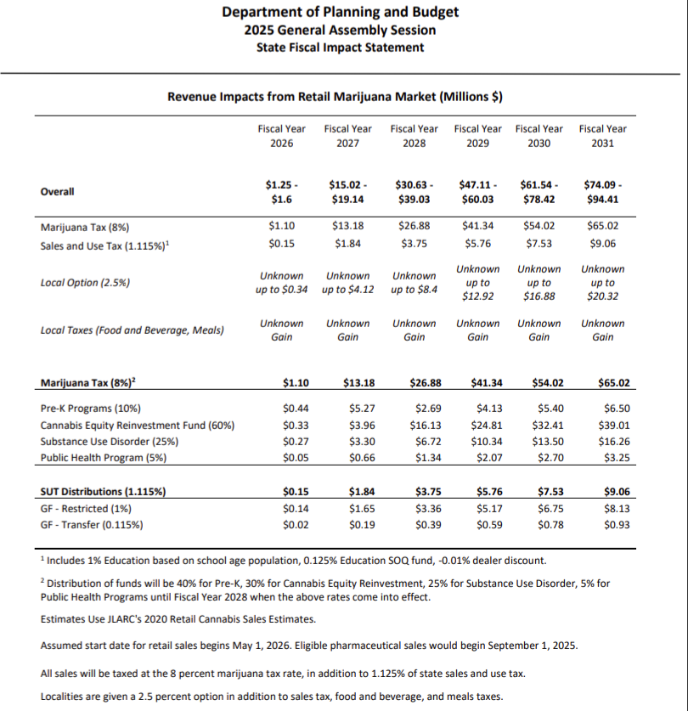

Slide 30
HB 2485/SB 970 - Taxes and Revenue Distribution
Increases marijuana tax revenue distributions for Cannabis Equity Reinvestment Fund in FY 28:
  Moneys shall be used solely for the purposes of:
    1. Supporting persons, families, and communities historically and disproportionately targeted and affected by drug enforcement;
    2. Providing scholarship opportunities and educational and vocational resources for historically marginalized persons, including persons in foster care, who have been adversely impacted by substance use individually, in families, or in communities;
    3. Awarding grants to support workforce development, mentoring programs, job training and placement services, apprenticeships, and reentry services that serve persons and communities historically and disproportionately targeted by drug enforcement.
    4. Contributing to the Virginia Indigent Defense Commission; and
    5. Contributing to the Virginia Cannabis Equity Business Loan Fund
      Grants, low-interest loans, zero-interest loans, and other supports and services to micro business licensees in order to foster business ownership and economic growth within communities that have been the most disproportionately impacted marijuana prohibitions

Slide 31
HB 2485/SB 970 - Local Authority
Localities may hold a referendum on question of “whether retail marijuana stores should be prohibited in the locality”
  Default with no local action = retail marijuana stores allowed to operate in a locality
  Enactment 9: Hold initial referendum by 12/31/2025 or forfeit prohibition referendum power!
  Prohibition vote fails? “NO”
    → retail marijuana stores may operate within 60 days after referendum results certified or 1/1/2026
  Prohibition vote prevails? “YES”
    (1) retail marijuana stores prohibited in locality starting 1/1 in year following referendum
    (2) Must wait 4 years before a new referendum
Local regulatory authority:
  May prohibit and penalize marijuana consumption in public (parks, playgrounds, streets)
  May still impose local business regs - zoning, land use requirements, business licenses
  May regulate time of sale (fix hours) by ordinance

Slide 32
HB 2485/SB 970 - Timeline and Effective Dates
Timeline
September 1, 2025 - CCA begins accepting license applications
Between September 1, 2025 and May 1, 2026 - licensees may operate but no licensee may engage in the retail sale of marijuana
By December 31, 2025 - (1) seed-to-sale tracking system established, CCA to promulgate regulations to implement act, (2) initial local referendum shall be held and certified or forfeit prohibition power
May 1, 2026 - retail sales begin
Effective Dates
July 1, 2025 - sections setting up licenses go into effect
May 1, 2026 - repeals of certain crimes and related sections with cross-references go into effect
*Note: This timeline is what was laid out in the bills from the 2025 session (HB 2485/SB 970) that ultimately did not pass.

Slide 33
Questions?

