Slide 1

Commissioner Update on
Election Preparedness
Presented to House Committee on Privileges and Elections
August 18, 2025

Slide 2

Agenda
2024-2025 Voting Trends
Year-to-Date Preparations
Operational Readiness
Looking Ahead

Slide 3

2024 Presidential Election
4,523,876 Ballots Cast

Slide 4
June 2025 Primary Elections
Democratic Primary
Statewide Lt. Governor
Republican Primary
House of Delegates 46
By Mail
13%
Mail
6%
Early In- Person
28%
Election Day
58%
Early In-Person
17%
Election Day
71%
497,135 ballots
2966 ballots

Slide 6
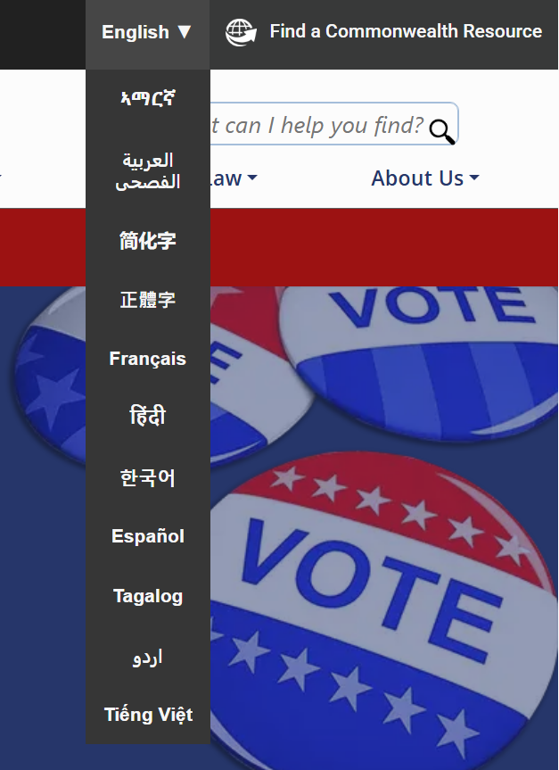
Accessibility Improvements
ELECT website in 12 languages
Website accessibility rating up 15 pts
Citizen Portal accessibility rating up 4 pts with 31 issues resolved
Improved screen reader user experience with color contrast and larger, structured headings
Accessibility certification from Siteimprove Frontier for web developers and content contributors

Slide 7

2025 Annual Training:
Virginia Elections Workshop
Topics based on feedback from registrars and electoral board members:
Authority of electoral board members and registrars
Certification process including canvass and provisional ballot meeting
VERIS improvements to streamline SDR processing

Slide 8
Same Day Registration
2024 - Overwhelming turnout in college towns
ELECT sought GR feedback / facilitated conversations
ELECT provided:
  Additional time for SDR app entry
  SDR duplicate report run statewide
  Training sessions on best practices
  VERIS enhancement to allow SDR batch upload for voter credit
Local registrars work with their colleges to encourage registration before election day

Slide 9
2025 List Maintenance Highlights
11 Bilateral State-to-State data sharing agreements - most in U.S.
State license surrender data from DMV – 44 states’ data
Change of Address mailings – completed in March and June 2025
Removal of Inactive voters under NVRA in February 2025

Slide 10
  Most One-to-One Data Sharing Agreements in the U.S.
DC
DMV Data Sharing
MOU States

Slide 11

2025 Election Timeline
January
3 special elections
February
Confirmation mailing
March
Candidate filing, LESS compliance
April
Ballot proofing, logic and accuracy testing of equipment
May
Early voting for June Primaries, Officer of Election training
June
Second Confirmation mailing, Primary Election
July
SBE certifies primary election results, Special Election Early voting begins, Annual Training
August
Ballot proofing, logic and accuracy testing of equipment
September
Special Election for Congress, General Election Early Voting begins
October
Early Voting
Officer of Election training
November
Election Day, Risk Limiting Audits conducted
December
SBE certifies election results

Slide 12

Operational Readiness
Preparedness/Testing
New Logic and Accuracy Testing Checklist
Ballot Proofing, Chain of Custody and Reconciliation
Vulnerability Management – passwords/patching
Compliance Audits
Locality Election Security Standards – each locality reports compliance w/ remediation plans
List maintenance - update voter lists daily
Risk Limiting Audits required following every election
Safeguards/Plans
System Redundancy
Triple check of election results – at precinct, canvass and by ELECT
Continuity of Operations Plan
Training
Annual Training for Registrars and Electoral Board Members
Cybersecurity Awareness Training for VERIS users
Tabletop exercise with state agencies, law enforcement, election officials to coordinate response

Slide 13

Virginia's Elections are Secure
100% hand-marked paper ballots
Counting machines certified at state and federal level
Wireless connectivity is prohibited by law
Every machine is tested before every election
Election results are triple-checked for accuracy – at precinct level, electoral board level and state level
Risk-limiting audits (a hand count) confirming machine results

Slide 14

Voter Education Campaign
Virginia Counts
Tools
Digital Ads
Radio Ads
Print Ads
Social Media Ads
Social Media Campaign
Multi-language
Messaging
When, where and how to register and vote
Accessibility options
Deadlines

Slide 15

Looking Ahead to 2026
New Statewide Voter Registration System
Testing – Post-November 2025 Election
Mock Election and Go Live – Spring 2026
2026 Campaign Finance Review
EVERY statewide campaign
10% of House of Delegates committees
1% of local committees

Slide 16
Thank you!

