Slide 1
2025 Internet Gaming (iGaming) Legislation
Presentation to the Virginia Joint Subcommittee on Gaming
Delegate Marcus Simon
HB2171 (Simon)|SB827 (Locke)

Slide 2
Background
What is iGaming?
“Internet Gaming” or “iGaming” describes online casino games of chance.
iGaming can be played from a mobile device, tablet or computer.
iGaming typically includes the following options:
  Roulette, Craps, Poker, Blackjack, Slots
When offered in a well-regulated manner, iGaming offers convenience and safety for participants across a jurisdiction.
Quick Stats
8 states have legalized iGaming (NV is iPoker only), translates to access for roughly 14% of the U.S. adult population.
In 2023, the legal iGaming Market Generated $5.6 billion in Gross Gaming Revenue.
Virginians wagered an estimated $16 billion in the illegal, unregulated online casino market in 2024.

Slide 3
iGaming in the Surrounding Region
Virginia is surrounded by jurisdictions that either have legalized iGaming or are seriously contemplating legalization in the next few years.
Legal Mobile Sports Betting and iGaming
Pennsylvania
Delaware
West Virginia
Legal Mobile Sports Betting
Virginia
Kentucky
North Carolina
Maryland
Washington, D.C.
Legal iGaming Under Consideration
Maryland
North Carolina
Washington, D.C.

Slide 4
Virginia’s iGaming Opportunity
iGaming is an opportunity for Virginia to modernize its gaming options to help land-based casinos keep pace with potential legalization of skill game machines.
Virginia could generate an additional $5.3 Billion in new taxable revenue for Virginia over a five-year period from iGaming.
Over that same period, growth rates of land-based casino gaming revenue is projected to grow 8.4% more alongside a market with iGaming, from $1.5 billion to $1.6 billion.
Job Growth. iGaming states have outperformed non-iGaming states in land-based gaming jobs, anywhere from 0.6% to 5.4% per year.

Slide 5
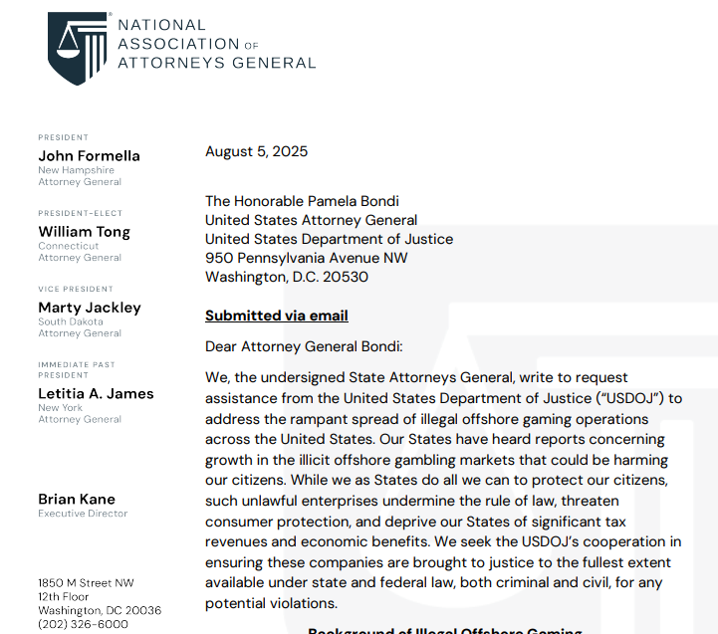
National Association of Attorneys General calls for crackdown on illegal market

Slide 6
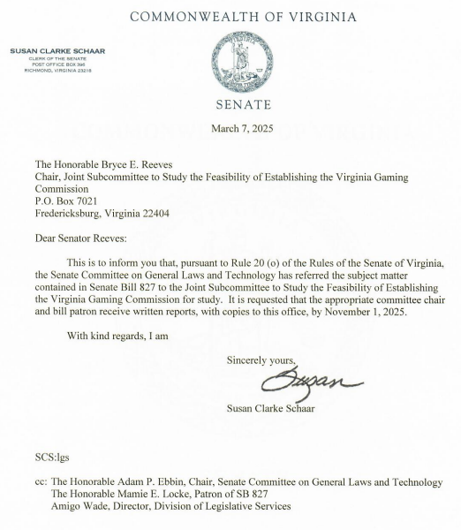
2025 Legislation
In the 2025 session, legislation to legalize iGaming in Virginia was sent to be studied by the Joint Subcommittee to Study the Feasibility of Establishing the Virginia Gaming Commission.

Slide 7
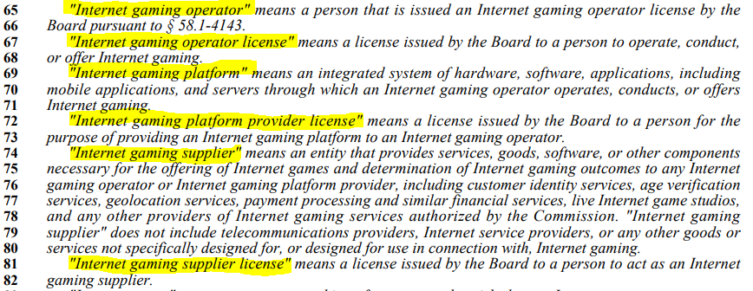
Definitions
“Internet Gaming Operator License” → The license awarded to the Virginia land-based casino that allows them to operate iGaming.
Key Definitions
“Internet Gaming Operator” → Only Virginia land-based casino operators (those licensed to run casinos in Virginia) are eligible to be iGaming operators.
“Internet Gaming Supplier” → The regulated, consumer-facing entity that will provide the platform and software to host iGaming. (Ex: Legal Virginia Sportsbooks)
“Internet Gaming Supplier License” → The license awarded to the regulated, consumer-facing entity to host iGaming.

Slide 8
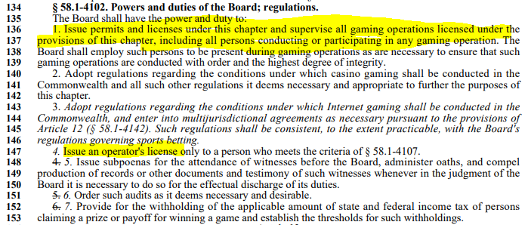
Oversight
Oversight
The 2025 legislation gave the Virginia Lottery Board oversight of iGaming.
Legislation in 2026 will ensure iGaming falls under the jurisdiction of the Virginia Gaming Commission.
We can also have regulations on temporary licenses through the Virginia Lottery, if needed.

Slide 9
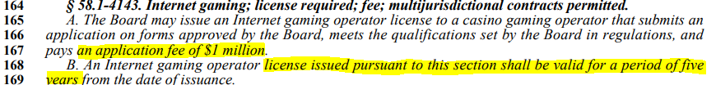
Potential Licensing Structure
Operator (Casino) License
Land-based casinos usually pay zero in license renewals – the suppliers they agree with pay both, as determined through private contract (“market access agreements”).
Through market access agreements, supplier license holders pay a large portion of the operator license as well.
Potential Operator License Renewal Time | Potential Operator License Renewal Cost
Annual | $1 million
3 year | $5 million
5 year | $8 million

Slide 10

Supplier/Platform Provider License
Potential Licensing Structure
iGaming operator and supplier licenses will help cover costs associated with establishing and operating the Virginia Gaming Commission.
Potential Supplier License Renewal Time | Potential Supplier License Renewal Cost | Other Options* (Swap costs with operators)
Annual | $50,000 | $1 million
3 year | $200,000 | $5 million
5 year | $300,000 | $8 million
*Though suppliers already pay a large portion of operator licensing cost, suppliers can swap license renewal costs, as currently written in the bill, with operators, if needed.

Slide 11
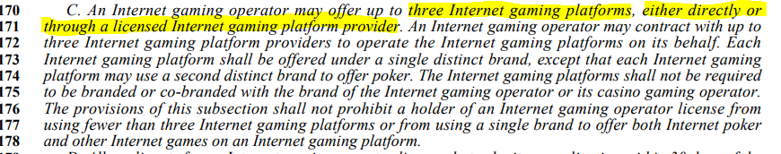
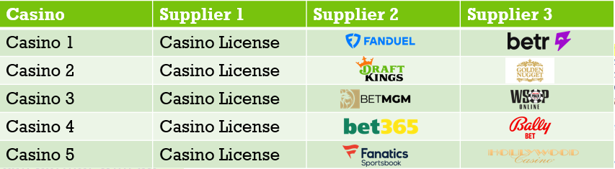

Potential Partnership with VA land-based casinos
Operator – Supplier Partnerships
Each casino (iGaming operator) can partner with up to three supplier platforms to offer iGaming. Players will access the internet casino games through their desired platform (Draft Kings, FanDuel, etc.)
*For illustrative purposes only. Chart does not reflect actual executed market access arrangements.

Slide 12


Internet Gaming Operator
CASINO
Operator – Supplier Partnerships
Operator selects up to 3 suppliers to partner with.
Each casino (iGaming operator) can partner with up to three supplier platforms to offer iGaming. Players will access the internet casino games through their desired platform (Draft Kings, FanDuel, etc.)
Internet Gaming Supplier and Platform Provider
Casino 1
Supplier provides platform directly to consumers.
Legal-aged gaming participants

Slide 13
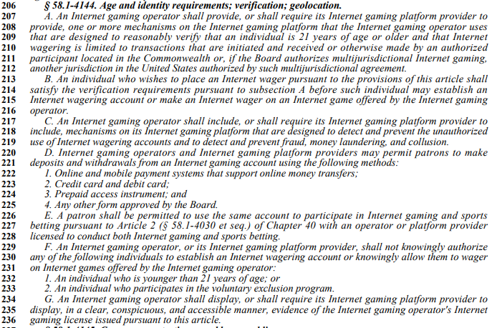
Age and identify requirements; verifications’ geolocation
Every transaction takes place through a registered account where customer age (21+), identify and location is verified.
Voluntary exclusion programs.
Geolocation technologies to restrict play in prohibited locations.

Slide 14

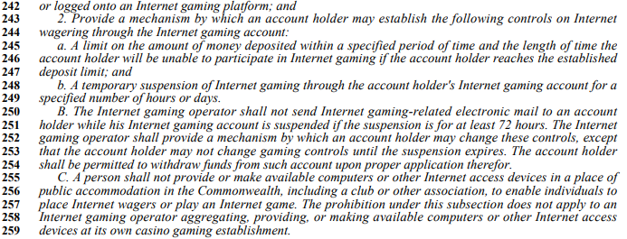
Consumer Protections
24/7 Problem Gaming hotline.
Allows users to set parameters on their own activity, including deposit, wagering and time limits.
Allows operators to implement monitoring and intervention capabilities for responsible gaming concerns.
Customers given tutorials on responsible gaming play.

Slide 15
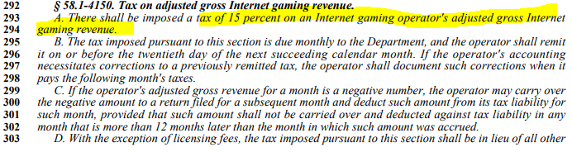
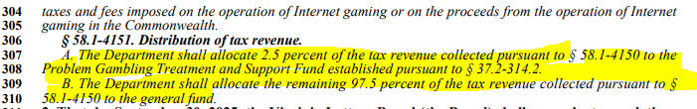
Tax Structure
Virginians wagered an estimated $16 billion in the illegal, unregulated online casino market in 2024.
The Virginia iGaming market could generate an estimated $5.3 billion in new taxable revenue over the first five years.

