Slide 1

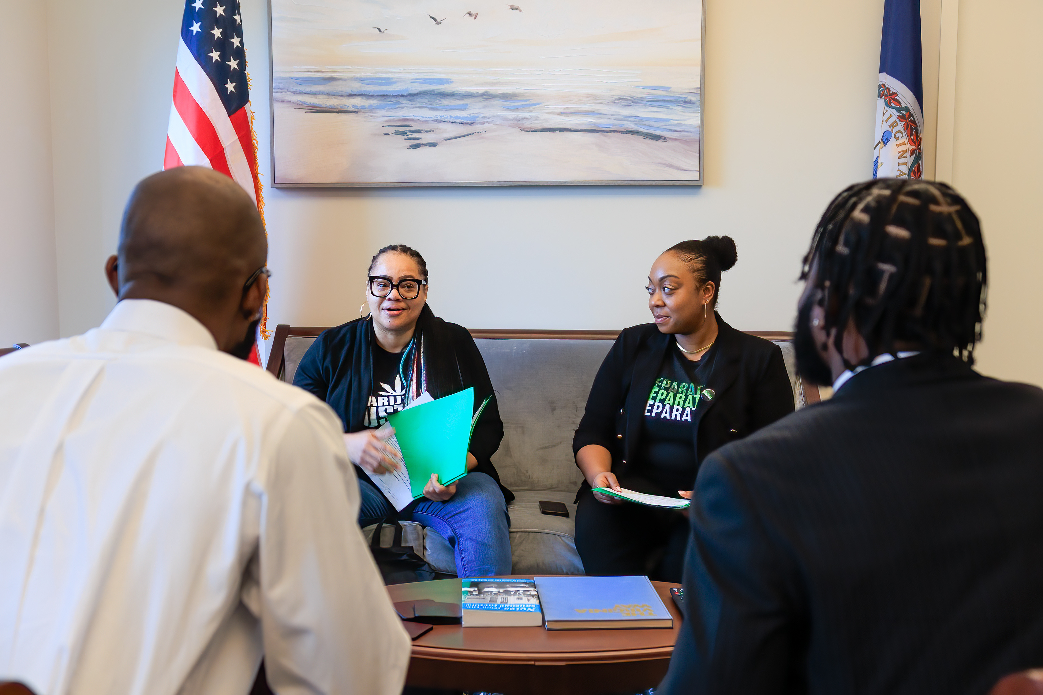


Use of Revenue
How We Legalize It Right
AUGUST 20, 2025
BY: MARIJUANA JUSTICE
Presented by Chelsea Higgs Wise, MSW

Slide 2

Agenda
03
04
05
06
About
The Past
The Promise
The Potential
09
11
12
13
Revenue Charts
CERF Allocations
Recommended
Changes
Legalize It Right
MARIJUANA JUSTICE | USE OF REVENUE
PREPARED FOR 8/20VA CANNABIS COMMISSION

Slide 3
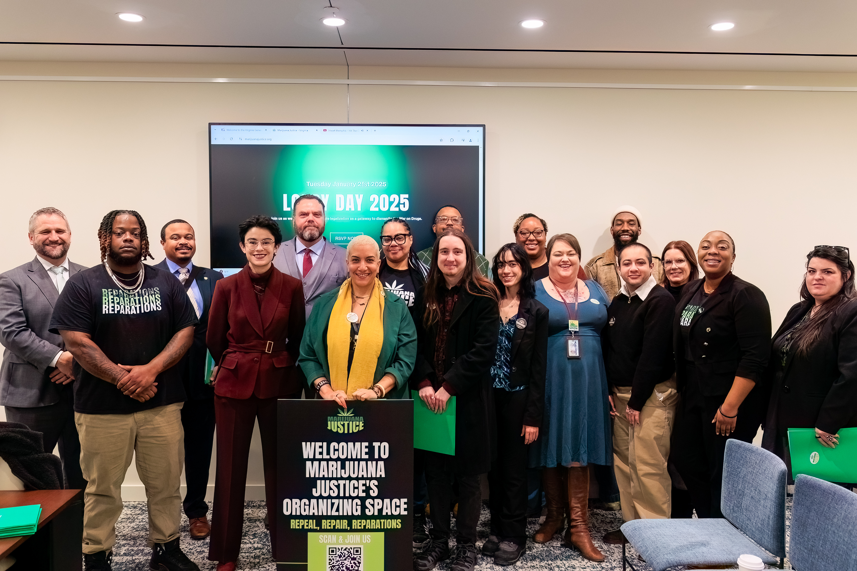

About Marijuana Justice
Established in 2019 to educate Virginia on the benefits of ending the prohibition of marijuana that centers repair, reinvestment and access to ownership.
Our Wins
2020 HJ130/SJ67
JLARC Study
2021 HB2312/ SB1406
2024 SB448/HB698
Retail Sales
2024 SB696
Resentecing
2025 HB2555
Resentecing
2025 HB2613
Parental Rights
2024 HB33/SB115
Parental Rights
2025 SB970/ HB2485
Retail Sales
2025 HJ497
Cannabis Commission

Slide 4
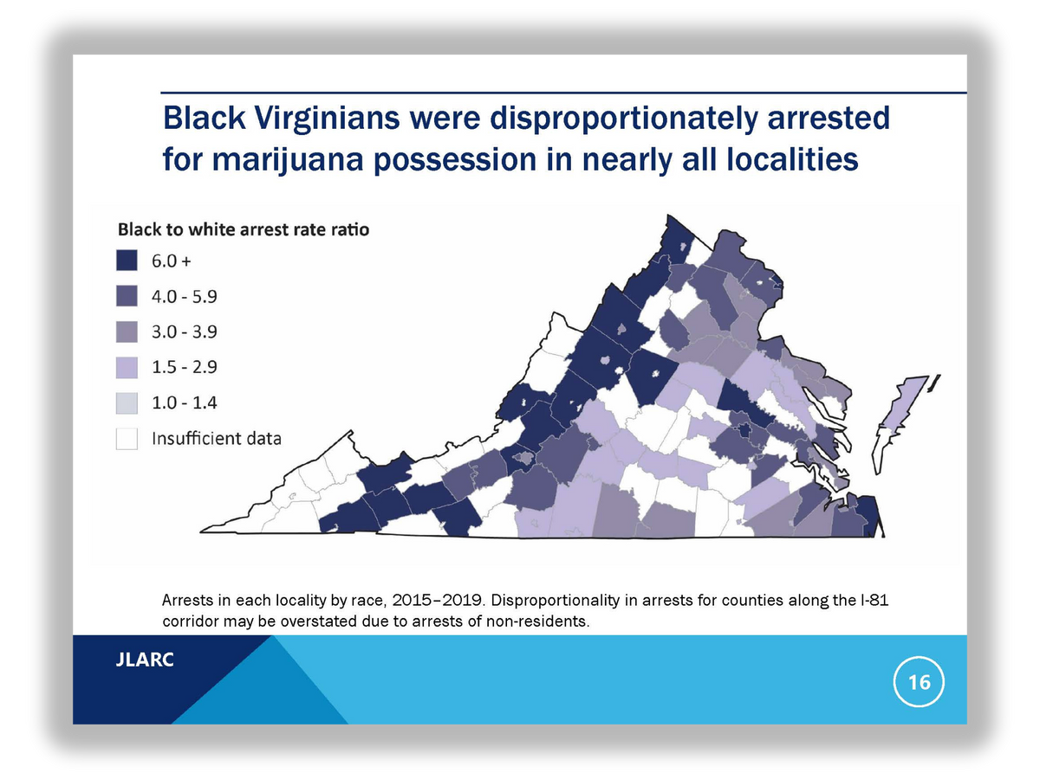
The Past
A 2020 JLARC reports stated that despite similar use, Black Virginians were arrested 3.5x more than whites and convicted at a rate of 3.9x its white counterparts.
Image Source: JLARC Study pg 16
In 2021, Virginia Legislature passed the first law in the U.S. South that stopped the criminalization of small amounts of marijuana and allowed access to consumption for adults and home cultivation.
MARIJUANA JUSTICE, USE OF REVENUE
PREPARED FOR 8/20 VA CANNABIS COMMISSION

Slide 5
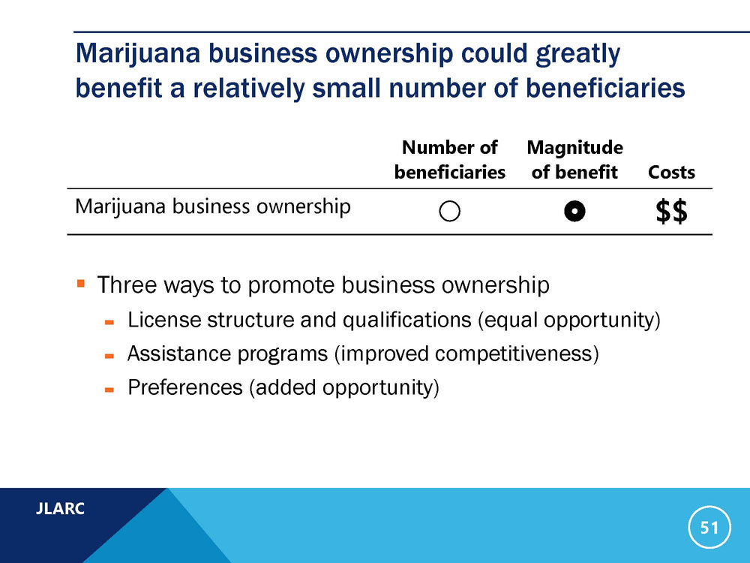
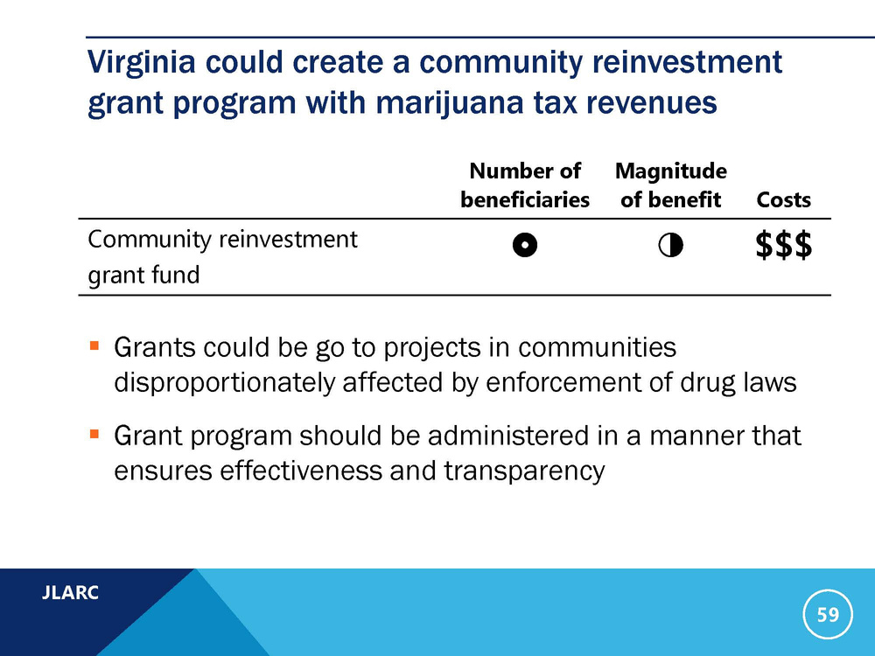
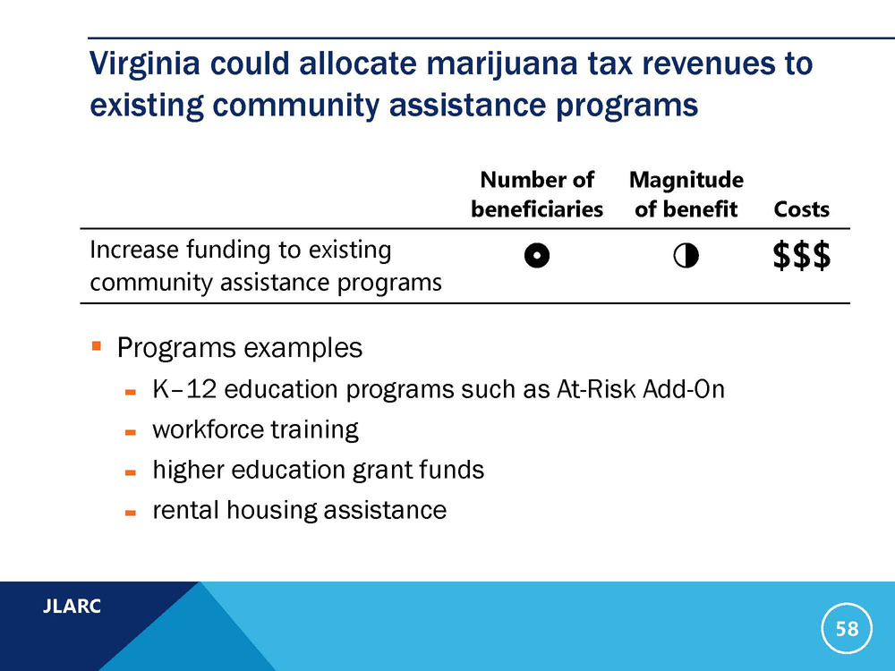
The Promise
The 2021 General Assembly promised pathways for support to those disproportionately impacted by marijuana prohibition by establishing the Cannabis Reinvestment Fund and Business Loan Fund
Image Source: JLARC Study pg 51
Image Source: JLARC Study pg 59
Image Source: JLARC Study pg 58
MARIJUANA JUSTICE, USE OF REVENUE
PREPARED FOR 8/20 VA CANNABIS COMMISSION

Slide 6

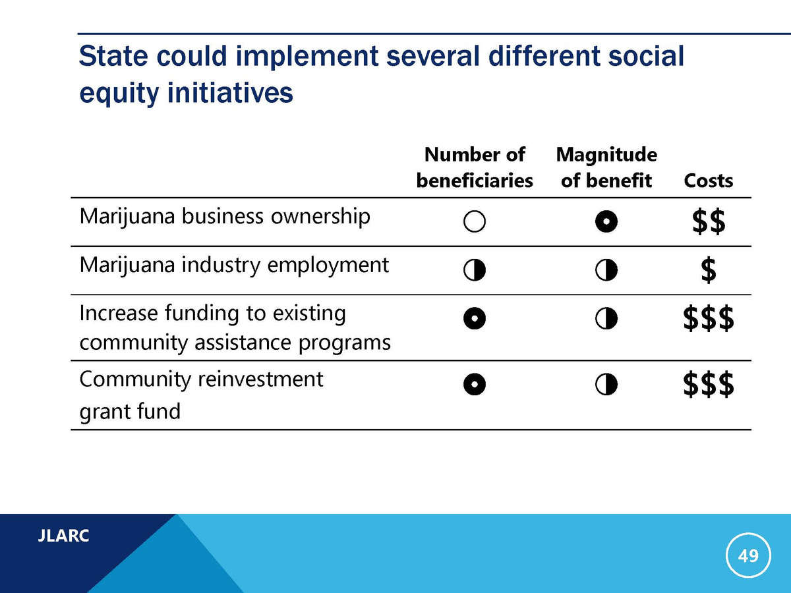
The Potential
Greater upfront investment in rollout leads to more stable industry overtime.
Effective rollout investments that generate tax revenue quicker, pay for itself in the long run.
Image Source: JLARC Study pg 49
MARIJUANA JUSTICE, USE OF REVENUE
PREPARED FOR 8/20 VA CANNABIS COMMISSION

Slide 7
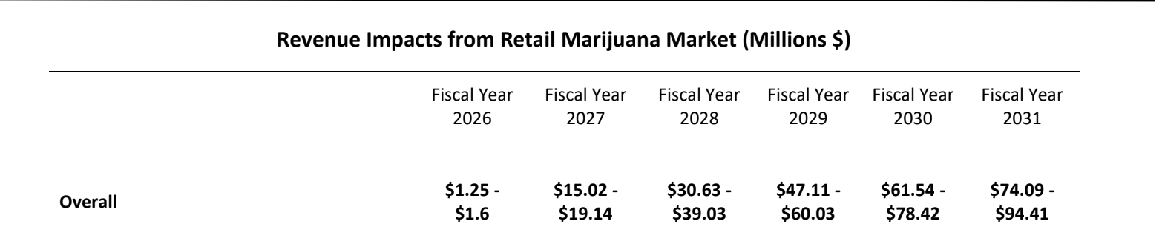

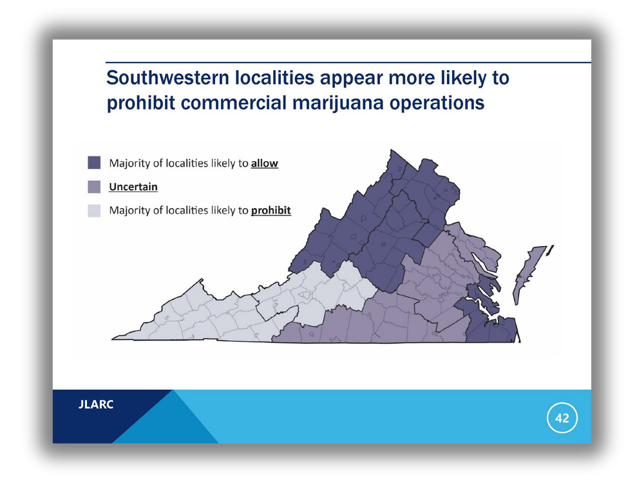
Projected Revenue from VA Marijuana Market
Image Source: JLARC Study pg 42
By making a higher investment into the industry, we have the potential to reap larger rewards to the impacted communities and the Commonwealth as a whole.
Note: Revenue projections are pending Dec 2026 opt-out referendum
MARIJUANA JUSTICE, USE OF REVENUE
PREPARED FOR 8/20 VA CANNABIS COMMISSION

Slide 8
The Importance of Investing in Virginia’s Industry
Problems faced in the legal industry...
  Rigid regulations
  Not regulating for size & location
  Rushed to revenue- oversupply
  Litigation
  Lack of competition
  Poor price management
  Need for capital
  Federally Schedule 1
  Delay in acquiring property
  Local zoning
  Interstate commerce
  Access to banking
  and more...
72.7%
According to a 2024 national study
of U.S. cannabis businesses are not profitable
Source
An adequate investment and a strategic rollout that considers these issues will give us a best chance for a successful long-term market.
MARIJUANA JUSTICE, USE OF REVENUE
PREPARED FOR 8/20 VA CANNABIS COMMISSION

Slide 9
PROPOSED MARIJUANA REVENUE DISTRIBUTION
REVENUE
2.5%: COLLECTIONS OF LOCAL MARIJUANA TAX
1.115% : SALES TAX
8% MARIJUANA TAX: CANNABIS CONTROL AUTHORITY
Distributed based on local sales tax
1% : Public School Age
UP TO $2.5M
RESERVE FUND
ADMIN,
SALARIES, ETC
Excludes opt-out localities
0.115% : Public Education Standards of Quality (SOQs)
GENERAL FUND
60% CANNABIS EQUITY REINVESTMENT FUND (CERF)
10% PRE- K
25% DEPARTMENT OF BEHAVIORAL HEALTH AND DEVELOPMENTAL SERVICES (DBHDS)
5% PUBLIC HEALTH PROGRAMS
% to the Cannabis Equity Loan Fund
% to the Indigent Fund
% for scholarships towards those in foster care & families impacted by substance abuse
% for grant programs in impacted communities (i.e. foster care, mentoring, workforce, etc.)
% to support those disproportionately
affected by drug enforcement
MARIJUANA JUSTICE, USE OF REVENUE
PREPARED FOR 8/20 VA CANNABIS COMMISSION

Slide 10
PROPOSED MARIJUANA TAX DISTRIBUTION
8% MARIJUANA TAX: CANNABIS CONTROL AUTHORITY
UP TO $2.5M
RESERVE FUND
ADMIN,
SALARIES, ETC
GENERAL FUND
60% CANNABIS EQUITY REINVESTMENT FUND (CERF)
10% PRE- K
25% DEPARTMENT OF BEHAVIORAL HEALTH AND DEVELOPMENTAL SERVICES (DBHDS)
5% PUBLIC HEALTH PROGRAMS
% to the Cannabis Equity Loan Fund
% to the Indigent Fund
% for scholarships towards those in foster care & families impacted by substance abuse
% to support those disproportionately
affected by drug enforcement
% for grant programs in impacted communities (i.e. foster care, mentoring, workforce, etc.)
MARIJUANA JUSTICE, USE OF REVENUE
PREPARED FOR 8/20 VA CANNABIS COMMISSION

Slide 11
RECOMMENDED CERF DISTRIBUTION
60% CANNABIS EQUITY REINVESTMENT FUND (CERF)
YEAR FIVE= $32MILLION
50%= $16M
40%= $12M
10%= $3.2M
% to the Cannabis Equity Loan Fund
% to support those disproportionately
affected by drug enforcement
% to the Indigent Fund
% for scholarships towards those in foster care & families impacted by substance abuse
% for grant programs in impacted communities (i.e. foster care, mentoring, workforce, etc.)
MARIJUANA JUSTICE, USE OF REVENUE
PREPARED FOR 8/20 VA CANNABIS COMMISSION

Slide 12


Recommended Updates
Current Challenges
Proposed Solutions
Future Outcomes
Initial Business Fund Allocation
THE FUND WILL NOT HAVE ANY $ TO SUPPORT
SMALL BUSINESSES IN THE FIRST YEAR
ALLOCATE $3 MILLION UPFRONT TO
SUPPORT 1ST ROUND OF LICENSEES
EARLY INVESTMENT WILL STRENGTHEN THE LONG-TERM SUCCESS OF SMALL BUSINESSES ACROSS THE LIFETIME OF THE INDUSTRY.
Compensate Non-Paid CERF Board
THE CERF BOARD IS MADE UP OF 7 PAID ADMINISTRATION MEMBERS AND 13 UNPAID COMMUNITY MEMBERS.
COMPENSATE COMMUNITY MEMBERS OF THE CERF BOARD TO STRENGTHEN THEIR ROLE IN OVERSEEING THE $32 MILLION INVESTMENT.
FAIR COMPENSATION WILL LEAD TO BETTER VALUE, STRONGER ENGAGEMENT, AND LONG-TERM SUPPORT FOR THE BOARD’S WORK.
Define %’s for CERF Investments (50% Business Fund, 40% Individual, workforce, education, 10% Indigent Fund)
CURRENTLY NO ALLOCATIONS FOR CERF REINVESTMENTS.
ESTABLISH PERCENTAGES TO GUIDE AND MAINTAIN THE INTENT OF REPARATIVE POLICY.
DEFINED ALLOCATIONS WILL ENSURE VIRGINIA KEEPS ITS PROMISE AND PROVIDE CLEAR PARAMETERS FOR THE CERF BOARD.
MARIJUANA JUSTICE, USE OF REVENUE
PREPARED FOR 8/20 VA CANNABIS COMMISSION

Slide 13
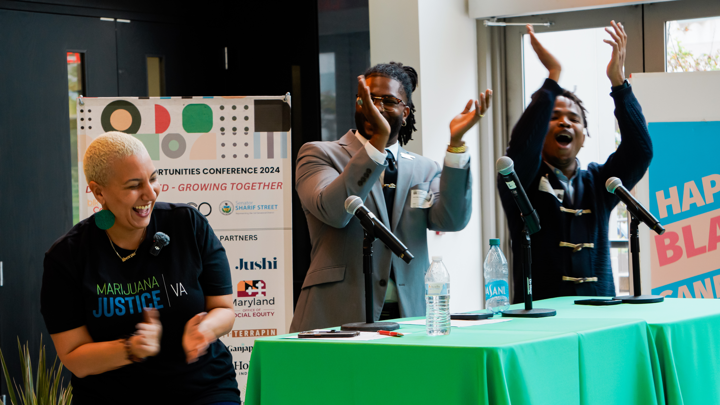






Legalize It Right
Strategic Rollout
Maintain Reparative Policy
Long-term Investment
Promoting Public Health & Safety
A rushed rollout will give harsh reality for market stabilization - the market will decline then stabilize
Reinvestment in those communities that were greatly impacted during marijuana prohibition by supporting small businesses and legacy farmers.
Significant initial investment in regulations and infrastructure, will allow for a long and prosperous industry vs. the crash and burn experienced by other states.
A high quality and competitively priced regulated industry is the best way to combat the illicit market
MARIJUANA JUSTICE, USE OF REVENUE
PREPARED FOR 8/20 VA CANNABIS COMMISSION

Slide 14
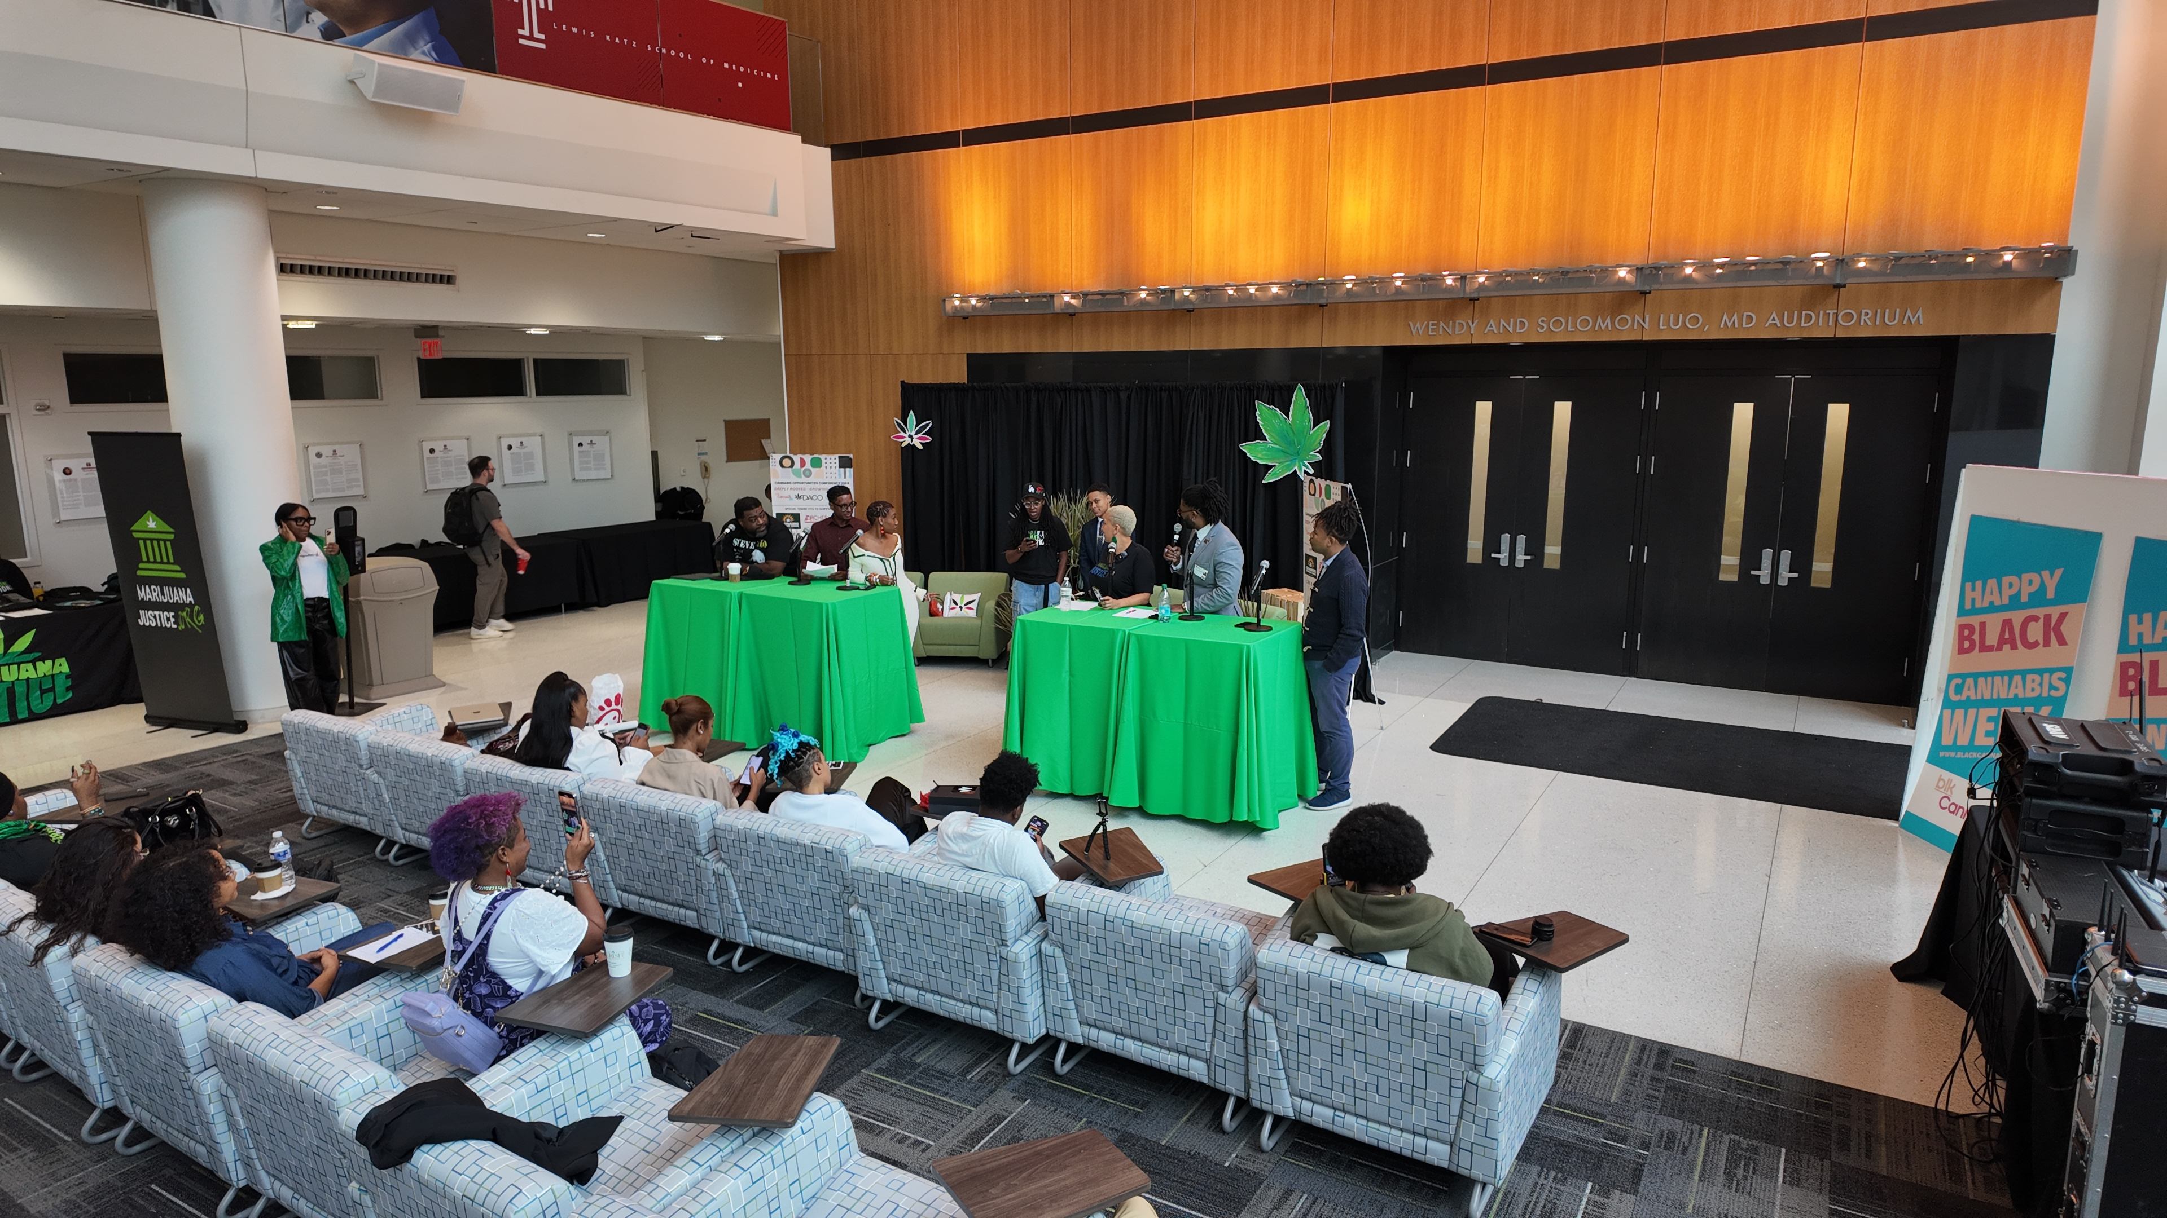



QUESTIONS?
marijuanajustice.org
@thcjusticenow
info@marijuanajustice.org

