Slide 1


Blue Envelope Program
Chief Joseph Hill & Ava Adenauer
September 4, 2025

Slide 2

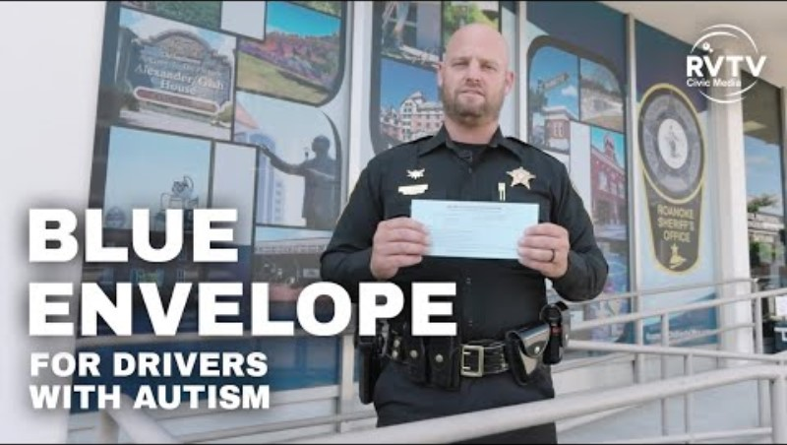
Notes:
Wanted to share this video this with you in case you have not seen it yet that the requesting agency for this legislation, the Roanoke County Sherriff’s Office put together.

Slide 3
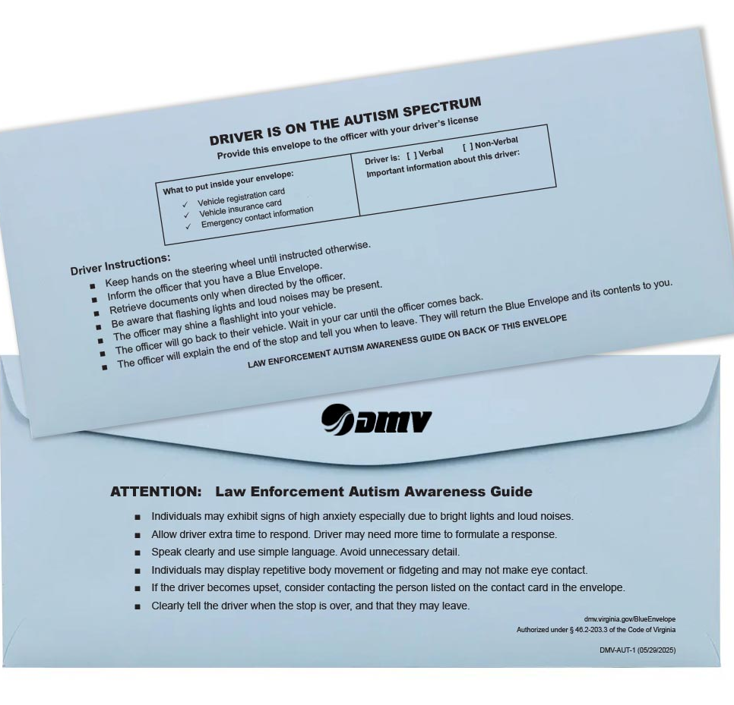
Background & Program Overview
How It Works
Virginia has over 6.2 million licensed drivers—with ____ identifying as autistic
Created by House Bill 2501 and § 46.2-203.3 Code of Virginia
Launched July 1, 2025
Designed to assist drivers with autism spectrum disorder during traffic stops
Program is free, voluntary, and confidential
No registration or documentation required
Holds key documents + emergency contact information
Available at all DMV CSCs and certain Select offices
Notes:
Wanted to share this video this with you in case you have not seen it yet that the requesting agency for this legislation, the Roanoke County Sherriff’s Office put together.

Slide 4




Development
How the Blue Envelope Program was created
Modeled after programs in Vermont, Arizona, and New Jersey
Partnered with requesting law enforcement agency every step of the way and with promotion
Collaborated with DMV’s Law Enforcement Division for training and awareness
Coordinated across internal teams for statewide launch
Printing
Customer Service Management Administration
Communications
Law Enforcement

Slide 5


Why It Matters
Benefits of the Program
Drivers
Law Enforcement
Reduces anxiety and improves safety
Provides a discreet way to signal communication needs
Keeps license, registration, insurance, and emergency contacts together
Reduces misunderstandings and promotes safer interactions
Provides a clear, consistent tool recognized statewide
Builds trust with the autism community
Notes:
Benefits for Drivers:
Improved Communication: Officers are alerted right away that a driver may need extra time or alternative communication methods.
Reduced Misunderstandings: Helps avoid escalation that can come from misreading behaviors or delayed responses.
Consistency: Provides a standard, recognizable tool across Virginia, so every officer knows what to expect when they see a blue envelope.
Efficiency: Keeps driver’s license, registration, insurance, and emergency contact info together in one place — easier for the officer to review.
Training Reinforcement: Supports officer training on interacting with drivers with autism by giving them a practical tool in the field.
Community Trust: Demonstrates law enforcement’s commitment to safety, inclusion, and respect, strengthening public confidence.
Law Enforcement Benefits:
Improved Communication: Officers are alerted right away that a driver may need extra time or alternative communication methods.
Reduced Misunderstandings: Helps avoid escalation that can come from misreading behaviors or delayed responses.
Consistency: Provides a standard, recognizable tool across Virginia, so every officer knows what to expect when they see a blue envelope.
Efficiency: Keeps driver’s license, registration, insurance, and emergency contact info together in one place — easier for the officer to review.
Training Reinforcement: Supports officer training on interacting with drivers with autism by giving them a practical tool in the field.
Community Trust: Demonstrates law enforcement’s commitment to safety, inclusion, and respect, strengthening public confidence.

Slide 6
Thank You!
Joseph Hill – Chief of Law Enforcement Division
 joseph.hill@dmv.virginia.gov
Ava Adenauer – Sr. Portfolio Analyst
 ava.adenauer@dmv.virginia.gov
Envelopes are available upon request. DMV will gladly provide them to organizations supporting outreach and awareness efforts.
Learn More About the Blue Envelope Program at dmv.virginia.gov/Blue Envelope.
Blue Envelope Program FAQ’s.

