Slide 1
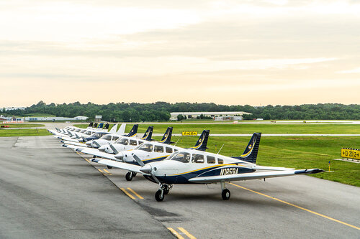
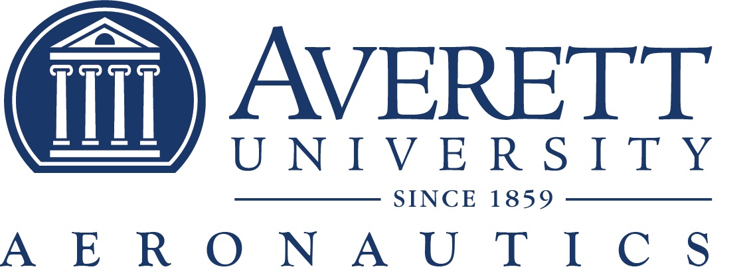
“Flying Forward: Innovation, Partnerships, and Career Outcomes”
Presentation to the Joint House-Senate Transportation Committee
October 17, 2025
Travis Williams, Averett University Chief Flight Instructor

Slide 2
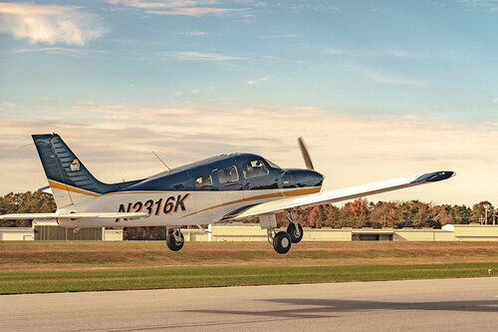
Introduction
2026 will mark 45 years of aviation training excellence
Averett University’s Aeronautics Program prepares students academically, ethically, and professionally for leadership in the aviation industry.
Mission: Building tomorrow’s aviation leaders through excellence in flight and management education.

Slide 3
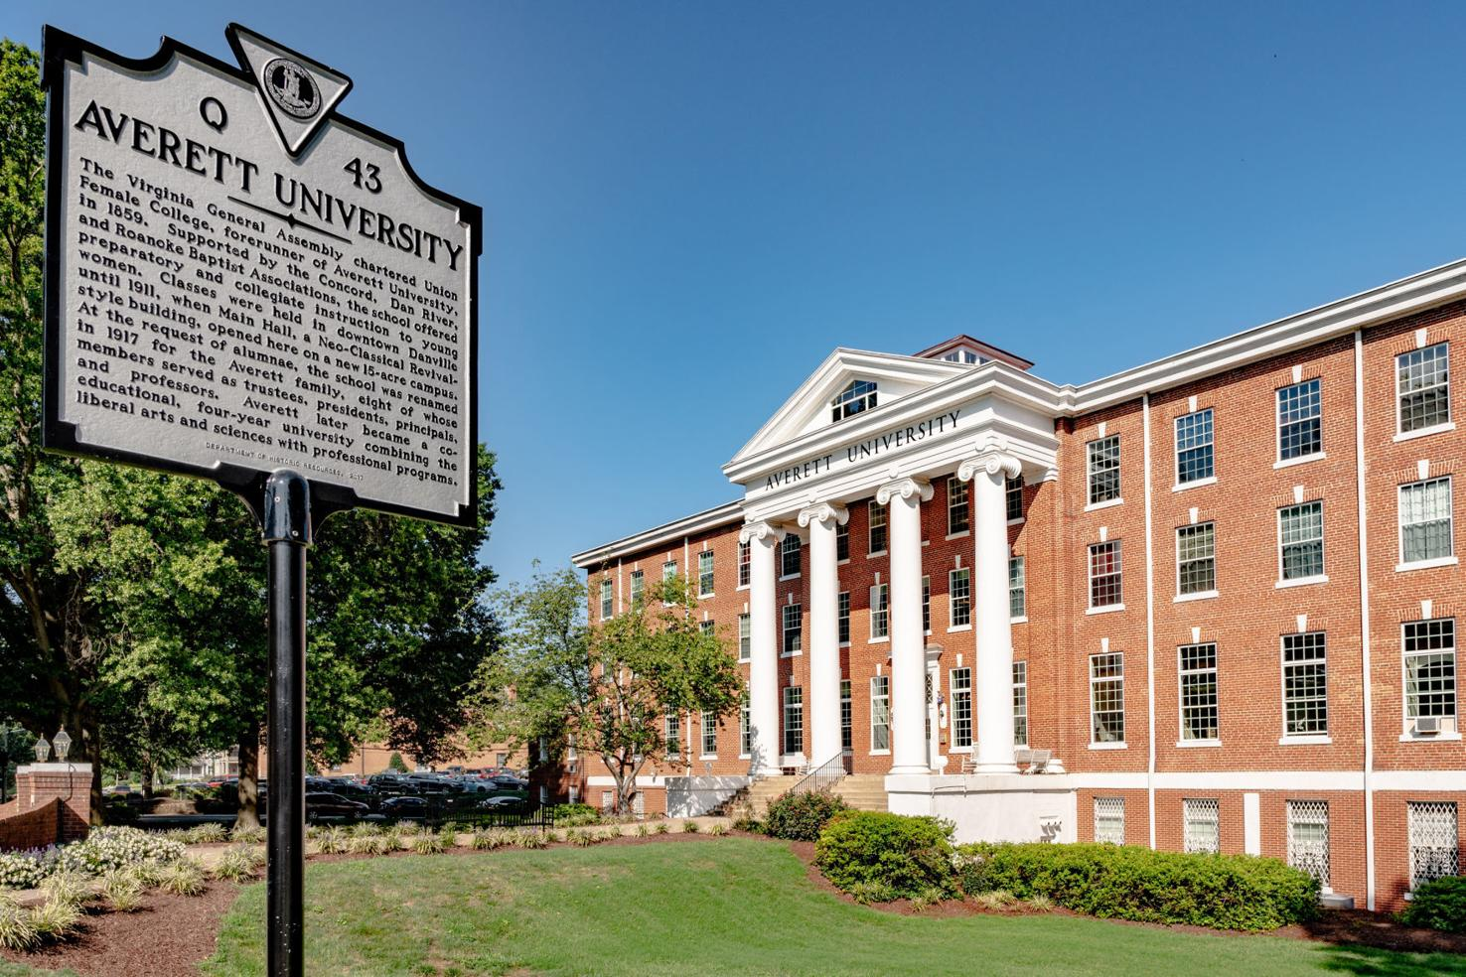
Degree Programs & Concentrations
Bachelor of Science in Aerospace Management with two concentrations:
Aviation Business
Flight Operations
Joint Aerospace Management / Criminal Justice degree also available

Slide 4
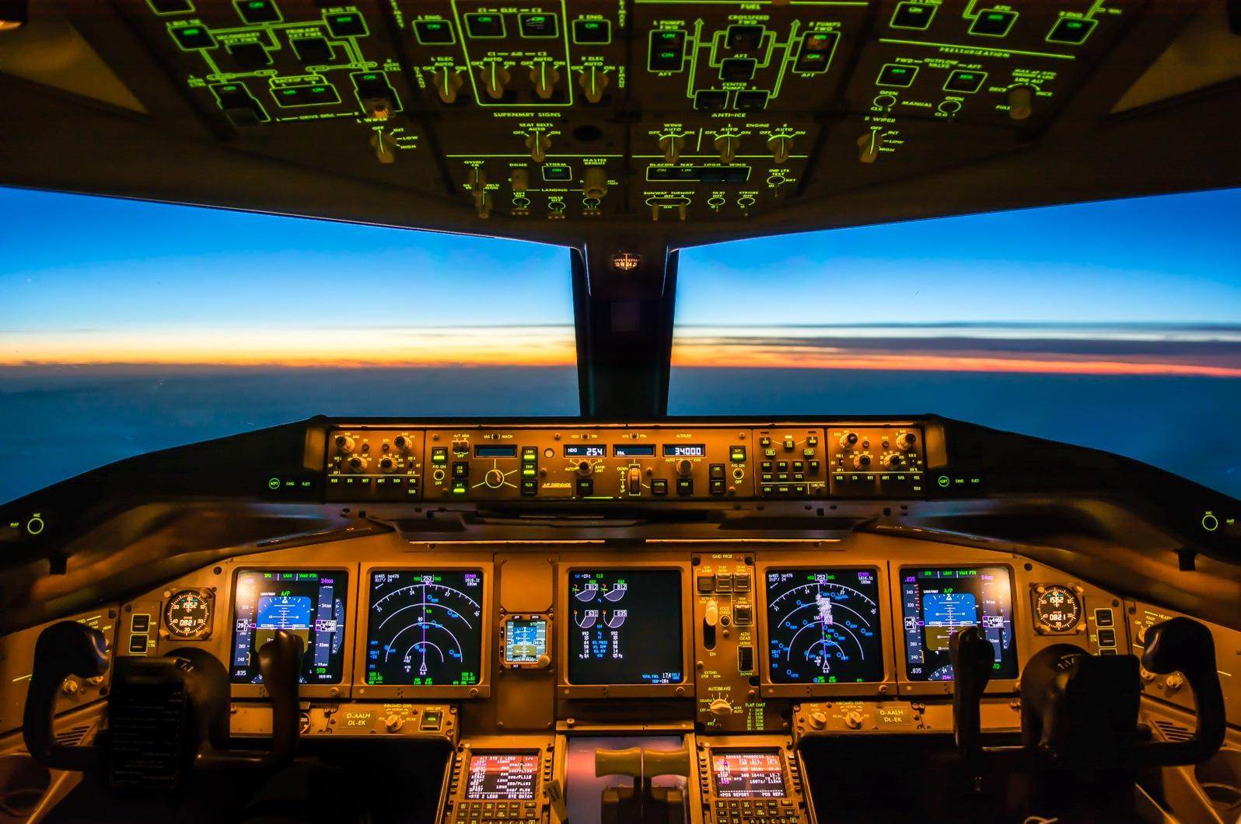
Excellence in Education & Values
High academic and safety standards
Strong emphasis on ethics, professionalism, and integrity
Experienced faculty with real‑world aviation expertise

Slide 5
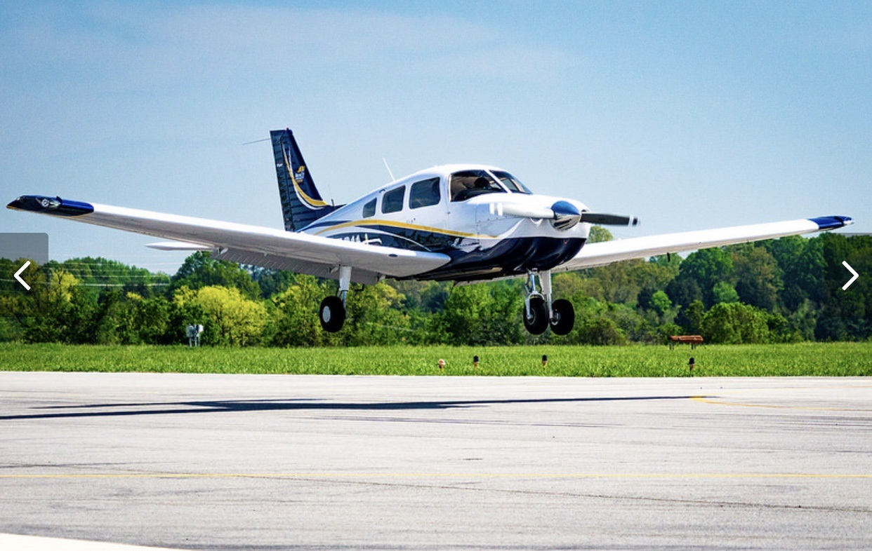
Partnerships & Community Engagement
Airline partnerships: PSA Airlines (ORF, DCA) provide pathways to American Airlines.
Hargrave Military Academy
Virginia Space Grant Consortium
City of Danville
Host free fly days every fall
Operate FBO which provides our students real world education

Slide 6
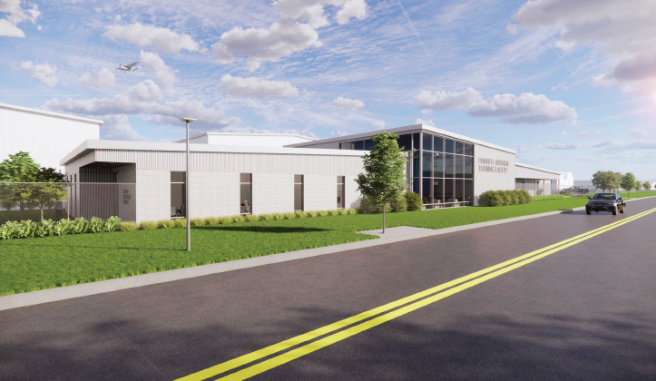
Partnerships & Community Engagement Cont.
Danville Regional airport
Construction will begin in December 2025 on a new 13,000 sq. ft. Aviation training facility
Partner with Danville Community College’s AMT Program
Will bring 15 new jobs to the airport, increasing employment to 47
Working with Danville Public Schools STEM Aviation program

Slide 7
Growth & Strategic Vision
Enrollment increasing from 130 to 200+ students (3 years)
Additional aircraft purchased to meet student demand
Ongoing airport renovations and facility upgrades to support expansion
New hangar construction to support growing fleet

Slide 8
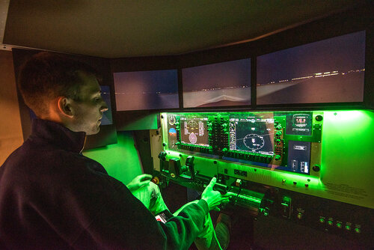
Achievements & Recognition
Recognized by *Virginia Living Magazine* among top STEM schools.
Recipient of the SPTC Innovative Stars Award for Education and Community Outreach.
FAA‑approved R‑ATP certification distinguishes Averett among elite aviation programs.

Slide 9
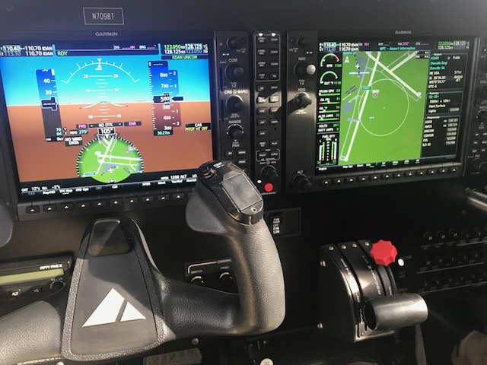
Challenges & Opportunities
Challenges:
Cost of flight training
Fleet maintenance and modernization
Opportunities:
Addressing national pilot shortage
Expanding airline partnerships
Strengthening aviation leadership pipeline

Slide 10
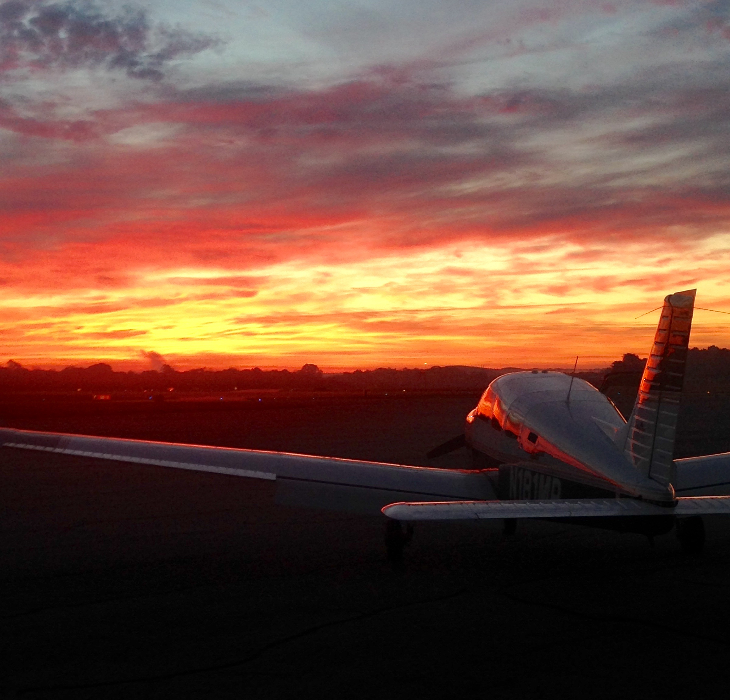
Conclusion
Averett University’s Aeronautics Program exemplifies excellence through:
Industry partnerships
Rigorous training
Alumni success
Visionary growth
Our program is shaping the FUTURE of aviation leadership in the Commonwealth of Virginia.

