Slide 1

Economic and Revenue Review and Update
Stephen E. Cummings
Secretary of Finance
Commonwealth of Virginia
www.finance.virginia.gov
October 2025

Slide 2
Summary
September revenues grew 2.7 percent over last year, bringing year-to-date growth to 5.1 percent or $374 million.
Revenues exceeded forecast for the month of September by $294 million or 9.8 percent. Year-to-date, revenues are ahead of expectations by 7.9 percent or $561 million.
Payroll withholding and sales tax collections continues to be the primary driver of growth and the positive variances in the forecast.
September was a major collection month for nonwithholding which saw considerable overperformance relative to forecast.
New economic datapoints are not yet available with the Federal government shutdown impacting the Bureau of Labor Statistics and Bureau of Economic Analysis publications.
US and Virginia job growth have trended lower but remain positive at 0.9 and 1.0 percent year-over-year respectively.
While the gap has narrowed, Virginia continues to outperform national averages on unemployment and labor force participation.
Inflation remains around 3.0 percent. Similar to levels at the outset of the calendar year.
Consumer spending continues steady growth at both the national and state level. Personal Consumption Expenditure are up 5.6 percent in August.
The renewed threat of a trade war with China adds uncertainty to the outlook.
September’s results vs forecast increase the available resource cushion to approximately $2.2 billion.

Slide 3
year-over-year Job growth continues to be positive
Over 10,000 Virginia jobs added in July and August
Over 10k jobs added FYTD
Source: Bureau of Labor Statistics.
Source: Bureau of Labor Statistics.
August data is not yet available due to the federal government shutdown.
The U.S. added 101,000 jobs in July and August, while Virginia added 10,500, with Virginia showing a proportionately better period-over-period growth rate.
Private sector employment in Virginia increased by 9,300 in August, more than offsetting a government payrolls decrease of 2,100.
Virginia remained above last year’s jobs totals by roughly 1 percent in August compared to 0.9 percent for the U.S.

Slide 4
PRIVATE SECTOR DATA OFFERS MIXED VIEW OF U.S. EMPLOYMENT GROWTH IN SEPTEMBER
Without official government employment statistics, data from the private sector provides approximations of employment growth.
Private payroll provider ADP, using payroll data of more than 26 million U.S. employees, estimated that private sector employment declined by 32,000 jobs in September. Education and health services showed the largest month-over-month increase (+33k). Leisure and hospitality (-19k), other services (-16k) and professional and business services (-13k) had the largest declines.
Revelio Labs, which uses a variety of data sources including professional profile data from LinkedIn, estimates the U.S. economy added approximately 60 thousand jobs. The growth in employment was driven by the education and health services sector and was concentrated in a few states.
Source: Moody’s Analytics; Revelio Labs; ADP; Carlyle Group.
Global investment firm Carlyle released proprietary U.S. economic indicators derived from its portfolio of 277 active companies, 694 real estate investments, and nearly 730,000 employees worldwide. Carlyle estimates that employers added 17,000 jobs in September.

Slide 5
ADP ESTIMATES THAT PRIVATE SECTOR PAYROLLS DECLINED 32,000 IN SEPTEMBER
Automatic Data Processing, Inc. (ADP) is likely the best non-governmental source of private sector payroll growth.
ADP uses payroll data of more than 26 million U.S. employees.
Long term trends tend to match well between the Bureau of Labor Statistics and ADP.
Month-to-month growth numbers are often significantly different.
There is no clear direction of bias between the two sources, under and over estimation are approximately equally likely.
Source: BLS; ADP.

Slide 6
EMPLOYMENT ESTIMATES FROM REVELIO LABS SUGGEST VIRGINIA EMPLOYMENT FELL IN SEPTEMBER
In the absence of official government employment statistics, data from the private sector provides some indication of Virginia job growth, though the reliability of the data is questionable.
According to data published by Revelio Labs, Virginia employment declined by 4,700 in September after increasing by 10,200 in August.
Revelio Labs uses a variety of data sources to construct workforce estimates, such as online professional profiles; job postings; employee sentiment; freelance platform data; layoff notices; and government data.
Historically, employment estimates are not well correlated with official employment statistics from the BLS.
Source: Bureau of Labor Statistics; Revelio Labs.

Slide 7
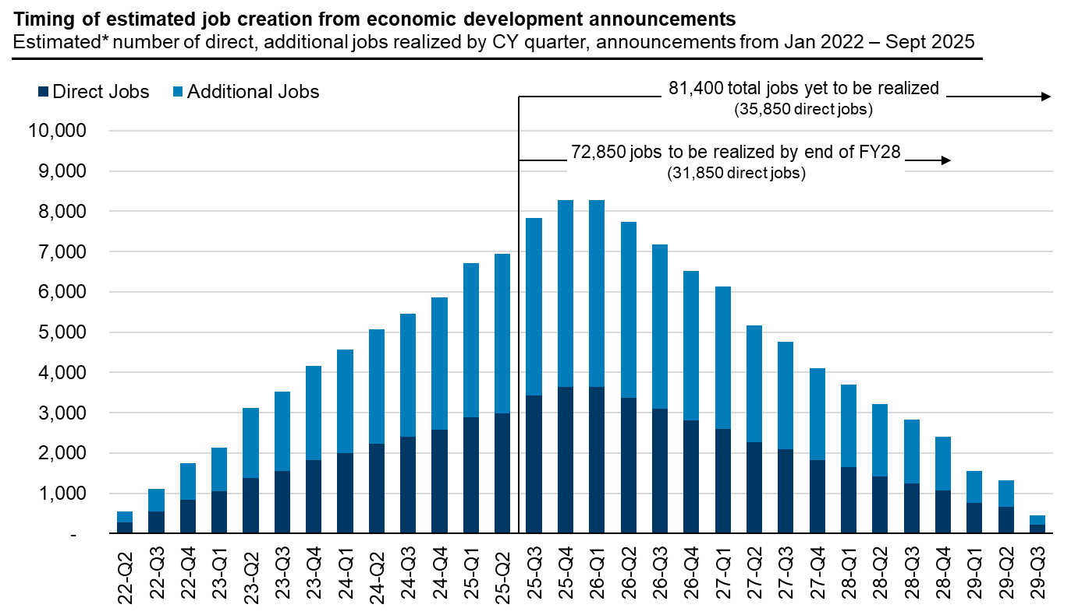
70,000+ VA jobs announced since January 2022 to be created by end of FY 2028
Virginia’s success in economic development is estimated to deliver ~2,500 jobs per month, excluding related construction jobs.
*Includes VEDP-assisted and other traded sector economic development projects tracked by VEDP. Assumes hiring begins one quarter after announcement and a 2-year average ramp, uses detailed IMPLAN multipliers, assumes publicly announced hiring plans do not shift due to company or economic changes. Not based on verified job creation.
Source: VEDP analysis based on the VEDP announcements database.

Slide 8
VIRGINIA UNEMPLOYMENT RATE CONTINUES TO OUTPERFORM THE U.S.
Source: Bureau of Labor Statistics; FRED.
Source: Bureau of Labor Statistics; FRED.
While unemployment in Virginia has trended up over the past two quarters, it remains at a historically low level of 3.6% versus 4.3% nationally, and a 20-year average of 4.3%.
Additionally, job openings increased in the latest month and now stand at 220,000 or 1.4 job openings per unemployed person in Virginia vs 1.0 nationally.

Slide 9
CONTINUED CLAIMS ARE UP YEAR-OVER-YEAR, BUT HAVE BEEN DECLINING
Source: US Department of Labor, Employment and Training Administration.
Source: Virginia Works.
In the week ending October 11, initial claims increased to 4,378, likely driven by initial federally-adjacent claims and limited reductions from the manufacturing sector.
Based on internal (unofficial) VEC initial UI claims tracking, from October 1–15, approximately 1,250 individuals identifying as a federal employee have been recorded, including about 700 during the week of October 8–15. Initial analysis indicates that more than 900 were related to a furlough. (Compensation for Federal Employees (UCFE) claim until the claimant’s federal wages have been verified. The data reported to the U.S. Department of Labor (DOL) includes only those claims that have completed that validation process.)
Continued claims totaled 18,839 and remain below the 10-year weekly average (excluding pandemic years).

Slide 10
Continued unemployment claims for VIRGINIA federal employees are significantly below MD and DC
Jobs openings per unemployed person:
VA: 1.4
US: 1.0
Source: US Department of Labor, Employment and Training Administration.
Source: BLS, JOLTS.
Federal Employment (Aug ‘25)
VA: 185,200
MD: 148,000
DC: 184,100
Top 10 Federal Agencies (as of June 2024) -- 72% of federal employment in VA is defense related
Dept. of the Navy – 45,662
Dept. of Defense – 28,403
Dept. of the Army – 15,208
Dept. of Veterans Affairs – 12,048
Dept. of Homeland Security – 8,928
Dept. of the Air Force – 6,497
Dept. of Commerce – 6,302
Dept. of the Interior – 3,343
Dept. of Agriculture – 2,372
Dept. of Transportation – 2,296
Source: BLS (by place of work, prelim.).
Source: Office of Personnel Management FedScope database.

Slide 11
initial unemployment claims for federal employees increased last week; VA claims are well below MD and DC
Last Shutdown
Source: US Department of Labor, Employment and Training Administration.
Source: US Department of Labor, Employment and Training Administration.
The number of unemployment claims filed by federal workers has grown sharply, reaching their highest level since a 35-day government shutdown that ended in January 2019.
UCFE initial claims in Virginia rose to 115 in the week ending October 11, well below Maryland at 1,167 and DC at 362.

Slide 12
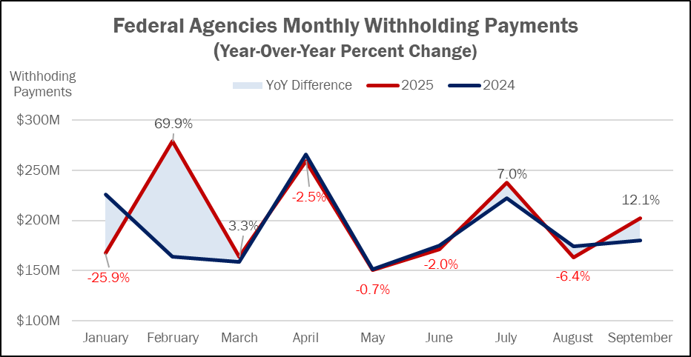
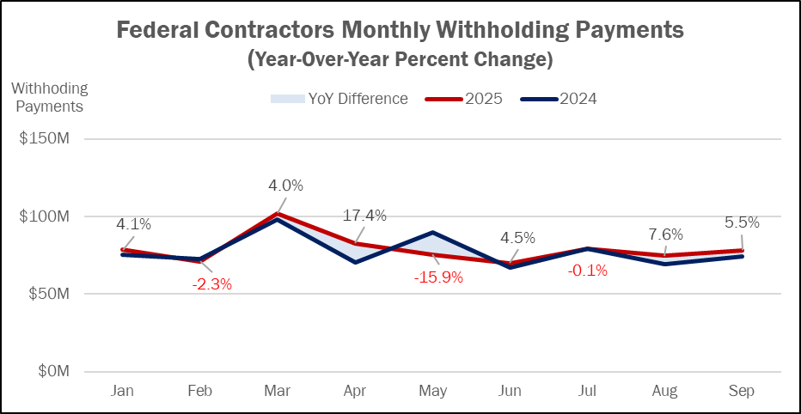
FEDERAL WITHHOLDING NUMBERS REMAIN STEADY
To monitor federal spending reductions, withholding payments from the largest federal agencies and contractors who do significant business in Virginia are tracked on a monthly basis.
Withholding payment growth has not shown signs of statistically significant decline. Timing of payments, such as the January and February, have driven most of the large month-over-month differences.
In the opening quarter of FY 2026, federal agencies (+4.5%) and federal contractors (+4.1%) are up year-over-year.

Slide 13
CORE PCE REMAINS AROUND 3 PERCENT
Source: U.S. Bureau of Economic Analysis; Bureau of Labor Statistics.
Source: U.S. Bureau of Economic Analysis; Bureau of Labor Statistics.
In August, the Consumer Price Index for all urban consumers increased by 0.4 percent for the month, a 2.9 percent year-over-year growth compared to August of last year. Core CPI, which excludes food and energy, increased by 3.1 percent over last August.
In August, Personal Consumption Expenditure Price Index for all items increased by 0.3 percent, equating to a 2.7 percent year-over-year growth. Core PCE, the Federal Reserve’s preferred inflation measure, increased by 0.2 percent for the month, which denotes a 2.9 percent year-over-year increase.

Slide 14
CONSUMERS CONTINUE TO SPEND
Real personal consumption expenditures and consumer sentiment were impacted early on in 2025 by the uncertainty surrounding trade policy and other national economic policies but has shown a strong rebound in recent months.
Virginia sales and use tax revenues remain solid, increasing 5.8% year-over-year in September. Year-to-date sales tax collections are up 5.4%.

Slide 15
Federal Shutdown May Impact Revenue Timing, but State Revenue Impact is not expected to be significant
Since 2000, there have been three government shutdowns, averaging 17 days.
The 2018-2019 partial shutdown lasted for a record 35 days.
TAX analyzed withholding payments during the 2018-2019 government shutdown from the 25 largest federal agencies who operate in Virginia and did not find a statistically significant difference in withholding payments compared to previous years.
Even as the longest shutdown on record, the Congressional Budget Office estimated that it delayed $18 billion in federal spending, estimating that all but $3 billion in real GDP (0.02%) impact would be made up in later quarters.
While the shutdown is not necessarily impactful to state revenues, missed paychecks create real pain for Virginia families.

Slide 16
INDIVIDUAL INCOME TAX CONTINUES TO LEAD EXCEPTIONAL YEAR-OVER-YEAR GROWTH
General fund revenues grew $87.6 million (2.7%) in September, bringing year-to-date growth to $374.4 million (5.1%).
Withholding saw another double-digit growth month at $130.6 million (10.2%) over last year. Some of this is explained by a small handful of large payers with three pay periods in September instead of the regular two. This only accounts for approximately $25 million in extra payments though.
Sales tax growth has also persisted, growing $22.8 million (5.8%) this month and $65.6 million (5.4%) year-to-date.
The year-to-date underperformance of $85.4 million is attributable to the accounting adjustments mentioned in prior meetings.

Slide 17
SEPTEMBER AND FYTD REVENUES GREATLY EXCEED FORECAST
Withholding outperformed forecast by $77.6 million (5.8%). This is significantly greater than the ~$25 million in identified extra deposits.
Last year, retroactive PTET payments for Tax Year 2021 were due. This created a surge in nonwithholding payments. Without these retroactive payments, the forecast assumed some declines. While PTET payments did decline approximately on track, regular nonwithholding payments increased a similar amount leading to this exceptional overage.
Interest income also significantly outperformed last year Investment returns can be lumpy, leading to exceptional months like this. Also note that the distributions to non-general fund grow as much as general collections, and so next month’s distribution should be proportionally larger.

Slide 18
In Excess of $2.2 billion in Incremental Resources Currently Available FOR FY 2026
In Millions
Excess Revenues, FY 2025* |  | $572.0
Budgeted Spending Cushion
Governor’s Vetoes | $900.0
Required Set Aside (incl. sum sufficient) | (61.3)
Net |  | $838.7
Unspent Appropriations, FY 2025
Total | 2,093.8
Mandatory Balance | (1,618.8)
Discretionary Balance | Estimated at | $252.8
Excess Revenue, FY 2026 (September) |  | $560.9
Total FY 2026 Starting Cushion |  | $2,224.4
* Reported as Committed Fund Balance on Preliminary Balance Sheet.

Slide 19
CONCLUSION
September revenues grew 2.7 percent over last year, bringing year-to-date growth to 5.1 percent ($374 million), exceeding the monthly forecast by 9.8 percent ($294 million) and 7.9 percent ($561.0 million) year-to-date.
The Commonwealth’s primary revenue drivers, withholding and sales and use taxes, continue to be strong year-over-year, growing 10.2 percent and 5.8 percent, respectively, in September and 10.6 percent and 5.4 percent year-to-date.
September is the first major collection month and nonwithholding revenues also significantly over-performed versus forecast.
Job growth in the US and Virginia is slowing but Virginia is performing at or above the national data in recent months and the unemployment rate remains at 3.6 percent vs 4.3 percent nationally and the 20-year average rate for Virginia of 4.3 percent.
The federal shutdown has not yet significantly impacted Virginia, as compared to MD and DC, given the unique mix of federal agencies in Virginia relative to current national budget priorities.
The impact of the shutdown is being closely tracked. While the timing of some revenue receipts may be delayed, the shutdown is not expected to have a significant impact on the Commonwealth’s financial results.
Uncertainty around global trade relationships and the federal budget continues to support a cautious revenue outlook.
With September results, approximately $2.2 billion in resources are available for budgeting purposes.

Slide 20
Federal Funding Lapse

Slide 21
FEDERAL GOVERNMENT SHUTDOWN HAS NOT YET IMPACTED MOST STATE PROGRAMS
Federal appropriations lapsed on September 30, 2025 resulting in a shutdown of the federal government.
The House of Representatives has passed a continuing resolution (CR) that would keep the government operating at the Federal Fiscal Year (FFY) 2025 funding levels until November 21.
The Senate has not yet been able to achieve the 60 votes required for passage.
Major direct benefit programs such as Medicaid and Social Security are not affected by the lapse in appropriations.
Federal highway contract authority funding remains available.
K-12 funding for Title I and IDEA funding is available through the end of the school year.
Federal student aid, Pell Grants and direct student loans, continue to be disbursed.
No new funding authority is available for most discretionary or mandatory grant programs.
Funding will continue for mandatory programs that are currently authorized and not subject to the annual appropriations process, such as the Children's Health Insurance Program.
For some programs, funds remain available for the first quarter of FFY 2026 under legislation adopted in March 2025.
Special Supplemental Nutrition Program for Women, Infants and Children (WIC) has been extended through October.
Supplemental Nutrition Assistance Program (SNAP) benefits are extended through October.
Certain functions that had funding authorizations in place continue to operate and, to date, the majority of programs operated by state agencies have been able to utilize prior year program balances to continue most programmatic spending.
Federal actions continue to evolve and will be evaluated on an ongoing basis once confirmed.

Slide 22
VIRGINIA HAS TAKEN PROACTIVE STEPS TO TRACK POTENTIAL IMPACTS AND MITIGATE RISK
On September 25, the Chief of Staff directed all Executive Branch agencies to identify and track any unfunded work completed by employees or contractors.
Includes employees who have restricted status, and wage or classified employees receiving more than 20% of salary from discretionary federal funds.
Higher Education was not included in this request as their grants have specific individualized rules that are mostly related to research grants.
Similar to tracking work related to paused federal grant reviews, the R3 institutions receive substantial federal funding and are closely monitoring the impacts on their day-to-day operations.
The Department of Human Resources Management and the Department of Planning and Budget have surveyed agencies to gather data needed to monitor:
Each agency’s ability to continue services from prior year grant awards or other revenue sources;
Number of days of operation that can be supported;
If non-federal funds are used, will they be reimbursed by the federal grant; and
Estimated financial impact and number of positions impacted.

Slide 23
EFFORTS UNDERWAY TO IDENTIFY POTENTIAL AGENCY IMPACTS
Functional Area ($ in millions) | FY 2025 Total | Average Per Pay Period | Average Per Week
Health & Human Resources | $356.2 | $14.8 | $6.9
Veterans & Defense Affairs | $62.1 | $2.6 | $1.2
Labor | $46.1 | $1.9 | $0.9
Department of Education | $42.6 | $1.8 | $0.8
Natural & Historic Resources | $26.6 | $1.1 | $0.5
Public Safety & Homeland Security | $26.1 | $1.1 | $0.5
Commerce & Trade | $14.4 | $0.6 | $0.3
Executive | $9.8 | $0.4 | $0.2
Agriculture & Forestry | $7.2 | $0.3 | $0.1
Administration | $3.9 | $0.2 | $0.1
All Other | $3.6 | $0.2 | $0.1
TOTAL (Ex. Higher Ed.) | $598.7 | $24.9 | $11.5
Higer Ed Institutions | $603.1 | $25.1 | $11.6
TOTAL | $1,201.7 | $50.1 | $23.1
Approximately 71 state agencies utilize some degree of federal funding sources to support personnel expenditures.
15 agencies make up almost 87% of federally supported personnel spending
Federal Funds support approximately $11.5 million in weekly state agency payroll expenses.
The amount varies by agency within each secretariat.
There is an additional $11.6 million in weekly payroll expenses at institutions of higher education.
To date, adequate funding has been available to support continued program level operations. however, should the shutdown be extended, the potential for furloughs or programmatic interruptions increase.
The risk is greater at agencies with higher based on their individual ability to draw funds.

Slide 24
VIRGINIA’S AGENCIES ARE PREPARED TO MOVE FORWARD THROUGH A PROTRACTED SHUTDOWN
Based on responses to the DHRM/DPB survey, agencies have identified potential workforce impacts and reported that they have between 2 weeks and 90 days of funding available, depending on the specific program. Potentially impacted employees:
5,485 federally funded classified employees;
1,416 federally funded wage employees; and
407 federally funded contractors.
Agencies have been directed to not assume that federal funds will be reimbursed or state-funding will be provided to cover any unavailable programmatic pass-through funding.
DHRM has policies in place that allow for invoking furloughs or reducing work schedules in order to maintain individual employee benefits.
To date, no Commonwealth employee has been placed into furlough status, however 13 employees at only one agency have been notified that they will be furloughed October 15th if the shutdown is not avoided.
TAX analysis of the January 2019 shutdown indicated that general fund revenue will likely not be impacted if federal government workers receive backpay when the federal government reopens.

Slide 25
Federal Grants Update

Slide 26
COORDINATED FEDERAL GRANT TRACKING ACROSS THE ADMINISTRATION
With the exception of Higher Education, the Finance Secretariat and Office of Federal Affairs, have been monitoring the impact of federal grant reviews across all Executive branch agencies.
Higher Education institutions are being asked to identify paused or suspended federal grants as part of their six-year plan submissions.
Grants have been paused to review compliance with the various federal Executive Orders as well as to ensure alignment with Administration priorities.
Paused grants have largely been tied to discretionary programs funded under the Infrastructure Investment and Jobs Act or the Inflation Reduction Act.
Amounts under review vary week to week and totals have ranged from under $200 million to more than $1.2 billion.
As of this week, approximately $466 million remains paused, down from $515 million in May.
Reflects an increase of $155 million to reflect cancelation of the “Solar for All” grant.
Continuing to work with federal agencies to provide necessary justification to release paused funds.

Slide 27
PAUSED GRANTS HAVE DROPPED SIGNIFICANTLY
Federal Grants Update (10/14/2025)
($ in millions)
Paused grants to Virginia agencies have been reduced by $2.2B since March
($ in millions)

