Slide 1
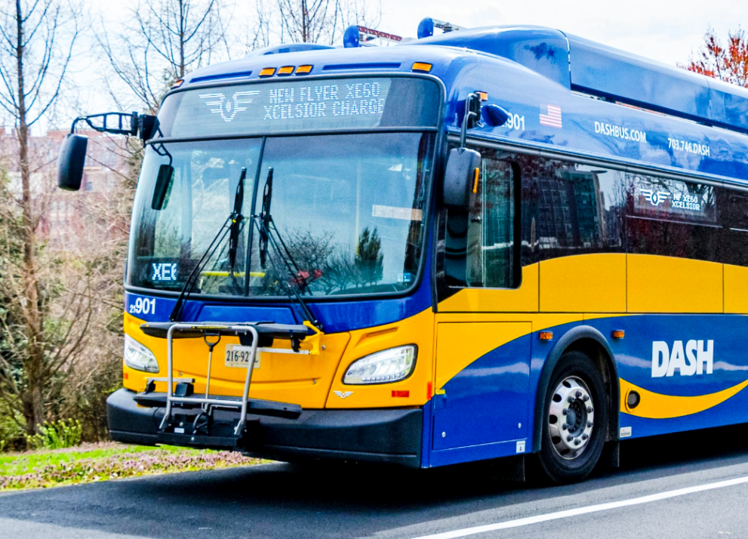
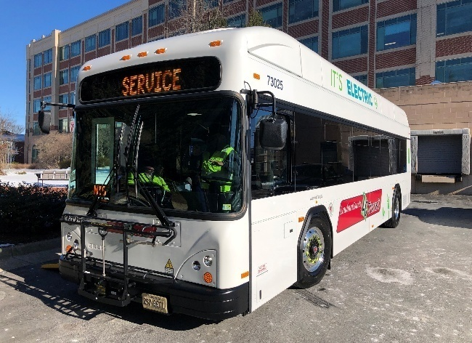
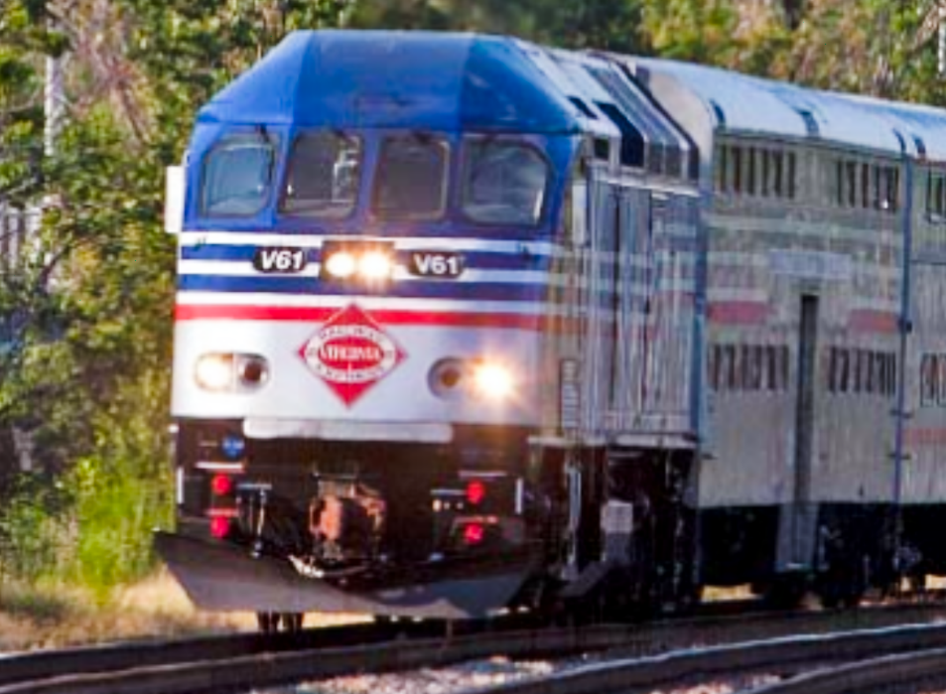
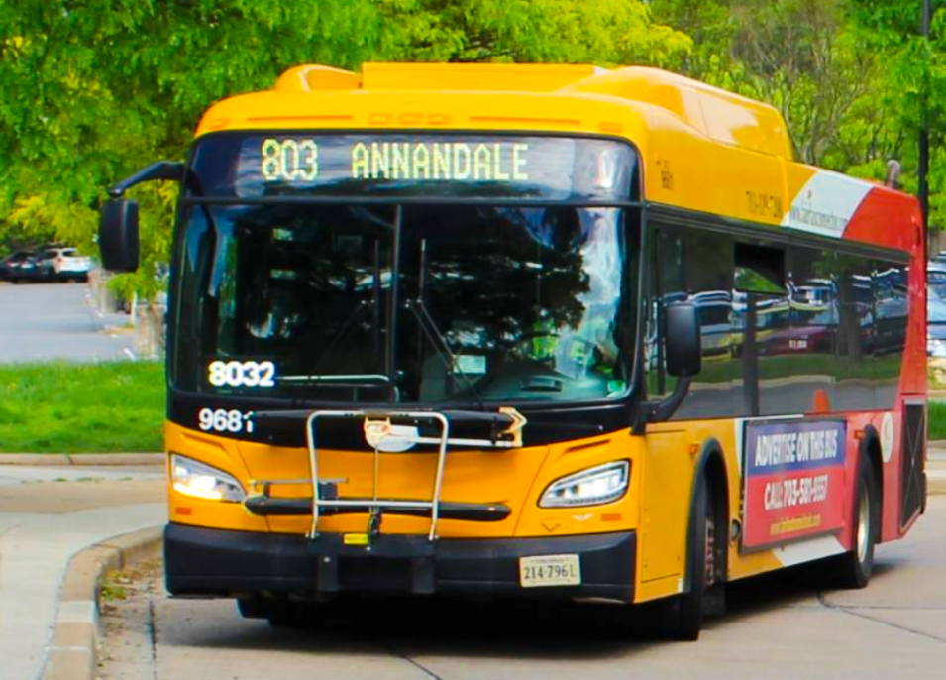
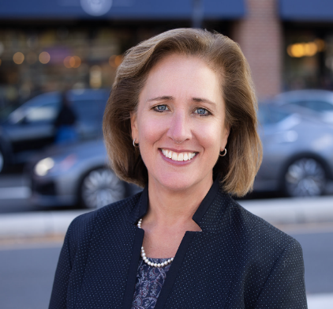
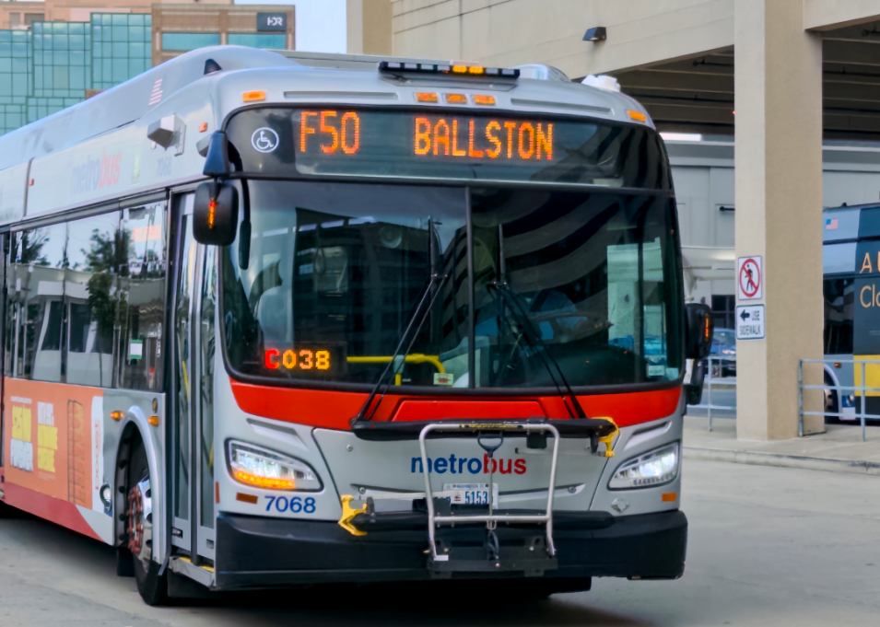
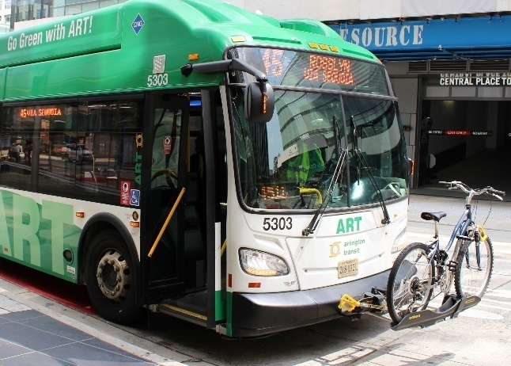
Making Northern Virginia’s Public Transit Network Sustainable and Strong
Overview of the
SJ 28 Joint Subcommittee on the Growing Needs of Public Transit in Northern Virginia
Briefing to the House Appropriations Committee
October 20, 2025
Kate Mattice
Executive Director
Northern Virginia Transportation Commission

Slide 2
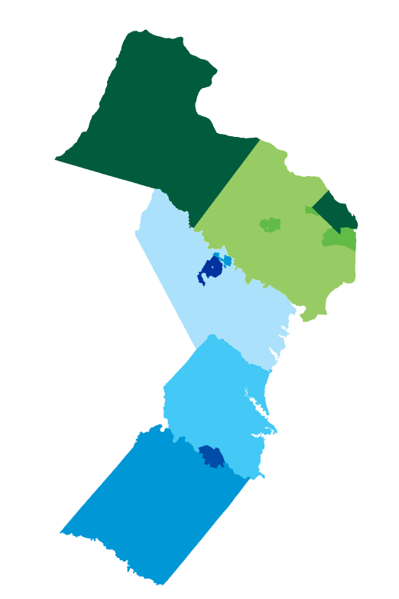

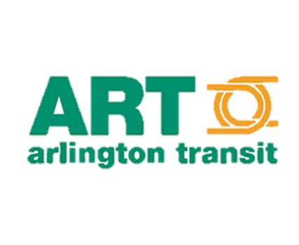
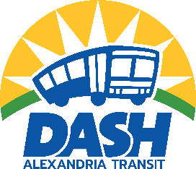
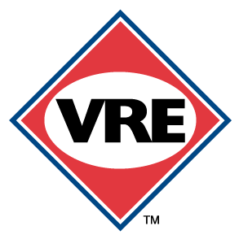






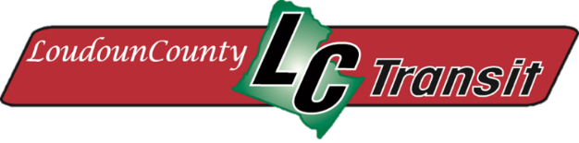
Serves a region of
Northern Virginia’s Transit Network
2.9M
people
1M
households
1.5M
jobs
Loudoun County
City of
Falls Church
Fairfax
County
Arlington
County
Transit Service Area
City of Alexandria
City of
Manassas Park
12+
Cities & Counties
243
Routes
2K
Square Miles
City of
Fairfax
City of
Manassas
Prince William County
City of
Fredericksburg
Stafford
County
2.1M
Riders every week
Spotsylvania
County
Source: NVTC Value of Northern Virginia Transit to the Commonwealth

Slide 3



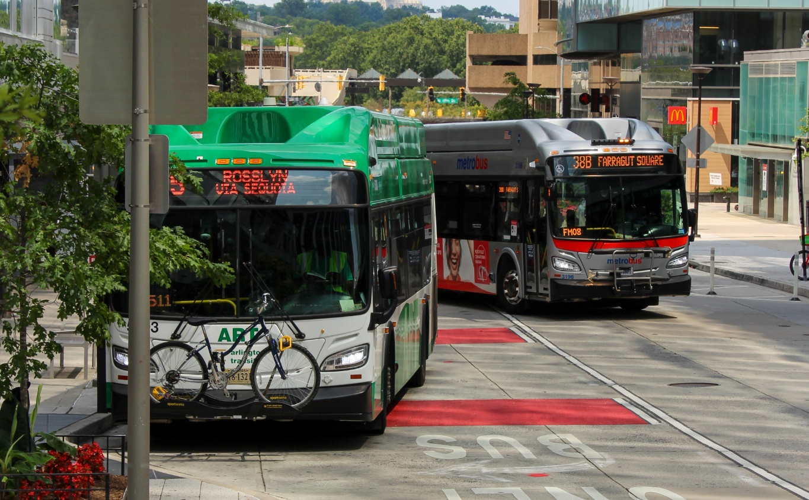
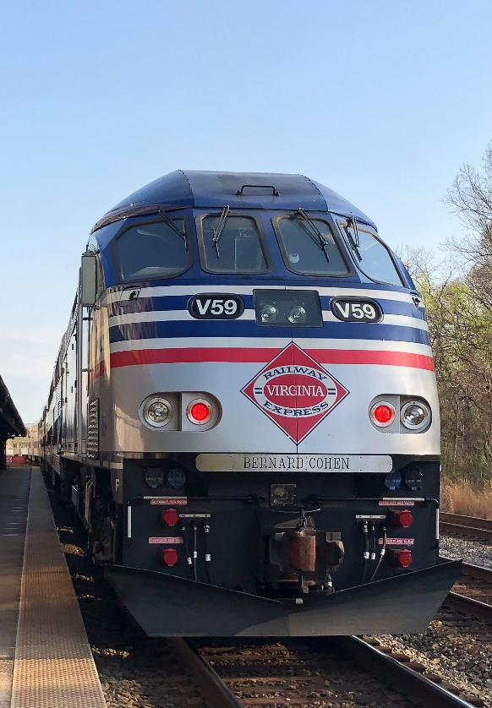
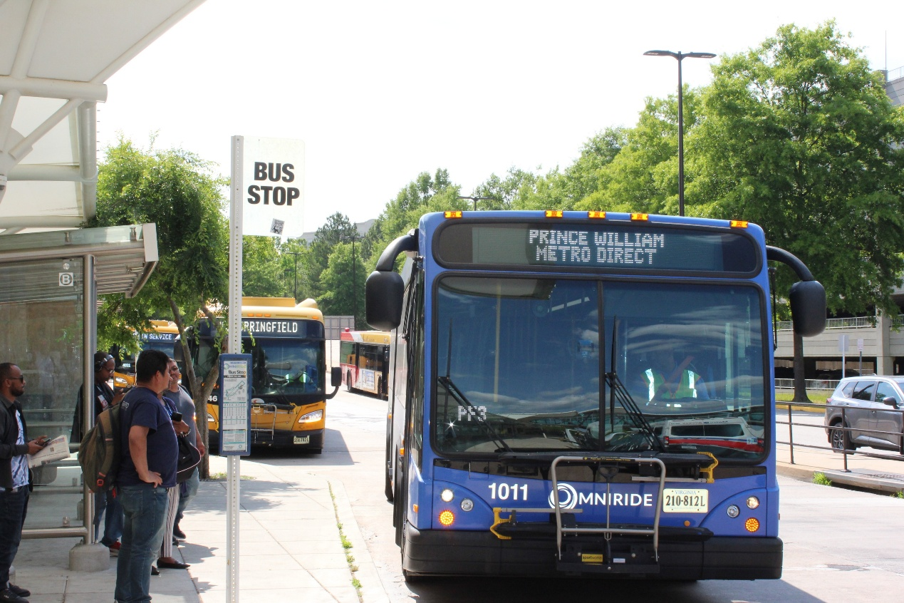
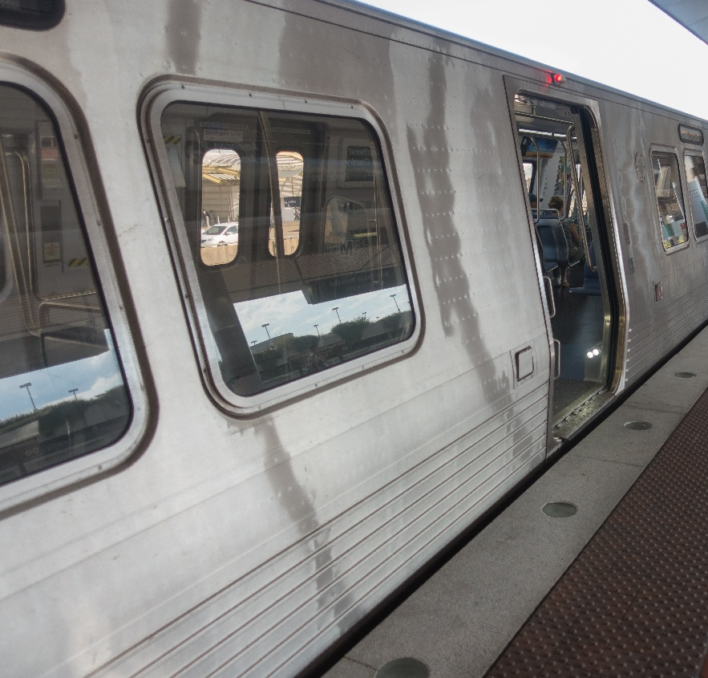
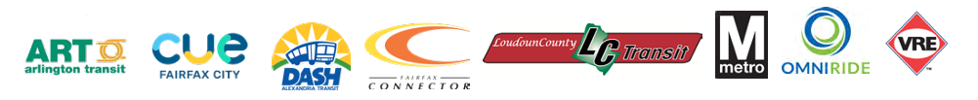
Northern Virginia’s Transit Network is an Economic Engine
Generates
$28B
in economic activity
Contributes
$1.5B
in revenues to the VA general fund
Provides
160%
return on
state investment
Source: NVTC Value of Northern Virginia Transit to the Commonwealth

Slide 4
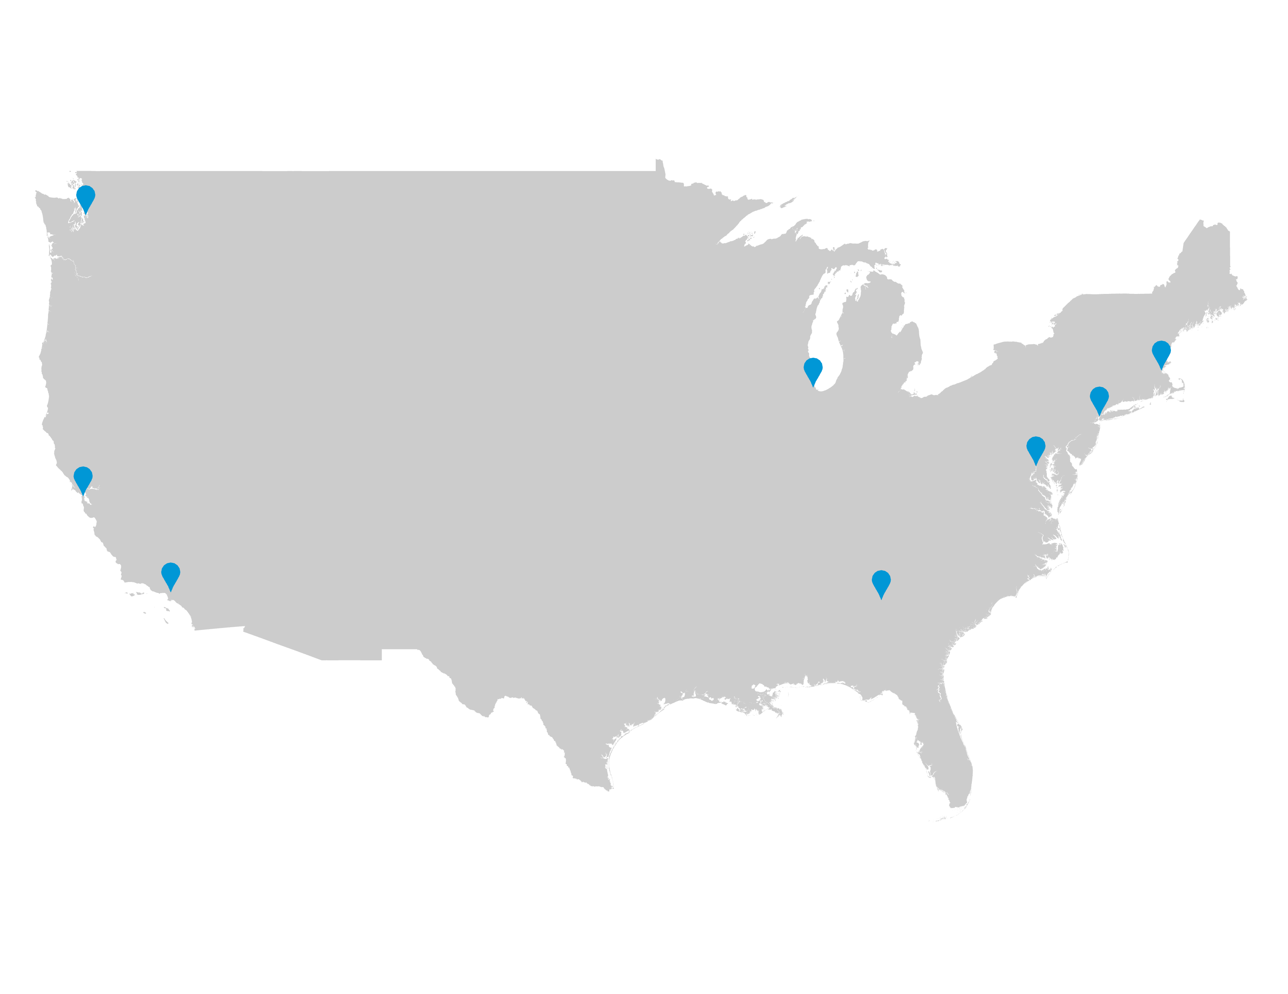

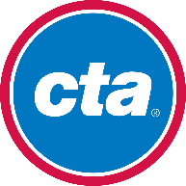






Ridership: WMATA’s Rebound is Exceeding its Peers
Change in Transit Ridership from FY 2022 to FY 2025
Seattle
50%
37%
25%
Chicago
Boston
New York
42%
52%
Washington, DC
San Francisco
Los Angeles
Atlanta
93%
24%
26%
Note: Agency ridership includes all modes as reported to the FTA. Source: FTA National Transit Database
Notes:
Over three year period, metro ridership increased the most (95%)

Slide 5

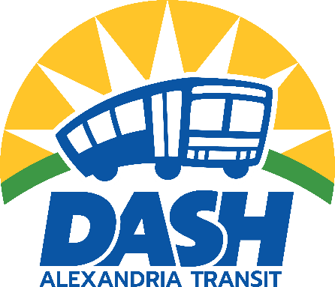

Ridership: NVTC/Local Bus Systems Stronger than Before (Ridership exceeds pre-pandemic)
CUE (Fairfax City)
53%
growth over FY 2019
DASH (Alexandria)
40%
growth over FY 2019
Fairfax Connector
16%
growth over FY 2019

Slide 6
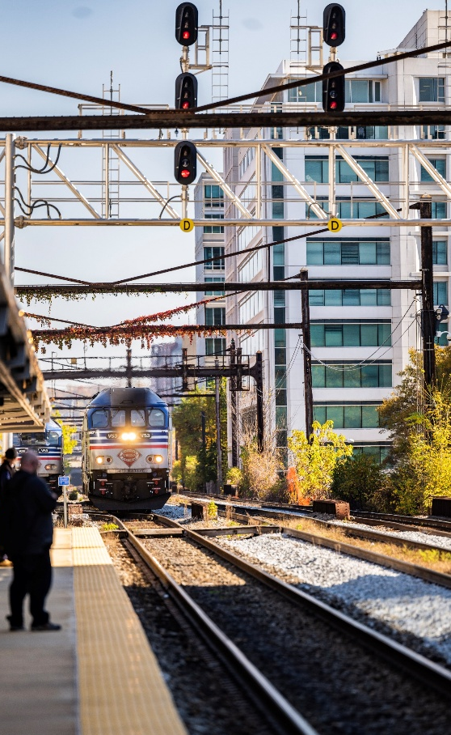
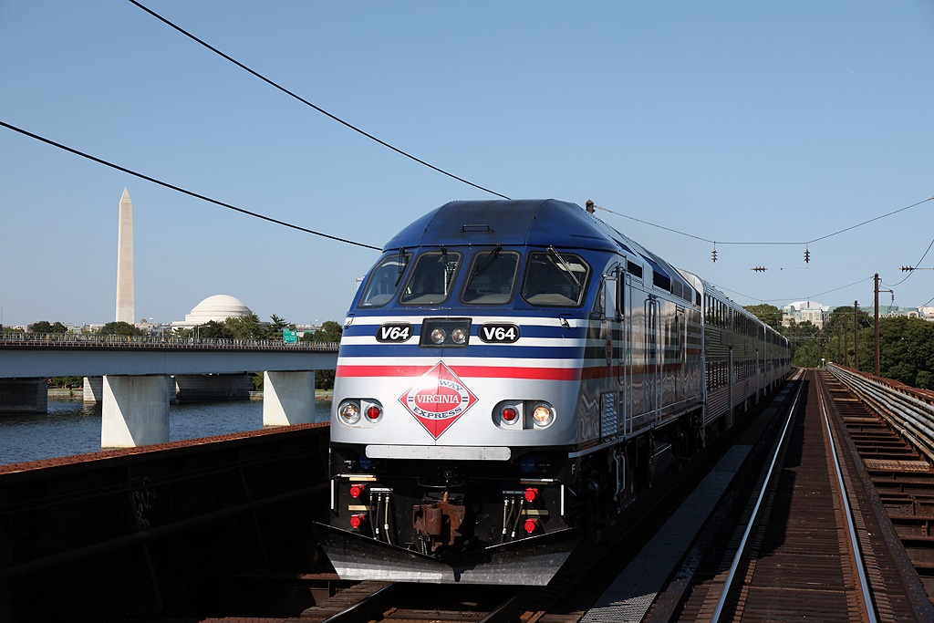



VRE is Being Transformed with Major Investments
VRE is planning for the future of rail in Virginia.
25%
year-over-year VRE ridership increase
By leveraging infrastructure improvements, such as VPRA's Long Bridge project to expand rail capacity across the Potomac, VRE will improve connectivity between DC and Virginia as soon as 2030.
Near-term funding will replace loss of COVID relief funding plus open the opportunity for weekend service.
VRE will be able to move more people, more efficiently—and every dollar invested today helps make that possible.
VRE and the Commonwealth are making major investments to:
Improve service
Reinvent the system
Increase riders

Slide 7
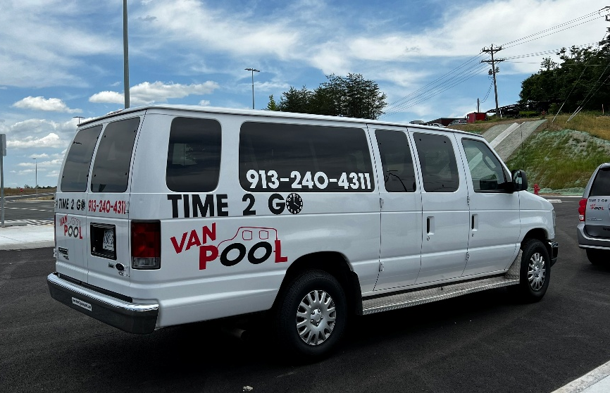
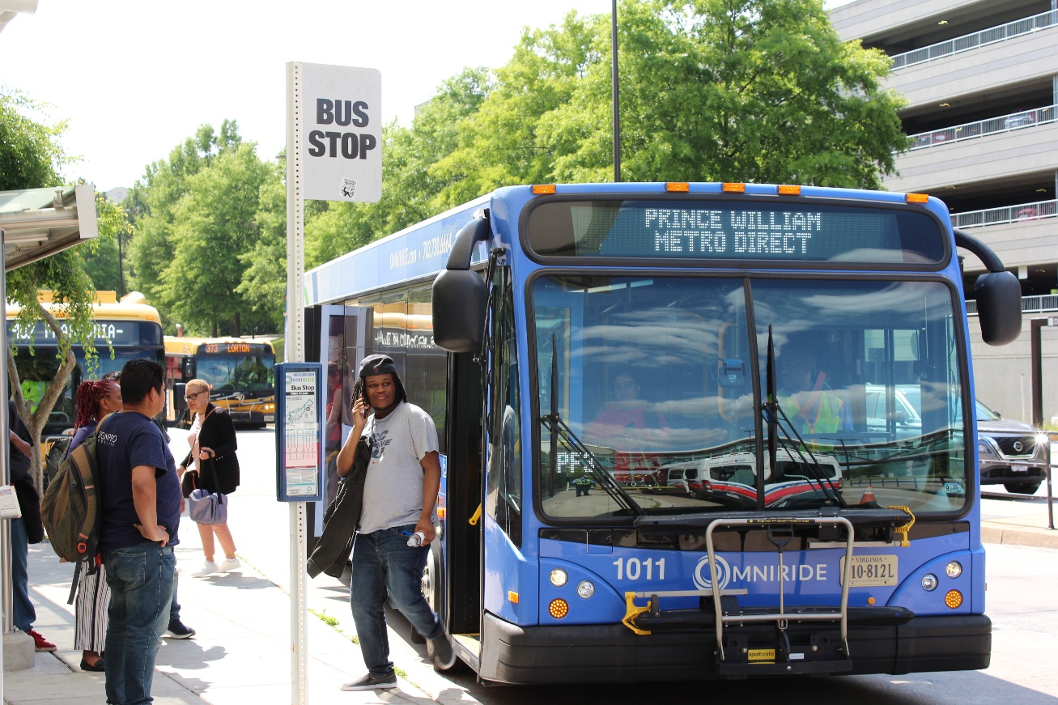

PRTC/OmniRide is Rebounding and Diversifying
Note: Large share of OmniRide’s funding comes from discretionary/unreliable sources
Strong ridership growth
Current I-66 and I-95 commuter routes to Pentagon, DC, Tysons at full capacity
Commuter Bus reach now extends to Spotsylvania, Front Royal and Warrenton
Affordable local bus offered within Prince William County, Manassas and Manassas Park
New Microtransit service providing vital link to key “transit desert” communities
Continue to offer Vanpool Alliance program key to commuters outside main destinations
19%
year-over-year OmniRide ridership increase

Slide 8
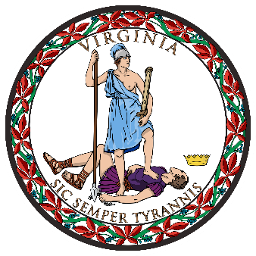
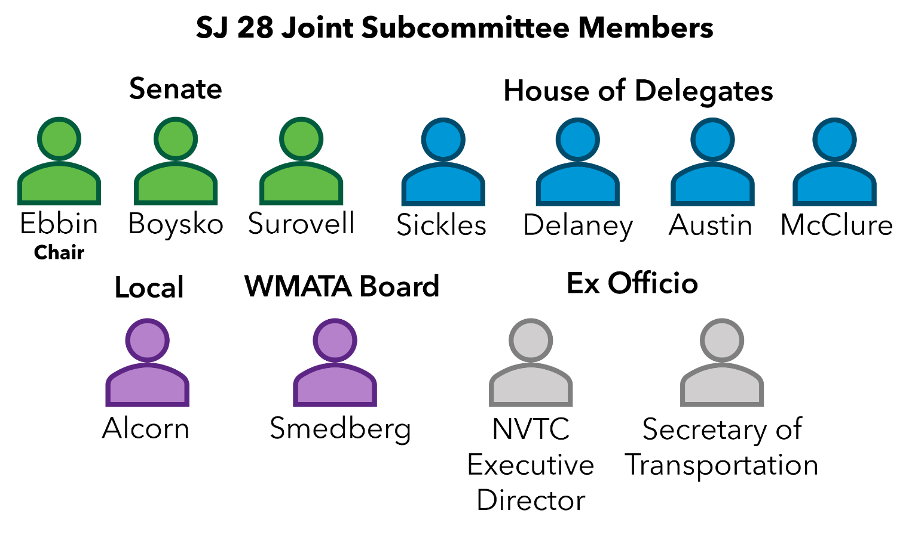


Solving Transit Funding Needs SJ 28 Joint Subcommittee
Chair Senator Adam Ebbin | Vice Chair Delegate Mark Sickles
Two-year effort of Virginia Legislators and Local Officials to:
Identify sustainable, dedicated funding sources for
WMATA
VRE
Examine WMATA cost-containment strategies
Provide a Virginia-focused solution to DC/MD/VA efforts (DMVMoves)
Recommendations expected November 2025
for 2026 General Assembly consideration
NVTC Local Bus systems
PRTC/OmniRide

Slide 9
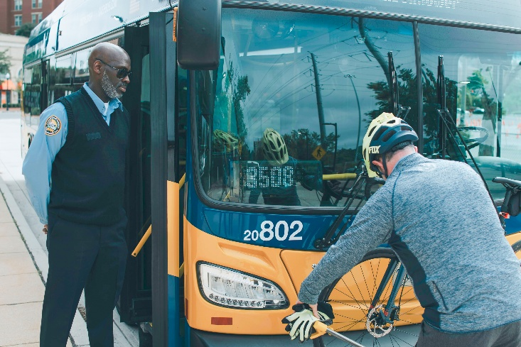
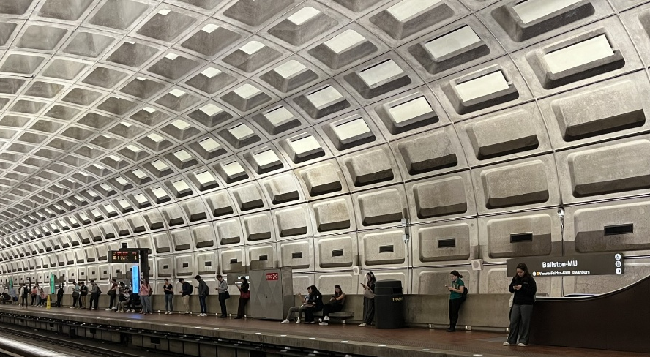
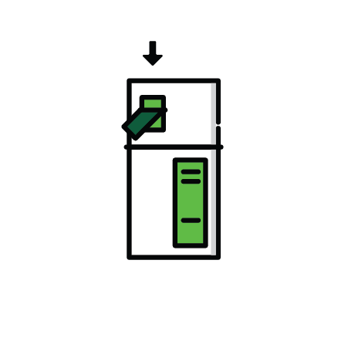
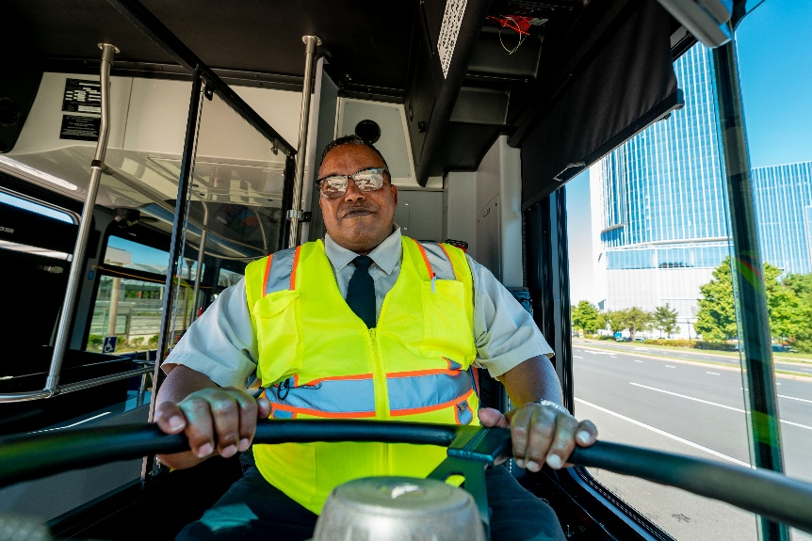

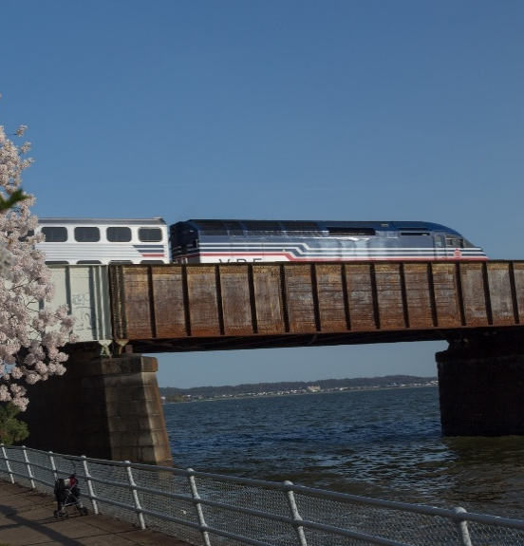
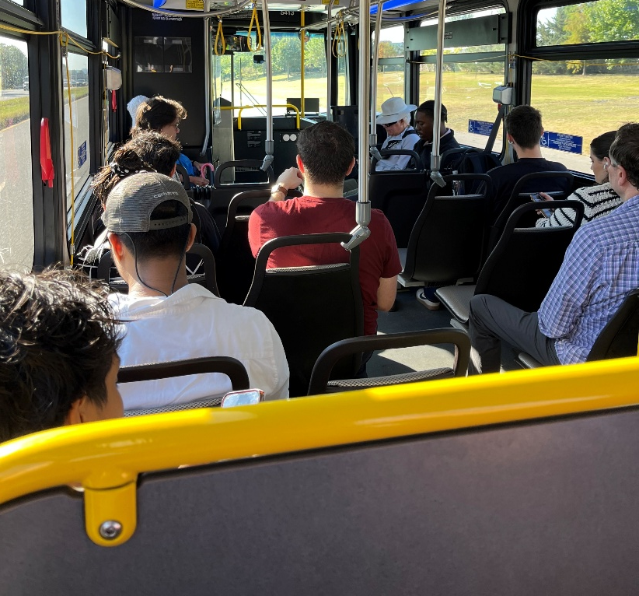
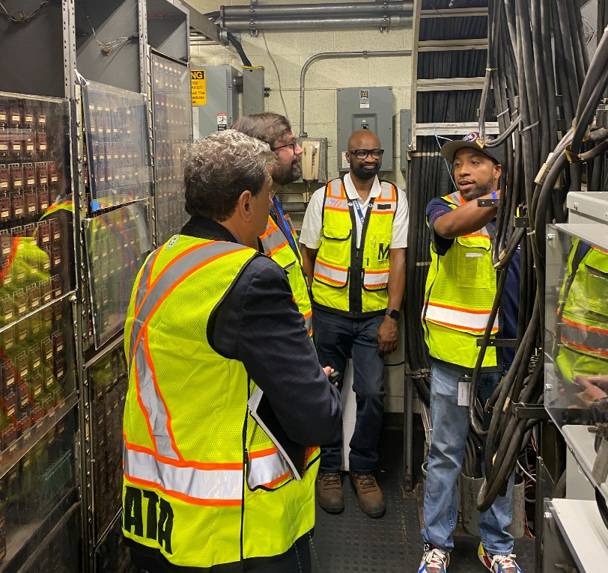
How is Transit Funded?
What Does It Pay For?
Agencies use a combination of the following sources
Federal Formula
Federal Discretionary
State Formula (DRPT)
State Discretionary
(DRPT)
Regional Funds
(NVTA, Gas Tax)
Toll Revenues
Local General Funds + Bonds
Fares
Notes:
Transit is people moving people – we need people (and to pay them) for reliable/safe transit - should pull in subtle reminder that if they support labor they should support transit.

Slide 10
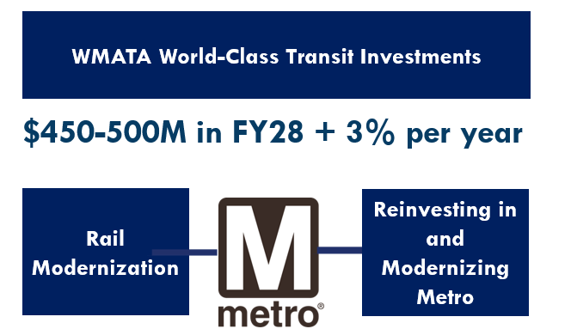
SJ28 Findings: DMVMoves Vision for WMATA

Slide 11
SJ28 Findings: Current Funds Not Meeting Other Transit Needs
These trends are consistent across all transit systems and revenue sources.
WMATA Capital Fund
NVTC Regional Gas Tax
DRPT MERIT Operating Funding
WMATA Capital funding is not indexed to inflation
Regional Gas tax has been affected by diversion and fuel-efficient vehicles.
State aid is growing, but cost inflation affects the ability to meet statewide transit needs.
$154.5M
$154.5M
$128.7M
$90.6M
$123.4M
$34.4M
$34.2M
adjusted for inflation
$102.8M
adjusted for inflation
adjusted for inflation
$27.3M
adjusted for inflation
FY 2019
FY 2025
FY 2019
FY 2025
FY 2019
FY 2025
Inflation adjusted number represents purchasing power in FY 2019 dollars

Slide 12
SJ 28 Findings: Sustainable + Reliable Funding is Needed for All Northern Virginia’s Transit Systems
WMATA Operating
Find permanent solution to FY 2025 and FY 2026 General Fund infusion in WMATA’s operating budget (MD/DC already fixed)
NVTC Local Bus
Address inflationary pressures to state aid + provide reliable and growing fund for current service
VRE
Address loss of federal COVID-aid , add weekend service and ready VRE for post-Long Bridge service
WMATA Capital
Solve for Virginia’s share of DMVMoves-identified capital funding in a bondable, indexed solution
PRTC/OmniRide
Address inflationary pressures to state aid + reduce reliance on discretionary funds

Slide 13


SJ28 Findings: WMATA Savings + Efficiencies
93%
growth in ridership since 2022, leading to increased revenue
82%
reduction in fare evasion
$532M
in capital and operating savings between FY 2023 and FY 2025
New funding formulas for DC, MD and VA that better align jurisdictional subsidies with service received.
Year over year ridership calculated using FY 2023 – FY 2025. Data Source: WMATA.
Notes:
In the $532M - $257M operating, $275 capital
No salary or wage increase in FY 25
New collective bargaining agreements
Zero growth budget in FY 25
Service optimization
Fare evasion down
Contract consolidation
Administrative savings

Slide 14

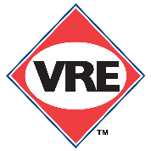
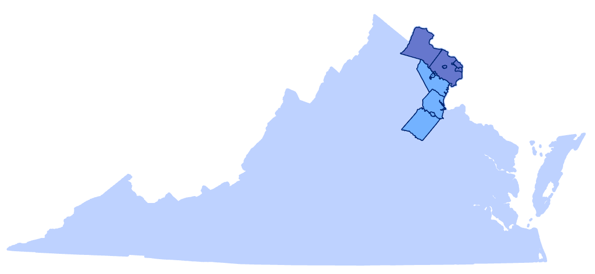
SJ 28 Findings: Revenue Sources
Transit Agencies
WMATA
Commuter Rail (VRE)
6 local bus agencies
SJ 28 examined more than 15 revenue sources, many of which already support transit and transportation including the:
retail sales and use tax
vehicle-based taxes and fees
emerging trends, such as a retail delivery fee
Each source was estimated at the NVTC, PRTC and statewide levels

Slide 15
SJ 28 Findings: Immediate and Long-Term Needs
WMATA Operating
$153M beginning in FY 2027
NVTC Local Bus
~$35M
beginning in FY 2028
In FY 2025, the General Assembly + NVTC localities provided a two-year fix for WMATA operating gap. MD and DC fix was permanent.
VRE
~$35M
beginning in FY 2028
After Long Bridge completion, an additional $40M is needed
WMATA Capital
~$135M - $150M beginning in FY 2028
PRTC/OmniRide
~$22M
beginning in FY 2028
All growing annually with inflation
Notes:
Dedicated and sustainable transit funding
Address inflation losses from fixed funding sources
Maintain current service levels and state of good repair needs
Bondable capital investment to reduce long term operating costs
Address depletion of Federal pandemic operating funds
Fill gap from temporary General Fund support (WMATA)
Prepare for future expansion (VRE)
Remove local reliance on temporary year-after-year asks (Omniride)

Slide 16
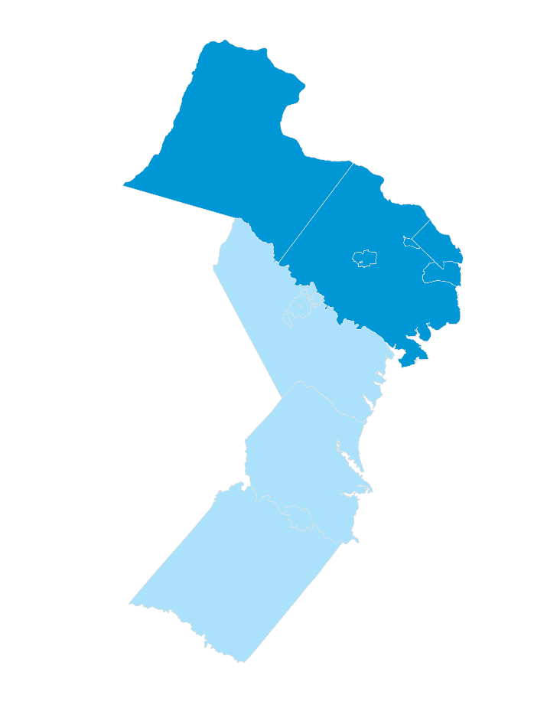
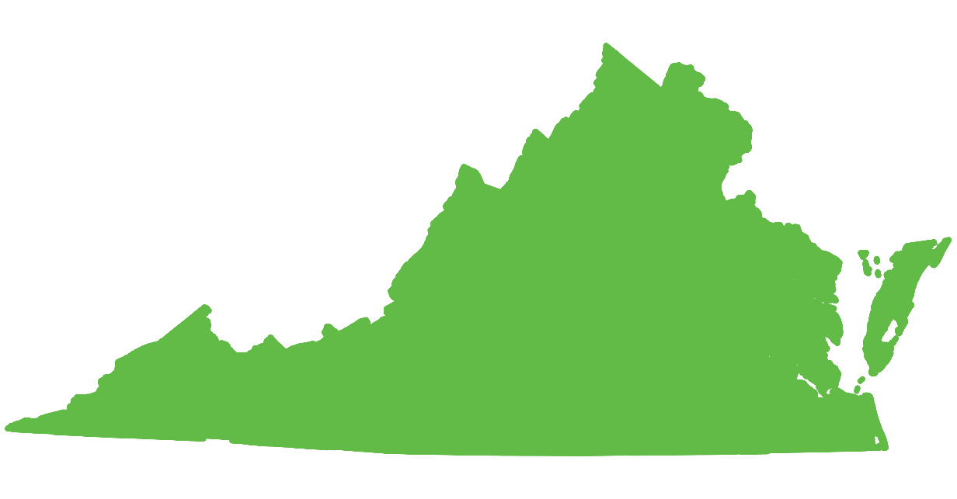
SJ 28 Findings: Potential State + Regional Approach
A funding concept for WMATA, VRE, NVTC Local Bus and PRTC/OmniRide transit agencies
~$400M
in new revenue starting in FY 2028
Generated at the Regional Level
Generated at the State Level
From NVTC District
NVTC District
From state transit funds*
+
Commonwealth of Virginia
PRTC District
From PRTC District
* Statewide solution would benefit all transit systems in Virginia

Slide 17
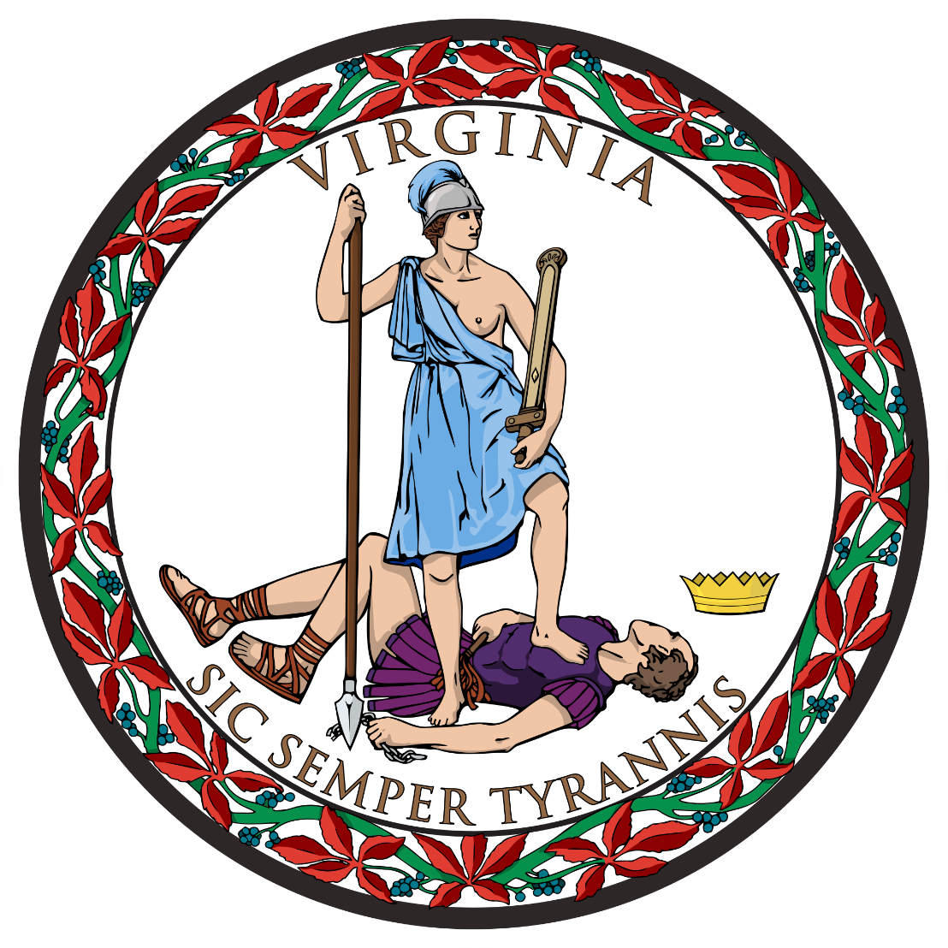
SJ28 Next Steps: Key Meetings + Recommendations
Tomorrow (Tues, October 21) – Subcommittee Meeting
Finalized agency needs, hear latest from WMATA on cost containment
Weds, November 5 – Subcommittee Meeting
SJ 28 to present final recommendations
Identify opportunities to address other statewide needs
SJ 28 recommendations seek to inform General Assembly 2026 legislation
https://studies.virginiageneralassembly.gov/studies/721
Notes:
What are the questions for Lucas and/or SFAC staff? What answers do we need, what would make this a successful meeting?

Slide 18





Transit Funding Needs to be Part of Funding Solutions
WMATA, VRE, NVTC Local Bus systems and OmniRide need reliable and growing funding.
Northern Virginia’s transit network fuels economic growth.
Transit is STRONG in Northern Virginia – we need to sustain this momentum.
Public transit is a people industry – bus drivers, mechanics, customer service, and back-office staff are necessary for a reliable system.
The funding solution can be shared between the State and the Region.
Raising state aid will also support the additional 30+ transit systems across the Commonwealth.
Education
Health
Housing
Food
Transit

Slide 19
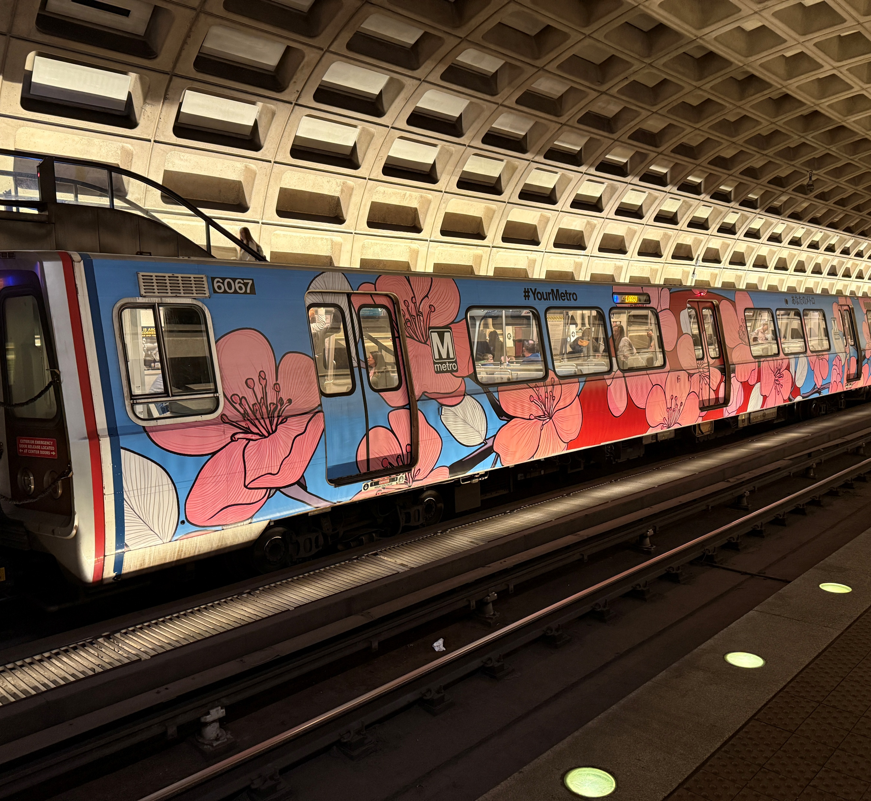

Thank you!
Kate Mattice
Executive Director
katemattice@novatransit.org

