Slide 1
FCPS Educational Specialist: Neurodiversity
Virginia’s Autism Advisory Council

Slide 2


Overview
Positionality
Role in FCPS Context
Structure
Mission
Scope
Core Functions
Recommendations
Q&A
#

Slide 3
Positionality
Neurodivergent
Professional career
Instructional Assistant
Special Education Teacher and Case Manager
504 Coordinator
Special Education Region Resource Teacher
Neurodiversity Specialist
Educational Career
Biology, B.S.
Special Education, M.Ed.
Educational Leadership and Administration, PMC
Education, PhD Candidate, International Inclusive Education/ND

Slide 4
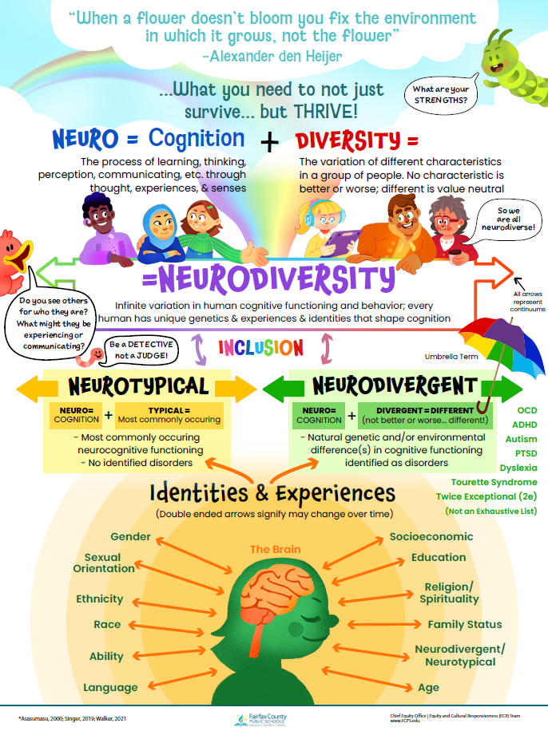

FCPS Neurodiversity Poster
Available digitally in:
English
Spanish
Chinese
Vietnamese
Korean
Website:
https://bit.ly/NDinFCPS

Slide 5
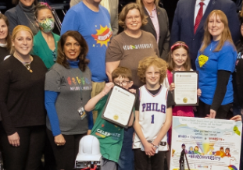
Neurodiversity Role in FCPS
Nearly 183,000 students PreK-12th grade
199 schools and centers
1 Neurodiversity Specialist
Advocacy and access for neurodivergent students with and without IEPs or 504s
Advocacy and affinity for neurodivergent staff
Creation due to school board member and parent/family advocacy
Strategic positioning of role in central office
1
2

Slide 6
Mission and Rationale
Aligned with the FCPS Strategic Plan 2023-2030
Differentiated and Culturally Responsive Learning Environments
Vibrant Home, School, and Community Partnerships
Diverse, Adaptive, and Supported Workforce
Culture of Equity, Excellence, and Accountability
Original Job Description: Develop, disseminate, and implement professional development; provide coaching around neurodiversity; normalizing diverse cognitive and behavior; support inclusive practices, policies, decision-making, and instructional programming. Serve as a resource for region, school and departmental staffs.
‘Start-up’ approach

Slide 7
Mission and Rationale
Operates from the Neurodiversity Model
Educational, societal, cultural shift away from Medical Model
Barriers exist in the environment: systems, spaces, attitudes, and discourse
Flip the script, from linear to whole person conceptualization
3
High Cost of Misconceptions
Historical barriers to academic and socioemotional access
Neuronormative instructional design and practices
Educator mental models of neurodivergence
Course-taking patterns
Misinterpretations of behavior
Negative impact on sense of belonging and mental health
4
5

Slide 8
Core Functions
Professional Development
Research, development, and facilitation
Audiences: Division-wide, school staff, central instructional departments (e.g. World Languages, Health and PE, etc.) and operational departments (Transportation, Family and School Partnerships, etc.)
Embedding content and practices in systems
Curriculum design, Tier 1 disciplines, Restorative Justice, Reducing Discipline Disproportionality, SEL, etc.
6

Slide 9
Core Functions
Coaching and Consultation
Audiences: School administrators, grade-level teams, central office leaders, etc.
Tier 1 systems and practices (e.g. UDL, Instructional Framework, Behavior Matrix)
Language/discourse analysis of resources, communication, etc.
7
Cross-Collaboration Teams
Advocate, participate, embed work
Inclusion work, UDL Initiative, 2e Committees
Elevating lived experiences of students, staff, and families
8

Slide 10
Recommendations
Funding for staff and resources to support both division-wide systemic, inclusive work and student support, teaching coaching, etc.
District-level specialists
Region/pyramid specialists, coaches, or resource teachers
Mandatory pre-service and in-service professional development
State and district-level
University and college programming and coursework (including career-switching programs) required for all teachers, administrators, specialists, etc.
Inclusion in division Strategic Plans, policies, instructional frameworks, and building/facilities design requirements
9

Slide 11


“When a flower doesn’t bloom you fix the environment in which it grows, not the flower.”
-Alexander Den Heijer

