Slide 1

Blue Envelope Program
Driver Communication Improvement Program (HB2501)
Ava Adenauer
Senior Portfolio Analyst
Virginia Department of Motor Vehicles
October 20, 2025

Slide 2
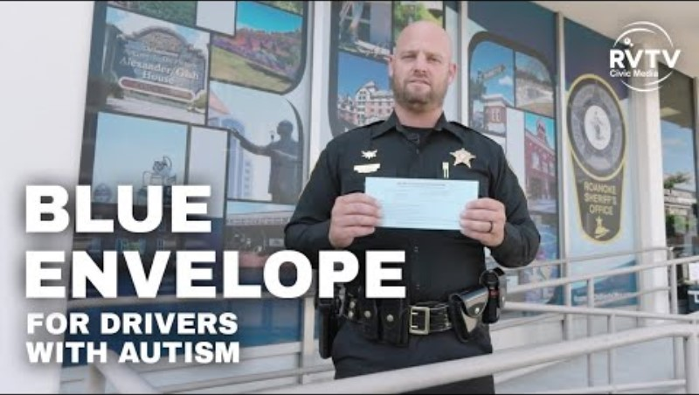

Slide 3
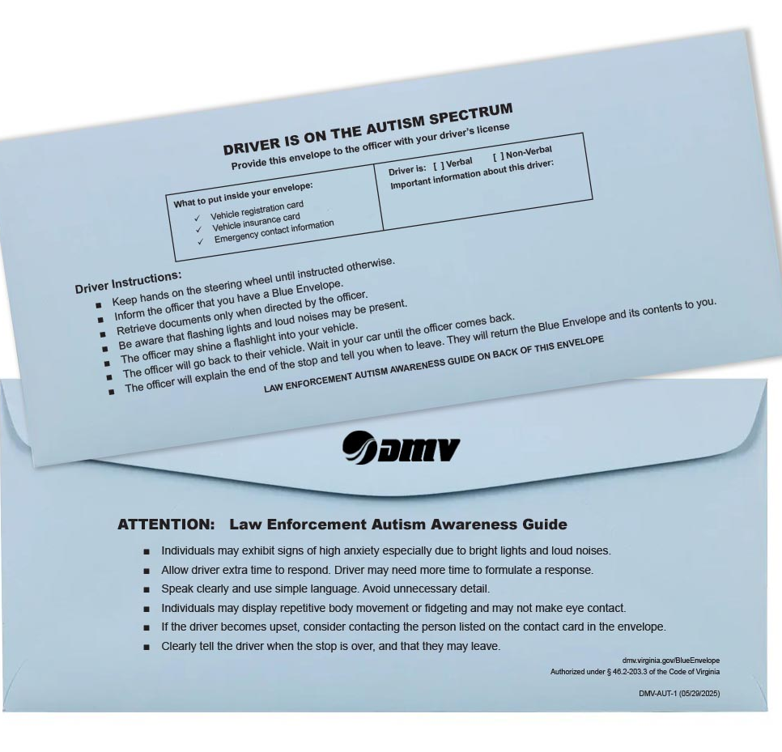
Why it was created and How it Works
Why it was created
Helps the thousands of drivers who have identified themselves on the autism spectrum communicate during traffic stops
Launched July 1, 2025
Created by House Bill 2501 (2025)
How it works
Free, voluntary, and confidential—no registration or paperwork required
Envelope holds key documents + emergency contact information
Available at all DMV CSCs and certain Select offices

Slide 4




Creation of the Blue Envelope Program in Virginia
Modeled after programs in Vermont, Arizona, and New Jersey
Partnered with the requesting law enforcement agency on implementation and promotion
Launched statewide with DMV Law Enforcement and internal teams coordinating training and awareness
Printing
Customer Service Management Administration
Communications
Law Enforcement

Slide 5


Benefits of the Program
Drivers
Law Enforcement
Reduces anxiety and improves safety
Provides a discreet way to signal communication needs
Keeps license, registration, insurance, and emergency contacts together
Reduces misunderstandings and promotes safer interactions
Provides a clear, consistent tool recognized statewide
Builds trust with the autism community

Slide 6
Statewide Rollout & Early Response
Statewide Launch: All CSCs received guidance and envelopes before July 1 rollout
Law Enforcement Outreach: Partnered with VSP, Sheriffs’ Association, and Chiefs of Police to notify members statewide
Training & Awareness: DMV available to provide materials and information as needed
Resources: Program details and FAQs available on DMV website
Positive Response: Early feedback strong; multiple offices, plus some of our Select offices, have requested additional envelopes
Community Engagement: Distributed envelopes to organizations, law enforcement agencies, and autism advocacy groups to expand awareness
Ongoing Efforts: Continued outreach to educate both drivers and law enforcement on program use

Slide 7
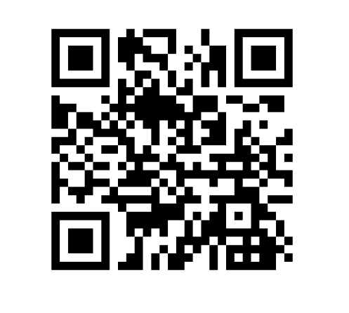
Learn More about the Blue Envelope Program
Need envelopes? Contact me at
 ava.adenauer@dmv.virginia.gov

