Slide 1

Breast Cancer Initiatives in Virginia
Virginia Breast Cancer Foundation:
Erin Steigleder, MSW
Director of Programs
Kirsta Millar, MA
Director of Policy

Slide 2

Who We Are
VBCF’s mission is to empower Virginians impacted by breast cancer through access, advocacy, education, and community action.
This painting by Virginia artist Parks P. Duffey, III, commemorates VBCF’s founding and depicts several of VBCF’s early events at Virginia’s State Capitol.

Slide 3

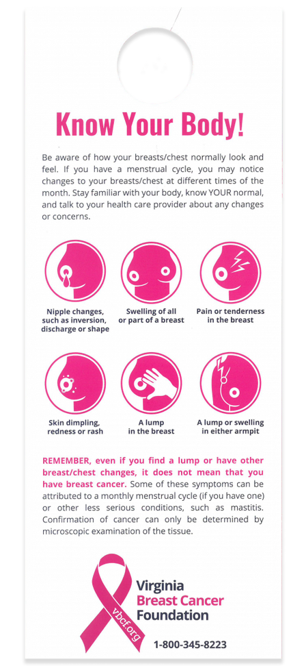
Breast Health
Education
  Free Breast Health Materials (English & Spanish)
  Support Kits for the Newly Diagnosed, Survivors, Thrivers, & Caregivers
  Community Education Events
  Online Resources and Webinars
  Connections to Community Resources

Slide 4
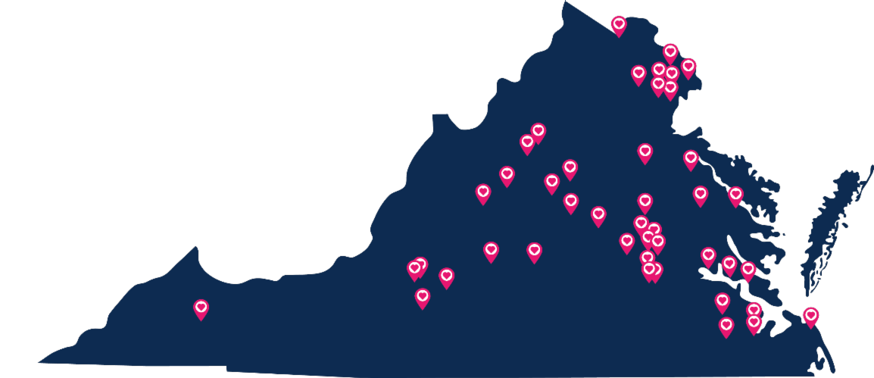
What We Hear from Our Community
Lack of Affordability
    Women in their 50s can’t afford $500/month in health insurance
Lack of Knowledge
    Importance of mammograms, clinical trials, genetic testing
Fear

Slide 5




This fund provides:
VBCF’s Screening & Diagnostic Services Fund
Serving Southwest & Central Virginia
  Served 1,044 Virginians from 2022-2024, spent $311,842.35
  Screening mammograms and diagnostic imaging tests provided, including biopsy and pathology
  Partners: Augusta Health, Ballad, Carilion Medical Center, Centra Lynchburg, VCU
  3 pending/potential partnerships, 2 in Southwest, 1 in Hampton Roads
SCREENING
MAMMOGRAMS
DIAGNOSTIC
MAMMOGAMS
MRIs
and other services to uninsured and underinsured Virginians earning up to 400% of the Federal Poverty Level—about $62,600 for one person or $128,600 for a family of four.
ULTRASOUNDS

Slide 6
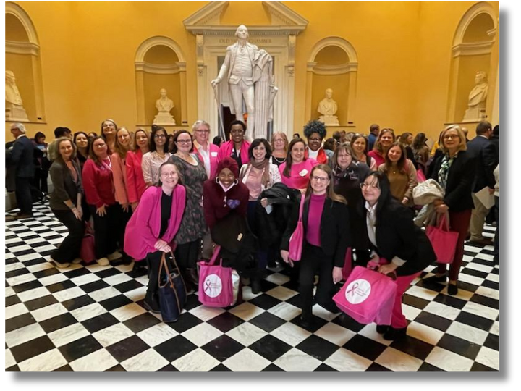
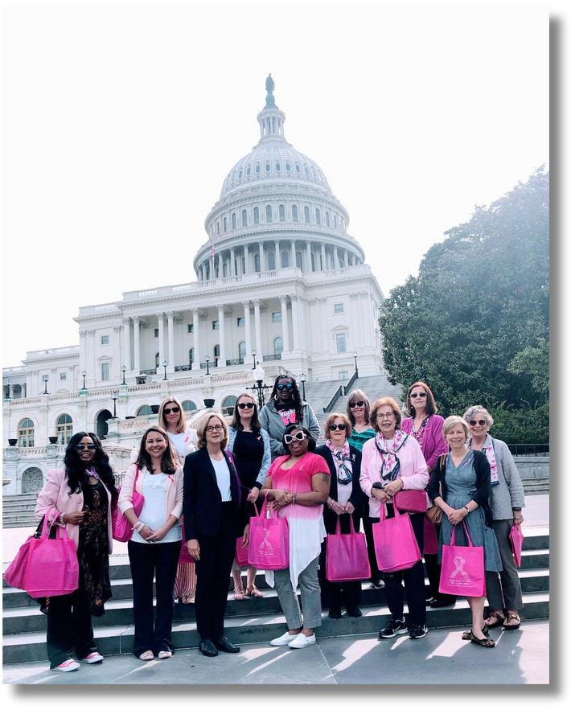
VBCF Advocacy
State
  Ended “drive-through” mastectomies
  Breast Density Notification Law - 3rd in the Nation
  Oral Chemotherapy Drug Parity
  Medicaid Expansion
  Medical Debt Reform
  2025: No-Cost Diagnostic & Supplemental Imaging Law
National
  Breast cancer research dollars brought to VA research institutions since 1993: $53.4 million

Slide 7

VBCF Advocacy
New Virginia Law Eliminates All Out of Pocket Costs for Diagnostic and Supplemental Breast Imaging
As of January 1, 2026, all state-regulated individual and group insurance plans will be prohibited from imposing cost-sharing requirements for diagnostic and supplemental breast examinations. Patients who are insured under Virginia law cannot be charged coinsurance, copayments, or a deductible for:
  diagnostic mammograms
  breast ultrasounds
  breast magnetic resonance imaging (MRI)

Slide 8
Opportunities to Improve Breast Cancer Outcomes in Virginia:
  State investment in Every Woman’s Life (EWL) to address unmet need
  Incentives to train and recruit more oncologists to work in Virginia
  State investment in the Research & Clinical Trail Cancer Consortium Initiative (passed in 2025)
  Paid Family and Medical Leave and Paid Sick Days

Slide 9
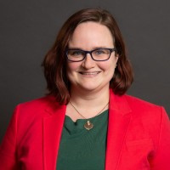
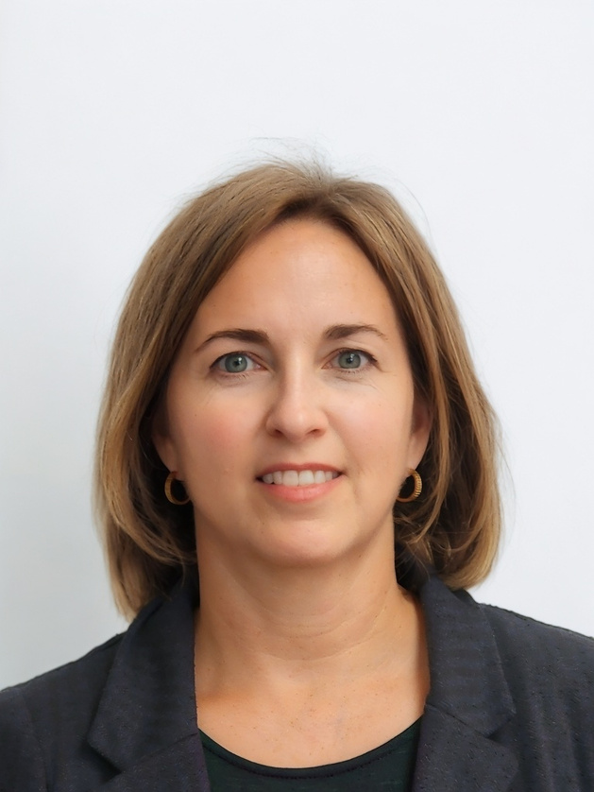
Erin Steigleder,
Director of Programs
erin@vbcf.org
804-285-1200 ext. 202
Contact Information:
Kirsta Millar,
Director of Policy
kirsta@vbcf.org
804-285-1200 ext. 203

