Slide 1

Elections Overview
Virginia House of Delegates
Privileges and Elections Committee
November 20, 2025

Slide 2
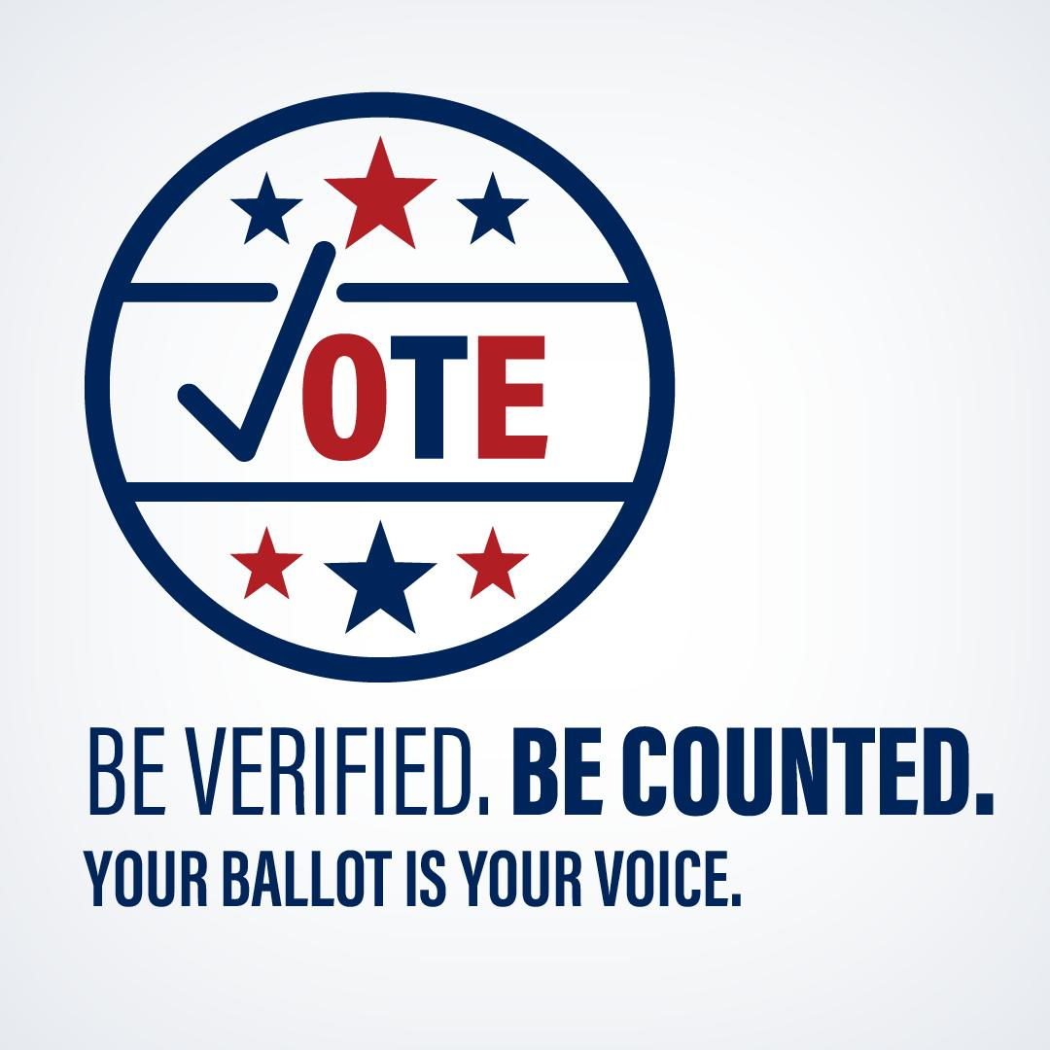
Agenda
Structure of Elections in Virginia
Roles and Responsibilities
Voter Registration
Ways to Vote
Post-Election Process
Looking Forward to 2026

Slide 3
Federal Law
Federal Election Commission (federal elections only)
Campaign finance jurisdiction over campaigns for U.S. House, U.S. Senate, Presidency and Vice Presidency
National Voter Registration Act (NVRA) 1993
Requires most states to coordinate with DMV for voter registration
Requires List Maintenance
Help America Vote Act (HAVA) 2002
Modernized elections, introduced touch screen machines
Created U.S. Election Assistance Commission to administer funds
Required states use a central voter registration database (VA first in 1972)
Military and Overseas Voter Empowerment Act (MOVE) 2009
Overseas military personnel get ballots at least 45 days before election

Slide 4
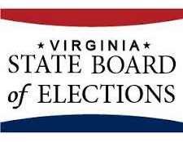
State Oversight
5 members recommended by parties, appointed by Governor, approved by General Assembly
3 representatives of Governor’s party, 2 from “2nd place party”
Certifies election results
Certifies voting equipment, ensures testing to meet standards
Responsible for promulgating regulations, approving forms, and advising on policies

Slide 5

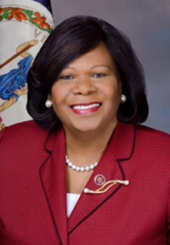
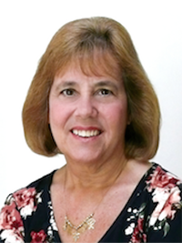
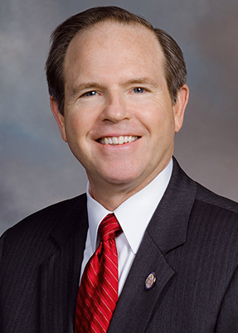

Virginia State Board of Elections
From left to right: Dr. John O’Bannon (Chairman of the Board), Rosalyn R. Dance (Vice-Chairman of the Board), Georgia Alvis-Long (Secretary of the Board), Christopher P. Stolle (Board Member), J. Chapman Petersen (Board Member)

Slide 6
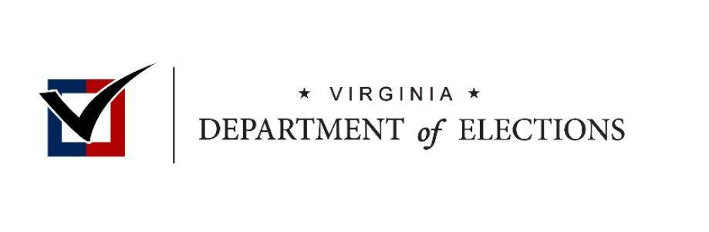
Virginia Department of Elections
Separate entity from Board
Day-to-day operations run by Commissioner, appointed by Governor
Provides guidance and promotes compliance for local registrars and electoral boards
Ensures election uniformity
Maintains statewide voter registration system
Proofs ballots
Trains registrars and electoral boards
Coordinates campaign finance reports

Slide 7
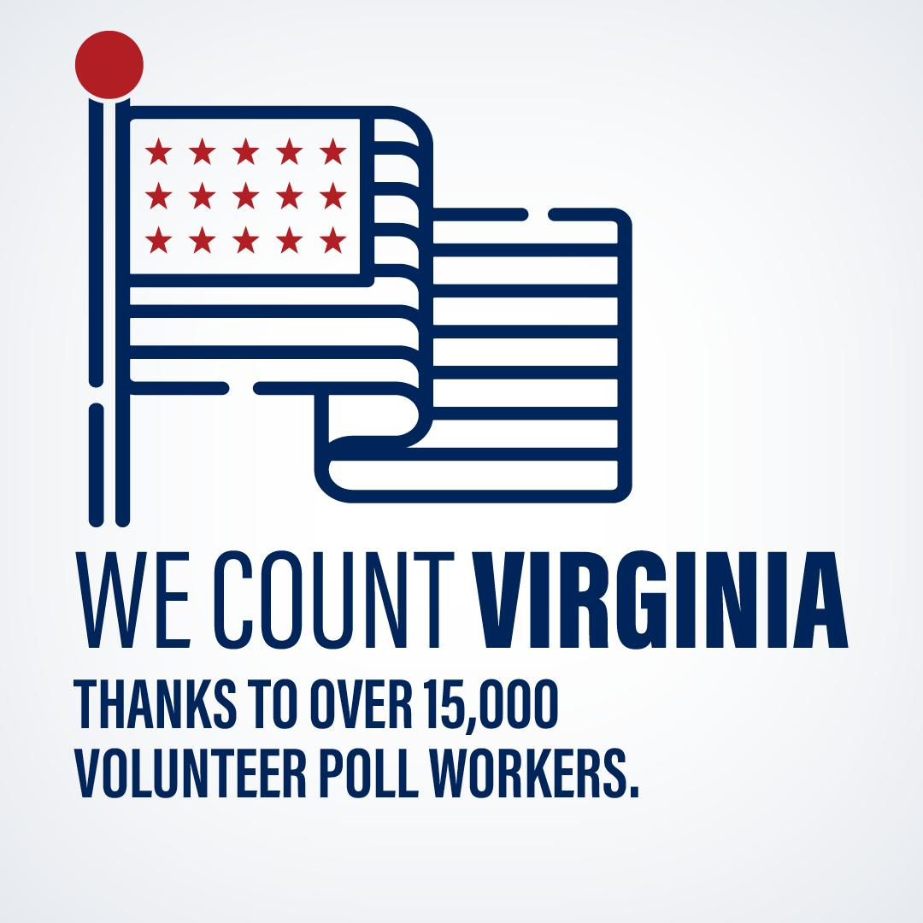
Local Administration
Elections administered at local levels (registration, voting)
Virginia has 133 counties and cities
133 General Registrars (GRs) determine voter eligibility
399 Electoral Board members provide oversight, appoint registrar and poll workers, certify local results, approve state results
15,000 Officers of Elections manage over 2500 precincts

Slide 8
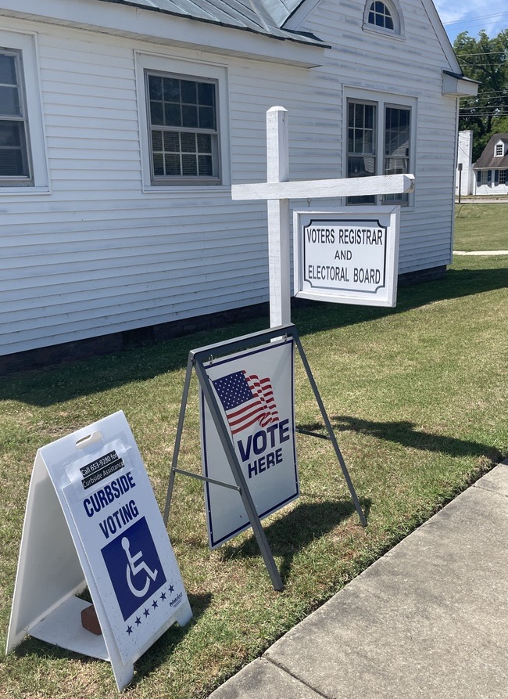
Definitions
What is a General Registrar?
      A non-partisan, four-year term position. Appointed by electoral board.
      Election professionals responsible for voter registration and the administration of elections in their county or city.
What is an Electoral Board?
3-member supervisory board in every city and county which appoints the registrar, appoints officers of election, assists with election administration and certifies election results.
Appointed by recommendations made from the local political parties. 2 of the Governor’s party and 1 from the 2nd place party.

Slide 9
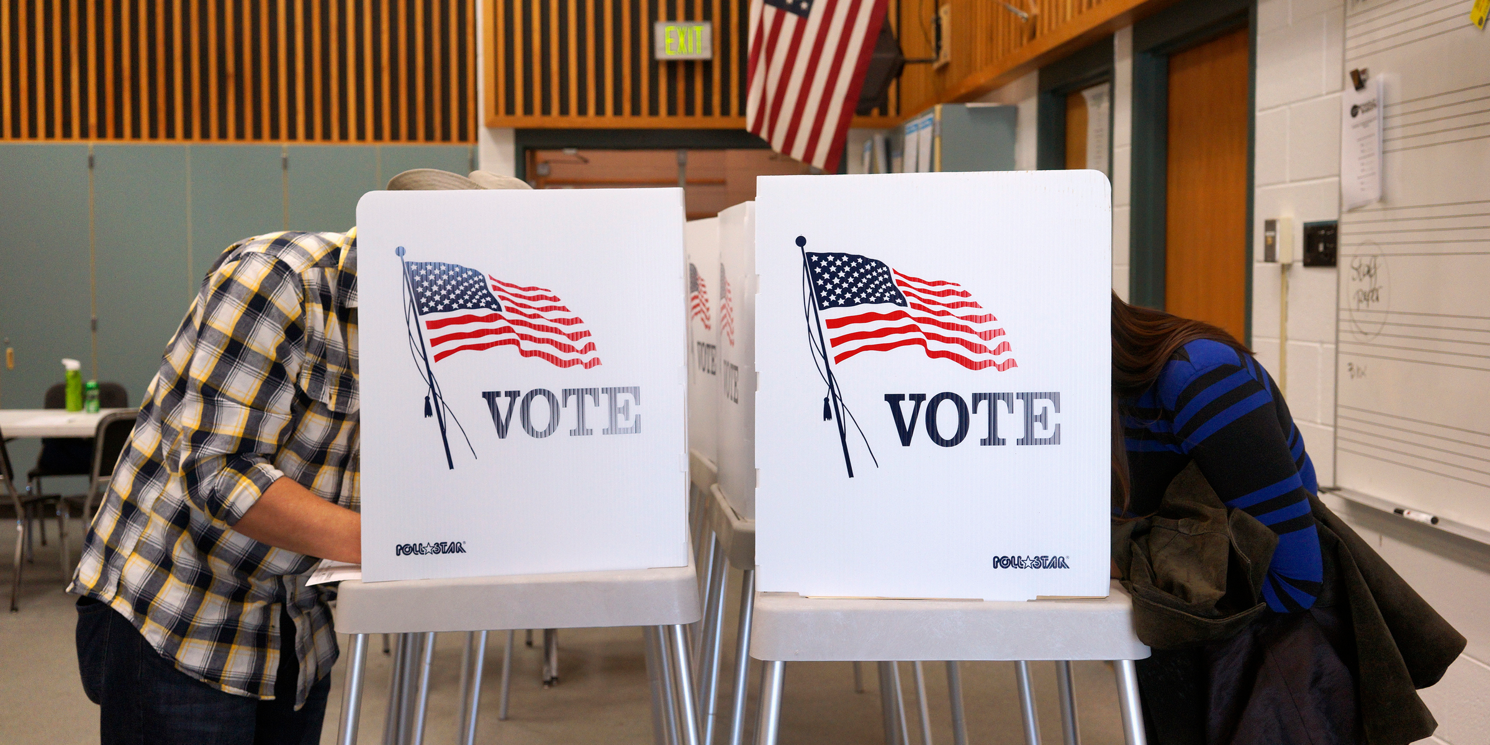
Definitions
What is a polling place?
A physical location where voters cast
ballots during an election
What is a precinct?
One of several districts into which a county
or city is divided for voting; each contains one polling place

Slide 10
Roles and Responsibilities
State-Level
Local-Level
Ensure uniformity, legality, and purity in elections
Oversee electoral boards and general registrars
Create regulations, standards, and guidance
Form creation
VERIS operation and maintenance
Campaign advertisement disclosure enforcement
Voting system certification
Shared
Day-to-day operations
Voter registration administration
Election and polling place management
Absentee voting process
Appointing, coordinating, and supervising officers of election
Voting equipment procurement, testing, and safeguarding
Post-election canvass, including provisional ballots
Election results reporting
Voter list maintenance
Candidate processing
Training
Campaign finance reporting
Records release
Review ballot proofs and abstracts of votes

Slide 11
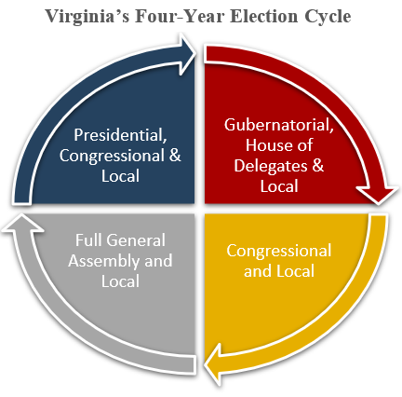
Virginia hosts major elections EVERY year...

Slide 12
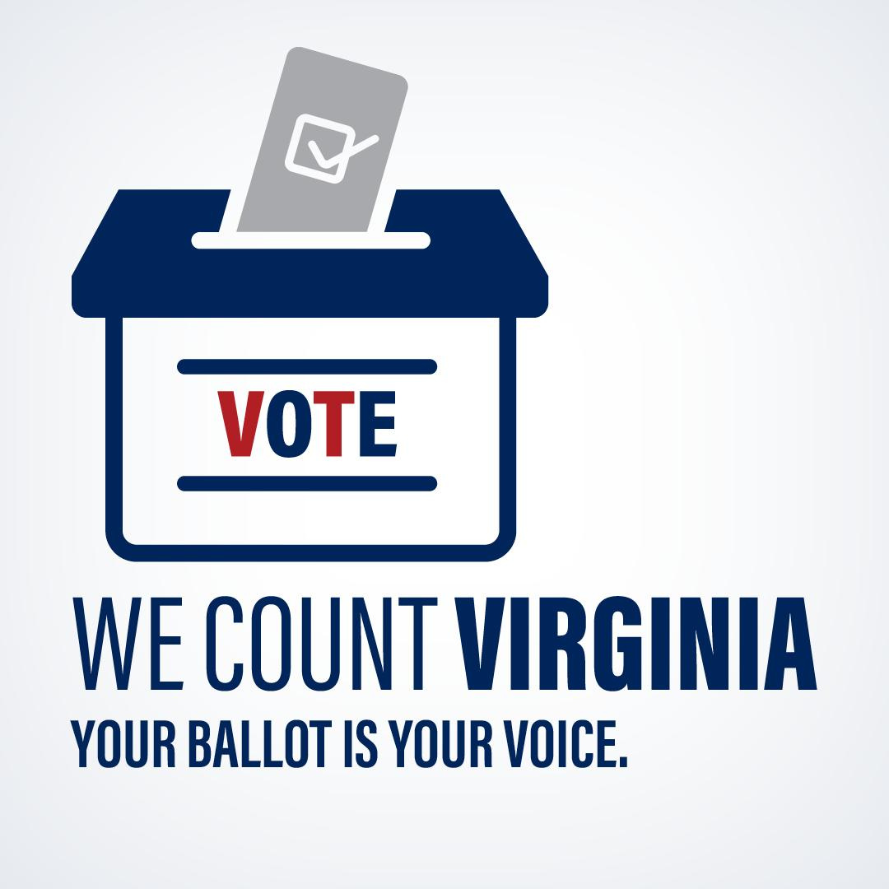
Types of Offices on the Ballot
FEDERAL – even years
President (4 yrs)
U.S. Senate (6 yrs)
U.S. House of Reps (2 yrs)
STATE – odd years
Governor (4 yrs)
Lt. Governor (4 yrs)
Attorney General (4 yrs)
VA Senate (4 yrs)
VA House of Delegates (2 yrs)
LOCAL
Board of Supervisors
School Board
Commonwealth’s Attorney
Sheriff
Treasurer
Commissioner of the Revenue
Water and Soil Conservation
City Council
Mayor
Town Council

Slide 13
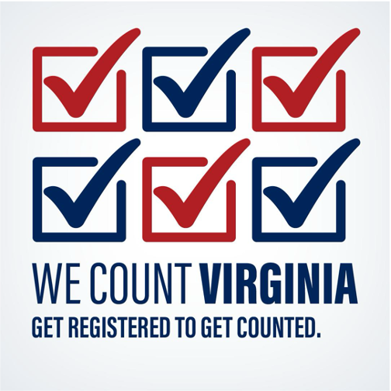
Voter Registration
Occurs year round
Available online, on paper,
at DMV and other agencies
General registrars determine
eligibility and register voters
Lists are constantly updated
through data provided to registrars

Slide 14

Voter Registration Database Models in the US
Bottom Up Model
Top Down Model
State aggregates data regularly
State Central Voter Registration Database
Individual Locality Database
Individual Locality Database
Individual Locality
Individual Locality
Individual Locality Database
Individual Locality

Slide 15
ELECT SENDS TO GENERAL REGISTRARS
GENERAL REGISTRAR DETERMINES ELIGIBILITY
IN GENERAL REGISTRAR’S OFFICE
SAME DAY REGISTRATIONS
DMV MOTOR VOTER TRANSACTIONS
GENERAL REGISTRAR
UPDATES VERIS
3RD PARTY VOTER REGISTRATION DRIVES
CITIZEN PORTAL
GENERAL REGISTRAR
COMMUNICATES WITH VOTER
MAILED VOTER REGISTRATION APPLICATIONS
DESIGNATED STATE AGENCIES & OTHER PAPER APPLICATIONS
IN-PERSON REGISTRATION

Slide 16
Types of Communication with Voters
Registration Confirmation
new or updated registration
Precinct or Polling Place Changes
changes to polling location or district
Supplemental Questions
information missing from registration application
Cure
absentee ballot envelope missing information
NVRA Confirmation Mailing
for voters who may have moved
Affirmation of Eligibility
to confirm citizenship
Denial or Cancellation
ineligible to be registered

Slide 17

List Maintenance Data Sources
Secretary of the Commonwealth
  Restoration of Rights
USPS
  National Change of Address (NCOA) Mailing
VDH, SSA, and NAPHSIS
  Deceased
Other States
  Duplicate Registrations & Out-of-State Movers
VSP and DOJ
  Felony Convictions
Dept Motor Vehicles
  New Registrations
  Out-of-State Movers
  Noncitizens
Courts
  Felony Convictions
  Mentally Incapacitated
VERIS

Slide 18
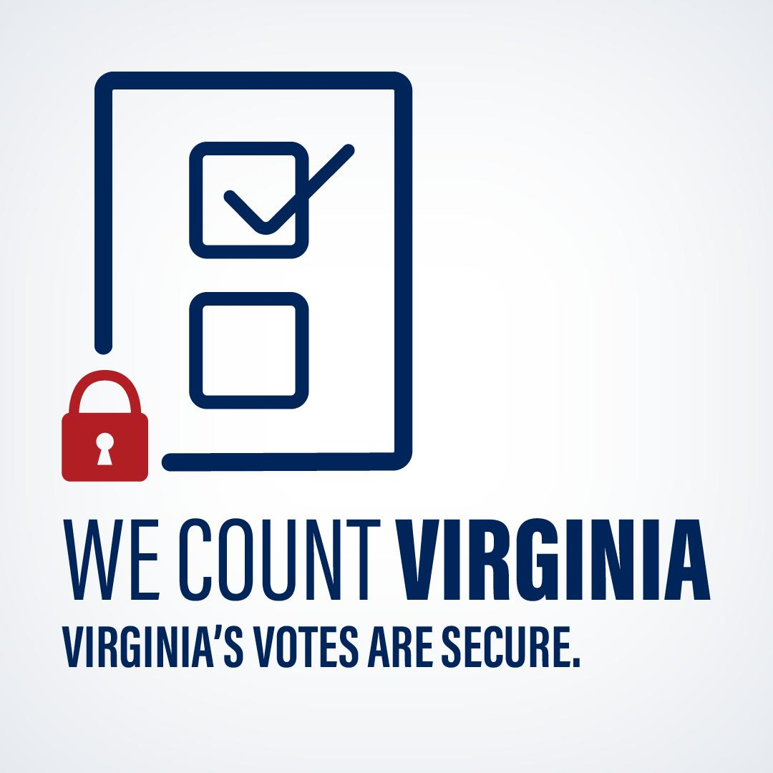
Election Security:
How Virginia Protects Your Vote
Documented Chain of Custody for Ballots:
  # of voters checked in = # of ballots used = # of ballots counted
  Paper ballots – physical representation of the voter’s intent
Locality Election Security Standards:
  Physical and Cybersecurity
  Each locality must confirm their compliance annually
Voter Lists Updated Daily:
  Remove deceased, felons, non-citizens, mentally incapacitated
  Identify voters who may have moved through data sharing agreements
  Register new voters
Vote Tabulators are Certified, Tested and Audited:
  Certified to state and federal standards
  Every piece of voting equipment tested before every election
Accurate Election Results that are Triple-checked
  Precinct level, post-election canvass, state-level review

Slide 19
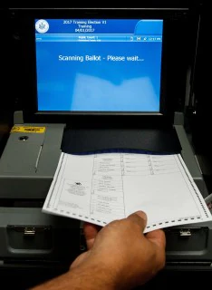
Voting Machine Standards
Certified to Federal and State Standards
  Federal standards set by the Election Assistance Commission (EAC)
  Stricter state standards, including financial information on the company
No Internet Connectivity
Voting machines in Virginia are prohibited from being connected to the internet by law
Paper Ballots
VA law requires the use of paper ballots
Permanent record of the voter’s intent
Stored with clerk of court
Can be used for a recount
Notes:
But what if someone should happen to have access to a machine?
that is when logic and accuracy testing comes in

Slide 20
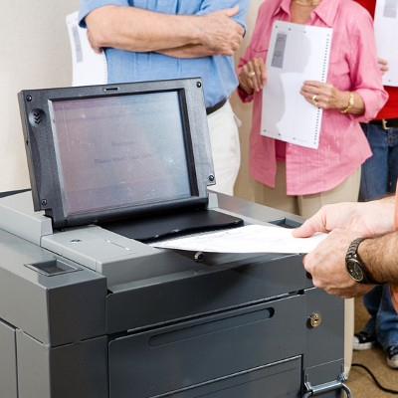
Logic & Accuracy Testing
Every machine tested before every election
Run a test deck of ballots to confirm that machine operates correctly and accurately counts votes
If machine functions properly, it is certified for use, sealed and secured until Election Day.
If there is a problem with the machine, it is not used.
Observers from each political party are invited to attend
Every locality certifies that they have completed testing with the Department of Elections.
Notes:
All voting machines go through logic accuracy testing
Tests involves simulating Election Day scenarios, issues and see if machines accurately counted votes, respond/operate accordingly
If yes, machine is certified for use, sealed and secured until Election Day
If no, or seal is broken, machine won’t be used and/or retested
Every locality is required to do this testing and certify that they have completed it with the Department of Elections

Slide 21
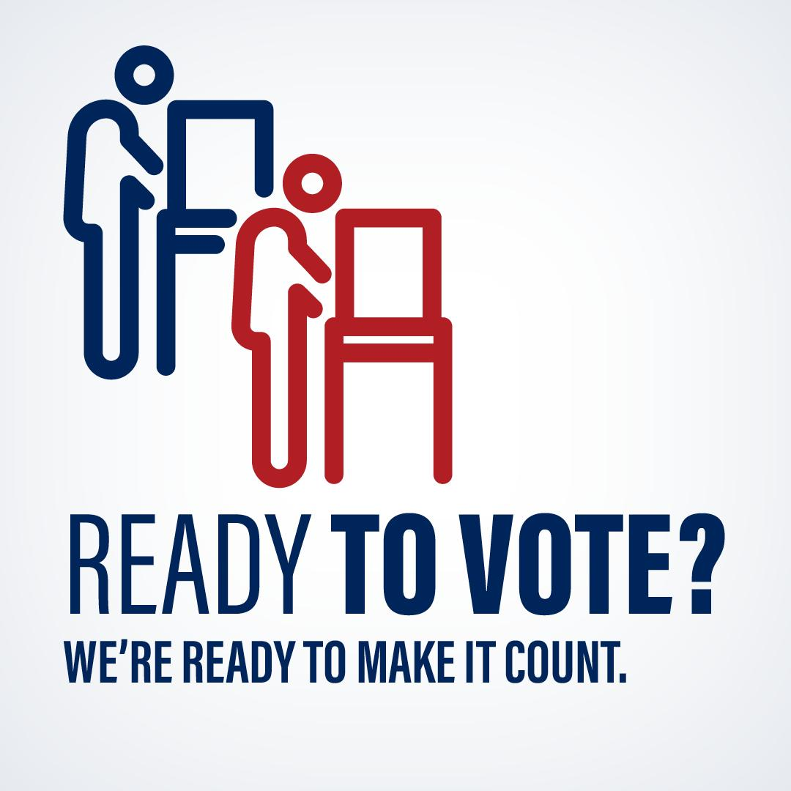
The ELECTION
Voting starts 45 days before election day
Before every election:
  Candidate filing
  Ballot access petitions/party nominations
  Ballot proofing and printing
  Voting machine testing
  Election official staffing and training
  Polling place security and accessibility reviews
  Processing of absentee ballot applications

Slide 22
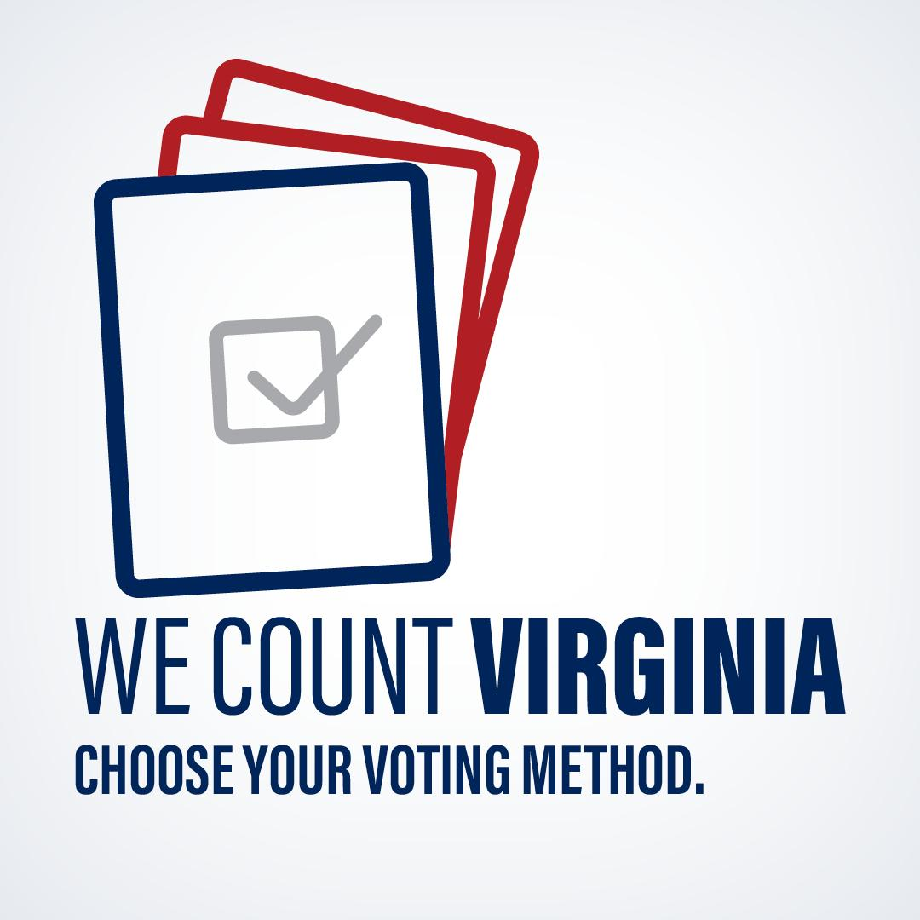
Ways to Vote
Election Day
  In your assigned precinct
Absentee
  Early In-Person – 45 days of early voting
  By Mail – must request a ballot

Slide 23
Life of an Absentee Ballot
Eligible Voter requests a ballot
(Ballots only sent when requested)
Voter completes the ballot and delivers it back quickly
Elections office receives ballot and checks SSN, YOB, address and signature
Central Absentee Precinct checks voter into pollbook and scans ballot into machine
At 7 p.m. on Election Night, an officer of election hits the button to run a results tape
General Registrar enters results into election night results system
REQUEST
MARK
VERIFY
CHECK-IN
TABULATE
REPORT

Slide 24
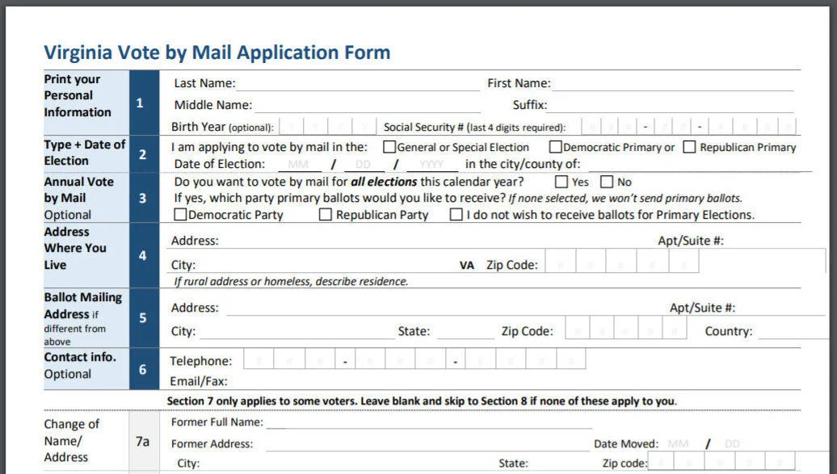
Absentee Voting
Early In-Person Voting
Available at your local registrar’s office
May have additional satellite locations
No reason or application necessary
Available last two Saturdays before election
Voter votes a regular ballot and feeds it into machine
Curbside voting available
Absentee by Mail Voting
Must apply to receive a ballot
Voter votes ballot and mails back or drops off
Every absentee ballot must match a voter who requested it
Central Absentee Precinct processes and counts

Slide 25
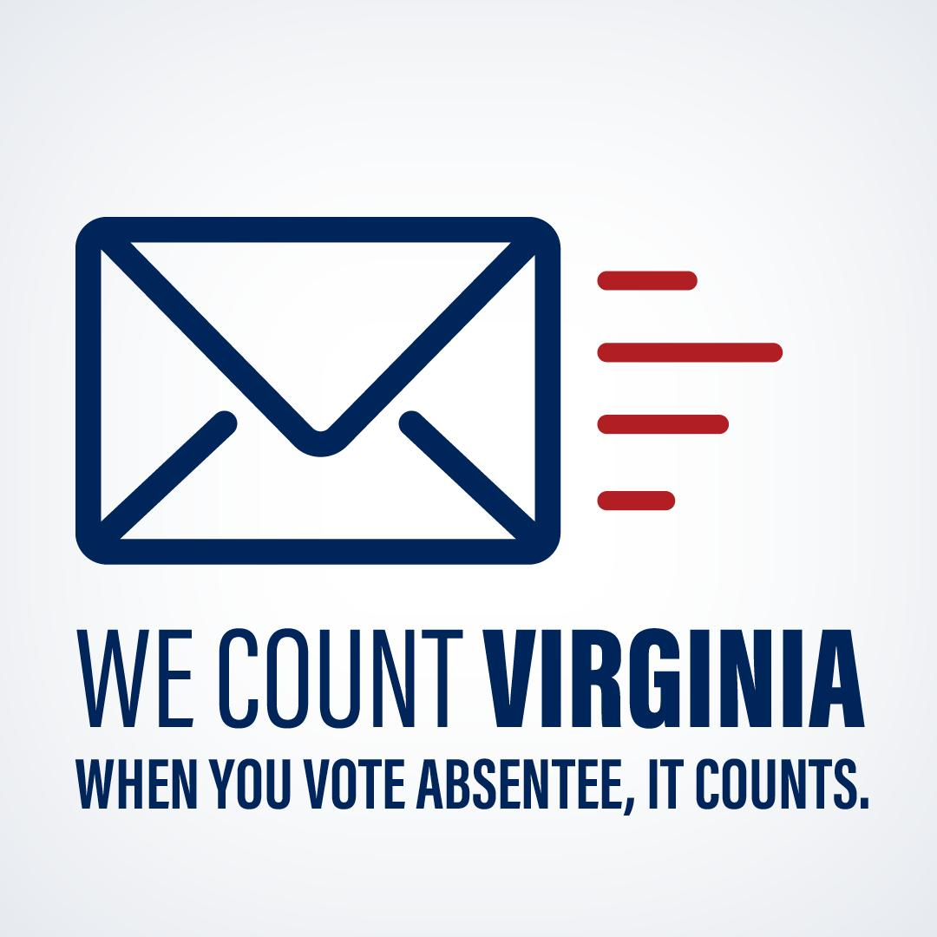
Absentee Voting
What is a Central Absentee Precinct (CAP)?
A precinct located inside the registrar’s office for the purpose of counting absentee ballots.
How results from all early votes and absentee by mail votes are reported
Officers of election must equally represent each party
Can meet before election day to start pre-processing ballots
Notes:
What is a Central Absentee Precinct(CAP)?
A general registrar uses a central absentee precinct or CAP is used to process absentee ballots in their locality.
CAPs are used to facilitate the counting of absentee ballots centrally and streamline the process of absentee ballot tabulation.
CAPs are important, because more voters are choosing to vote absentee.

Slide 26
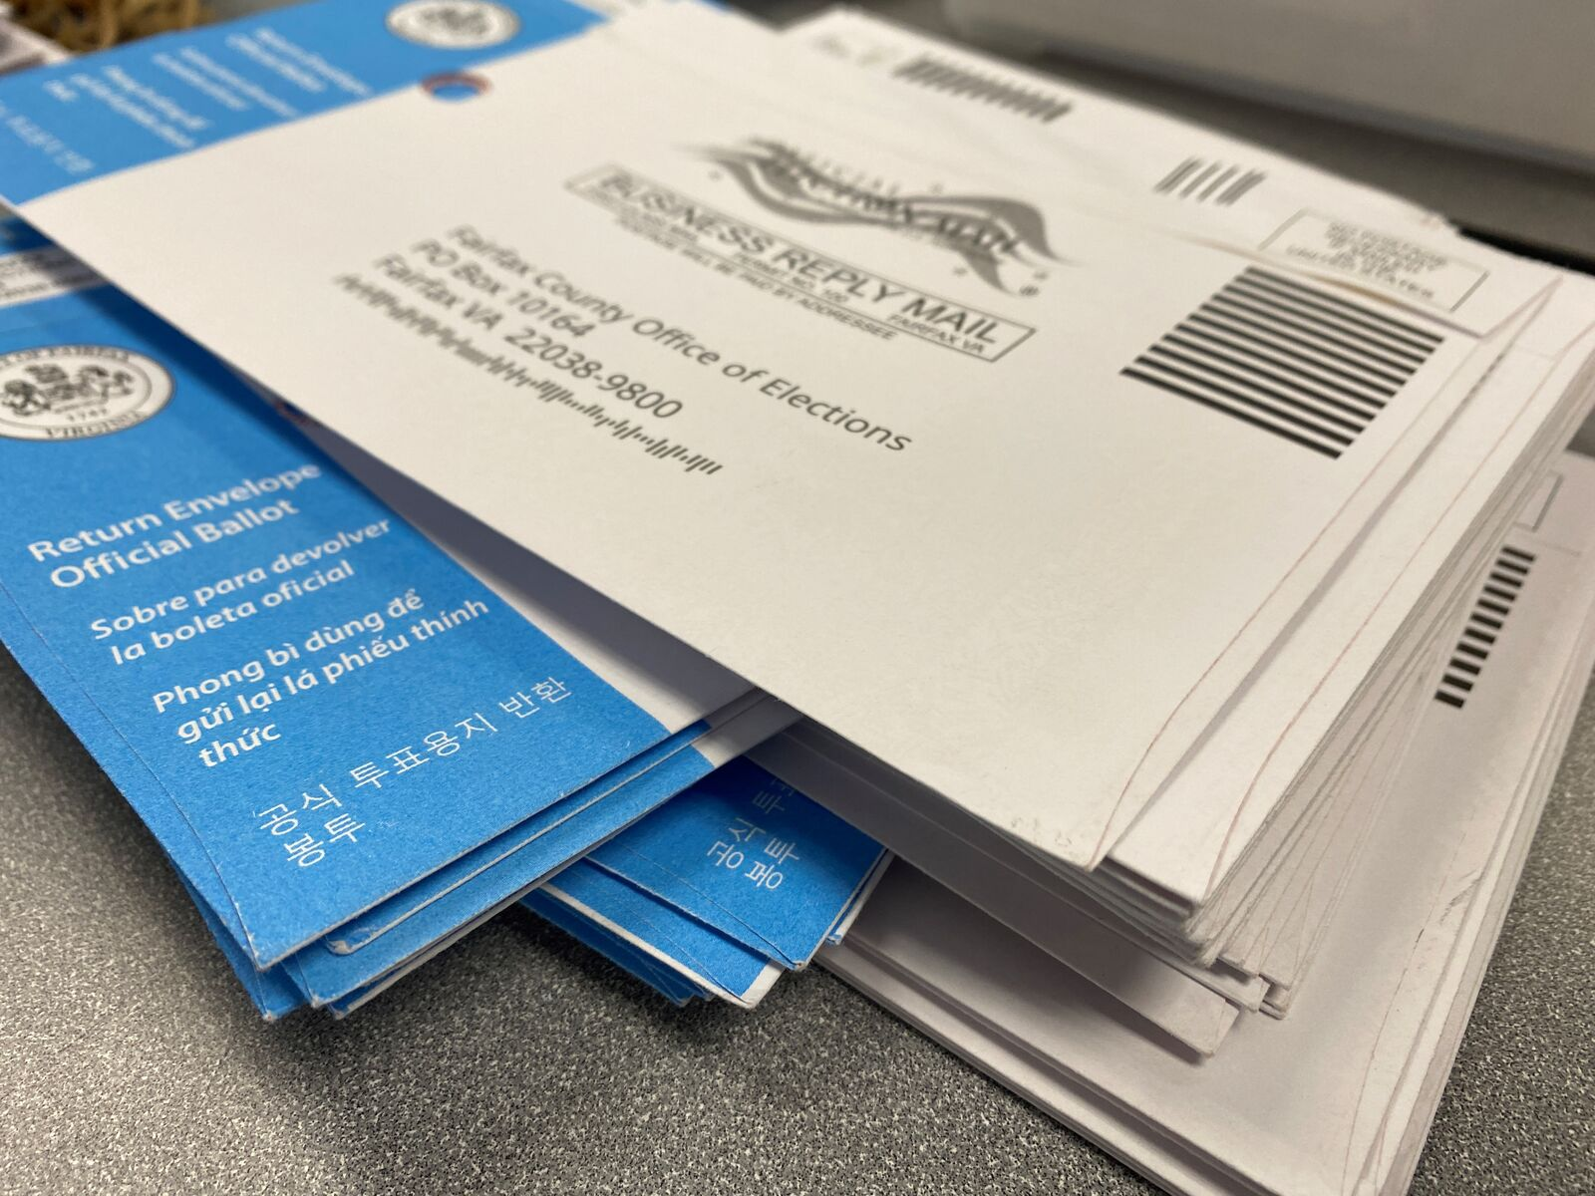
Absentee Pre-Processing
What is Pre-Processing?
Bipartisan teams check envelopes, check-in voter, confirm ballot was requested
Ballot is scanned into voting machine, but results not run until 7pm Election night
Ballot envelopes with omissions can be cured
Reduces waiting for absentee results – must meet week before election
Notes:
Pre-Processing Steps
1. Select an election precinct or district to process.
2. Gather the absentee ballots for the precinct/district you will be counting.
3. Obtain a daily Pre-Election Absentee Ballot Processing Worksheet (called the “Worksheet”) for that precinct/district and fill in the current day’s date.
4. Obtain the pollbook section (called the “Final Absentee List”) for the precinct chosen. It may be a single sheet or a number of pages, depending upon how many ABs were requested for that precinct.
5. If the precinct already has a Pollbook Count (PBC) form, identify the next unused number and begin your processing with that number. If not, obtain a blank PBC form and fill in the precinct number and name and the date of the pre-processing.
6. Count the ballot return envelopes and date the envelopes in the front, lower left-hand corner. Note: There may be ballots already noted that you cannot process. Leave them in the original container for the Election Day CAP.
7. Enter the total number of envelopes on the Worksheet.
8. If not already done, alphabetize return envelopes.
9. Handle one envelope at a time.
10. Read the voter’s name out loud. Find voter's name on the precinct pollbook.
11. Pull the “B” envelope from the returned envelope. Check the Statement of Voter for completeness.
12. If the voter is found on the AB List, repeat the voter’s name and address; assign and cross off a Pollbook Count Form (PBC) number.
13. Write the PBC number in the “Vote Rec” column next to voter’s name in the pollbook.
14. Write the PBC number and initials of one EO below the date in the lower left hand corner on the Return Envelope for that voter.
15. Carefully open Envelope “B,” pull out folded ballot; place the still-folded ballot into a ballot container or face down in a stack. Do not look at the vote on ballot; just be certain there is only one ballot.
16. Reinsert the empty Envelope “B” Envelope into the Return Envelope and turn upside down in the stack.
17. Band the empty Return envelopes containing the empty Envelope “B” and place in the “Empty Envelopes” container when finished.
18. Place the PBC Form back where you found the ballots with any ballots you could not process.
19. Complete the Worksheet, clip the precinct pollbook to the worksheet, and return it to the assigned staff person.
20. Repeat these steps until processing for the day is complete.

Slide 27

Important Election Day Laws
Voting hours – 6 a.m. – 7 p.m. Anyone in line at 7 p.m. can vote.
40-foot line – no electioneering within 40 feet of polling location
Curbside Voting – available to anyone 65 or older or disabled
Campaign shirts, stickers, hats – voters allowed to wear; election officials are not

Slide 28
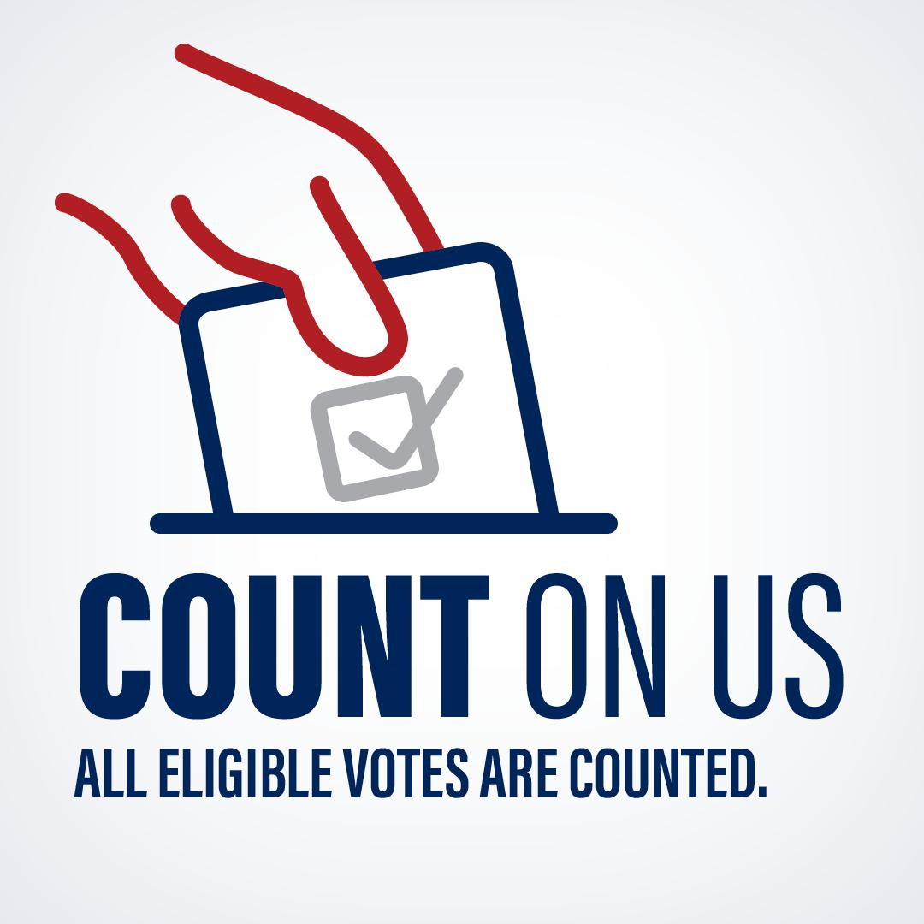
How are votes counted?
  Results tapes - Election Day, Early Voting and Absentee by Mail ballot results tapes are run after all polls have closed on Election Day at 7 p.m.
  End of day reconciliation - # of voters checked into pollbook = # of ballots used = # of ballots cast on machine
  Canvass – Electoral Board ensures that:
  tapes = statement of results = reported results
  Results are unofficial on election night, and are not official until the election is certified.
  All election results are triple checked (by precinct chief, by the electoral board, by the state board) before certification

Slide 29
From Cast to Counted: Verifying Vote Totals
7:00 PM on Election Day
Officers close polls, tabulate and complete Statement of Results.
The day after the election, the Local Electoral Board convenes to ascertain results.
SBE reviews Abstracts of Votes Cast a third time and votes to certify the Election in a public meeting.
Risk-Limiting Audits are conducted pre-certification to verify machines accurately reported election results.
Local Electoral Boards must conduct provisional ballot meetings and finalize election results within 10 days.
ELECT staff reviews abstracts of votes to check results for accuracy.
1st CHECK
2nd CHECK
ASCERTAIN
3rd CHECK
AUDIT
CERTIFY

Slide 30

Local Certification Period Overview
Open Canvass and Provisional Meetings
Canvass
Certification
Review and ascertain totals for Election Day and early in-person absentee votes
Recess as needed until certification
No later than 10 days after Election Day (6 days for primaries)
Execute Abstracts of Votes and Certificates of Election
Canvass Continued
No later than 5pm the day after Election Day
Recess provisional meeting immediately for GR staff research
Review and ascertain totals for post-election, provisional, and write-in votes
Provisional Research
Provisional Ballot Meeting
GR staff review provisional voter information and process SDR applications
EB holds limited-attendance meeting to determine voter eligibility

Slide 31
What is a Risk-Limiting Audit? a statistical random sampling to confirm accurate reporting of results
Submit list of all organized ballots (ballot manifest)
1
Generate random sample size -determine ballots to be pulled
2
Pull ballots
3
Hand Count for results
4
Compare to outcome
5

Slide 32
Risk-Limiting Audits
Voting System Certification
Logic and Accuracy Testing
Risk-Limiting Audits
The Code of Virginia mandates the use of several checks on voting systems conducted at both the state and local level.
  §24.2-629 SBE Approval of Electronic Voting Systems
  §24.2-625.1 Voting Equipment Security
  §24.2-633 Notice of final testing of voting system; sealing of equipment
  §24.2-671.2 Risk-Limiting Audits
Every risk-limiting audit conducted in VA has proven that the machines are accurately reporting election results.
24 RLAs (including pilots)
  1 Ballot Comparison (Pilot)
  5 Batch Comparison Audits
  18 Ballot Polling Audits
Voting Equipment Security

Slide 33
Risk-Limiting Audits in VA: A Brief History
-First ballot polling RLAs of a statewide contests conducted.
Nov. 2022
The 9th CD localities perform an RLA after the Nov 2022 election.
Nov. 2023
Multiple localities perform RLAs after the Nov 2023 election.
Former HOD 13 and 75 perform an RLA of the Nov. 2021 election.
June 2023
Loudoun County performs the first batch comparison method RLA for a primary race.
Chapter 367 of the Govs. Acts of Assembly requires a risk-limiting audit annually of ballot scanner machines.
July 2017
-Fairfax City pilots the first RLAs in VA.
Jan 2022
-RLA Manual is created
July 2022
Chapter 443 of the Govs. Acts of Assembly significantly amends RLA code provisions.
March 2023
SBE approves batch comparison as a method for conducting RLAs.
Nov. 2024
-First batch comparison RLA required by SBE (U.S. House District 1 contest)
-U.S. Senate race
Feb. 2021
2018-2021
-Chapter 367 takes effect.
-12 pilots are conducted.

Slide 34
Real-Life Examples
Contest | Margin | Batch Comparison | Ballot Polling
Chesapeake 2021 Commonwealth Attorney | 15% | 17 Batches/22,100 Ballots | 570 Ballots
Prince Edward 2023 Sheriff | 27.3% | 10 Batches/13,000 Ballots | 150 Ballots
Henrico 2023 Va. Senate District 16 | 9.6% | 27 Batches/35,100 Ballots | 1,568 Ballots
Contests with smaller margins will require more ballots to be sampled.
Batches are defined as precincts. The average size of a precinct is approximately 1,300 voters.
Using ballot polling, audit review boards can pull anywhere from 20-25 ballots per hour for ballot polling.
Using batch comparison, audit review boards can pull anywhere from 200-250 ballots per hour.

Slide 35
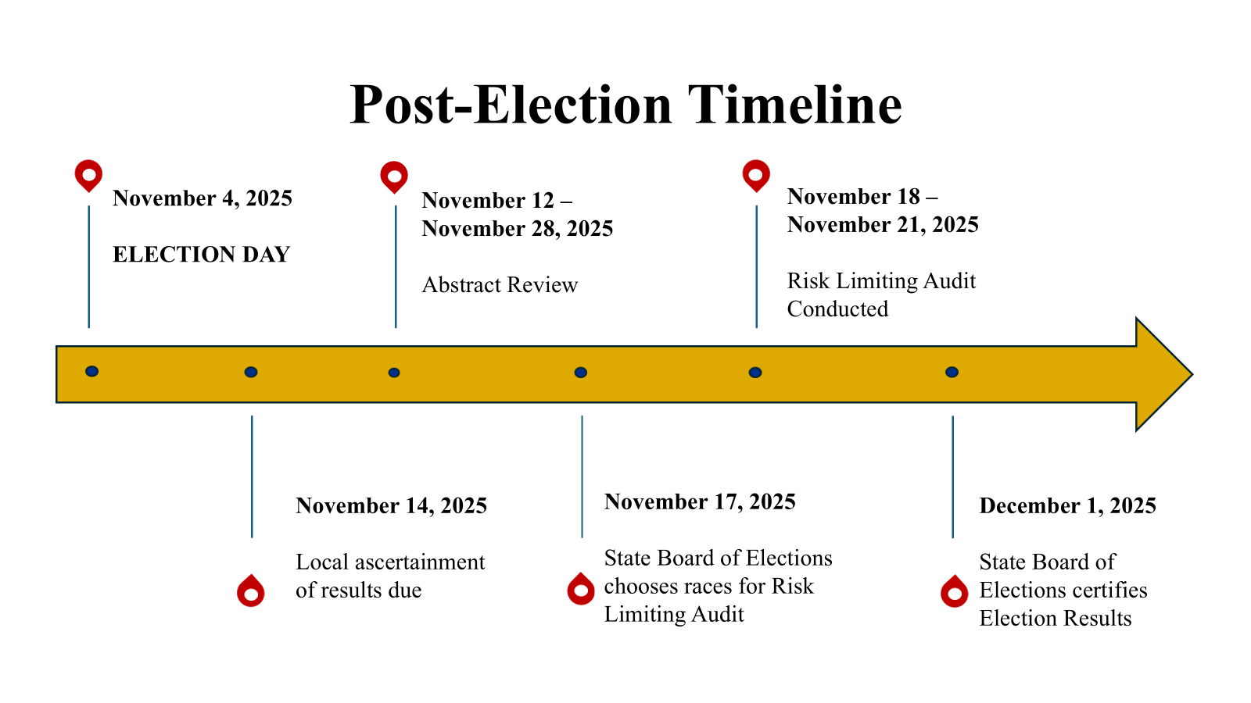

Slide 36
Looking Forward: 2026 Key Election Dates
December 9, 2025
Special Election: Fairfax County
January 1, 2026
Petition Signature Collection Starts
January 6, 2026
Potential Special Election
February 3, 2026
Special Election, Caroline County Treasurer
April 13- April 24, 2026
May 2, 2026
Ballot Proofing for June Primary
March 16-April 2, 2026
Filing period.
February 15, 2026
June 16, 2026
Primary
Early Voting Begins
June 23, 2026
Local Certification Deadline for Primary
June 30, 2026
SBE Certification for Primary
August 20-September 9, 2026
Ballot Proofing for Nov. General
September 18, 2026
Start of Early Voting for General
November 3, 2026
General Election
November 16-20, 2026
RLA of General
December 7, 2026
SBE Certification
November 4-11
Local Canvass
NCOA Mailing

Slide 37
365 Days of Elections – 2026 Election Year
Special Election Senate Dist. 15
NVRA mailing
Primary
June 16
January | February | March | April | May | June
Declarations of Candidacy, petitions, filing fee receipts submitted 92 to 75 days before the primary
Print Ballots Test Machines
45 days early voting for the Primary Election
Canvass & Prov. Ballot
General Election Nov. 3
Certification
NVRA mailing
July | August | September | October | November | December
Training
Print Ballots Test Machines
45 days early voting for the General Election
Canvass & Prov. Ballot
Certification

