Slide 1
Virginia House Elections Committee
November 2025
Notes:
As the former VA Commissioner of Elections, I am glad I am able to speak before you today.

Slide 2

About the EAC
Independent, bipartisan Commission established by the Help America Vote Act (HAVA).
Develops guidance to meet HAVA requirements.
Adopts voluntary voting system guidelines, certifies voting systems and accredits testing laboratories.
Serves as a national clearinghouse of information on election administration.
Distributes, administers, and audits the use of HAVA funds.
Maintains the National Mail Voter Registration Form.
Notes:
The U.S. Election Assistance Commission or EAC helps election officials improve the administration of elections and helps Americans participate in the voting process.
To fulfill our mission, the EAC has 4 main buckets of work:
Developing voluntary voting system guidelines;
Testing and certification of voting systems;
Administering Help America Vote Act or HAVA funding; and
Serving as a national clearinghouse of election administration information.
As a clearinghouse, we are a central agency for the collection, creation and distribution of information about elections

Slide 3
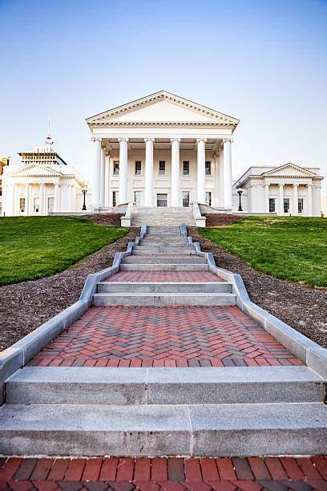
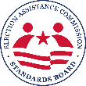
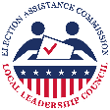
EAC Advisory Boards
Standards Board
Susan Beals, VA Commissioner of Elections
Mark Coakley, Henrico County General Registrar
Local Leadership Council
Barbara Tabb, Prince George County Electoral Board Member
Notes:
The EAC also has 4 advisory boards, made up of elections officials, technical experts, federal partners, and other elections stakeholders.​
These boards provide valuable feedback to inform and guide the work of the Commission.​
Virginia election officials are represented the Standards Board and Local Leadership Council.
The other two boards are the Board of Advisors and Technical Guidance and Development Committee.

Slide 4
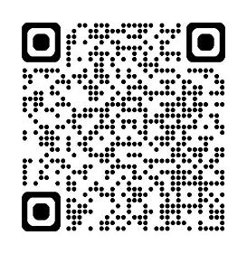
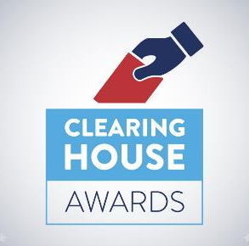
National Clearinghouse Awards
The Clearinghouse Awards, or “Clearie” Awards, celebrate innovation and best practices in election administration across the country.
Congratulations to our winners from Virginia:
Fairfax County
Prince William County
eac.gov/clearies
Notes:
I would like to continue to brag on Virginia a little bit more and the excellent work of their election offices
In April, we announced our 2024 “Clearie” Awards.
These awards recognize best practices in election administration from the 2024 election.
Congratulations Fairfax County and Prince William County
Fairfax County (Election Administration)-Pollbook Unclear? No Need to Fear! A Worksheet Leads the Way for Processing Nonroutine Voters: The nonroutine voter worksheet is a simple step-by-step tool that eliminates guesswork and gives poll workers confidence in tricky situations. At first, some poll workers were hesitant to fill out yet another form. But once they tried it and saw how it simplified their process, many said they wouldn’t want to work without it.
Prince William County (Election Administration)-Publishing Result Tapes Online: Prince William County publishes tapes of all officer-signed results online, giving the public access to primary sources of election results. Allowing the public being able to verify that a particular precinct’s results match reported totals is valuable as a validation test increasing confidence in the election results.
Fairfax County (Poll Workers) No More Waits, No Misplaced Tapes: Closing the Polls Faster on Election Night: Fairfax County created a Closing Procedures Workshop with two hands-on exercises helping poll workers better understand their tasks and reduce closing times on Election Night. First, the Timeline Exercise uses 20 flashcards representing key closing tasks. Teams must sort these into categories based on who can complete them and the overall process. Second, the Tapes Exercise tackles the difficult process of matching the DS200 ballot scanner tapes with the correct forms. Using laminated tape samples, poll workers practice identifying and attaching tapes to the appropriate documentation.

Slide 5
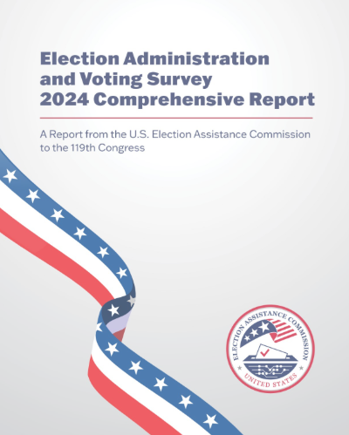
2024 EAVS - Virginia
Turnout was 70.5% of CVAP
42% voted early, 11% voted by mail and 47% voted on election day
Over half a million confirmation notices were sent to confirm address or eligibility
Over 3 million registration transactions were processed by election offices
Notes:
The Election Administration and Voting Survey creates the nation’s most comprehensive report on federal election administration, registration and voting on the federal, state and local levels.​
Here is a little taste of what you will find about Virginia in our 2024 EAVS
This almost 70% percent turnout is a 2% decrease from 2020
As expected, mail voting dropped from 2020 (10%).
And 2.5 % of these mail ballots entered the cure process
Voter list maintenance resulted in 784,000 records being removed between 2022 and 2024
Of the confirmation notices sent 80% were not returned
Of the 3 million registration transactions, 46% were updates and 17% were new and valid registrations

Slide 6
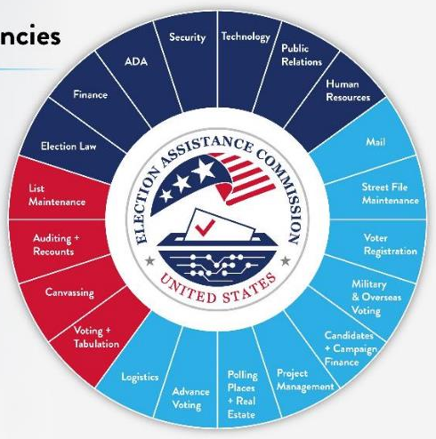

Election Administrator Competencies
Ongoing
Election Preparation
Election Night & Beyond
Notes:
Election officials at every level (state, county, municipal) are required to have skills and knowledge in many areas to effectively manage an election. The EAC does their best to provide best practices on these matters
Some of those tasks are show in the image above, including:
Before election day:
Voter registration
Mail and absentee voting
Military and overseas voters
Candidate filing
Election day and beyond:
Election technology and tabulation
Auditing and recount rules
Canvassing and certification
Ongoing:
Finance
Election law
Accessibility
Security
Technology
Communications
Human Resources

Slide 7
EAC Testing and Certification
Notes:
One of our most well-known ways in securing the vote is through our certification of election technologies
Establishing these testing standards is one the core functions of the EAC as established in HAVA

Slide 8
Election Technology and Security
EAC Testing and Certification (T&C)
Accreditation of Voting System Test Laboratories (VSTLS) and Certification of Voting Systems to the Voluntary Voting System Guidelines (VVSG)
EAC Election Supporting Technology Evaluation Program (ESTEP)
Voluntary Electronic Poll Book Certification Requirements (VEPBCR)
EAC Field Services Program (FSP)
Quality Monitoring Program (QMP)
Notes:
One of our most well-known ways in securing the vote is through our certification of election technologies
Establishing these testing standards is one the core functions of the EAC as established in HAVA

Slide 9
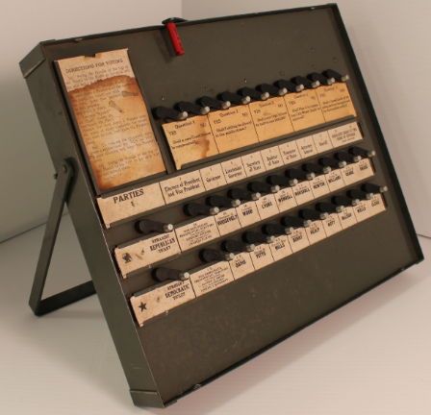
History of Voting Machines
“It cannot be denied that the only way to guarantee an honest and accurate count is to use voting machines.”
1934 Brookings Institute
Notes:
Sound familiar?
In 1940, Kentucky amended their state constitution to allow for voting machines to be used after experiencing fraud from hand-counting. As a result of these machines, tabulation and reporting time was sped up and the machines actually saved money despite the initial out lay because it eliminated the slow and often quarrelsome hand counting that required a slew of watchers, tabulators and miscellaneous other employees.
From another mid-century article: These election frauds are largely, if not entirely, eliminated by the use of machines. While it may be possible to manipulate the machine and steal votes, the experience in many cities seems to indicate that it is not practicable and review of the machines could ferret out issues. And it should be noted that voting frauds have tended to disappear in many communities with the use of machines.
The U.S. has the longest ballots in the democratic world. Without automation, it would take weeks if not months to count ballots in many places, with a significant chance of human error and at a great expense
The U.S. also has a commitment to making secret ballots accessible to people with disabilities—a commitment that is difficult if not impossible to achieve without the use of computers.

Slide 10
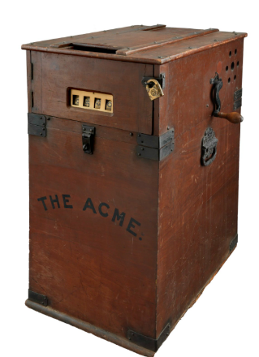
20th Century Hand Counting Issues
Pennsylvania-voters cannot tell whether their votes will be counted or whether they would be offset by fraudulent ballots
New York-remember Tammany Hall anyone?
Chicago-it is safer and cheaper to have the election officers steal the election by turning in an election return which is not based upon an actual count of the ballots
Pittsburgh-stuffing the ballot box with marked ballots or writing in the poll books the names of voters who failed to vote or who have died or moved away
Notes:
From that same 1934 Brookings Institute Article
Machines expedite returns. The work of reading off the counters and recording the vote on the return sheets requires such a short time that it is likely to be carefully watched by party representatives and voters, who would not think of remaining at the polls for hours to watch the count of paper ballots.
While it may be possible to manipulate the machine and steal votes, the experience in many cities seems to indicate that it is not practicable and review of the machines could ferret out issues. For the community affected with election frauds, the voting machine provides real relief, though not absolute security against all frauds, but it should be noted that voting frauds have tended to disappear in many communities with the use of machines and the honesty of the election is safeguarded in other ways.
In a 1930s review of voting processes, political scientist Joseph Harris concluded that “probably no part of election administration is conducted so poorly as the count of ballots.”

Slide 11
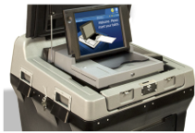
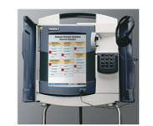
21st Century Hand Counting Issues
Nye County, NV-election officials hand counted all ballots in the 2022 election resulting in an error rate as high as 25%.
Esmeralda County, NV-it took the county more than seven hours to count 317 ballots. At that rate, it would have taken Clark County, Nevada’s most populous county, 6,375 hours, or more than 265 days, to hand count the 288,683 ballots cast in its primary.
Gillespie County, TX-a hand-count of Republican primary election ballots took almost 24 consecutive hours with 200 people counting ballots. The hand-count cost taxpayers about double the wage costs of the 2020 Republican primary and involved fixing a series of errors.
Notes:
Rice University conducted a study in which participants hand counted just two races on 120 ballots. The participants accurately counted the results of the two races only 58% of the time.
An MIT study in New Hampshire found that poll workers who counted ballots by hand were off by 8%. The error rate for machine counting was about 0.5%.

Slide 12
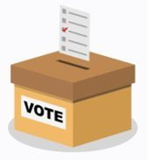
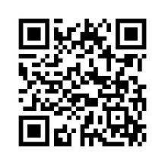
Voluntary Voting System Guidelines (VVSG)
VVSG are a set of specifications and requirements against which voting systems can be tested to determine if the systems meet required standards.
Some factors examined under these tests include functionality, accessibility, usability, and security capabilities.
EAC Election Security Video
Notes:
The Voluntary Voting System Guidelines, or VVSG, create a system of requirements to independently verify that voting systems comply with the functional capabilities, accessibility, and security requirements necessary to ensure the integrity and reliability of voting system operation
These guidelines are completely voluntary; however, some states do require adherence to VVSG by law. ​
The original VVSG started with version 1.0.​ The EAC recently adopted higher standards for voting systems – known as the VVSG 2.0.​

Slide 13

Penetration Testing
Physical and virtual testing for weaknesses in an information system, system security procedures, internal controls, or implementation that could be exploited or triggered by a threat source.
Notes:
Prior to application approval, every machine must undergo penetration testing to determine what if any vulnerabilities are present, evaluate any mitigating controls, and determine both the likelihood and potential impact of a successful exploit.
Given the evolving nature of election security, such measures play an essential role in strengthening the integrity and resilience of electoral systems, ultimately reinforcing public confidence in the election process.
Penetration testing helps uncover exploitable security weaknesses before formal certification testing begins, allowing manufacturers to address issues proactively.
By simulating real-world attack scenarios, penetration testing ensures voting systems are better equipped to withstand malicious threats, enhancing overall trust in the system’s security posture.
Access to the machines can be through table top exercises, physical component audits, vulnerability scanning and precertification assessments

Slide 14
VVSG 1.0 Limited Maintenance Modifications
Limited maintenance modifications are allowed for legacy systems including:
Security updates
Bug fixes
COTS replacements
Jurisdictional rule changes
Updating and adding new components to be evaluated against the latest VVSG standard
1.0 Systems in Test:
Smartmatic VSR1 2.1
ClearVote 2.5
Verity Voting 2.7.8
Notes:
To ensure current systems can realize their full expected lifespan, limited maintenance modifications will be allowed by the EAC to previously certified systems in the areas of security patches, replacing end-of life components, bug fixes, and adding functionality required by jurisdictional rule changes.
No currently used voting systems will be decertified by the EAC through this process, and you will be able to continue using any system that has been certified by the EAC.
Current systems do not need to be replaced or recertified unless otherwise dictated by individual state statute.

Slide 15
Submitted Systems to VVSG 2.0
Systems received:
Smartmatic VSR1 2.1
VotingWorks VxSuite 4.0
Hart Verity Vanguard 1.1
Unisyn Optio 1.0
Other systems expected to enter soon!
Application
Application Approval
Test Plan Submission
Test Plan Approval
Test Case Submission
Test Case Execution
Test Report Submission
Test Report Approval
Scope and Certification
Notes:
In addition to the certified system, we currently have 4 additional 2.0 systems in the test case development stages and at varying locations with new drops, penetration testing, source code review, documentation review, and hardware testing completion
Above is a basic outline of a test campaign. Although there are additional steps for each section, this shows the overall flow.
The review process is to provide us with confidence that there is sufficient testing occurring by making sure that the test cases contain sufficient detail and information for us to have confidence that it was tested.
The process may have to be repeated should the final report show that the system is not ready for certification

Slide 16
VVSG 2.0
In 2021, the EAC updated voluntary standards for voting systems to lay the groundwork for 21st century voting systems that will significantly improve cybersecurity, accessibility, and usability requirements.
The EAC is a resource for election officials to help guide them through the VVSG 2.0 migration process – from procurement to implementation.
To help state and local jurisdictions in the transition to VVSG 2.0, the EAC is consistently releasing resources to assist election officials in communicating about the migration of these standards and reassuring the public that our voting systems remain secure and accurate.
Notes:
These guidelines are completely voluntary; however, some states do require adherence to VVSG by law. ​
Major updates were made to all areas including: cybersecurity, interoperability, accessibility, and auditability.​
Additionally, the EAC now requires penetration testing on all systems prior to entering the testing and certification program.​
It will take time for new systems to be developed, certified to VVSG 2.0, and fielded for use in elections, particularly in an environment of constrained funding for state and local elections.​
If you need assistance in responding to questions from press or the public, please contact the EAC. We have a toolkit with messaging and FAQ information and more at eac.gov.​

Slide 17

VVSG 1.0 vs 2.0 Enhancements
 | VVSG 1.0 | VVSG 2.0
Structure | Two-volume technical document with prescriptive requirements | 15 high-level principles and 56 guidelines
Auditability | Baseline audit trail requirements | Durable records, unique tracking numbers, greater transparency
Cyber & Physical Security | Baseline physical and cybersecurity requirements (limited access controls, physical protections, audit logs) | Robust cybersecurity (air gapped systems, integrity checks, MFA, secure updates), improved physical security
Accessibility | Early standards for accessibility | Human-centered design, clear performance benchmarks for independent and private voting
Technology | Device-level requirements, encouraged but did not require voter-verifiable paper record | System-level requirements for flexible, secure, paper-based systems
Interoperability | Focused on complete integrated systems | Introduces interoperability, common data formats, component-based systems
Software Independence | Allowed but did not require software independence | Requires software independence (e.g., paper-based auditable systems)
Notes:
1.0 to 2.0 improvements include:
Advanced Security: Incorporates software independence, stronger auditability, and modern cybersecurity best practices.
Improved Usability & Accessibility: Expands design guidance to better support voters with disabilities and overall voter experience.
Greater Transparency: Enhances system clarity to support public confidence and robust verification.
Modular & Interoperable Design: Enables updates to individual components without requiring full system re-certification.

Slide 18
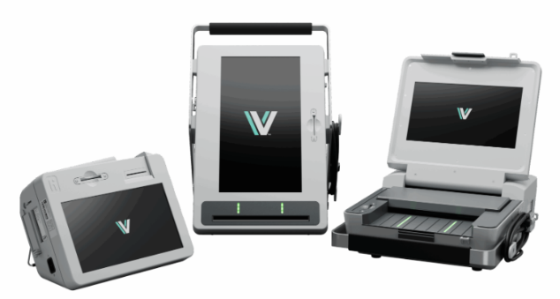

On July 7,2025, the EAC certified the nation’s first 2.0 system, marking a new milestone for election technologies in our nation’s history!
Notes:
Thanks to all of this work, I am pleased to announce that the EAC has certified our first 2.0 VVSG System – Hart Verity Vanguard 1.0
VVSG 2.0 and increases transparency, security, accuracy, accessibility
These systems are also paper based allowing for better audibility

Slide 19



Election Supporting Technology Evaluation Program (ESTEP)
FUNCTIONALITY
SECURITY
ACCESSIBILITY
Usability Features
Functional Configuration
Compatibility
Telecommunications
System Maintenance & Troubleshooting
Access Control
Physical Security Measures
System Integrity
Network/Telecommunications Security
Software Design & Architecture
Supply Chain Risk Management
Baseline Accessibility
Supporting Visual Features
Supporting Physical Features
Supporting Audio Features
Additional Languages
Questions? Contact ESTEP@eac.gov
Notes:
ESTEP stands for “Election Supporting Technology Evaluation Program​.”
The program evaluates the security, accessibility and functionality of election supporting technologies such as e-poll books, electronic ballot delivery, voter portals and election night reporting systems.
Through ESTEP, we aim to:​
Produce election technology standards similar to VVSG​
Create draft standards that can be used by Voting System Testing Laboratories, or VSTLS​
Create program manuals ​
Administer and report results of pilot programs ​

Slide 20
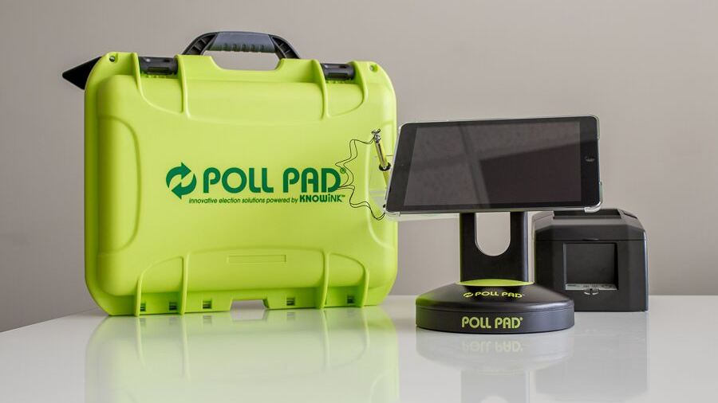
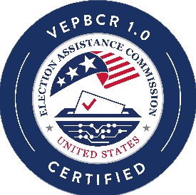
On February 18, 2023, the EAC certified the nation’s first electronic poll book at the federal level, marking a new milestone for election technologies in our nation’s history!
Notes:
I am pleased to announce that the EAC has certified our first e-poll book under this program – Poll Pad v.3.5
Simply defined, electronic poll books (EPBs) are laptops, tablets, or kiosks designed to replace paper poll lists, that access digital voter registration records for their representative jurisdiction.
EPBs were initially designed in an effort to automate the election process and alleviate the burden on election workers, who update voter registration records and evaluate a voter’s eligibility to participate in the election process. In recent years, these systems have evolved to serve a variety of administrative functions before, during, and after an election. EPBs can now be used to capture voter signatures, identify a voter’s ballot style or preferred language, detect ineligible voters, and extract data reports.
In contrast to a voting system, EPBs’ primary users are election workers and do not collect or tabulate cast vote records.

Slide 21



ESTEP Pilot Programs
Electronic Ballot Delivery
Election Night Reporting
Voter Registration Systems
Notes:
Now that the agency has formally adopted the e-poll book program, the current technologies ESTEP is examining are:
The Electronic Ballot Delivery Pilot will launch mid-2025;
[FYI: Ballot delivery systems are used for the electronic delivery of ballot and voter information packets to UOCAVA voters. Some jurisdictions also offer electronic ballot delivery to voters with disabilities, voters who have been displaced, or specified unique situations.]
The Election Night Reporting Pilot will launch late 2025, with added emphasis on accessibility of results reporting webpages; and
[FYI: Election night reporting software facilitates the collection, aggregation, reporting, and secure sharing of unofficial election results to the public.]
ESTEP is planning on launching their next pilot program focusing on Voter Registration Systems in early 2026.
[FYI: Voter registration systems can be defined as a combination of either hardware, software, or firmware, materials, and documentation used to automate the process of voter registration and secure voter information within a county, state, or election jurisdiction by election administrators.]
The hope with this is also to create a level of data standardization to allow better communication between the states and other sources for list maintenance
If you have any technologies that you would like to be a part of these pilot programs, please let us know.

Slide 22

Parallel Testing Program
A reduction in redundant testing efforts.
A standardized framework that can be applied across multiple states.
Enhanced collaboration between federal and state testing authorities.
Increased efficiency and clarity in the election system certification processes.
Notes:
The goal of a this "parallel testing program" is to streamline election technology testing programs that must comply with both federal and state regulations in the effort to speed up timelines, remove inefficiencies, and decrease costs
This will be an ongoing discussion at the EAC and may present pilot opportunities with states such as Virginia

Slide 23
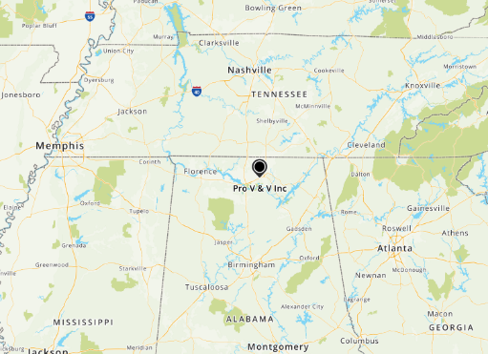
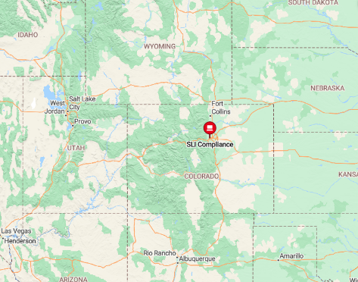
Voting System Test Laboratories
Pro V&V Huntsville, Alabama
SLI Compliance
Wheat Ridge, Colorado
Notes:
HAVA requires that the EAC provide for the accreditation and revocation of accreditation of independent, non-federal laboratories qualified to test voting systems to Federal standards.
In order to meet these statutory requirements, the EAC has developed the EAC’s Voting System Test Laboratory Accreditation Program. Although participation in the program is voluntary, adherence to the program’s procedural requirements is mandatory for participants.
Currently we have two accredited VSTLs: Pro V&V in Huntsville, Alabama and SLI Compliance in Wheat Ridge, Colorado.

Slide 24
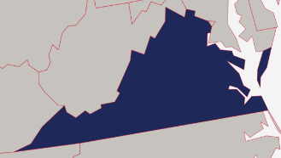
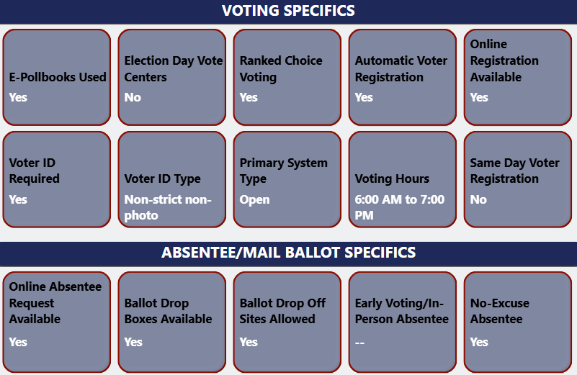
Field Services Program
Assists States and Territories with:
Hash Verification
Fielded System Reviews
Anomalies
Manufacturer Audits
For more information contact:
fieldservices@eac.gov
Notes:
Another new program we launched is the Field Services Program to allow us to engage with users of our certified systems in the field.
In this picture, you see our internal tracking tool giving you a visual on the level of outreach in the first full year of the program
​​This program will proactively provides a combination of virtual and onsite best practices trainings and services for election offices such as:
Hash Verification: Hash verification is the best tool we have at our disposal to verify that the election technology deployed are still performing the same functions to which they were certified.
System Reviews: System reviews allow us to notify jurisdictions when system changes affect them. On more than one occasion and in at least two states, working with the FSP on a system review has expedited a state system acceptance test - and contributed directly to time and budget savings on a current federal certification campaign.
Anomalies: during all election cycles this past year, the FSP team has been monitoring for anomalies in election technology. Doing so allows us to respond with an analysis as quickly as possible to questions about systems in use by the public, but also allows us to coordinate public response, and streamlines the distance between a potential system change and our folks at the EAC.
Manufacturer Audits: our visits are not just limited to election offices, but also include the businesses that are engaged in the manufacturing of the machines.

Slide 25
Take Aways
What is Virginia's plan for VVSG 2.0? County and State partnership?
Federal funding to implement VVSG 2.0 in a timely unform manner would greatly improve security across the country.
How will Virginia use the federal Certification Process and Accredited Labs for VVSG 2.0?
VVSG 2.0 Parallel Testing to find efficiences and savings?
E-Poll Book Testing and Certification Program
Voter Registration Systems Security Testing Pilot

Slide 26
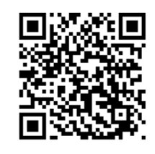

Where to Find EAC Information
Email
clearinghouse@eac.gov
YouTube Channel
@U.S. Election Assistance Commission
Facebook
Facebook.com/eacgov1
Instagram
us.eac
Sign up for the EAC Monthly Newsletter on eac.gov
X
@EACgov
eac.gov
Notes:
In addition to eac.gov, here are some other places to find EAC information
We are constantly rolling out new products to add to already large collection of election resources
The EAC has a monthly newsletter that includes upcoming events, new resources, and any other relevant information to assist you

Slide 27
Questions and Feedback

Slide 28

Contact Information
Donald Palmer
Chairman
dpalmer@eac.gov
@VotingGuy
Notes:
If you think of anything else please feel free to reach out to me at a later time.

