Slide 1

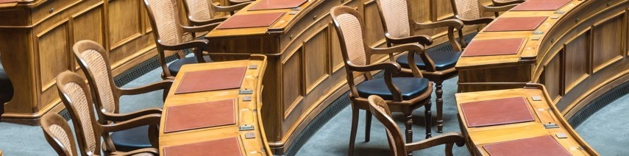
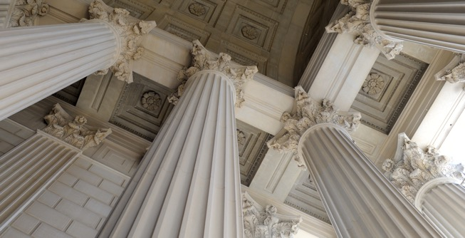
2025 Virginia House Committee on Privileges and Elections: Election Policy Overview
Katy Owens Hubler, Director, NCSL Elections & Redistricting

Slide 2



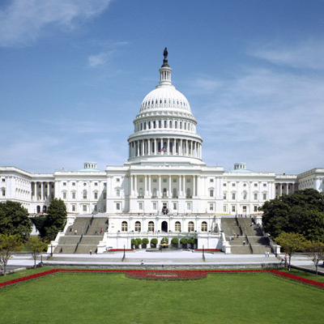

How NCSL Strengthens Legislatures
Policy Research
Connections
Training
State Voice in D.C.
Meetings
Notes:
Research
NCSL tracks more than 1,400 issue areas.
From criminal justice reform, education, health care and transportation to the more obscure issues–chances are we have someone tracking the issue and can provide timely information.
Connections
NCSL brings together legislators and staff from both sides of the aisle to tackle and discuss difficult problems and find reasonable solutions.
Training
NCSL specializes in professional development tailored specifically for legislators and staff, and many of these professional development opportunities are at no cost to you or your state.
State Voice in D.C.
NCSL advocates on Capitol Hill on behalf of all states –fighting against preemption, for the 10th amendment and maintaining federalism. We have eight committees—very similar to your states.
Meetings
NCSL creates regular platforms for leading discussions on some of our nation’s most pressing issues. Many of you may have heard of the Legislative Summit—NCSL’s annual meeting—but this is just one example. We host more than 100 policy-oriented meetings during a typical year.

Slide 3
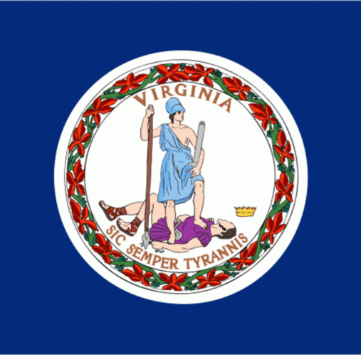
Election Administration in Virginia
Chief election official: Commissioner of Elections, appointed by the governor.
Virginia Department of Elections oversees elections
  10 other states + D.C. have a similar structure
  7 states share election responsibilities between the board and the secretary of state
  33 states elect the chief election official – usually the secretary of state (lieutenant governor in Alaska and Utah)
Running elections locally: County and City Electoral Boards, County and City General Registrars
133 jurisdictions

Slide 4
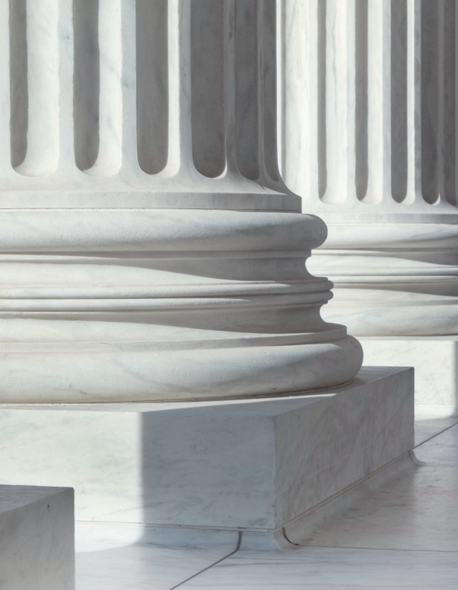
Voter Registration
Online voter registration – permitted in Virginia.
  42 states + D.C. permit OVR.
Automatic voter registration – permitted in Virginia
  24 states + D.C. permit AVR
Preregistration for young voters – Voters may preregister at 16 years old in Virginia.
  18 states + D.C allow preregistration for 16-year-olds.
  4 states allow 17-year-olds to preregister.
  1 state (Colorado) allows 15-year-olds to preregister.
Election Day/same-day registration – permitted in Virginia.
  24 states + D.C have same-day registration.

Slide 5
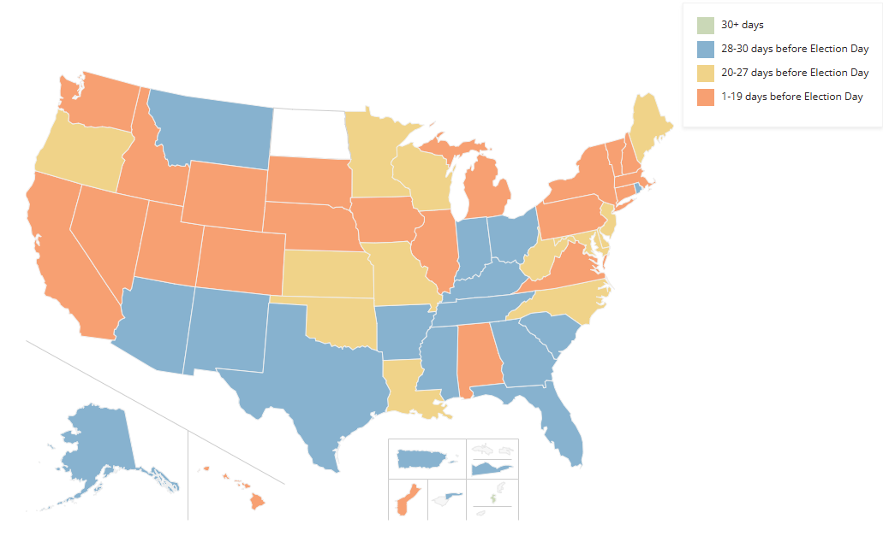
Voter Registration Deadlines
Virginia: 11 days before an election, but same-day registration is permitted during early voting.
Notes:
VA HB 1735/SB 991 passed this year to change the deadline from 22 days to 11 days before an election

Slide 6
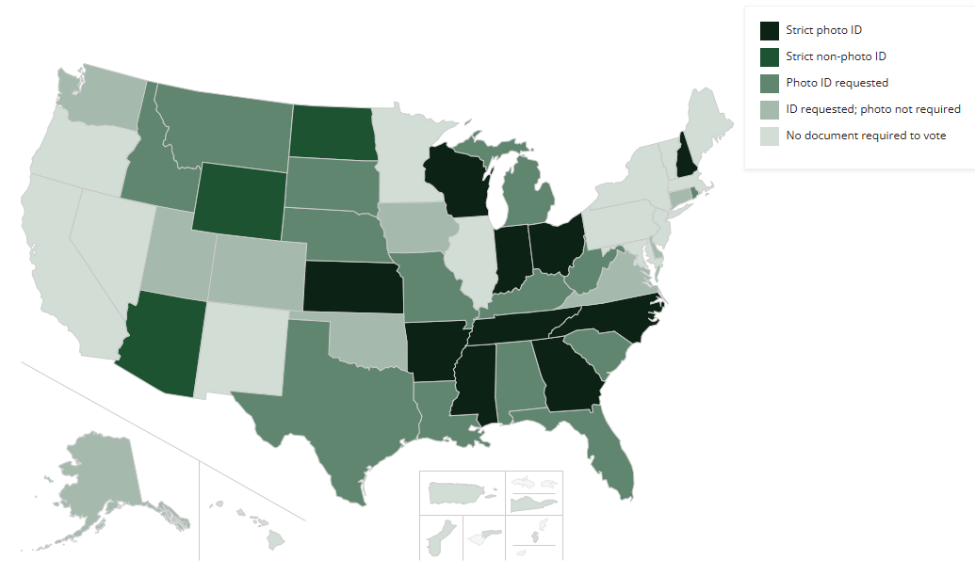
Voter ID
Virginia: ID requested; photo not required. If an ID is not presented, a voter signs a statement affirming their identity.
Notes:
36 states require an ID to voter in person

Slide 7
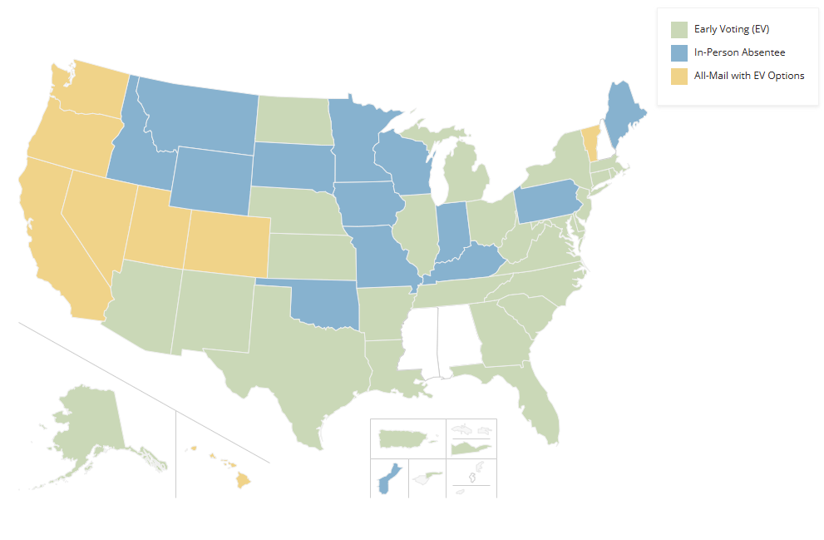
Early In-Person Voting
Virginia: Starts 45 days before an election and ends on the Saturday before an election.
Notes:
47 states allow early in-person voting; average number of days is 20

Slide 8

Vote Centers
Not used in Virgina.
Polling places that are an alternative to neighborhood-based precincts.
Voters may cast their ballot at any polling place within a jurisdiction rather than only being able to go to one location.
21 states plus D.C allow jurisdictions to use vote centers on Election Day.
Additional states may allow vote centers for early voting.

Slide 9

Absentee and Mail Voting
No-excuse absentee voting – permitted in Virginia.
  36 states permit no-excuse absentee voting.
Mailing ballots to all registered voters – not in Virginia.
  8 states and D.C. mail ballots to all active registered voters.
Absentee ballot receipt deadline – 3 days after and election if postmarked by Election Day.
  34 states require absentee ballots to be received by Election Day.
Ballot curing – permitted statewide in Virginia.
  33 states and D.C. have ballot curing processes.
Absentee ballot processing – begins upon receipt, but counting happens after polls close
  44 states begin ballot processing before Election Day.

Slide 10
Other Policies
Post-Election Tabulation Audits
Primary Types
Virginia requires a risk-limiting audit (RLA).
RLAs check a sample of ballots using statistical methods to ensure the outcome of an election.
7 other states require an RLA: GA, CO, ME, MD, NV and RI.
Other states require a traditional audit or a procedural audit.
Virginia has open primaries.
Primaries range from open to closed.
  Open
  Open to unaffiliated voters
  Partially open
  Partially closed
  Closed
Multi-party
  Top-two and top-four

Slide 11
Election Legislation by the Numbers

Slide 12
3,325 bills introduced
399 enacted
Citizenship and Voter Eligibility
Candidates and Political Parties
Voter Registration and List Maintenance
Absentee/Mail Voting
Election Dates

Slide 13
Drawing Maps: Who’s in Charge?
Redistricting Commissions
State Legislatures
Majority of states
Process:
  Public input?
  Passage threshold?
  Enactment
    Governor approval?
15 states
  15 state legislative
  10 congressional
Process:
  Commissioner selection
  Public input?
  Passage threshold?
  Adoption
    Court approval?
    Legislative adoption?

Slide 14
State Legislative Redistricting Authorities
AK
WA
ID
MT
ME
OR
ND
MN
MI
WI
NY
RI
WY
SD
CA
CT
NV
IA
PA
UT
NE
IL
OH
VT
NH
CO
IN
WV
NJ
UT
MO
VA
MA
KS
KY
DE
AZ
MD
Legislature
Primary Commission
NM
NC
DC
OK
TN
TX
AR
SC
MS
AL
GA
Advisory Commission
Other
LA
Backup Commission
HI
At-Large District

Slide 15
Congressional Redistricting Authorities
AK
WA
ID
MT
ME
OR
ND
MN
MI
WI
NY
RI
WY
SD
CA
CT
NV
IA
PA
UT
NE
IL
OH
VT
NH
CO
IN
WV
NJ
UT
MO
VA
MA
KS
KY
DE
AZ
MD
Legislature
Primary Commission
NM
NC
DC
OK
TN
TX
AR
SC
MS
AL
GA
Advisory Commission
Other
LA
Backup Commission
HI
At-Large District

Slide 16
Mid-Decade Redistricting Action
AK
WA
ID
MT
ME
OR
ND
MN
MI
WI
NY
WY
SD
CA
NV
PA
UT
NE
IA
OH
IL
IN
CO
WV
UT
KS
MO
VA
KY
AZ
NM
NC
OK
TN
TX
AR
SC
MS
AL
GA
HI
LA
FL

Slide 17
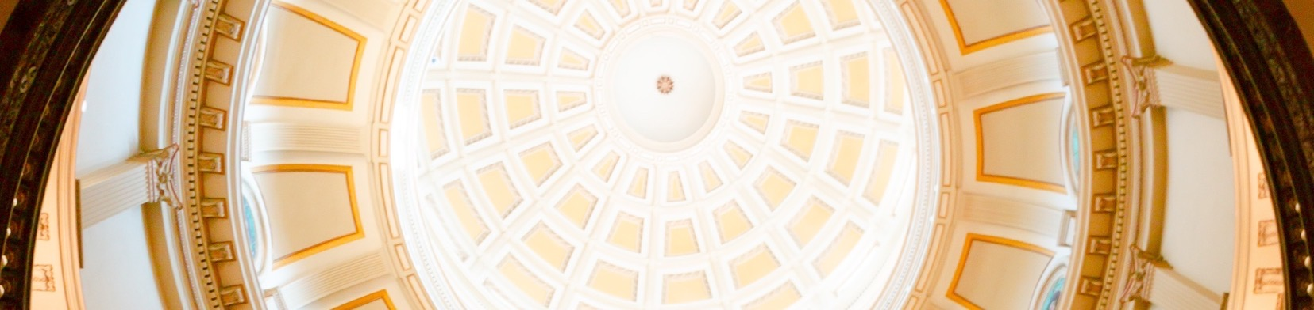
Thank you for having me today!
Katy Owens Hubler
Director, Elections & Redistricting Program
katy.owenshubler@ncsl.org
303.856.1448
www.ncsl.org
@NCSLorg
Denver
7700 East First Place,
Denver CO 80230
Washington D.C.
444 North Capitol Street, N.W.
Suite 515,
Washington, D.C. 20001

