Slide 1
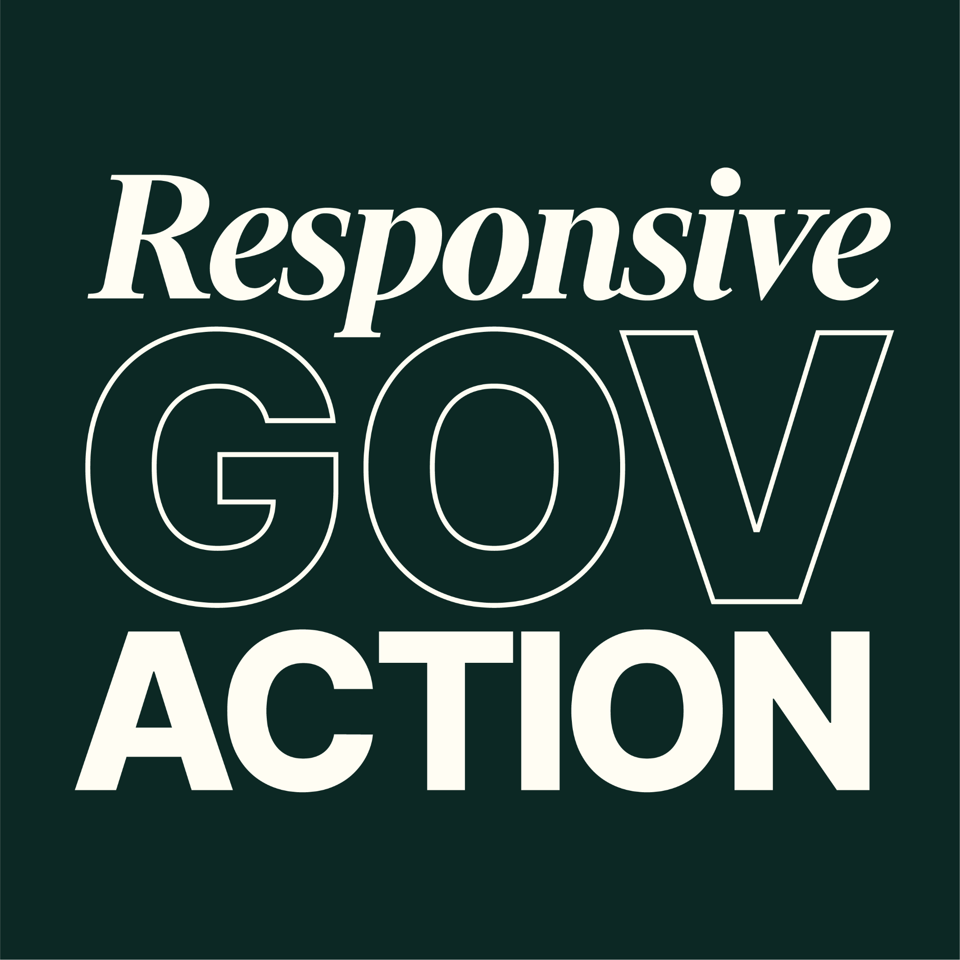
VIRGINIA’S AVR SYSTEM
November 20, 2025
Responsive Gov Action
Virginia’s AVR System | 1

Slide 2

CONTENTS
Who We Are
Registration in Virginia
Partial AVR
Secure AVR
03
05
17
Responsive Gov Action
Virginia’s AVR System | 2

Slide 3
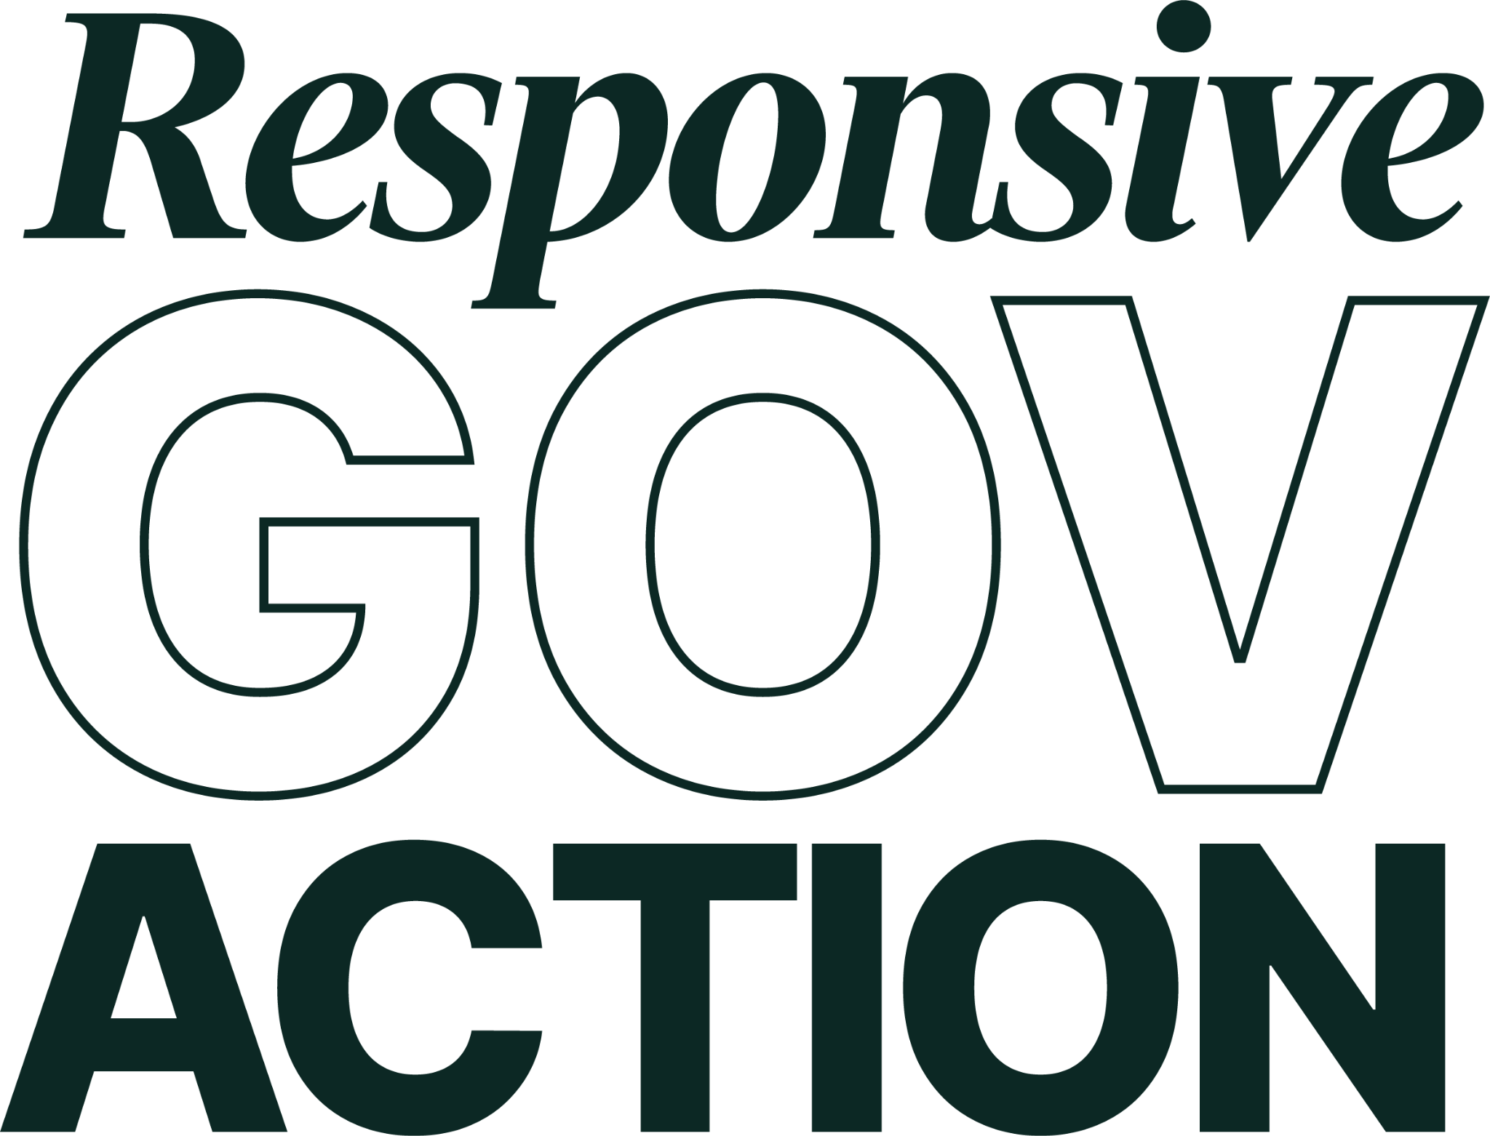
1
RESPONSIVE GOV ACTION: WHO WE ARE
Responsive Gov Action
Virginia’s AVR System | 3

Slide 4
WHO WE ARE
Our mission is to help policy makers find solutions that make government more efficient, accessible, and responsive to the needs of real human beings.
Policy areas:
Making participation possible & powerful
Democracy that delivers
Responsive Gov Action
Virginia’s AVR System | 4

Slide 5
2
REGISTRATION: HISTORY IN VIRGINIA
Responsive Gov Action
Virginia’s AVR System | 5

Slide 6
REGISTRATION: HISTORY IN VIRGINIA
Registration first adopted alongside other franchise-limiting measures in the Jim Crow era (Keyssar 2000)
20th century civil rights movement secures Voting Rights Act of 1965, begins to curtail discriminatory practices in voter registration.
1993 National Voter Registration Act requires voter registration services at Department of Motor Vehicles and other public assistance agencies.
Partial AVR adopted in 2020; builds on NVRA foundation.
Responsive Gov Action
Virginia’s AVR System | 6
Notes:
Anderson-McCormick Act of 1884 first mention of registrars

Slide 7
Registration in Virginia
PARTIAL AVR
Responsive Gov Action
Virginia’s AVR System | 7

Slide 8
PARTIAL AVR
AREAS FOR IMPROVEMENT
Partial AVR (“good, but not great”)
System relies on customer input during the agency transaction
  Agency customers attest to U.S. citizenship
  Agency customers can opt-out during the transaction
Three central Issues
  Registers fewer people than it could
  Updates fewer people than it could
  Creates risks for non-citizens and US citizens if they make a mistake
Responsive Gov Action
Virginia’s AVR System | 8

Slide 9
PARTIAL AVR
Large share of eligible people decline DMV voter registration
  Opt-Out Rates: 55% in CA, 70% in ME, 60% in CO (pre-2020)
~750,000 unregistered eligible Virginians
  Partial AVR is an less efficient way to register these people
  Missing a crucial opportunity to easily register more clearly eligible people who interact with the DMV
The majority of eligible voters decline registration in a partial AVR system.
Responsive Gov Action
Virginia’s AVR System | 9

Slide 10
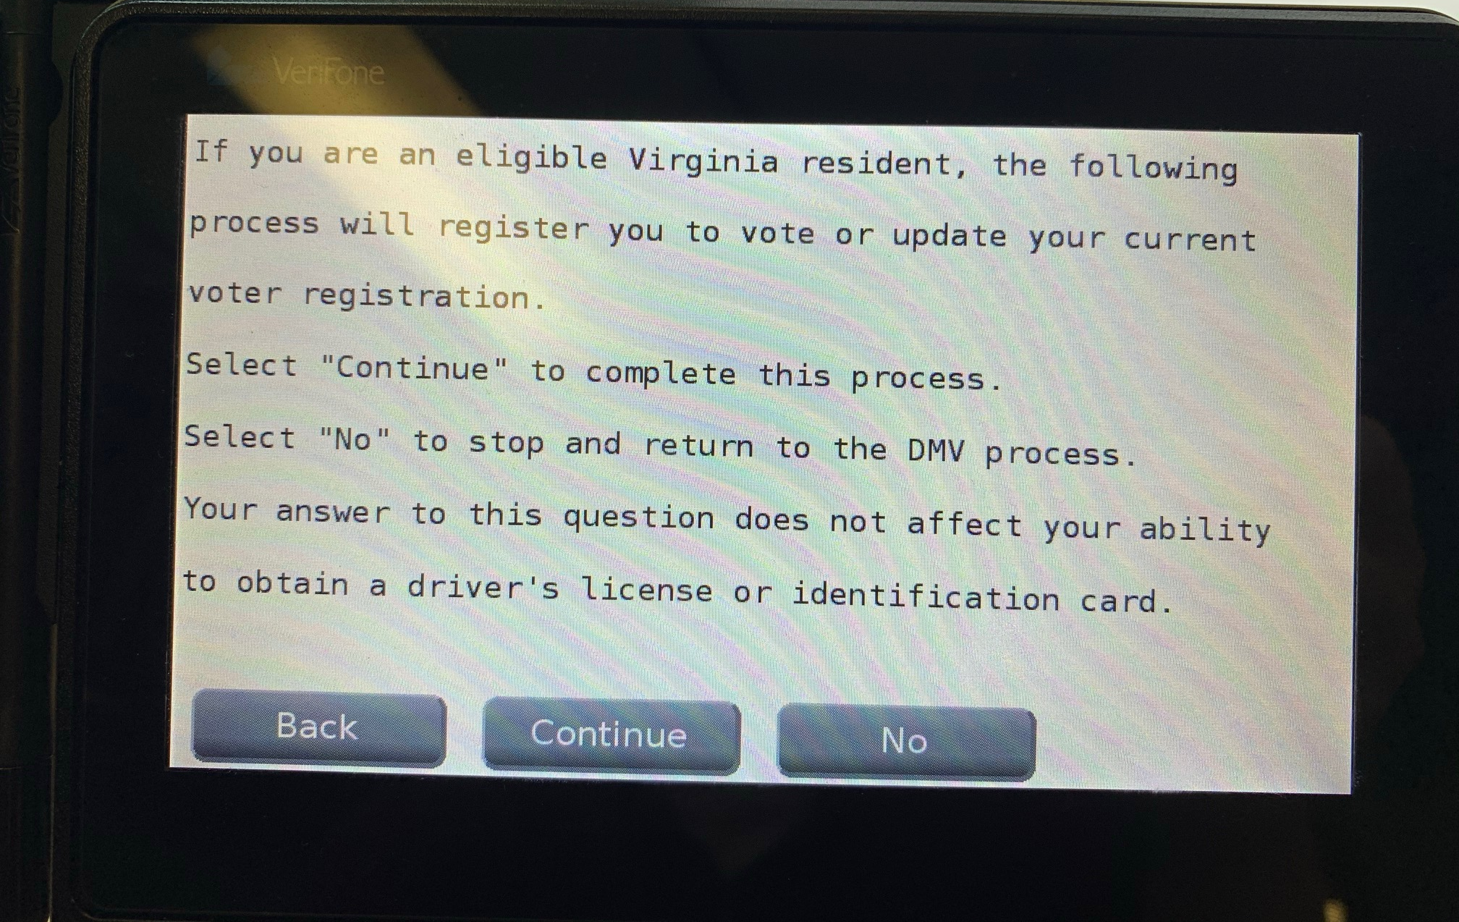
PARTIAL AVR
RELIES ON CUSTOMER
Responsive Gov Action
Virginia’s AVR System | 10

Slide 11
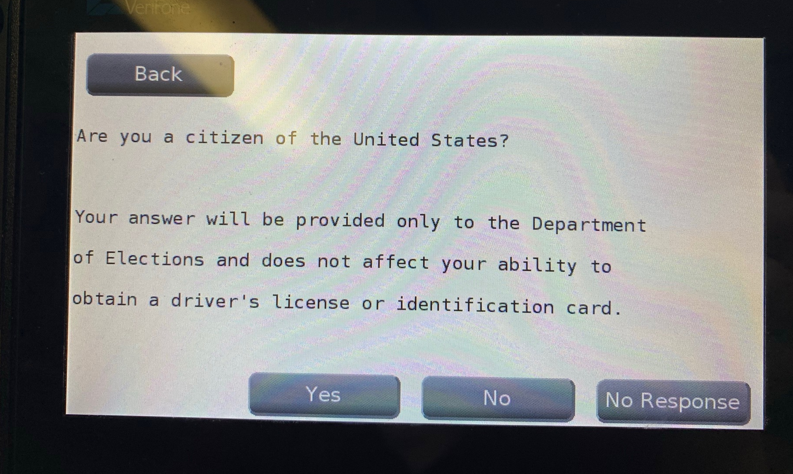
PARTIAL AVR
RELIES ON CUSTOMER CONT.
Responsive Gov Action
Virginia’s AVR System | 11

Slide 12
PARTIAL AVR
Why do > 40% of eligible people decline in the transaction?
01
02
03
04
05
06
Incorrectly believe they are already registered
Path of least resistance (work, childcare responsibilities)
Long, complicated forms
Confusion about eligibility (ex: young voters)
“Why am I being asked about voter registration at the DMV?”
Responsive Gov Action
Virginia’s AVR System | 12

Slide 13
PARTIAL AVR
LOST ADDRESS UPDATES
Millions of registered voters decline the chance to update their voter registration at the DMV each year with Partial AVR
Many of these people actually need an update
  May not realize their registration is out of date
CO: 33% of people who decline an update actually need one
  Hundreds of thousands of missing updates each year
Missed updates hurt voters and add costs for election officials
Responsive Gov Action
Virginia’s AVR System | 13

Slide 14
PARTIAL AVR
RISK TO NON-CITIZENS
Onus is on many non-citizens to affirmatively opt-out
  Non-citizen can falsely indicate citizenship and register due to limited English proficiency, confusion, inattention
Catastrophic immigration consequences: Deportation, denial of a naturalization application, or criminal prosecution
Responsive Gov Action
Virginia’s AVR System | 14

Slide 15

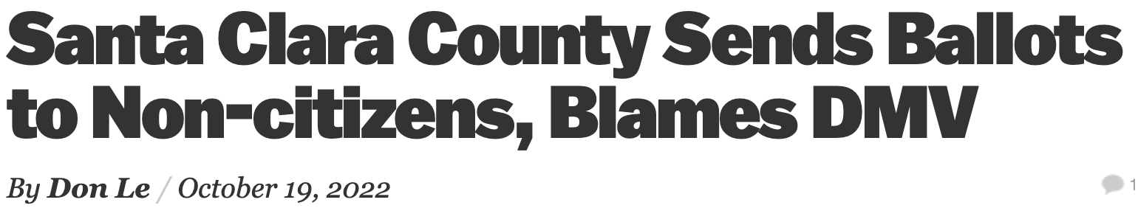

PARTIAL AVR
RISK TO NON-CITIZENS
Responsive Gov Action
Virginia’s AVR System | 15

Slide 16
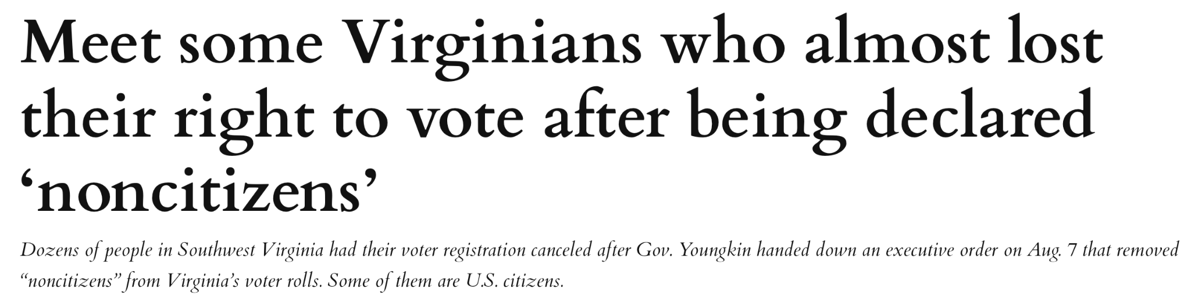
PARTIAL AVR
RISK TO U.S. CITIZENS
Responsive Gov Action
Virginia’s AVR System | 16

Slide 17
3
SECURE AVR
Responsive Gov Action
Virginia’s AVR System | 17

Slide 18
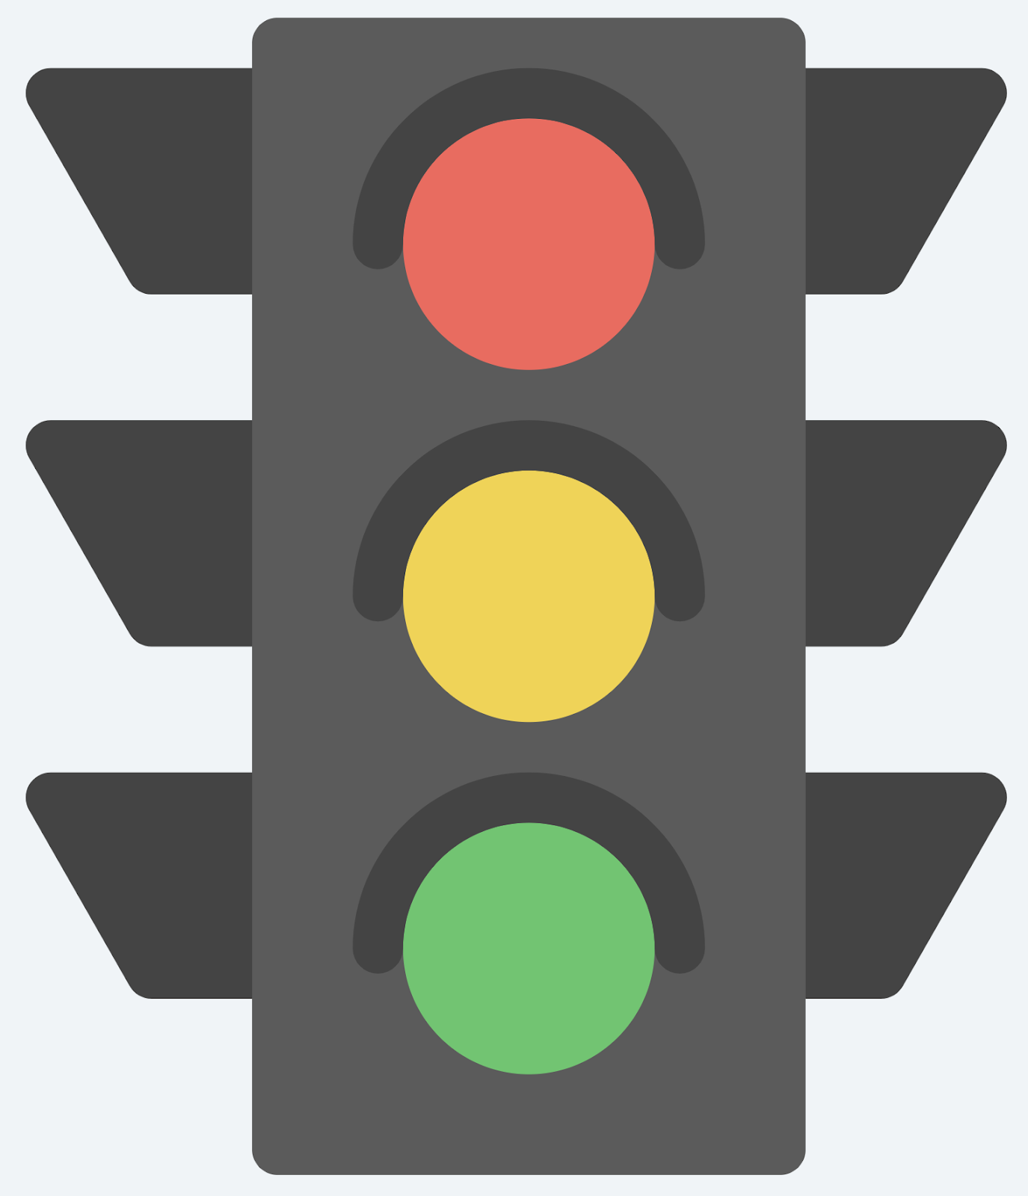
SECURE AVR
Best practices from other states
Three main components
  Register clearly eligible people
  Automatically update registration records based on agency data
  Protect non-citizens from a mistake
Adopted by 10 states and DC
Responsive Gov Action
Virginia’s AVR System | 18

Slide 19
SECURE AVR
STREAMLINING REGISTRATION
Voter registration is the default for clearly eligible people
Clearly eligible people (demonstrated U.S. citizens) applying for a license automatically filtered into voter registration
  Relies on existing verification processes at DMV
  Data on eligible people automatically sent to SOS and counties to be used for voter registration purposes
  Counties send mailer that can be used to decline registration
Responsive Gov Action
Virginia’s AVR System | 19

Slide 20
SECURE AVR
STREAMLINING REGISTRATION CONT.
Dramatically increases registration rates
  CO: 0.6% decline; DE: 1.4% decline, OR: 2.5% decline
Stanford Study: Doubled registration rates at the Colorado DMV
Particularly large impact for 16- and 17-year-olds
McGhee, Romero, Hill: 8.1% increase in registration rates with Secure AVR, compared to 2.9% increase from Partial AVR
Delaware: Registrations up 26.1% (report on our website)
Responsive Gov Action
Virginia’s AVR System | 20

Slide 21
SECURE AVR
STREAMLINING UPDATES
Name and address from license/ID transactions is automatically shared with State Board and counties
  Election officials use info to update registration records for anyone who is already registered to vote in Virginia
  Voter is mailed a notice of the change, with information on how to correct if needed
Colorado saw 200,000 additional updates each year
Keeps the voter rolls current to protect voters, save money
Responsive Gov Action
Virginia’s AVR System | 21

Slide 22
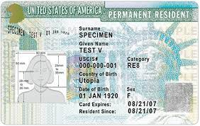
SECURE AVR
NON-CITIZEN PROTECTIONS
Clear non-citizens (e.g. green card holders) automatically filtered out of voter registration
  Uses information already provided to protect non-citizens from error
People with ambiguous citizenship get a yes/no voter registration question at DMV
  Required to comply with federal law
  Minimizing the risk of a mistake
Responsive Gov Action
Virginia’s AVR System | 22

Slide 23
SECURE AVR
PROTECTING NON-CITIZENS CONT.
Uses existing agency verification procedures for citizenship
  People are automatically filtered in (and out) of registration
  Removes risk of error by the non-citizen customer
Even if an error occurs, non-citizen is still protected
  No false claim of citizenship (protected under USCIS policy)
  State bears the risk of the error (federal case law)
Responsive Gov Action
Virginia’s AVR System | 23

Slide 24
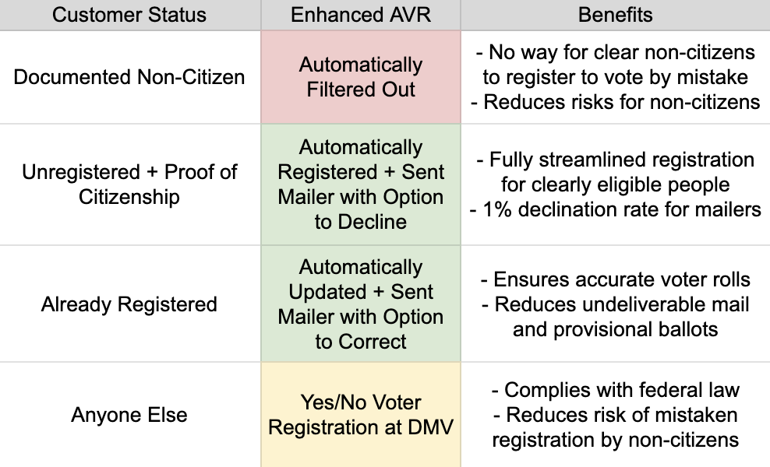
SECURE AVR
MAKING AVR EVEN STRONGER
Responsive Gov Action
Virginia’s AVR System | 24

Slide 25
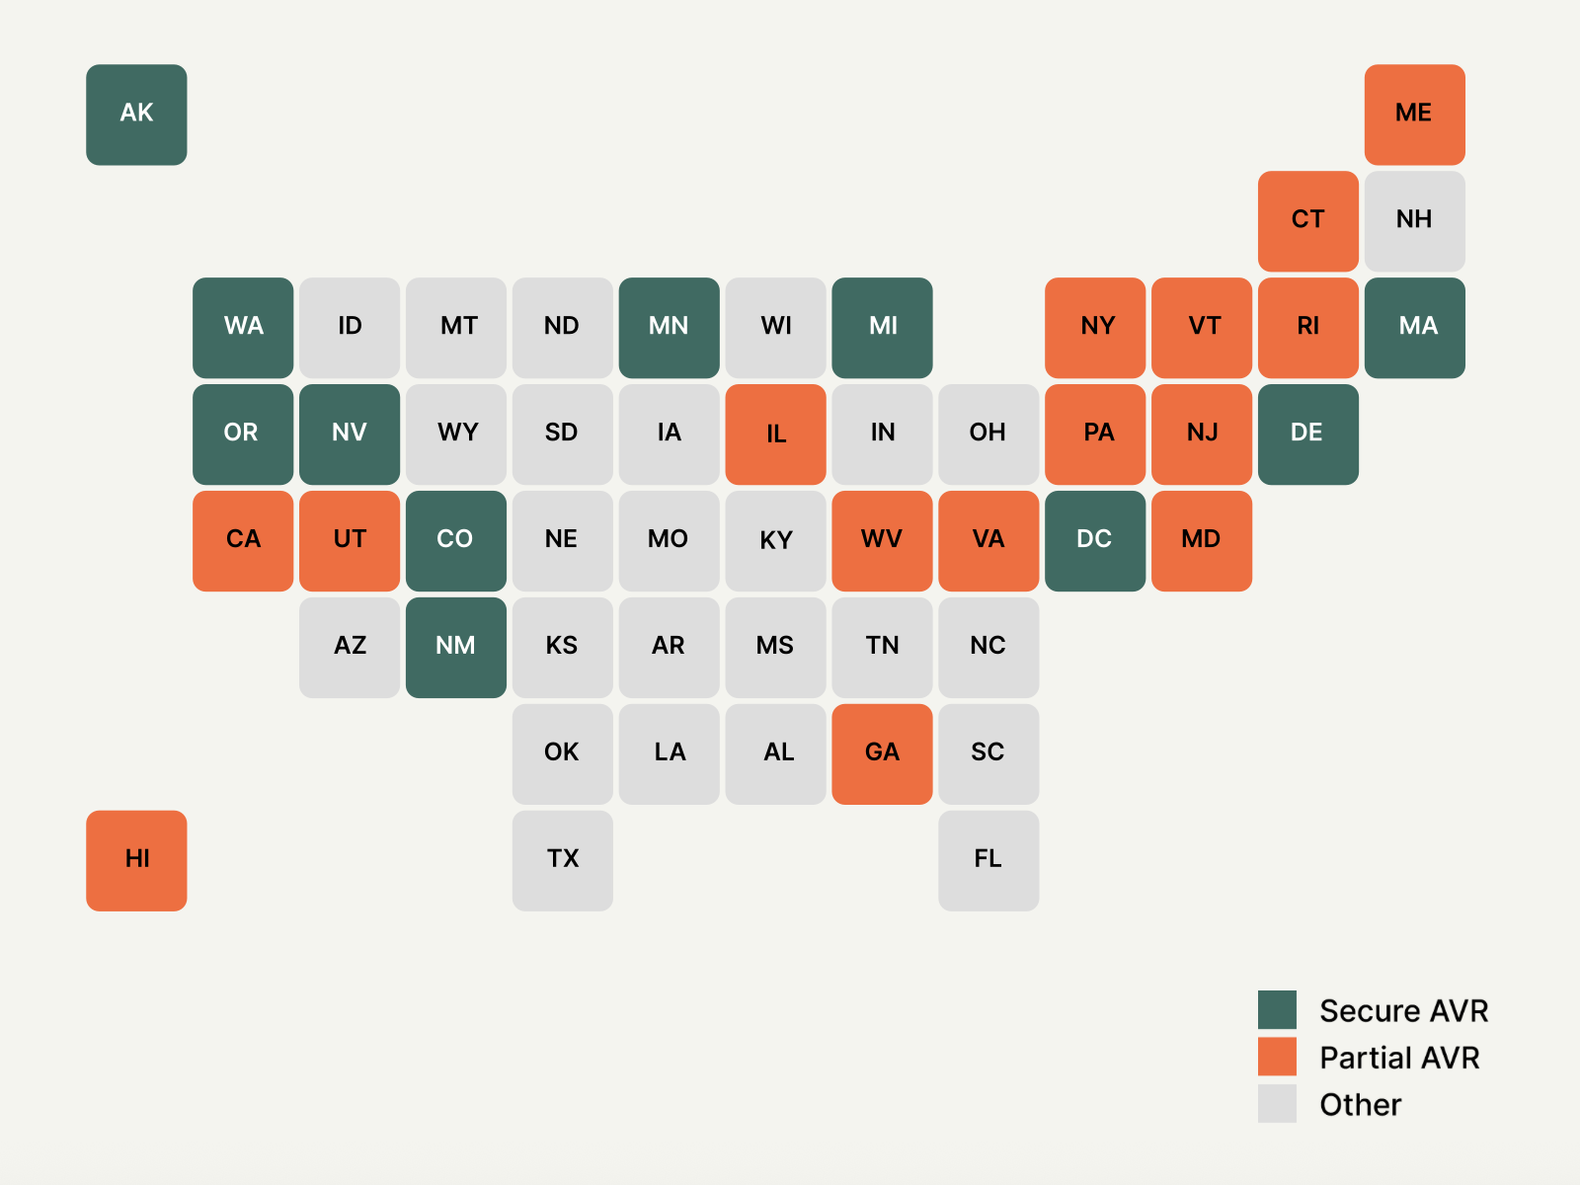
SECURE AVR
A GROWING TREND
Responsive Gov Action
Virginia’s AVR System | 25

Slide 26
SECURE AVR
WILL PEOPLE ACTUALLY VOTE
Triple the turnout effect of Partial AVR (McGhee, Romero, Hill)
  3.3% boost in turnout, compared to 1.1% for Partial AVR
  44% among Secure AVR registrants in Oregon
When people are registered, it’s much easier to get them to vote
  Campaigns, organizers, election official outreach matters
Not being registered is most common reason for not voting
  Helping people past this burden makes participation easier
Responsive Gov Action
Virginia’s AVR System | 26

Slide 27
SECURE AVR
STREAMLINING REGISTRATION
Not forcing anyone to be registered to vote or vote
  People can still decline if they wish
  Just prioritizes registration for clearly eligible people, allowing them to participate if they wish
Have not seen complaints in other states from people who don’t want to be registered – they can just decline if they are unhappy
  Oregon hotline shut down when no one complained
People with a confidential address are automatically filtered out
Responsive Gov Action
Virginia’s AVR System | 27

Slide 28
SECURE AVR
CLOSING REGISTRATION GAPS
Voter registration created partially as an intentional barrier
  Secure AVR: State has burden of registering eligible people
  More consistent with other countries (Germany, Australia)
Responsive Gov Action
Virginia’s AVR System | 28

Slide 29
Thank YOU
Questions? jess@responsivegovaction.org
Responsive Gov Action
Virginia’s AVR System | 29

