Slide 1

Rural Health Transformation in Virginia
House Select Committee on Advancing Rural and Small Town Health Care
June 17, 2026
This presentation is supported by the Centers for Medicare & Medicaid Services (CMS) of the U.S. Department of Health and Human Services (HHS) as part of a financial assistance award totaling $189M with 100 percent funded by CMS/HHS. The contents are those of the author(s) and do not necessarily represent the official views of, nor an endorsement, by CMS/HHS, or the U.S. Government.​
@reallygreatsite
+123-456-7890

Slide 2
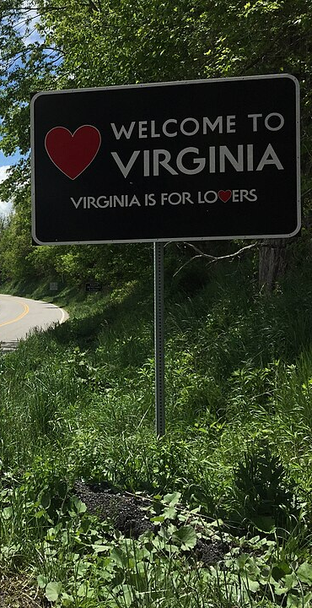
Overview
Rural Health Transformation Background
Virginia’s Journey to Rural Health Transformation
Next Steps
Questions
“Welcome to Virginia" sign along the southbound Potomac River Road (U.S. Route 220) entering Highland County, Virginia from Pendleton County, West Virginia. Credit: Famartin.

Slide 3

Program Background
Wachapreague, Virginia. Credit Idawriter.

Slide 4
Impact of H.R. 1
Enacted on July 4, 2025, the “One Big Beautiful Bill Act” (H.R. 1) made sweeping changes to the Health and Social Services Systems.
Impact
Virginia Footprint
Nearly 2 million Virginians are enrolled in Medicaid (~550,000 Expansion adults)
More than 850,000 Virginians receive SNAP benefits
Reduces size of Medicaid and SNAP and shifts administrative funding to include a larger state share
~$1 Trillion in federal fund reductions to Medicaid over 10 years
CBO estimates 11.8 million fewer individuals insured through Medicaid, Medicare and state-based exchange
Expands eligible uses for Health Savings Accounts
Modifies health workforce loan options and tax deductions for overtime

Slide 5
RHTP Background
Overview
National Distribution of Baseline Funding and Workload Funding
The Rural Health Transformation Program was established through federal legislation (H.R. 1).
The program is backed by $50 billion in total federal funding over a five‑year period, making it one of the largest federal investments ever dedicated specifically to rural health systems.
All 50 states are participating in the Rural Health Transformation Program.
Virginia was awarded $189.5 million for Year 1. These funds are administered by the Virginia Department of Medical Assistance Services (DMAS).
$50 billion awarded from FY 2026 to FY 2030, with $10 billion awarded each budget period (plus any redistributed funds)
For each budget period, available funding is split equally between baseline and workload funding
2026
2027
2028
$10 billion
$10 billion
$10 billion (redistributed)
2029
2030
$10 billion (redistributed)
$10 billion (redistributed)
Baseline funding distributed equally among all approved States.

Slide 6
RHTP Application Process
Following the CMS Notice of Funding Opportunity for the RHTP, Virginia developed and submitted a comprehensive plan that included a description of the state's rural health needs and target populations; goals, proposed initiatives, and sustainability plans; an implementation plan, timeline, and budget narrative; a metrics and evaluation plan; and evidence of stakeholder engagement.
CMS released the Notice of Funding Opportunity (NOFO) and application instructions via Grants.gov. Only the 50 state governments were eligible to apply.
September 15, 2025
September – October 2025
Virginia informed its application development through twelve stakeholder listening sessions and a publicly advertised inbox.
November 5, 2025
Deadline for all 50 states to submit their applications to CMS.
December 29, 2025
CMS issued determinations, officially approving all state applications.
February 10, 2026
Start of the program’s period of performance.
March – April 2026
RHTP staff onboarded.

Slide 7
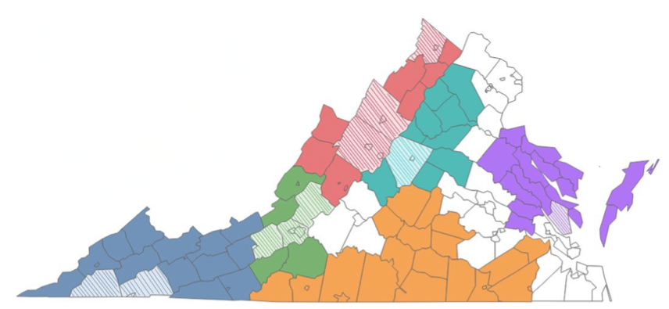
Virginia’s Rural Regions
The Commonwealth uses the Federal Office of Rural Health Policy’s (FORHP) definition of rural regions. Eligible subrecipients are those that are in rural regions as defined by FORHP or those that can demonstrate that their project will target residents of rural counties.
FORHP’s Definition of Rural Regions
All non-metro counties, All outlying metro counties without an Urbanized Area, All metro census tracts with Rural Urban Commuting Area (RUCA) codes 4-10, and Metro census tracts of at least 400 square miles in area with population density of 35 or less per square mile with RUCA codes 2-3.
Shenandoah Valley
Northern Piedmont
Roanoke/Alleghany
Eastern Shore & Northern Neck
Southwest Virginia
Map of Virginia’s Rural Regions
Southside Virginia
Striped colors denote non-rural counties of rural regions.

Slide 8
Virginia’s RHTP Funding
Virginia was awarded $189.5M for Budget Period 1. Funding for budget periods 2 through 5 will be awarded annually, subject to annual review.
9/30/2026
9/30/2027
9/30/2028
9/30/2029
9/30/2030
9/30/2031
9/30/2032
Spending for Budget Period 1
Anticipated Spending Period for Redistributed Funds
Dec. 31, 2025
Spending for Budget Period 2
Oct. 31, 2026
Spending for Budget Period 3
BP 1 funds
Oct. 31, 2027
Spending for Budget Period 4
Funding Requirements
There are five budget periods. Recipients will have until the end of the following fiscal year (September 30) to spend awarded funding. Funds that a State does not spend by the end of the following fiscal year, or that are not allocated by CMS will be redistributed in the upcoming fiscal year.
BP 2 funds
Oct. 31, 2028
Spending for Budget Period 5
BP 3 funds
Oct. 31, 2029
BP 4 funds
Oct. 31, 2030
BP 5 funds
Oct. 31, 2031

Slide 9

Virginia’s Journey to Rural Health Transformation
Blue Ridge Mountains at Montebello, Virginia. Credit Olwhitey.
Notes:
Nelson County

Slide 10
Virginia RHTP Overview
The Rural Health Transformation Program (RHTP) aims to improve access to care and reduce health care disparities in rural Virginia through the program's four initiatives.
Virginia RHTP’s Four Initiatives
CareIQ
Connected to Care, Closer to Home
  Modernizes healthcare via technology and data-driven healthcare.
  Brings healthcare options, including specialists, closer to Virginians' homes.​
Homegrown Health Heroes
Live Well, Together
  Expands the rural healthcare workforce and creates pathways for rural residents into healthcare careers.​
  ​Ensures prevention and chronic disease management stay at the forefront of Virginians’ care plans.

Slide 11





Virginia’s Four Initiatives
Virginia’s RHTP includes four core initiatives, with stakeholder input playing a key role in shaping their design and focus.
Phase 1: Implementers Selected
CareIQ
Homegrown
Health Heroes
Will deploy cutting edge technology and increase provider efficiency, reduce hospital admissions and readmissions, and improve chronic disease prevention and management.
Will increase the workforce in rural Virginia for both clinicians and Allied Health Professionals, with a focus on developing local talent.
Purpose
Tech Innovation Fund
Provider Productivity
Provider Interoperability
Remote Patient Monitoring
Attract and Retain Physicians
Allied Health Degrees
Earn to Learn Programs
Build Career Pipelines
Sub-
Initiatives
Implementers

Slide 12
Virginia’s Four Initiatives
Virginia’s RHTP includes four core initiatives, with stakeholder input playing a key role in shaping their design and focus.
Phase 2: Implementer Selections Underway
Connected Care,
Closer to Home
Live Well,
Together
Will bring flexible and sustainable care to communities, driving care accessibility and reducing avoidable Emergency Department (ED) admissions.
Will expand prevention efforts, decrease rates of key chronic disease indicators, increase fresh food consumption and reduce avoidable hospitalizations by empowering Virginians to live healthier lifestyles.
Purpose
Mobile and Hybrid Care
Community Paramedicine
Innovative Maternal Care
Food is Medicine
Active Kids
Consumer Tech
Integrated Care for Duals
Sub-
Initiatives
Rural Healthcare Providers
Hospitals and Federally Qualified Health Centers
Rural Health Clinics, free clinics, and independent rural providers
Implementers
Faith-Based and Community-Based Organizations
Education Institutions

Slide 13




Program Structure
Federal Awarding Agency
Centers for Medicare & Medicaid Services (CMS)
Implementation Management Contractor
Oversight Entity
Virginia Health and Human Resources (HHR)
Program Evaluation
Grant Recipient
Virginia Department of Medical Assistance Services (DMAS)
Initiatives
CareIQ
Homegrown Health Heroes
Connected Care,
Closer to Home
Live Well, Together
Phase 1 Key Implementation Partners
Subrecipients and Contractors
Phase 2 Key Implementation Partners
Hospitals and Federally Qualified Health Centers
Rural Health Clinics, free clinics, and independent rural providers
Faith-Based and Community-Based Organizations
Education Institutions
Downstream Subrecipients

Slide 14
Program Year 1: Timeline
Budget Year 1 for RHTP runs through October 30, 2026. The milestones below reflect estimates for agreements, subawards, and payments.
DMAS and Key Implementation Partners (KIPs) Execute Agreements to Obligate Funds
KIPs Release RFAs for Funding Opportunities
KIPs Make Awards and Fund Distribution Begins
Late June 2026
Late July / August 2026
Early Fall 2026
  Targeting execution of agreements for approximately 12 to 15 KIPs in June
  Executed agreements allow Virginia to obligate funds in advance of 10/30/2026 federal deadline
  KIPs may begin invoicing for eligible RHTP work once agreements are executed
  Outcome: Funds obligated for executed agreements
  KIPs begin releasing RFAs for downstream subgrantee opportunities
  Eligible applicants apply through initiative-specific processes
  Application review and award planning begin
  Outcome: Funding opportunities open to eligible applicants
  Subgrantee selections are finalized, as applicable
  Award documentation is completed
  Funds begin flowing to subgrantees in Virginia’s rural communities through approved award and payment processes
  Outcome: Funds begin reaching communities and providers

Slide 15
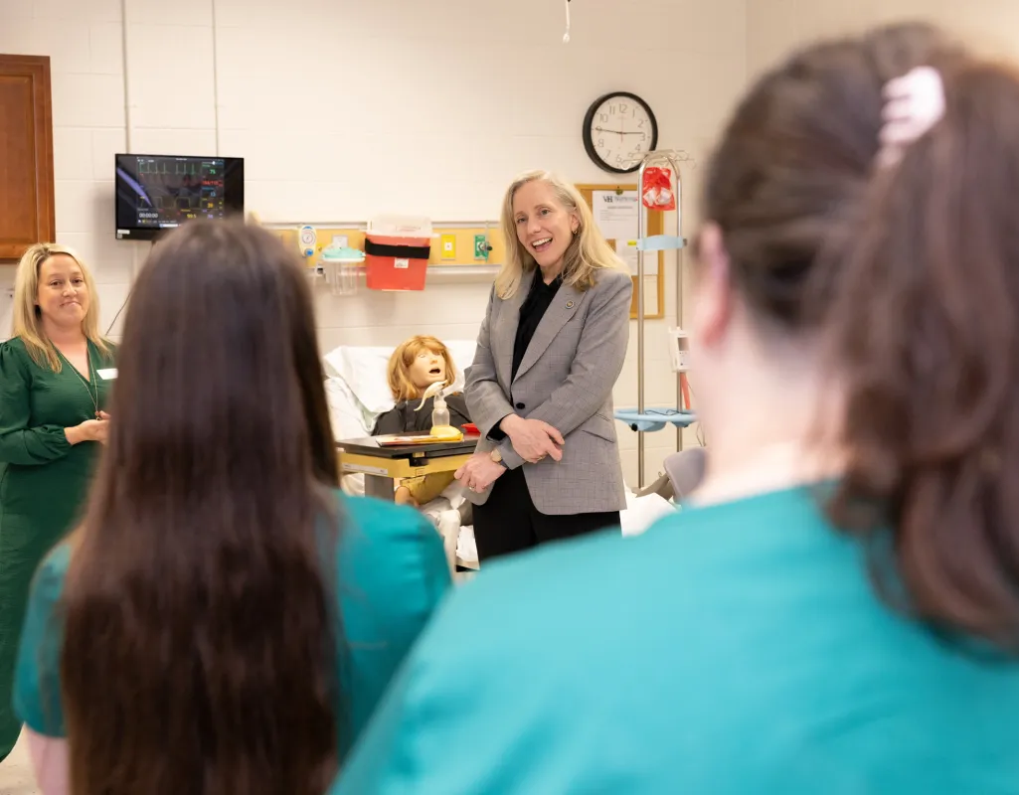
Recent Successes
Expanding the rural healthcare workforce:
Virginia Highlands Community College will be awarded $127,500 through the Rural Health Transformation grant to expand healthcare workforce training opportunities.
Listening to local healthcare leaders:
At Virginia Highlands Community College, Governor Spanberger convened a roundtable with regional healthcare providers to hear firsthand about challenges facing rural communities.
Increasing access to care:
The Governor also marked the opening of a new facility at the Appalachian Highlands Community Dental Center.

Slide 16
Current Focus Areas
Virginia’s RHTP is advancing rapidly despite being launched with limited initial infrastructure, reflecting significant program implementation progress. Currently, the program is advancing with three core priorities: aligning with federal requirements, strengthening communication channels, and developing contractual agreements.
Aligning with Federal Requirements
Building Communication Channels
Developing Subrecipient Agreements
Strengthening compliance with CMS funding, reporting, and performance requirements to position VA for future funding years.
Standardizing guidance on metrics, reporting, and allowable use of funds to support effective implementation and efficiently distribute funds into rural communities.
Communicating RFA opportunities and providing clear navigation across RHT's key initiatives so stakeholders are informed about ongoing activities and available funding opportunities.
Expanding public access to program information through the RHTP website and newsletter to maintain transparency.
Supporting ongoing engagement through webinars, regional listening sessions, and stakeholder forums to continue ongoing dialogue with implementers and the public.
Advancing agreements with implementation partners to support program launch and funding distribution.
Equipping implementation partners with the tools to develop Requests for Applications (RFAs).

Slide 17
Alignment with House Select Committee on Advancing Rural and Small Town Health Care
In January 2024, the Select Committee on Advancing Rural and Small Town Health Care was established to study and develop recommendations to strengthen access to care in rural communities across Virginia. In April 2026, the Select Committee was re-established for an additional two years to continue evaluating rural health care challenges and develop recommendations for consideration by the 2028 General Assembly Session.
Committee Membership
Rodney Willett (Chair)
Israel O’Quinn (Vice-Chair)
Nadarius Clark
Josh Cole
Amy Laufer
Rozia Henson
Garrett McGuire
Lily Franklin
Ellen McLaughlin
Chris Runion
Otto Wachsmann
Wendell Walker
Select Committee Focus Areas
Federal Health Care Policy Changes
Hospital and Clinic Closures
Workforce Shortages
Patient Displacement
The committee’s continued focus on addressing these challenges closely aligns with the RHTP’s investments to strengthen access and health outcomes in rural communities.

Slide 18
Key Implementation Risks and Decisions Needed
Successful implementation will require timely coordination, stakeholder engagement, and continued alignment with federal requirements.
Key Implementation Risks
Decisions/Support Needed
CMS deadlines are tight which requires very rapid finalization of grant agreements, RFA release, and funding distribution. |  | Support timely coordination across agencies and implementation partners to accelerate contracting and award processes.
Strict and evolving federal requirements present compliance and reporting challenges. |  | Maintain alignment with CMS guidance and support investments in program oversight, monitoring, and reporting infrastructure.
Rural provider capacity constraints may affect participation, staffing, and readiness to implement initiatives in underserved regions. |  | Continue engagement with rural providers, workforce organizations, and community partners to expand participation opportunities.
Awareness of funding opportunities may vary across regions and organizations, particularly among smaller rural entities. |  | Support statewide communication and outreach efforts to increase visibility of RFAs and stakeholder engagement activities.
Long-term sustainability will depend on demonstrating measurable outcomes and scalable implementation models across budget periods. |  | Prioritize data collection, evaluation, and sustainability planning to inform future funding decisions and long-term rural health investments.

Slide 19
How Success Will Be Measured: Virginia’s RHT Program
Virginia will measure program success across 7 key performance objectives, tracking improvements through defined metrics aligned to each initiative.
Initiative(s)
Key Performance Objective
Example Metric
Decrease rates of chronic disease in rural adults and children
Decline in HbA1c level (for participants with diabetes) or decline in blood pressure (for participants with hypertension) after food as medicine sub-initiative program participation
Increase access to primary care for rural residents
Rate of annual wellness visits in rural regions
Decrease rates of substance use disorders
Rate of avoidable ED visits by residents in rural localities targeted by the sub-initiative
Increase number of prenatal and postpartum visits conducted for rural mothers
Timeliness of prenatal care and completion of postpartum care in rural counties targeted by the sub-initiative
Improve maternal and infant health outcomes
Rate of postpartum hospital readmissions in rural localities targeted by the sub-initiative
Build a lasting pipeline of rural residents into healthcare careers
Physician to population ratio in rural localities in fields targeted by sub-initiative
Modernize provider operations and increase adoption of technology in rural communities
Number of rural providers making new or expanded use of provider productivity tools by provider type
KEY
CareIQ
Homegrown Health Heroes
Connected Care, Closer to Home
Live Well Together

Slide 20
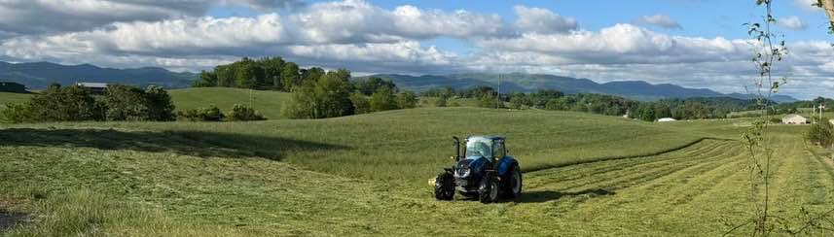
What’s Next

Slide 21
Championing Progress Through Continued Engagement
Upcoming opportunities to stay informed and support outreach in rural communities.
Upcoming Activity
Regional Engagement Meetings
RFA Awareness
Funding Award Updates
District Newsletter Content
Two meetings are being planned in each of Virginia’s six rural regions by the end of October
Meetings will provide opportunities for regional updates, questions, and stakeholder input
Upcoming RFAs will provide funding opportunities for eligible downstream applicants
Legislative offices can help amplify and advertise RFA announcements
DMAS will share updates as funding awards are made
Award information will support transparency as implementation progresses
DMAS will provide content for district newsletters and constituent communications
Materials may include meeting details, RFA announcements, award updates, program links, and success stories
What to
Expect
Legislative offices can help share meeting information with local partners
Advertising RFAs will help connect rural stakeholders in your district to available opportunities
Updates can help legislative offices communicate local and regional impacts
Newsletter content will help constituents stay informed about opportunities to be engaged and program impact
How Your Office
Can Help
Your legislative office can also reach out directly to Heidi Hertz at heidi.hertz@governor.virginia.gov for more information.

Slide 22

Questions?

Slide 23

Thank You!
Contact
www.ruralhealthtransformationva.virginia.gov
heidi.hertz@governor.virginia.gov
Scan to access Virginia RHTP
Website, Newsletter, and Contact Form
RuralTransformation@governor.virginia.gov

