Slide 1
Maternal Mortality Review Team Overview
Melanie J. Rouse, PHD, MSHP
Maternal Mortality Programs Manager
Division of Death Prevention
Office of the Chief Medical Examiner

Slide 2
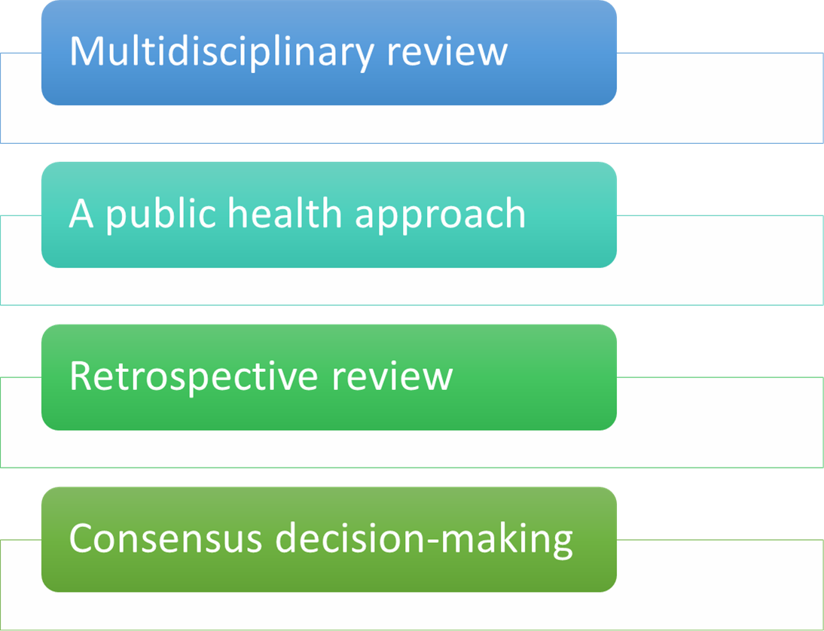
Values Governing the MMRT

Slide 3
Maternal Mortality Review Team (MMRT)
Co-Chairs:
William Gormley, MD, PhD, Co-Chair, VDH, Office of the Chief Medical Examiner
Vanessa Walker-Harris, MD, Co-Chair, VDH, Office of Family Health Services

Slide 4
Maternal Mortality Review Team (MMRT)
•Team members are currently appointed through the Governor’s Office.
•Additional Team members are added, as needed, by the Team co-chairs.
Organizations | Core Disciplines | Specialty Disciplines
Academic Institutions | Forensic Pathology** | Critical Care Medicine**
Behavioral Health Agencies** | Maternal Fetal Medicine/ Perinatology** | Nutrition**
Community Service Boards** | Midwifery** | Emergency Response**
Healthy Start Agencies | Obstetrics and Gynecology** | Epidemiology
Hospital Associations** | Patient Safety | Fire**
Prof. Assoc. State Chapters** | Perinatal Nursing** | Home Nursing**
State Medical Society** | Psychiatry | Law Enforcement**
State Medicaid Agency** | Public Health | Mental Health Provider
State Title V Program | Social Work** | Pharmacy
Violence Prevention Agencies |  | Public Health Nursing**
Other State and Local Agencies** |  | Quality/Risk Management
**Team member is appointed through the Governor’s Office.

Slide 5
Virginia MMRT Scope and Mission
Scope:
Collects and reviews retrospective data on all pregnancy-associated deaths in the state of Virginia.
    Pregnancy-Associated Death: The death of a woman within 365 days of the end of a pregnancy, regardless of the cause of death or the outcome of the pregnancy.
Mission:
To identify all pregnancy-associated deaths in the Commonwealth, review those caused by pregnancy complications and other associated causes and identify the factors contributing to these deaths and recommend public health and clinical interventions that may reduce these deaths and improve systems of care.

Slide 6
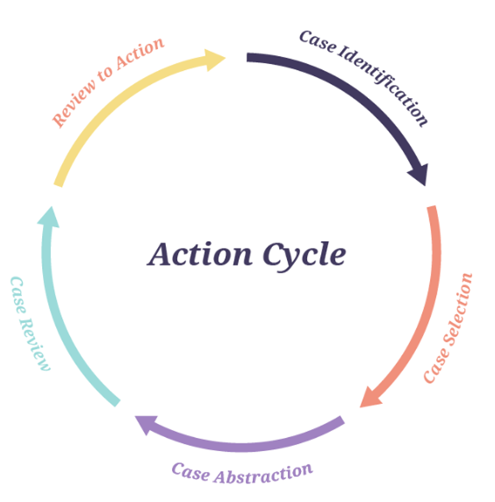
Maternal Mortality Review

Slide 7
Case Identification
Vital Record Linkage (maternal death and birth or fetal death)
  Death certificates linked with birth and fetal death certificates for year prior to death
  Death records should be selected for linkage if they are for:
    Women ages 10 – 60 years and residents of the state, regardless of where the death occurred
  Death certificates that did not link, but have pregnancy checkbox marked, or contain ICD-10 O codes or select key words (e.g., amniotic, eclampsia)
Additional sources:
  Cases listed in the Virginia Violent Death Reporting System who were known to be pregnant within a year of death.
  Media reports
  Social media
  Obituaries

Slide 8
Case Verification
Using information obtained from the death certificates, birth certificates, fetal death certificates, and the VVDRS, the Maternal Mortality Program Staff identify, request and abstract records from:
  The hospital where the birth or pregnancy occurred & birth attendants’ records
  Hospital records where the death occurred
  Autopsy records
  Medical Examiner case investigation records.
These records are used to confirm that the decedent was pregnant within 365 days of death.

Slide 9
Additional Sources of Data for Abstraction
  Vital statistics (death certificates, birth certificates, fetal death records)
  Prenatal records
  Hospital records (outpatient and inpatient stays)
  Other provider/specialist records: these records may be from preconception/family planning clinics, or primary care providers, etc.
  Autopsy reports and case findings from hospital, coroner, or other medical examiner
  Police/investigative reports
  Social services records
  Mental health records
  Substance abuse treatment records
  Medical transport records
  Court records
  News articles, where relevant

Slide 10
Guiding Questions for MMRT Case Review
Was the death pregnancy-related?
What was the underlying cause of death?
Was the death preventable?
What are the contributing factors to the death?
What specific and feasible actions might have changed the course of events?

Slide 11
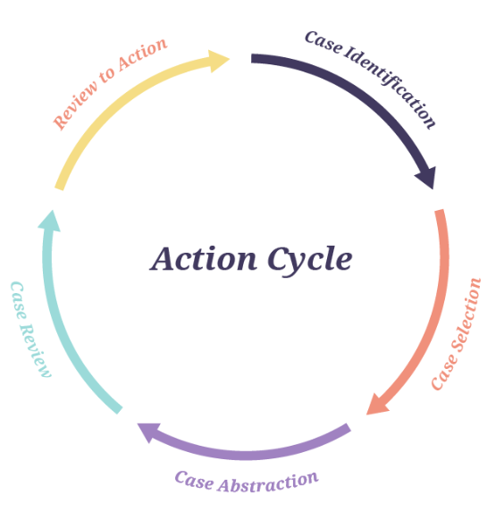
MMRT Recommendation Development
At the conclusion of each review cycle, the team develops and disseminates formal recommendations for the prevention of future deaths.
The last completed review cycle of pregnancy-associated death cases that the MMRT has reviewed is 2021.
The MMRT is currently completing the review of 2022 pregnancy-associated death case with plans to begin the review of 2023 cases in the fall of 2026.

Slide 12
Select MMRT Data

Slide 13
MMRT Findings Related to Intimate Partner Violence (IPV) 2018-2023
18.2% of cases had a history of known IPV
Over 58% of cases had no known history of IPV.
History of IPV was unknown for 19.3% of cases.
Prior to the 2022 cohort, IPV was found to be a significant contributor to Violent (non-natural) pregnancy associated deaths.
  We do not see this trend in more recent years though more years of data is necessary to identify any specific trends as the numbers for PADs are relatively low.

Slide 14
Links to Pregnancy-Loss and Fetal/Infant Mortality 2018-2023
We do not have data that directly relates to fetal/infant mortality in the state. However, we do track the outcome of the index pregnancy.
  56.2% of cases resulted in a live birth.
  27.8% of cases were pregnant at the time of death.
  10.7% of cases resulted in a fetal death.
  3.7% of cases had a termination (either elective or spontaneous abortion) during the index pregnancy.

Slide 15
Data Limitations
Timing of case review – due to the nature of fatality review all reviews are retrospective.
  It may take 12-18 months to identify cases, verify eligibility, and begin collecting records and abstracting data to prepare the cases for review by the MMRT.
For cohort years with higher numbers of cases, not all cases can be reviewed in depth within a reasonable amount of time. As such, the Team has developed a system that allows for the full in-depth review of pregnancy-related and potentially pregnancy-related deaths. A sample of all other pregnancy-associated deaths then undergo an abbreviated review by the team.

Slide 16
Data Limitations (con’t)
Due to changes within the federal landscape, there has been increasing difficulty in obtaining medical records. We continue to work internally and with hospital/provider systems to provide clarity on the Code governing the MMRT and our authorization to request records.
  Ex. The Model Attestation form for obtaining records for pregnant and post-partum women

Slide 17
Relevant Reports and Recommendations
The team releases an Annual Report highlighting the Pregnancy-Associated Death Data and the MMRT review findings. The reports are available on the OCME website and the LIS website. https://www.vdh.virginia.gov/medical-examiner/virginia-maternal-mortality-review-team-reports/
  These reports also include recommendations based on the cohort year reviewed.
The team also releases topic-specific reports, such as a report on chronic conditions and pregnancy-associated deaths. These reports are also available on the website and include recommendations specific to that topic.
The VNPC has published a dashboard that highlights all of the individual recommendations that have been made throughout the years of MMRT case review. https://govnpc.org/portfolio-items/mmrt-dashboard/

Slide 18
Recommendation Examples From 2025 MMRT Annual Report
We recommend that the Virginia General Assembly require all hospitals to participate in the Virginia Neonatal Perinatal Collaborative’s survey of Levels of Maternal Care using the Center for Disease Control’s (CDC) Levels of Care Assessment Tool (LOCATe) and that the information be publicly available.
We recommend that the Virginia General Assembly require anyone who dispenses medication for an Opioid Treatment Program be required to report to the Virginia Maternal Mortality Review Team, 2025 26 Prescription Monitoring Program. There should also be a system in place through the Prescription Monitoring Program that will allow providers to see and follow up on prescriptions that are not being filled as prescribed. This is particularly important for medications used in medication-assisted addiction treatment.

Slide 19
Recommendation Examples From 2025 MMRT Annual Report (con’t)
There is a need for mental health and substance misuse treatment systems that encourage seeking residential and outpatient treatment and include the entire family (including partners and spouses). The MMRT recommends that the General Assembly fund the development of at least one evidence-based residential program for families including partners and children within every health district in the state. These programs should be developed in partnership with relevant community stakeholders, including, but not limited to, the Department of Behavioral Health and Developmental Services (DBHDS), Community Service Boards (CSBs), community-based organizations (CBOs), and other relevant local or regional organizations.

Slide 20
Questions?
Melanie.rouse@vdh.virginia.gov

