Slide 1
Cannabis Control Authority Update
08/17/2026

Slide 2
Background

Slide 3
History of the CCA
2021
2022
2024
Established by General Assembly
First staff hired
Began regulating medical cannabis

Slide 4
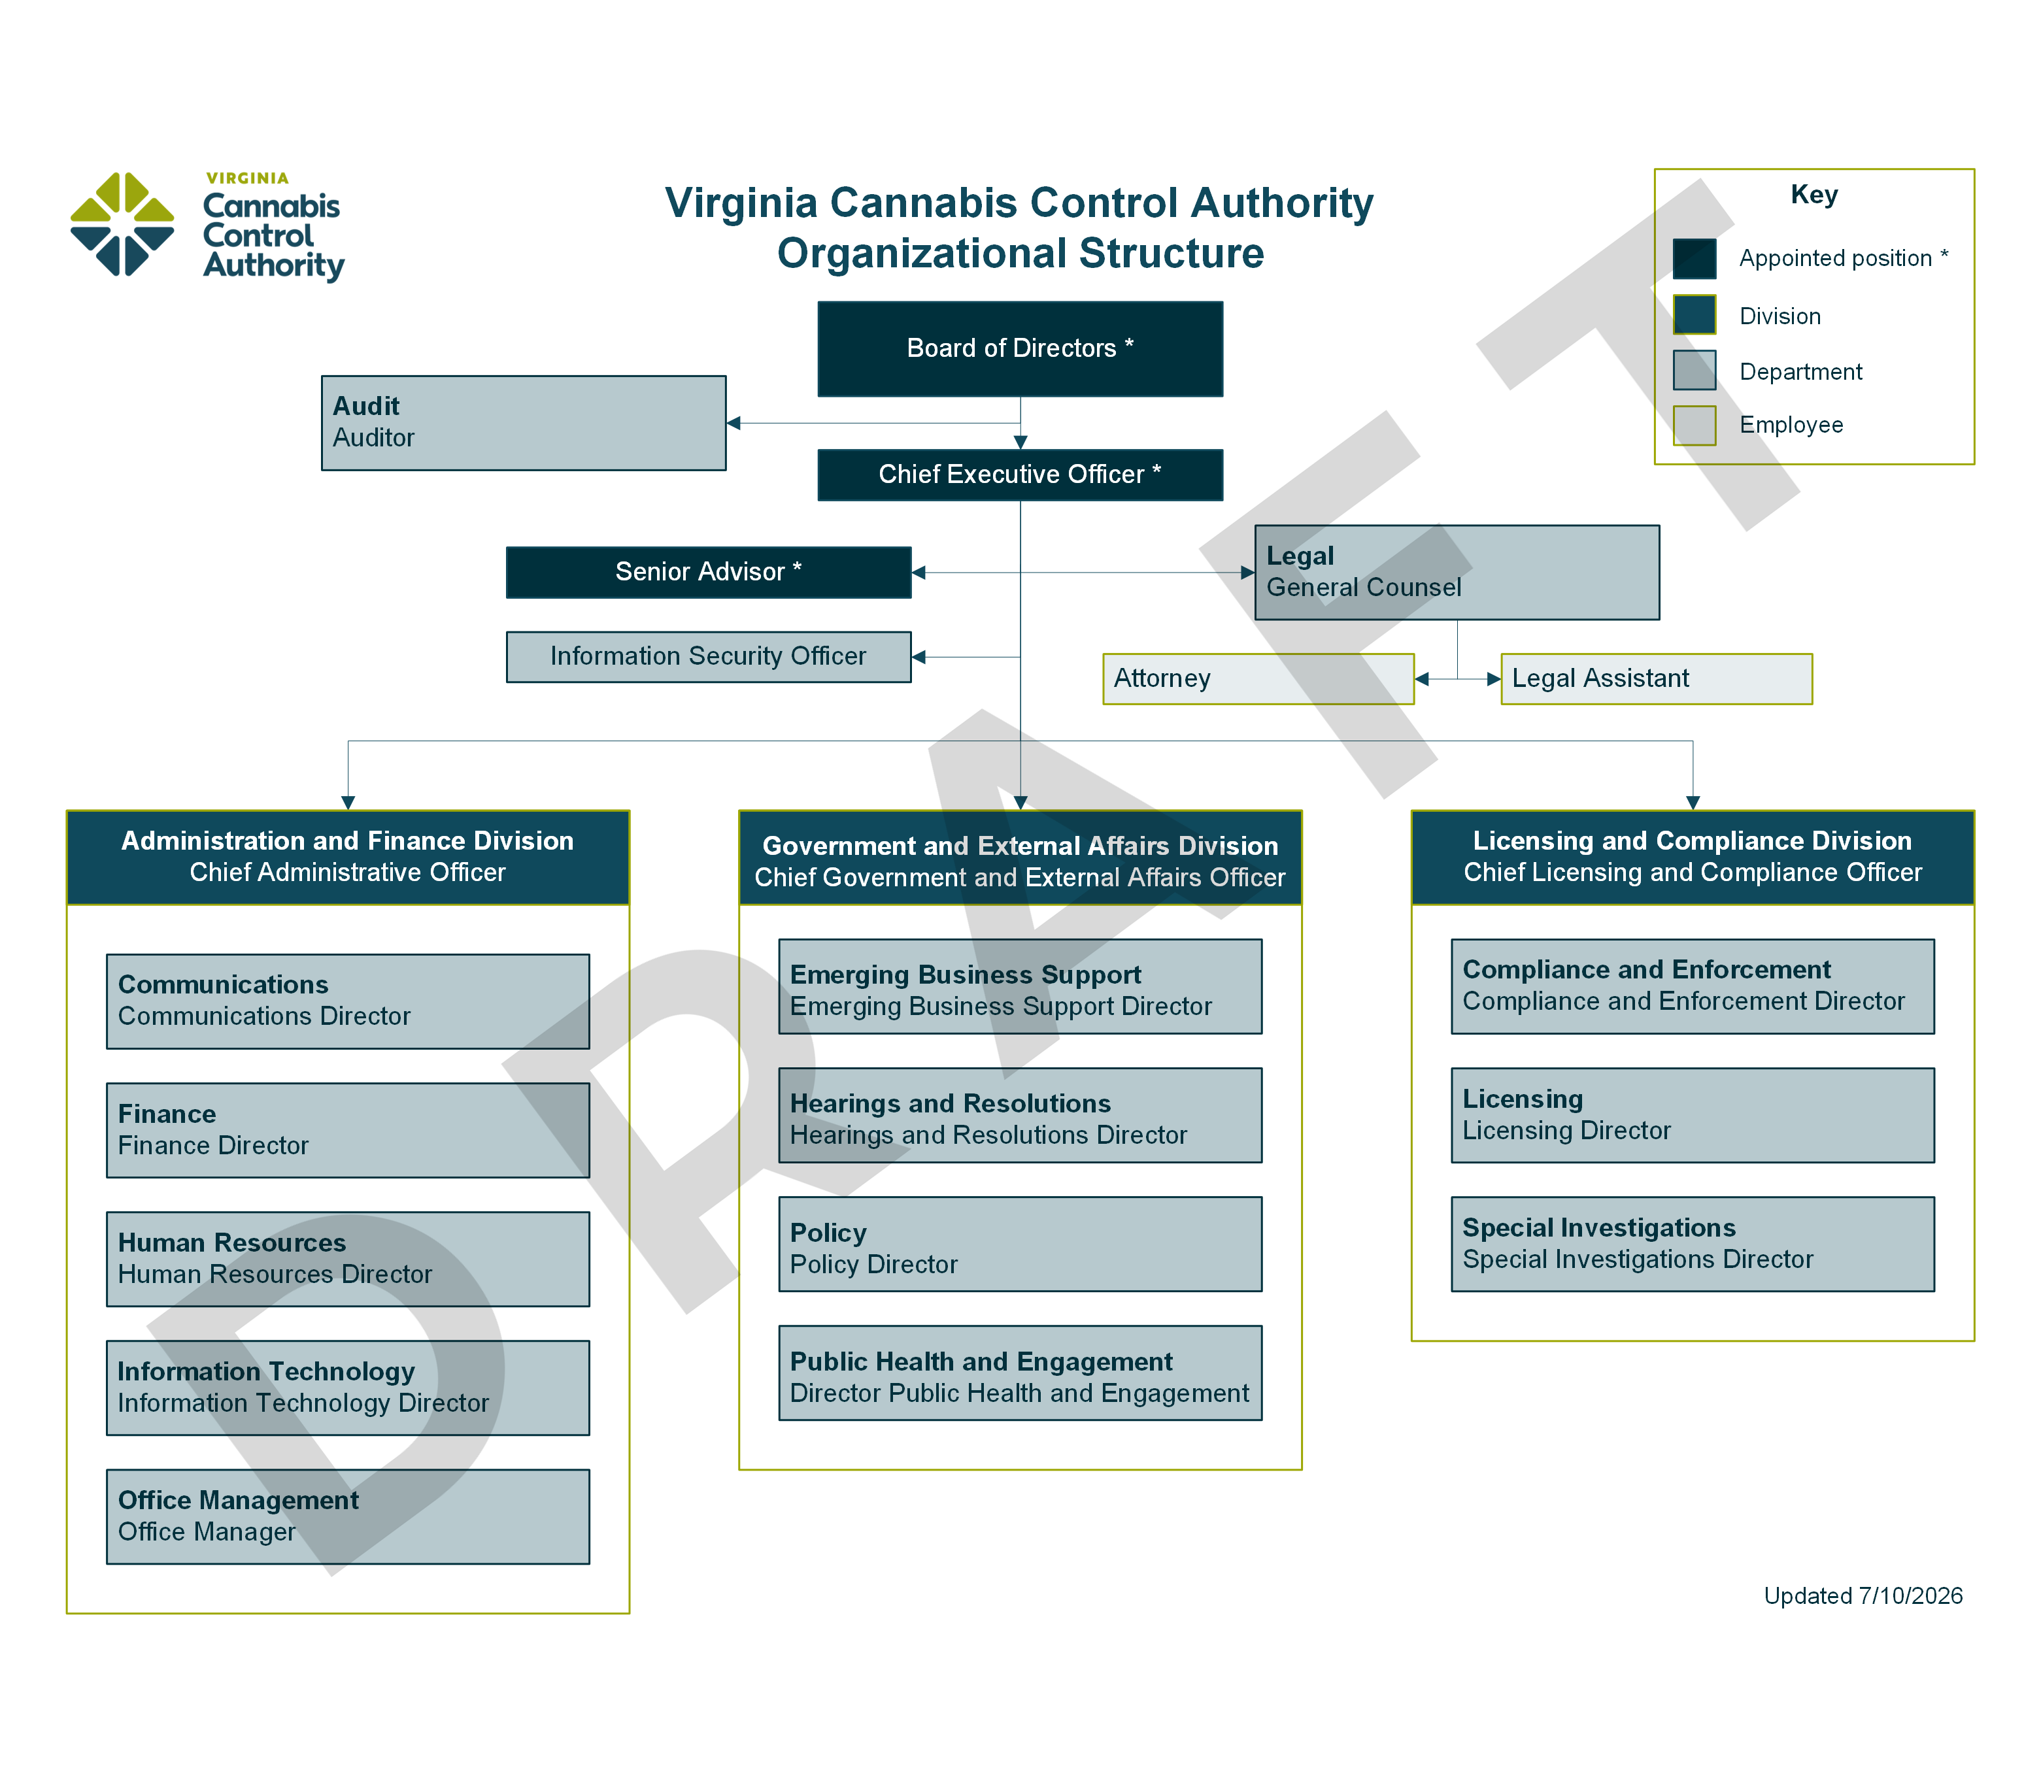
*Legal positions subject to approval by the OAG

Slide 5
Leadership
  Board
    John Keohane, Chair
    Anthony Williams
    Roxann Robinson
    Tonya James
  Staff
    Jamie Patten, Chief Administrative Officer & Acting Head
    Shawn Casey, Chief Government & External Affairs Officer
    Nikeya Thomas, Chief Compliance & Licensing Officer
    Adam Ebbin, Senior Advisor
Notes:
Comment on Board & CEO vacancy

Slide 6
Hiring
  Recruiting 104 FTE
    Completed recruitment for 22 positions since 7/1
    42 active recruitments in progress
    4 additional postings expected in next week
  Initial priorities:
    Directors/managers
    Emerging business support, including impact business support team
    Compliance and enforcement staff
    Licensing staff
Notes:
4 of the 22 haven’t started yet

Slide 7
Operations
  Office of Hemp Enforcement transition complete
  Seed-to-sale system updates
  New licensing, enforcement, and tax system
    Go live in advance of accepting conversion and microbusiness applications by February 1, 2027
  Additional office space
  Establishing regional offices

Slide 8
Medical Cannabis

Slide 9
Program Updates
Anticipate facility openings in Health Service Area 1
Federal rescheduling
  Drug Enforcement Administration oversight
  Assessing other potential impacts
Retail market transition
  Product differentiation for patients
  Best practices for operators to preserve patient access
  Seed-to-sale tracking system updates will ensure retail and patient sales tracked separately

Slide 10
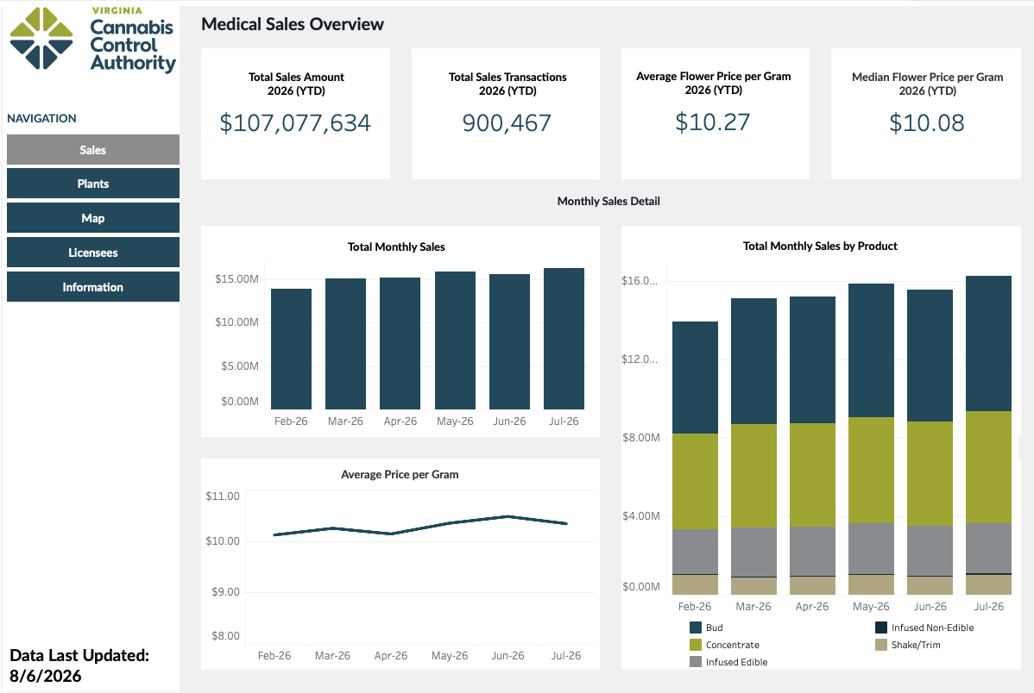
https://cca.virginia.gov/data/dashboard

Slide 11
Retail Market
Regulations

Slide 12
External Engagement
  Cannabis Public Policy Consulting
    Licensing numbers/potential caps
    Report required by Enactment Clause #19
  Regulatory Input Form
    Open from June 30, 2026 to July 21, 2026
      Received 704 submissions
    Some themes:
      Pathways for hemp stakeholders
      Support for small businesses
      Protection of minors
      Reinvestment of revenue for public education
  Email
    rules@cca.virginia.gov

Slide 13
Regulatory Timeline
Initial Draft Released
CPHAC Review Begins
September
CPHAC Review Complete
October
November/December
Regulations Submitted to Registrar
Regulations Published
Early January
Regulations Finalized
December
Late January

Slide 14
CPHAC Review
Sanitary standards for product preparation
Testing program
Requirements for health and safety warning labels
Maximum tetrahydrocannabinol level for retail marijuana products and other product and dispensing limitations on tetrahydrocannabinol;
Criteria for evaluating new licensees based on the density of retail marijuana stores in the community and metrics that have similarly shown an association with negative community-level health outcomes or health disparities.

Slide 15
Compliance and
Enforcement

Slide 16
Structure
  Regional compliance and enforcement teams
  Centralized intake and data analysis
  Statewide financial compliance and auditing team
  Special investigations unit
  Align enforcement with other regulatory agencies

Slide 17
Priorities
October – January
Promote education prior to enforcement for key stakeholders (ongoing)
October
Complete onboarding of regional compliance inspection positions and financial auditing positions.
November
Onboard special investigations unit
September
Establish guidance document for civil penalties
Notes:
Law enforcement education
Retailers

Slide 18
Public Education
Campaigns

Slide 19
Goals
  Educate consumers on why they should buy regulated cannabis products, as opposed to unregulated cannabis products;
  Describe the potential benefits Virginia’s medical cannabis program has for patients, including when the program might be the right choice for certain individuals;
  Highlight the ways purchasing cannabis and cannabis products from licensees supports farmers, small businesses, and community reinvestment;
  Inform consumers of how to recognize licensed retail marijuana stores and microbusinesses;
  Emphasize the risks and consequences of underage cannabis use; and
  Educate consumers on responsible cannabis consumption and health risks associated with cannabis consumption.

Slide 20
Timeline
July 27, 2026: RFP issued
August 18, 2026: Proposals due
October 2026: Estimated contract award
NLT April 1, 2027: Campaign launch
Notes:
Proactive messaging ahead of the start of sales (esp. youth prevention)

Slide 21
Safe Driving Campaign

Slide 22



Bad Combinations

Slide 23
Next Steps
3rd Safe Driving Survey going live in next few weeks
  Expect final report by early October
Increase campaign activity around fall/winter holidays and 4/20
Plan to launch new Bad Combination advertisements by January
Notes:
This campaign will also work in tandem with our retail education campaign in the spring to ensure message consistency around public safety.

Slide 24
Questions?

