Slide 1


340B Basics
Michael Jackson, MPH, CFE
Director of Government and Legislative Affairs
Virginia Community Healthcare Association
David W. Christian, DPh
Pharmacy Director, 340B ACE
Central Virginia Health Services, Inc.

Slide 2
Topics of Discussion
340B History
340B Patient Impact
Transparency
Current Federal 340B Reform Bills
State Actions
* Through the Lens of Virginia’s FQHCs

Slide 3



Funding Model of FQHCs
FQHC SUSTAINABILITY
3
4
0
B
GRANT
P
P
S

Slide 4
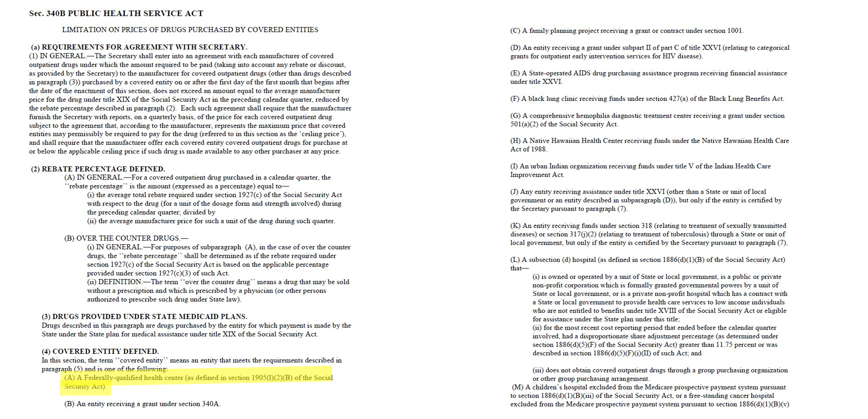
Sec. 340B Public Health Service Act

Slide 5
Topics of Discussion
1992-2010 – Pre-Affordable Care Act
2010-2020 – Pre-Shipping Restrictions
2020-2026 – Manufacturer Shipping Restrictions
Notes:
Children's Hospitals added in 2006
Critical Assess Hospitals in 2010
Shipping restriction imposed in 2020

Slide 6
340B Savings Losses
Notes:
this totals $106 Million in 5 years

Slide 7
Patient Impact
91% of Virginia’s FQHC patients have income below 200% of FPL
2. 58% of Virginia’s FQHC patients have income below 100% of FPL
(thus, can not be charged for services; only assessed a nominal fee)
21% of Virginia’s FQHC patients are uninsured
35% of Virginia’s FQHC patients were insured by Medicaid in 2025
17% of Virginia’s FQHC patients were insured by Medicare in 2025
27% of Virginia’s FQHC patients had commercial insurance in 2025
340B Savings have funded:
OBGYN services in Hampton Roads (CLOSED 2025)
School-based clinics in Southwest Virginia (CLOSED 2026)
OBGYN services in the Danville area (Potential CLOSING in 2027)
FQHC PATIENTS RECEIVE
30-DAYS OF MEDICATION
FOR AS LITTLE AS $1
DUE TO 340B SAVINGS
AND FQHC-PROVIDED SLIDING FEE DISCOUNTS

Slide 8
Challenges That Shipping Restrictions Impose
Patient:
  Barrier to starting treatment
  Medication non-compliance
  Transportation
  USPS Challenges
FQHC:
  Increased cost to provide medication
    Increased cost of dispensing
    Additional accreditation
      Specialty
      Mail Order
  Shipping challenges
    Logistics and drug viability

Slide 9
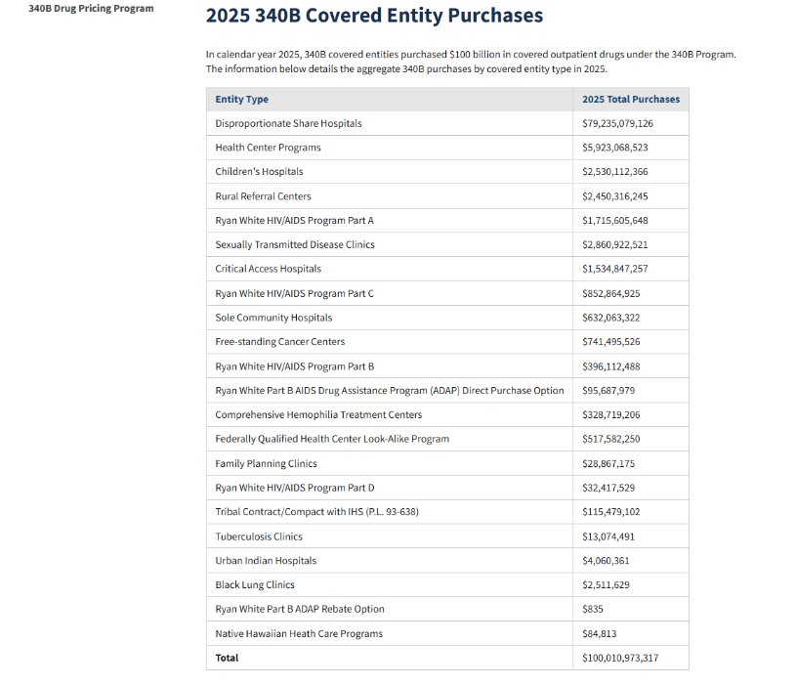
5.9%
Source:
Health Resources and Services Administration, “2025 340B Covered Entity Purchases,” 2025 340B Covered Entity Purchases | HRSA
Notes:
Indian Health Services $5.3 Billion– Serving nearly 2.75 million (1,927.27272727)
FQHCs - $4.6 billion- 34Million

Slide 10
Need for Transparency
FQHCs are required by statute and grant conditions to reinvest 100% of 340B savings into patient care
FQHCs are subject to Federal oversight and audits
  Operational Site Visits every 3 years & visits from the Office of Pharmacy Affairs, the Department of Financial Integrity, and the Office of the Inspector General
FAC.GOV

Slide 11
Virginia’s Neutral Clearing House Pilot
  Was initiated by the FQHCs to show transparency and compliance
      In-house Pharmacy
      Contract Pharmacy
      Clinic
  Scrubs claims data against patient eligibility and duplicate discounts
  Is the only solution for giving the necessary data to the manufacturers that doesn’t result in health centers closing or patients losing access to life-saving medications

Slide 12
Preventing Diversion to Ineligible Patients
Entities must not resell or transfer 340B drugs to ineligible patients
Patient definition¹:
  Records of an individual’s care
  Health care services, health care professional
    Employed by, under contractual or other arrangements (referral)
  Entity has responsibility for care
  Service received is consistent with funding or designation status
  (hospitals exempt)
  Services are more than dispensing
¹ An individual registered in a State-operated or funded AIDS drug purchasing assistance program receiving financial assistance under Title XXVI

Slide 13

Applying Patient Definition in Practice
Covered Outpatient Drug Order/ Prescription
Consistent with scope of grant (grantees only)
Eligible for 340B Drug
Eligible Service Location
Outpatient Status
Patient Health Record
Entity- Prescriber Relationship

Slide 14
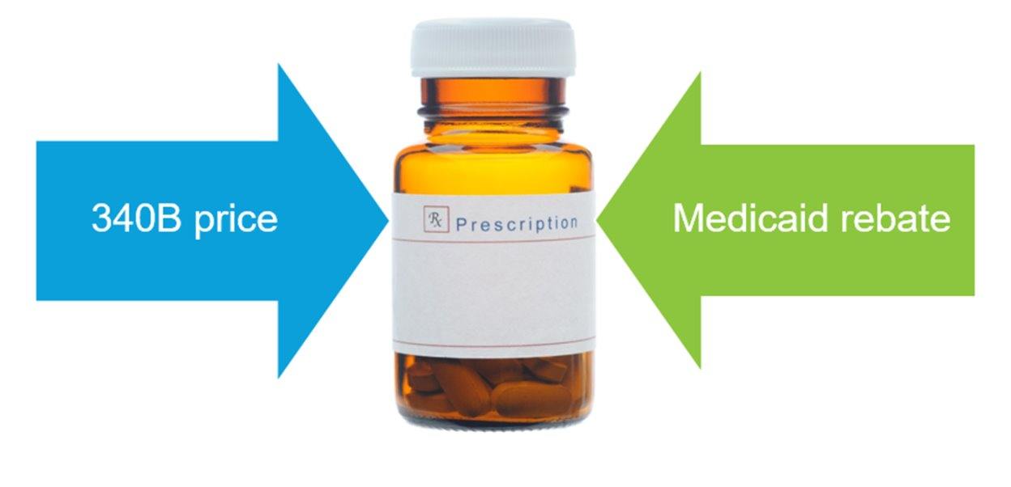
Duplicate Discount Prohibition

Slide 15
Current Federal 340B Reform Bills
340B SUSTAIN Act (House Version) – Sen. Kaine & Gang of Six
340B for Patient Act (Senate Version) – Sen. Cassidy
340B Secure ACT (House Version) – Congressmen Joyce and Peters

Slide 16
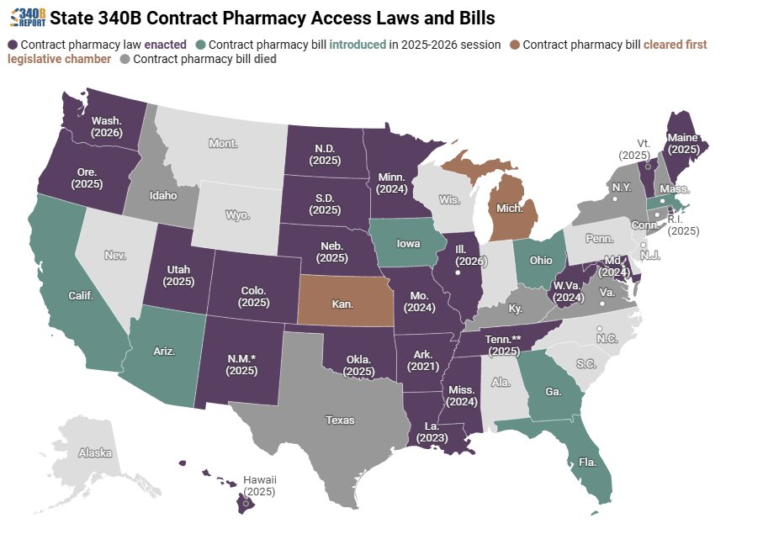
State Action
20 states have passed 340B contract pharmacy access laws​
7 states have active legislation pending​
Virginia’s General Assembly passed SB119 in 2024 but was vetoed ​
In 2026 SB278 was made into a study​

Slide 17
Questions?

Slide 18
Contact Information
Michael Jackson
Mjackson@vcha.org
804-396-5688
David Christian
DavidChristian@cvhsinc.org
(434) 390-8788

