Slide 1


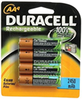
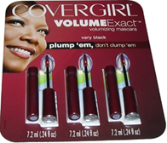


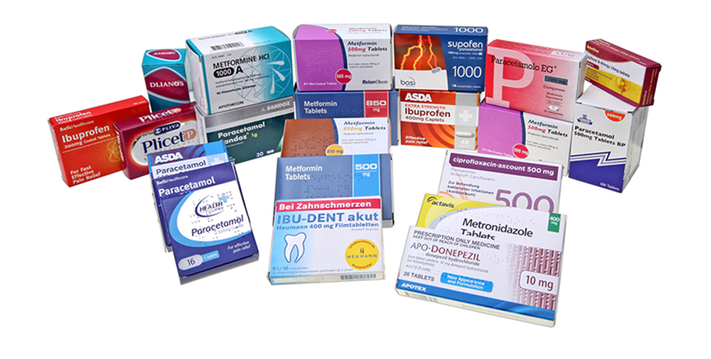
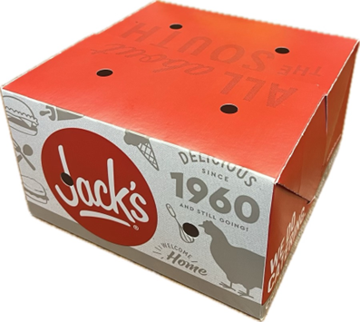
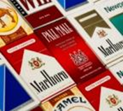
Innovative packaging solutions for a sustainable future
The largest variety of solutions in corrugated and consumer packaging.
Smurfit Westrock
The need for plastic alternatives inspires us to pursue the untapped possibilities of paper. | Customers don’t have to choose between function and sustainability.
Strong customer partnerships allow us to innovate and develop more sustainable products. | We help our customers increase sustainability and efficiency.
1
Paper | Packaging | Solutions
Notes:
Smurfit Westrock makes the following products in Virginia:

Slide 2






~$31
billion net sales
500+
packaging and
other facilities*
Smurfit Westrock
The go-to sustainable packaging partner of choice. We offer an unrivalled product portfolio and bring expertise, scale and a global presence of 500+ packaging and other facilities as well as 57 mills across 40 countries.
40
countries
57
mills
~13
million tons of recovered paper consumed
~308,000
acres of forestland
(124,643 hectares)
~23
million tons of
paper capacity
~97,000
colleagues
Source: Smurfit Westrock 2025 10K.
*This includes converting plants, mills, recycling plants, forestry/wood procurement, distribution and experience centers.
2 Paper | Packaging | Solutions
Notes:
1. Note that none of the forestland is in the U.S.
2. Over 97,000 employees.

Slide 3
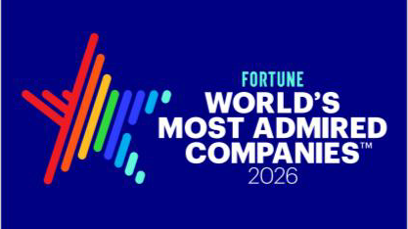

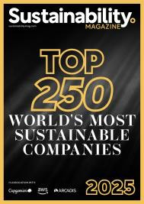
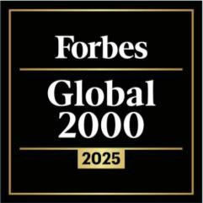
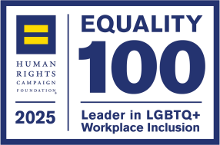
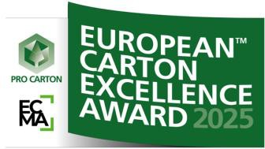
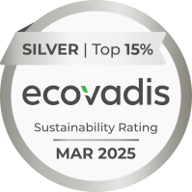
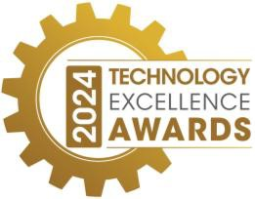
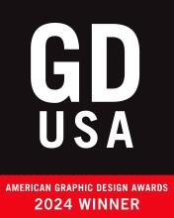
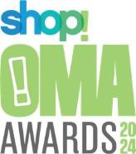
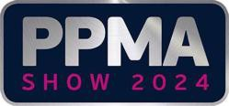




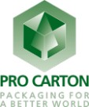
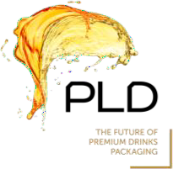
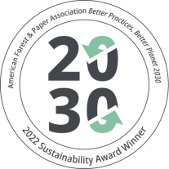
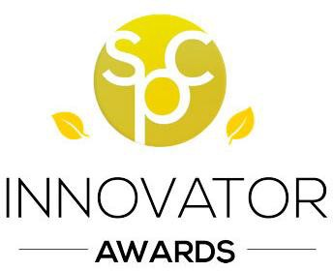
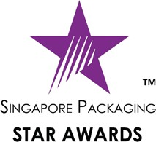




Awards & Recognition
Recognized by industry partners and customers for our innovative sustainable solutions.
Planet
People and Communities
Impactful Business

Slide 4
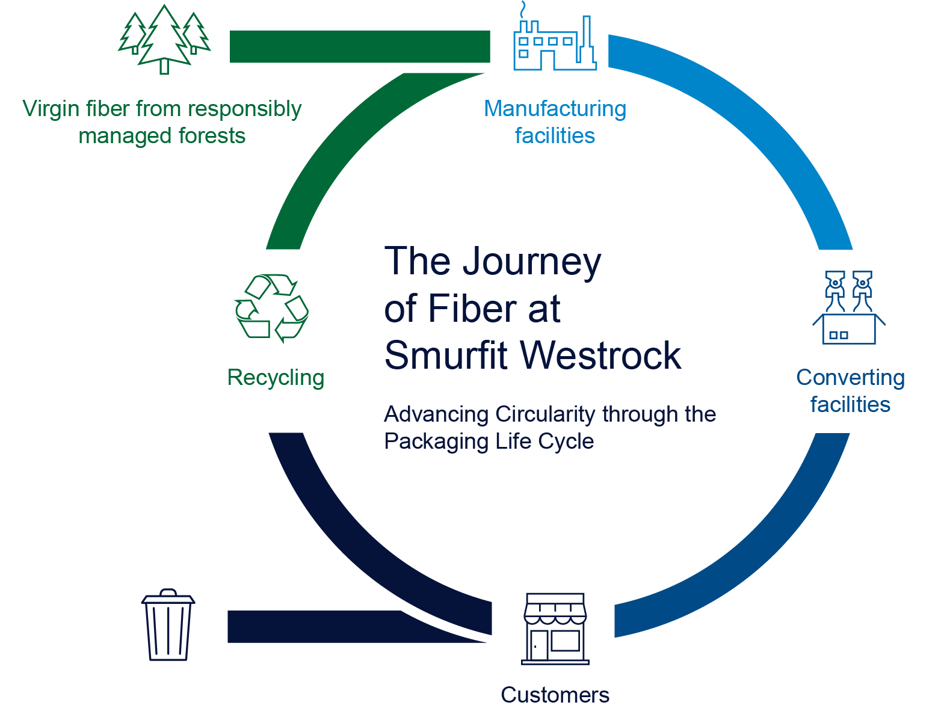
The circular economy is at the core of
our business
We use renewable, recycled and recyclable materials to produce our products.
Source fiber only from responsibly managed forests.
Minimize waste and use byproducts as fuel energy.
Increase the use of recycled fiber and coordinate fiber recovery with customers.
Help our customers meet their sustainability goals through our products, experience and guidance.

Slide 5


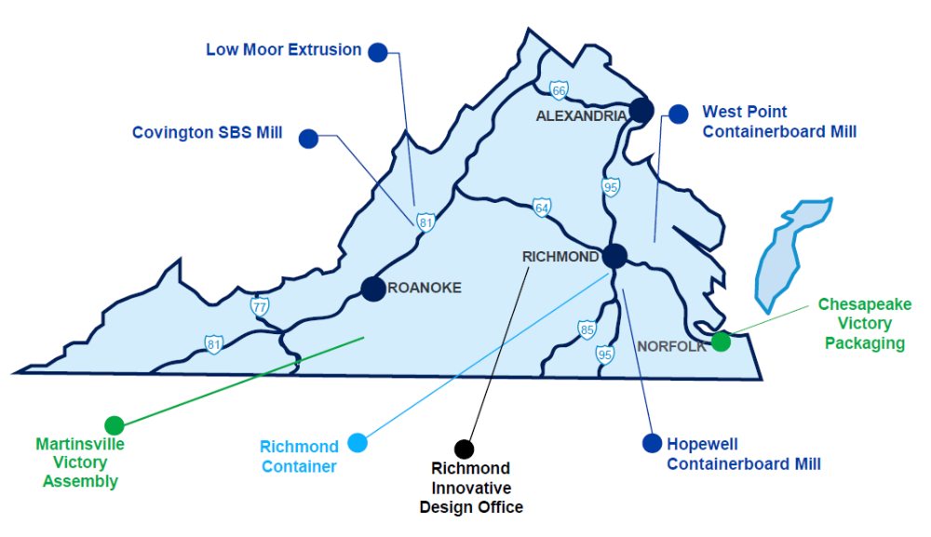
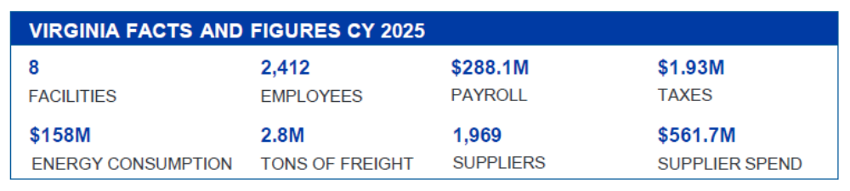
Virginia
Footprint
5 Paper | Packaging | Solutions

Slide 6
Smurfit Westrock’s Impact on Virginia’s Forest Economy
Virginia forest industries had a total impact of $23.6 billion in total industry output, 108,451 jobs, and $11.3 billion in value-added.
According to Forisk*, Smurfit Westrock consumes 28% of wood in Virginia, annually. Applying that percentage to the findings from UVA’s The Economic Impact of Agriculture and Forest Industries in Virginia:
Smurfit Westrock’s three mills had a total impact of $6.6 billion in total industry output, 29,500 jobs, and $3.2 billion in value-added.
*The source of the Smurfit Westrock’s percentage is from Forisk and that the content is being used and presented by you under license from Forisk.
6 Paper | Packaging | Solutions
Notes:
**The wood consumption data applied to research from the University of Virginia. The Economic Impact of Agriculture and Forest Industries in Virginia. Terance J Rephann, Ph.D. Published November 2022.

Slide 7
The Covington Mill’s Economic Impact in the Community
Salaries / Wages |  |  |  |  | Property and sales taxes
 |  | FY23: | $129.6 million |  |  |  | FY23: | $15.54 million
Capital Investments |  |  |  |  | Environmental investments
 | 1986-2023: FY23: | 1986 to 2018: FY19F: | $2.6 billion $44.6 million |  |  | 1986-2023: FY23: | 1986 to 2018: FY19F: | $488.5 million $ 21.4 million
Local Purchases |  |  |  |  | Purchases (pulpwood, biofuel, sawdust, coal, gas, other fuel)
 | FY23: | FY18: | $41.2 million |  |  |  | FY23: | $246.8 million
Notes:
The Mill’s influence extends beyond its 250-acre footprint, touching every corner of the local economy through direct employment, regional procurement, timber harvesting, energy generation, capital investment, and community engagement.
The Covington Mill employs ~880 people, making Smurfit Westrock the largest single-site employer in the Alleghany Highlands. The annual payroll of $118 million represents one of the largest injection of wages into the local economy, supporting families, local businesses, and the broader tax base across Covington, Clifton Forge, and the surrounding communities.
Every $1 of mill payroll generates an estimated $1.50 to $2.50 in total regional economic activity. For every direct mill job, an estimated 2 to 3 additional jobs are supported in the supply chain, local services, and retail sectors.
The Covington Mill directly and indirectly supports an estimated 4,500 or more jobs.

Slide 8
The Covington Mill’s Impact on the Forest Economy
Fiber is sourced from ~150-mile radius across the Appalachian timber belt, sustaining an estimated 3,500+ jobs in the forestry supply chain.
Fiber mix consists of ~80% hardwood and 20% softwood, with procurement split between 53% roundwood (pulpwood) and 47% chips purchased from sawmills.
In 2025, the mill spent ~$130 million on fiber purchases.
8 Paper | Packaging | Solutions
Notes:
Behind every ton of paperboard produced at Covington is a vast network of loggers, truck drivers, and sawmill workers.
The regional sourcing model for fiber keeps dollars circulating within the local and surrounding communities and support multi-generational logging families throughout the Alleghany Highlands.

Slide 9



Three Types of Forest Certification
Forest Management
Certification
Fiber Sourcing
Chain of Custody
Forest Purchase Harvest Manufacturing Converter
Notes:
There are three types of certifications:
Forest (or Land) Management Certification is a proof point, demonstrating that a forest is well-managed in accordance with social, environmental, and economic requirements.
Fiber sourcing certification ensures responsible sourcing of all fiber sourced directly from the forest, whether the forest is certified or not.
It’s important to note that this certification does not require fiber purchases to be limited to certified lands. This certification is meant to address the non-certified portion of forests and ensure responsible fiber procurement from these sources.
Chain-of-custody is a set of standards that apply to suppliers and manufacturers. These standards are about tracking certified and responsibly sourced fiber as it moves through the supply chain, and permitting the application of certified content claims and labels for products.
(CLICK) These certifications all work together. (CLICK) Forest management certifications are focused on the forest. (CLICK) Fiber sourcing is about ensuring responsible sourcing focused on forest, purchase and harvest. (CLICK) And Chain of custody tracks the fiber through the supply chain and links the end product to the certified and responsibly sourced fiber.
We covered a lot here, but what we want you to understand is that these three types of certifications work together to ensure fiber is sourced from forests in a way that is legal and does not harm the environment or biodiversity of the forest.
Now let’s look at the organizations that set and ensure compliance with globally recognized standards related to forest management, fiber sourcing and chain of custody.

Slide 10
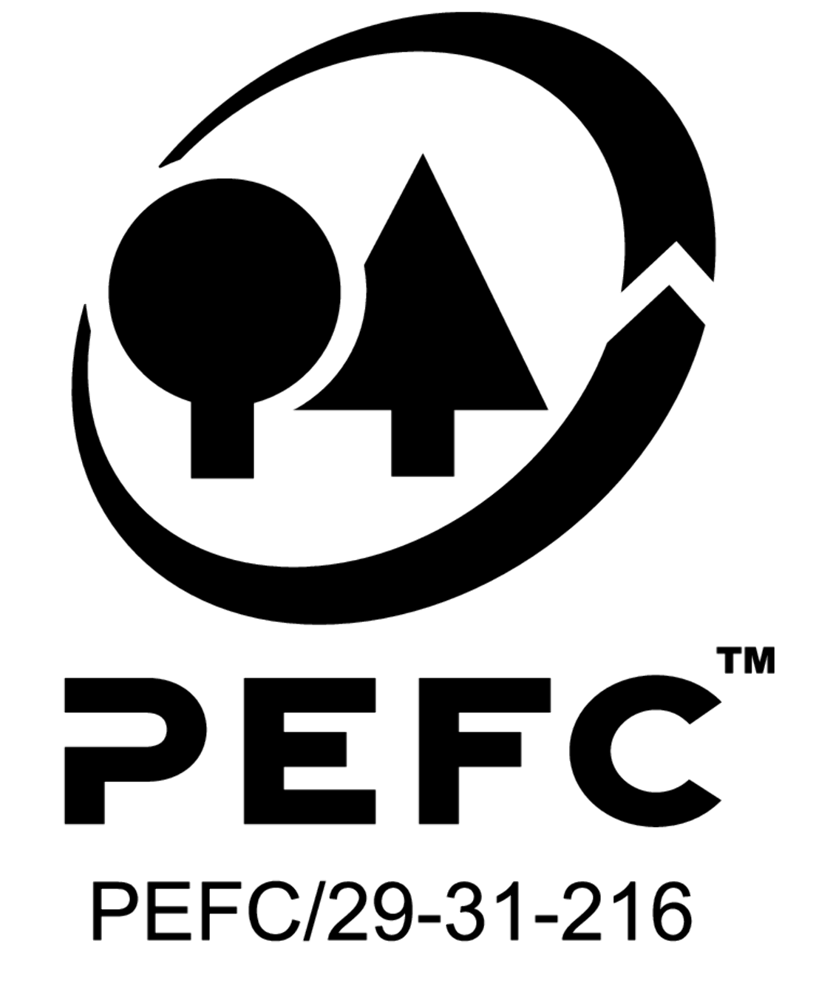
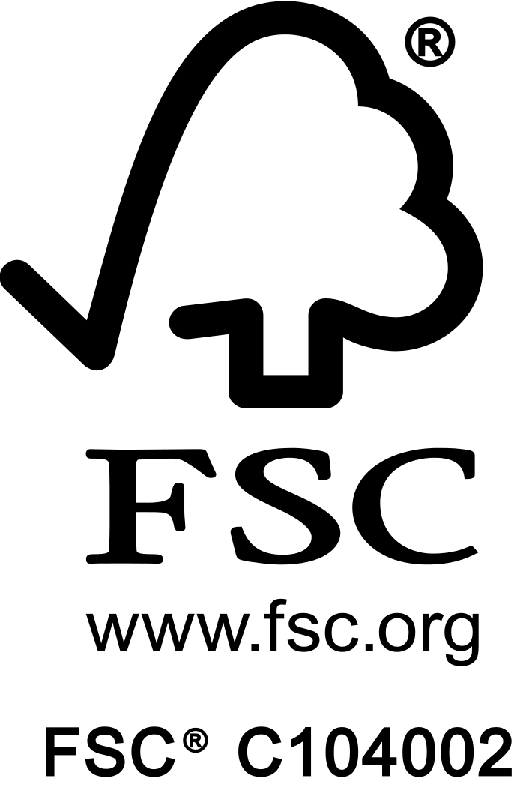
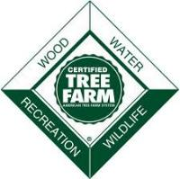
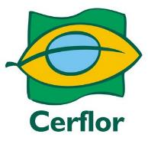
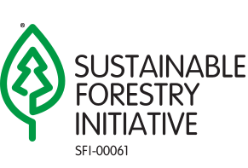
Our products meet globally recognized standards
Smurfit Westrock has one of the largest 3rd party certified fiber sourcing programs in the industry
Programme for the Endorsement of
Forest Certification^{tm}
Forest Stewardship
Council®
Sustainable Forestry
Initiative®
American Tree
Farm System
Brazilian Forest
Certification Programme
Global
North America
U.S.
Brazil
Notes:
There are several third-party certification standards. The Programme for the Endorsement of Forest Certifications (PEFC) and Forest Stewardship Council (FSC) are the two global credible certification systems. Both have certifications for all three types of certifications we just talked about, so they cover all aspects of forestry, from forest management to the production and sales of finished products.
PEFC endorses the Sustainable Forestry Initiative (SFI) and the American Tree Farm System (ATFS) in North America, and Cerflor in Brazil, while FSC has a network of national partners.
So, you or your customers might wonder – which is better, PEFC or FSC? WestRock promotes certifications and encourages and assists landowners to certify their lands, and we maintain an agnostic approach to certifications – meaning no one is better than another in our view. However, certain programs may be preferred in different parts of the world for a variety of reasons. Kaleb -
So why do these certifications matter and what should you understand about them as a WestRock sales rep?
First, these certifications are important because they provide our customers with assurance that our products meet globally recognized standards for responsible fiber sourcing and sustainable forest management.
What’s important for you to know is that WestRock products meet globally and locally recognized forest certification standards. In fact, we have one of the largest third-party certified fiber sourcing programs in our industry.
As you can see, this is a complex topic. If your customer has specific questions related to forest certification or certified product claims, we encourage you to connect with subject matter experts to navigate those conversations.

Slide 11
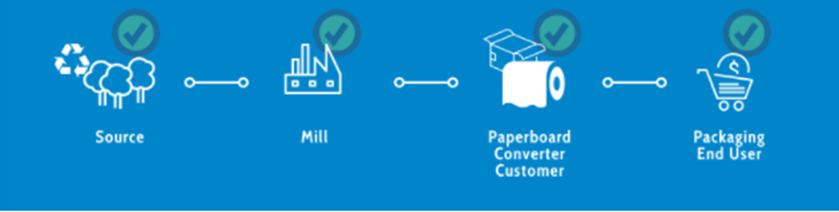
Chain of Custody (CoC)
European Union Deforestation Regulation (EUDR)
Companies shipping specific commodities into or out of the European Union (“EU”) will have to prove the products were not produced from lands that were deforested (for agricultural use) or degraded.
Commodities in scope for this legislation include: wood, soy, coffee, cocoa, rubber, beef, and palm oil.
Unbroken trail of transparency for fiber-based products from certified forests and recycled inputs (3rd party verified)
CoC required at each change of possession and ownership
CoC declarations are required to communicate the certified content claim at each change
Smurfit Westrock has a management approval process required prior to the sale of any Chain of Custody certified materials.
Any time a forest or facility along the supply chain is not certified there is a break in the chain, and no product claim can be made.
Regulation was passed in July 2023 and moves into enforcement December 30, 2026.
Intended to ensure European countries do not use products associated with deforestation or forest degradation
Bulk sale of paper or packaging, lumber, other wood products into Europe (or out of Europe) are in scope of the EUDR
Printed products (books, greeting cards, lottery, etc.) are excluded.
The EUDR requires individual landowner & forest parcel level compliance regardless of acres.
Each tract of land where trees are harvested must comply with the EUDR’s definitions of deforestation and forest degradation.
Notes:
Fiber procured is from known legal and non-controversial sources.
Following categories are highly controversial and often illegal:
Illegally harvested wood
Wood harvested in violation of traditional and civil rights
Wood harvested in forests where high conservation values are threatened by management activities
Wood harvested in the forest being converted to plantations, or non-forest uses when the conversion is not considered limited and legal or threatens high conservation values
Wood from forests in which genetically modified trees are planted
EUDR
Deforestation is defined in the EUDR as “conversion of forest to agricultural use, whether human-induced or not”
Forest Degradation is defined in the EUDR as “structural changes to forest cover, taking the form of the conversion of primary forest to planted or plantation forests, or naturally regenerating forest into plantation forests”
Geographic coordinates and polygons for each harvest unit are captured, tied to each product made during the identified production period, and made available for review/audit.

Slide 12
Smurfit Westrock’s Continued Investment in Virginia
Covington $28M natural gas boiler
Hopewell $30M white liquor clarifier
12 Paper | Packaging | Solutions
Notes:
Covington:
Hopewell is installing a new $30M white liquor clarifier that is used in the process that recycles pulping chemicals. It will alleviate the mill’s bottleneck and reduce operating costs.
West Point:

