Slide 1
Updates from the Secretariat of Agriculture & Forestry
Deputy Secretary Ben Rowe

Slide 2
Impact of Virginia Forestry & Agriculture
Agriculture is Virginia's largest private sector industry; Forestry ranked 3rd
  Combined economic impact: over $105 billion (as of 2022 Weldon Cooper Study)
95% of Virginia is in rural use
  Of the 25.3 million acres in the Commonwealth, 7.3 million (29 percent) are used for agriculture and 15.98 million (63 percent) are forested (National Agricultural Statistics Service 2022, VDOF 2024).
Agriculture & Forestry provide more than 490,000 jobs across the Commonwealth
  Employment and value-added impact together make up 9.3% of state's total GDP
Additional impacts to Virginia’s culture, economy, and communities
  Recreation, tourism, wildlife habitat, biodiversity, flood mitigation, water quality, and soil health
Virginia’s production is one of the most diverse in the nation
  Livestock and dairy, aquaculture, row crops, fruits and vegetables, to tobacco, wool and cotton, nursery plants, cut flowers, forest products, renewable energy, Christmas trees and more.

Slide 3

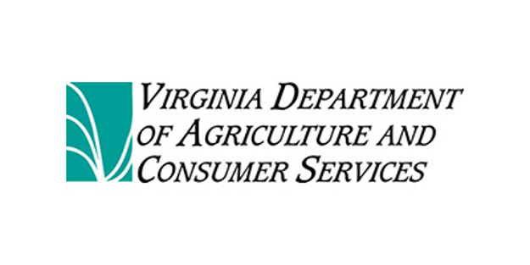

Agencies:

Slide 4
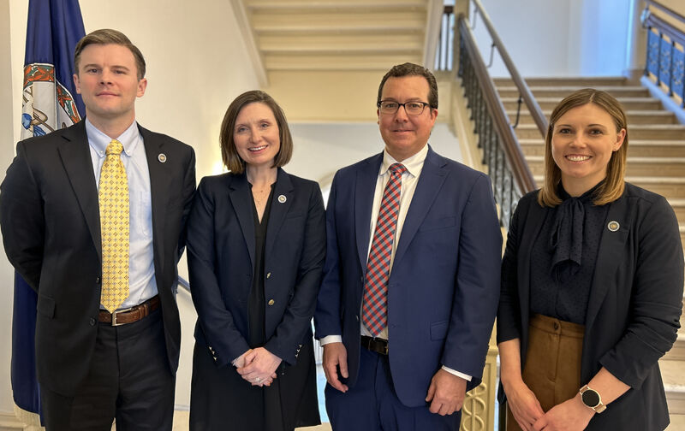
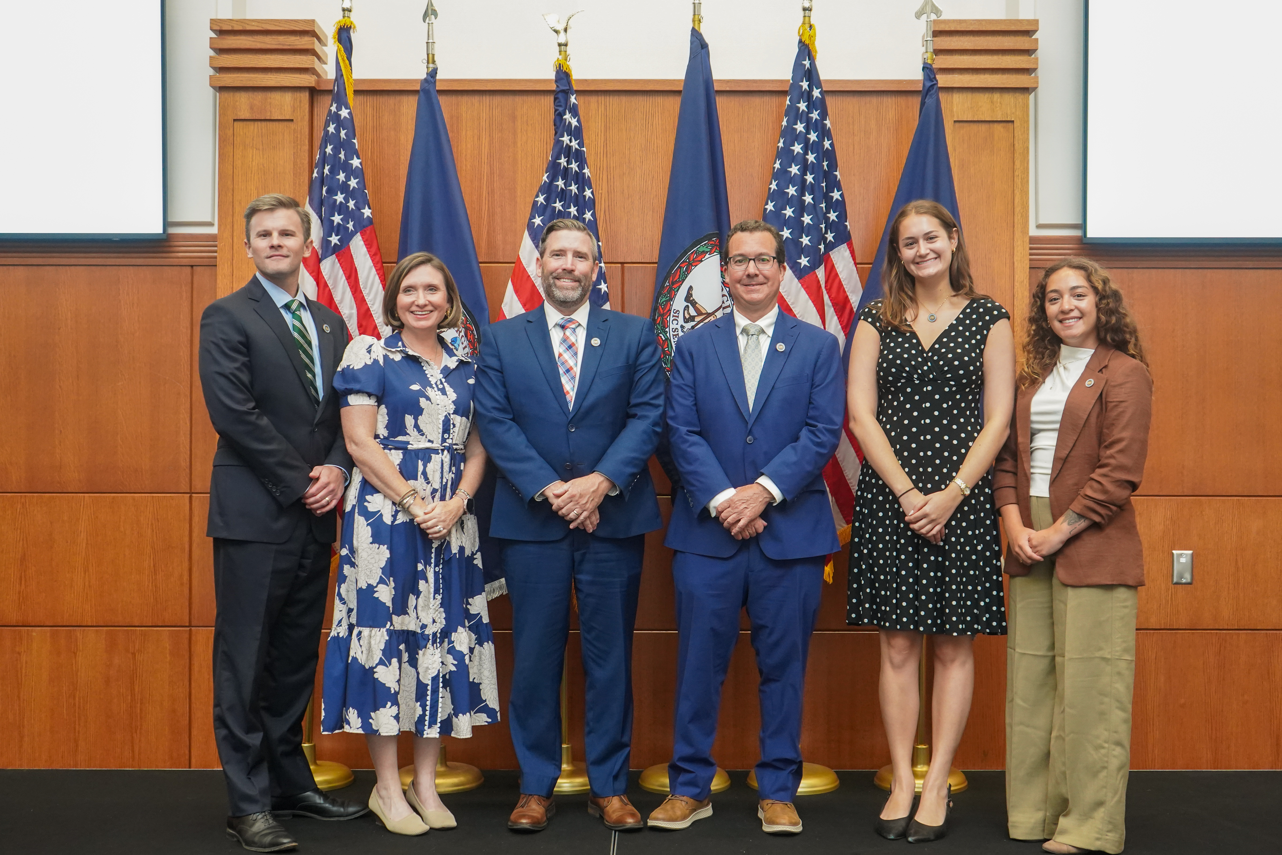
Secretariat Backgrounds
Secretary Frazier
  House Agricultural Committee
  Virginia Agribusiness Council
  Alliance Group
  Farm Credit of the Virginias
Deputy Secretary Rowe
  Alliance Group
  Virginia Farm Bureau Federation
Assistant Secretary Buscaglia
  Virginia Tech
Special Assistant Eliza Yeaker
  James Madison University

Slide 5
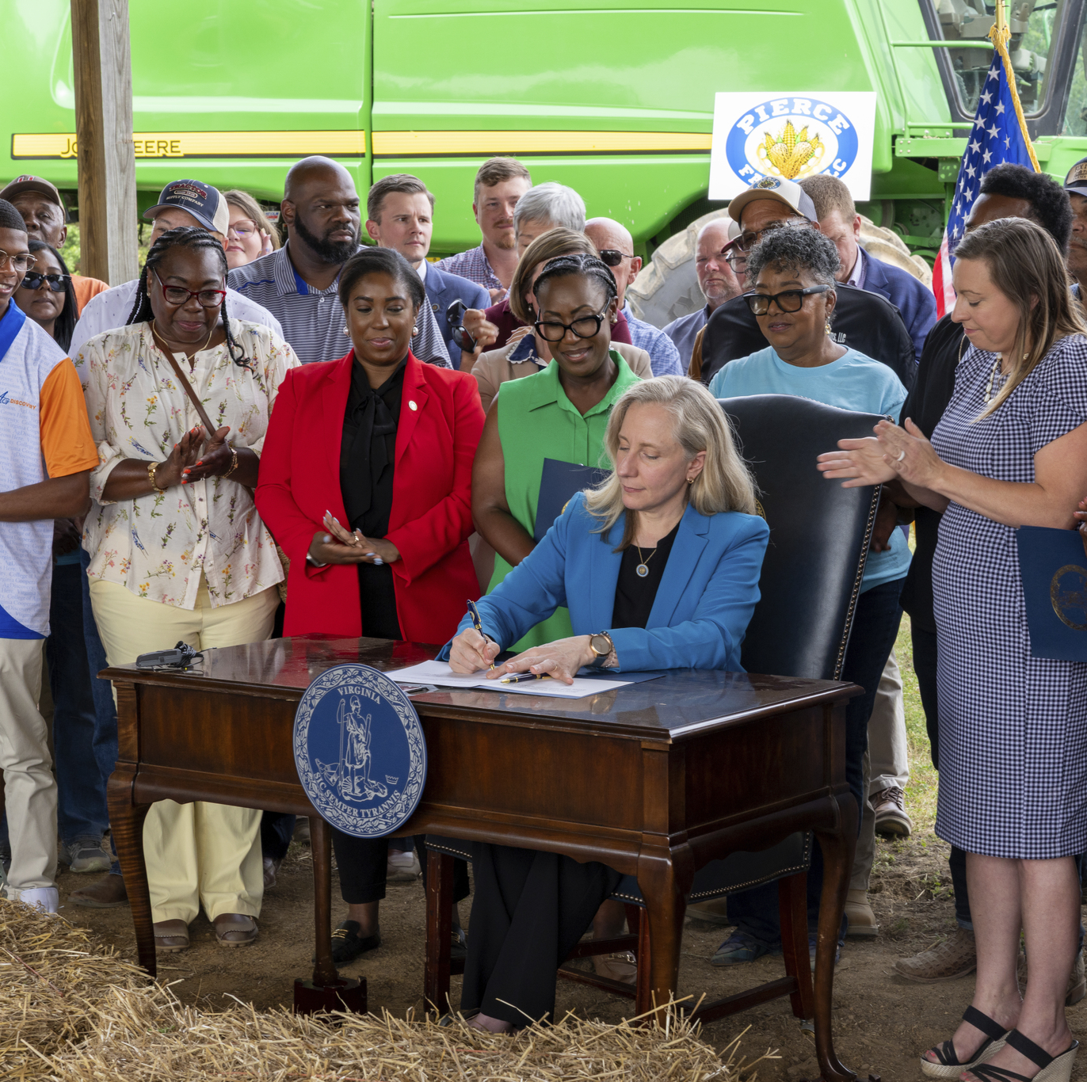
Farm & Forest Prosperity Plan: Legislative Priority
Legislation passed in the 2026 Session that directs the Secretariat to develop the Commonwealth’s first Farm & Forest Prosperity Plan
SOAF conducted stakeholder meetings throughout the summer of 2026 with Cooperative Extension
Survey coming out this week
Build legislative, regulatory, and budgetary actions required over the remainder of the Administration’s term in office to meet goals of Plan
Annual updates to Governor & General Assembly on progress

Slide 6
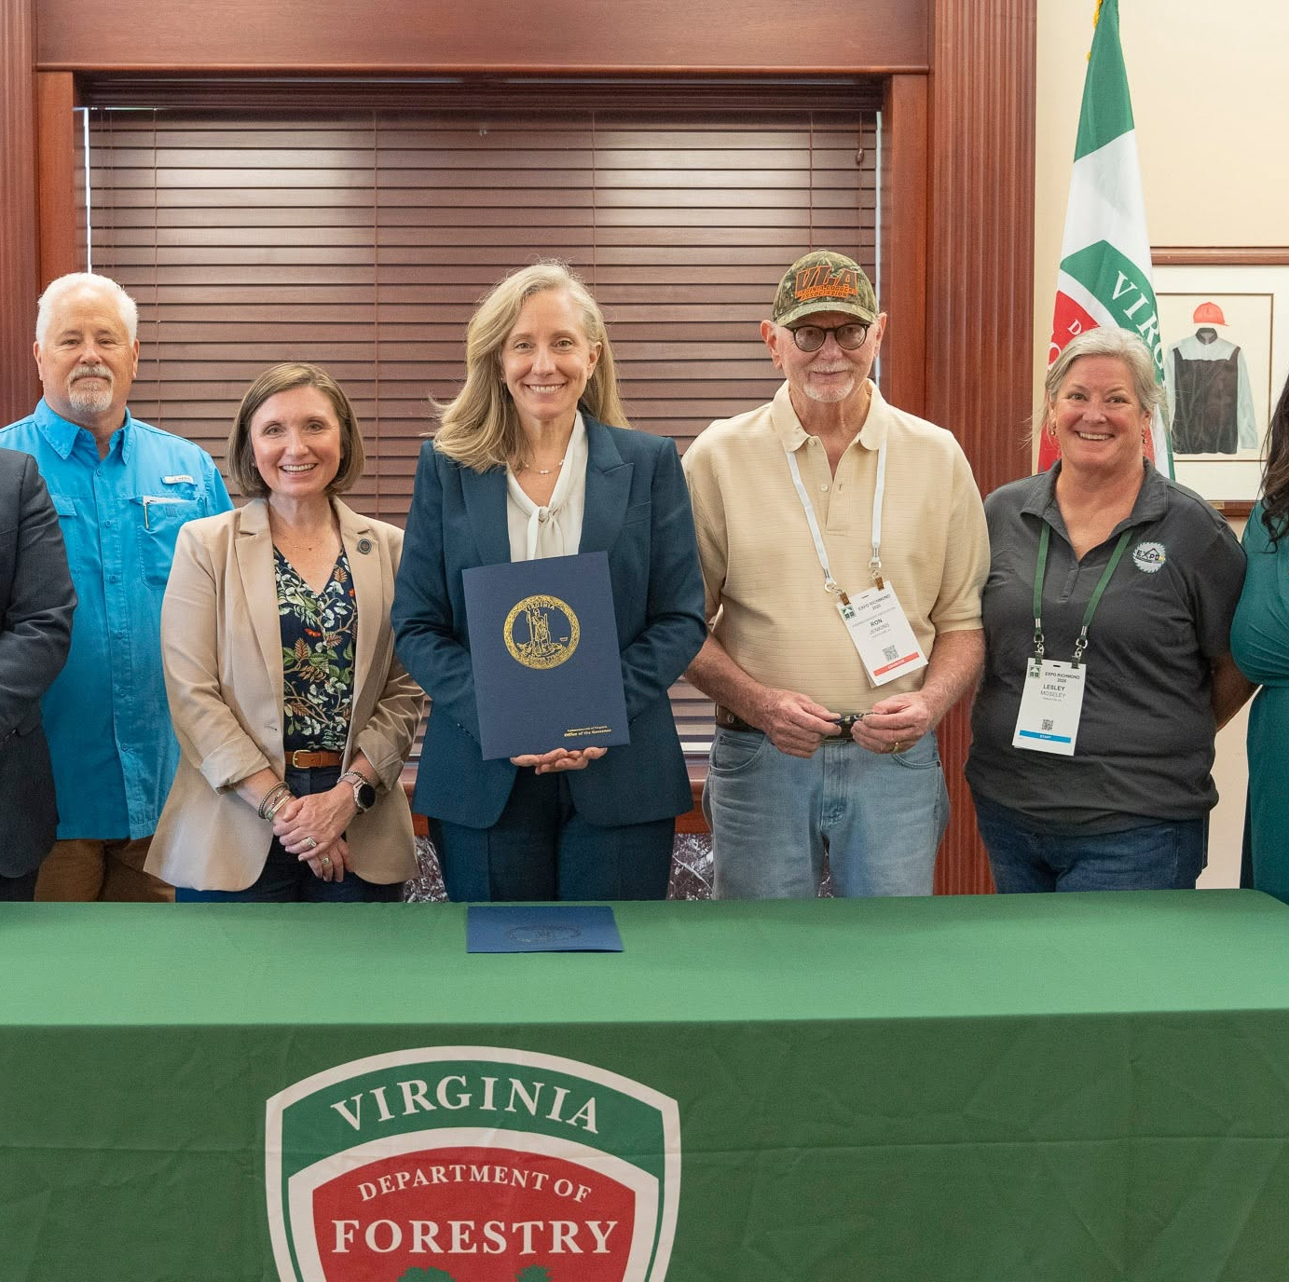
Expanding Market Access & Rural Economic Development
Goal: Focused plans to increase opportunities across agriculture and forestry markets within the Commonwealth, US, and internationally.
Formally established the Virginia Wood Council by Executive Directive.
Completed first trade mission with the Governor to the UK, Italy, France. Sec. Frazier in Thailand now.
Opened $450M port widening and deepening project. Part of overall $1.4B Gateway Investment Program
Executive Order 5

Slide 7
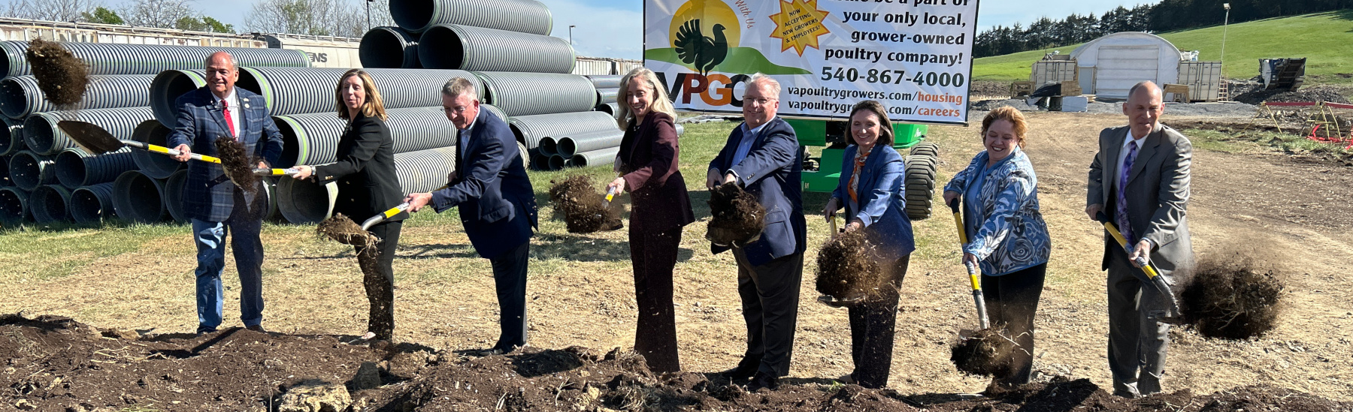
Expanding Market Access & Rural Economic Development:
Agriculture and Forestry Industries Development (AFID) Fund
AFID Facility Grants: $650,000 in grants, which represents the commitment of more than $121.2 million in new capital investment, 212 new rural jobs, and over $83 million in new Virginia-grown purchases.
AFID Planning Grant: 4 grants in 2026 for a total of $94,949 in funding.
AFID Infrastructure Grant: 14 projects awarded $507,522 in 2026.
AFID Blue Catfish Processing, Flash Freezing, and Infrastructure Grant: $248,000 awarded in 2026 to build an additional 4M lbs of processing capacity.

Slide 8
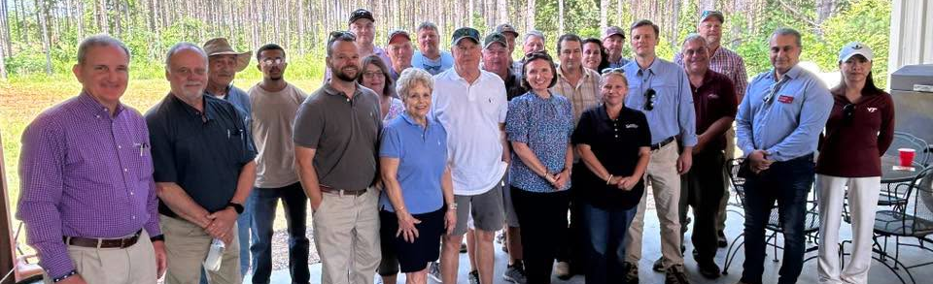
Sustaining, Stewarding, and Protecting our Working Lands
Goal: Ensure viability/productivity of farm & forest lands by investing in working lands preservation resources, leveraging conservation programs, and expanding agriculture & forestry’s role in renewable energy solutions.
Office of Working Lands
Solar Mitigation Funds
$304M Record VACS Funding
Logger BMP Funding
Biomass, SAF, Biofuels, Pellets

Slide 9
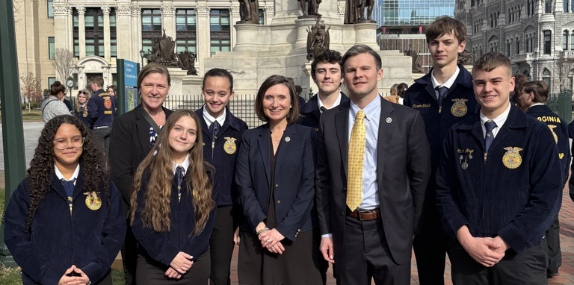
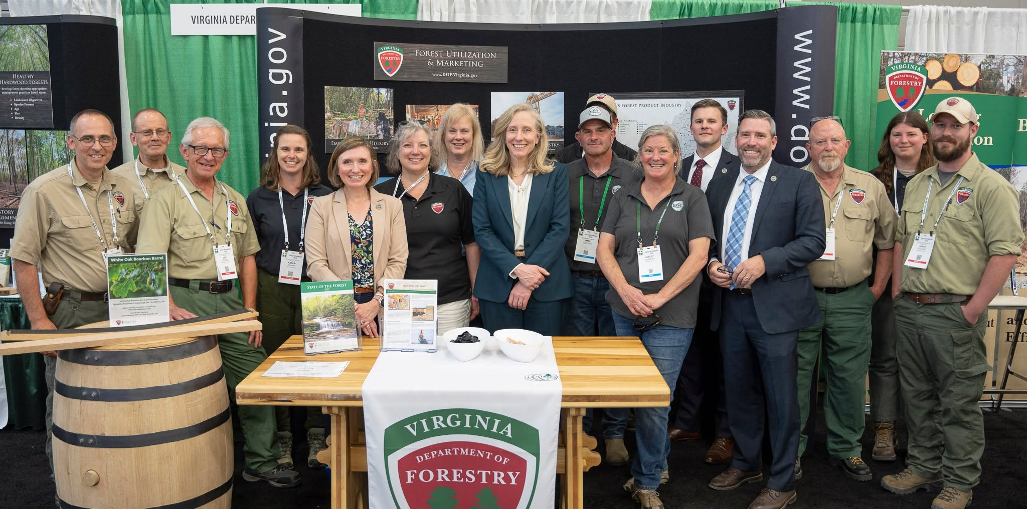
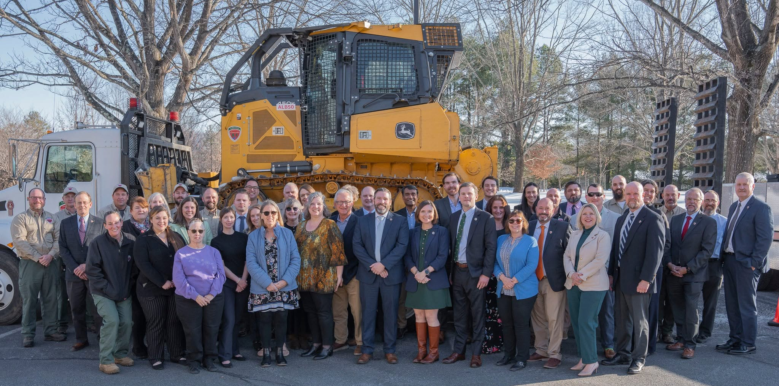
Workforce for the Future
Goal: Expand and develop workforce within agriculture and forestry sectors
Virginia’s farmers, forest professionals, and agribusinesses face persistent workforce challenges, labor shortages, and difficulty hiring adequately trained employees for the specialized needs of the industry.
We seek to educate young Virginians about career paths in agriculture and forestry and encourage them to pursue careers within these fields.

Slide 10
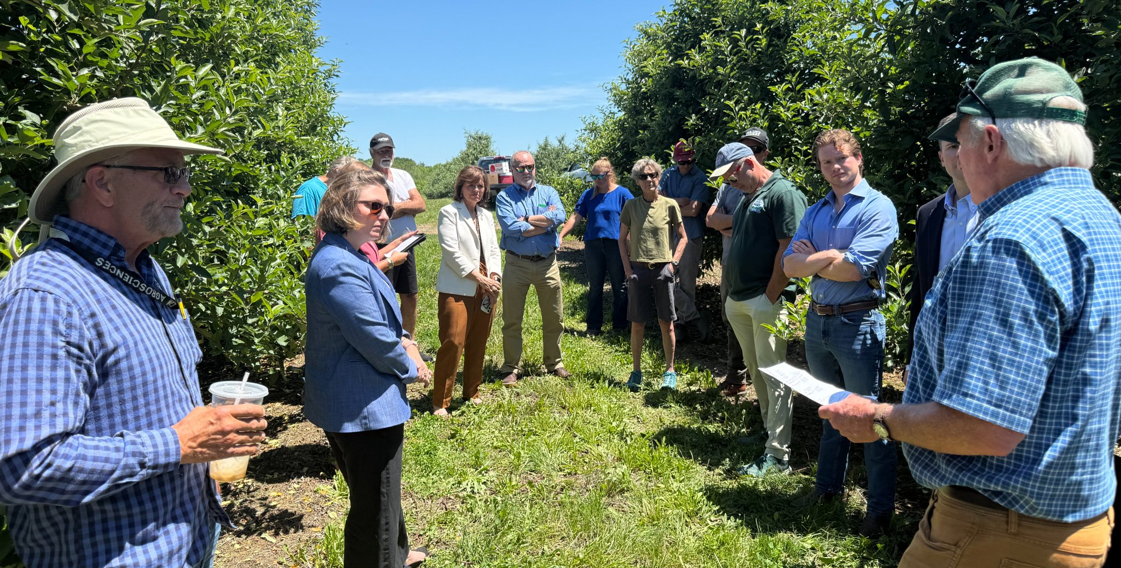
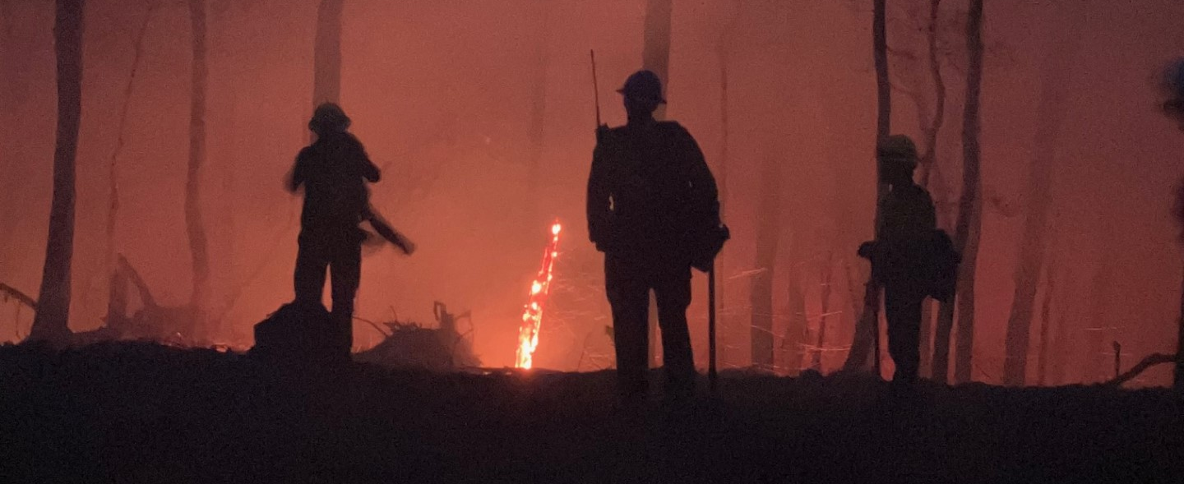
Agriculture & Forestry Disaster Response and Resiliency
Goal: Protect the health of the people, places, and environment that Virginians rely on.
Shifting from reactive emergency responses to proactive risk-reduction
Enabling farms and working forests to withstand and quickly recover from ever-increasing natural disaster events and a changing climate.
Drought update

Slide 11
Questions?

