Slide 1
Virginia Marketplace Eligibility and Enrollment Updates
Keven Patchett- Executive Director
Virginia Health Benefit Exchange
September 23, 2026

Slide 2
Regulatory and Policy Landscape
Plan Year 2026
  Expiration of Enhanced Premium Tax Credits
  Loss of APTC for legal immigrants under 100% FPL (H.R. 1)
  CMS Marketplace and Program Integrity Rule; Legal challenges
Plan Year 2027+
  PY 27 Premium Pressures
  H.R. 1 – Marketplace & Medicaid Changes
  CMS 2027 Notice of Benefit and Payment Parameters; Legal challenges
  Other CMS initiatives
  Virginia Premium Savings Program

Slide 3
Weekly OE Total Enrollment Data, PY25 & PY26
Note: Weekly enrollment data through 1/22/2025 (PY25) and 1/30/26 (PY26); rounded up to the nearest thousand.

Slide 4
Enrollment Changes for Plan Years 2024 - 2026

Slide 5

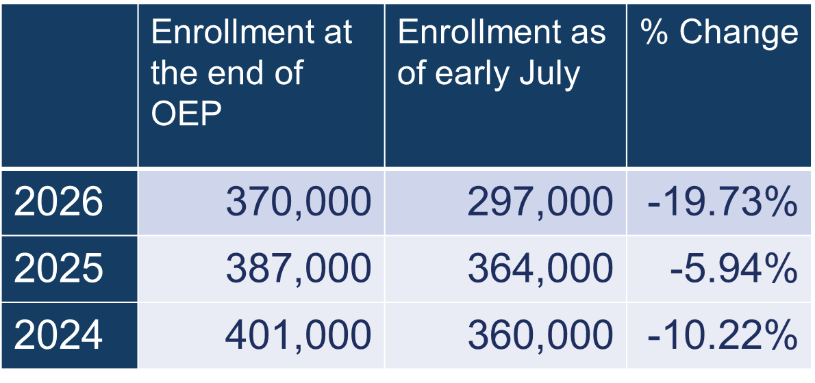

Slide 6
Metal Level Enrollment
PY25, PY26 OE, PY26 July 2026
 | Catastrophic | Bronze | Silver | Gold | Platinum | Total
PY25 End of OE | 1,700 | 147,900 | 133,900 | 101,500 | 3,800 | 388,800
% of Total | <1% | 38% | 34% | 26% | 1%
PY26 End of OE | 3,200 | 156,700 | 115,300 | 9,3500 | 1,400 | 370,100
% of Total | 1% | 42% | 31% | 25% | <1%
PY26 As of July 2026 | 1,200 | 112,900 | 93,800 | 86,500 | 3,000 | 297,600
% of Total | <1% | 38% | 32% | 29% | 1%

Slide 7
Plan Selections with Net Premiums <$10 PY25-PY26
11% of enrollments with a net premium of $10 or less for PY 26, compared to 30% in PY25.

Slide 8
Launching Virginia Premium Savings: PY2027
Virginia Biennial Budget signed by Gov. Spanberger- June 29
  Creates Health Care Affordability Fund
  Provides $150M in state funding for premium assistance
  Applies to households earning between 138%-250% FPL
  Targets 70% reduction in premium - after federal APTC
  Benefits as many as ~200,000 Virginians

Slide 9
Terminations By Income
Income as % of Federal Poverty Level | November 2025 – June 2026 | 2026 % of total
< 100 | 14,500 | 12%
100 - 138 | 25,300 | 20%
138 - 150 | 15,700 | 13%
150 - 200 | 22,900 | 18%
200 - 250 | 13,300 | 11%
250 - 300 | 7,500 | 6%
300 - 350 | 4,400 | 4%
350 - 400 | 2,600 | 2%
> 400 | 7,300 | 6%
Unknown | 9,400 | 8%
Total | 122,900 | 100%

Slide 10
PY26 Enrollment Trends by FPL
138% FPL – 250% FPL
Virginia Premium Savings eligible group
250% FPL – 400% FPL
Steadier enrollment in PY26

Slide 11
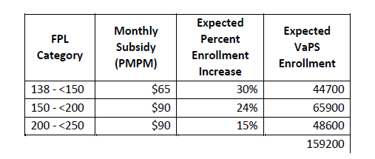
Virginia Premium Savings Parameters PY 2027
Goal: Promote affordability; Recapture and stabilize enrollment
Parameters:
  QHP-eligible consumers, some without APTC may qualify
  Covers remaining premium after APTC
  Fixed per-member, per month carrier payment
  Applied at household level
  Available to applicant plus ratable dependents

Slide 12
Virginia Premium Savings: Modeling Results
FPL | Subsidy Offered | Effective Subsidy PMPM | Net Premium Decrease
200-250 | $90 | $84 | -47%
150-200 | $90 | $86 | -70%
138 – 150 | $65 | $60 | -69%
Average |  | $78 | -62%

Slide 13
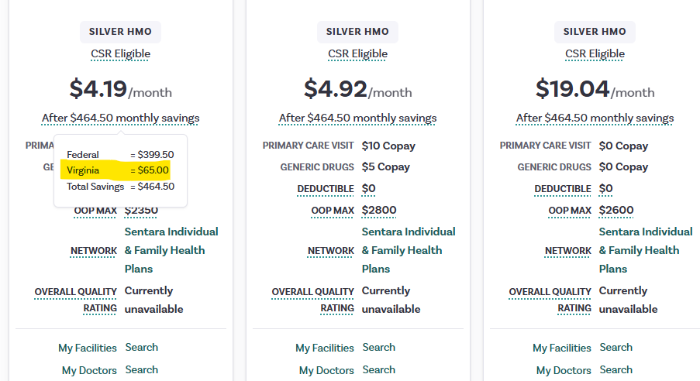

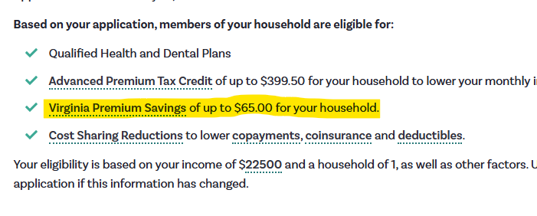
Virginia Premium Savings: Consumer Experience
Sample Case: Single, 30-year-old consumer, Henrico County, $22,500 MAGI (138%-150% FPL)

Slide 14
VirVirginia Premium Savings Implementation Roadmap
June:
  Virginia Biennial Budget adopted. (6/29)
  Included $150,000,000 for the Virginia Health Insurance Affordability Fund.
  Carrier pre-testing.
July-August:
  Exchange process development.
  Actuarial modeling.
  System updates development.
September:
  Statewide outreach and marketing campaign begins
  System updates
October:
  Expected- VaPS information live for window shopping 10/1.
  Marketplace systems and notices will display VaPS eligibility.
November+
  VaPS available for PY 27 coverage.
  Ongoing consumer outreach and marketing

Slide 15
Notice of Benefit and Payment Parameters

Slide 16
NBPP and PY27 Legal Landscape
May 15: 2027 NBPP finalized
June 3: City of Columbus v. Kennedy (2026) filed; challenges several provisions of 2027 NBPP
June 12: City of Columbus v. Kennedy (2025) decision; vacates several provisions from Marketplace Integrity Rule impacting PY26
July 16: City of Columbus v. Kennedy (2026) initial ruling; blocks several provisions of 2027 NBPP
The 2025 and 2026 filings challenge overlapping provisions across plan years
HBE is closely monitoring legal updates and making PY27 policy decisions within this context

Slide 17
Provisions Stayed or Overturned by Federal Court
Elimination of standardized plan designs and limits (stayed)
Failure to reconcile tax credits PY27 (stayed)
Expanded eligibility for catastrophic plans (stayed)
Increased verifications for Special Enrollment Periods (stayed)
Additional income verifications (stayed)
Option for Bronze plans to increase max out of pocket (stayed)
Shortened open enrollment (overturned)
Loosened network adequacy rules (stayed)

Slide 18
Provisions Required for State-based Marketplaces
Increased maximum out of pocket for catastrophic plans (PY28).*
State requirement to defray state mandated benefits since 2011 (PY2028).
State Exchange Improper Payment Measurement- increased federal oversight.
*Challenged and stay not requested.

Slide 19
Areas of Discretion for State-based Marketplaces
Multi-year catastrophic plan design*
Permitting non-network plans*
*Challenged and stay not requested.

Slide 20
Looking Ahead
Looking Ahead: Future Federal Regulatory Actions
  Pre-enrollment Verification NPRM
  Expanding access to ICHRA’s and STLDI NPRMs
  Improper Payments/"CRUSH" NPRM

Slide 21
Contacts
Holly Mortlock, Deputy Director - External Affairs & Policy
Holly.Mortlock@scc.virginia.gov
Keven Patchett, Executive Director
Keven.Patchett@scc.virginia.gov

