Slide 1




SUFFOLK TRANSIT
HJ 28 JOINT SUBCOMMITTEE PRESENTATION
SEPTEMBER 23, 2026
Suffolktransit.org

Slide 2
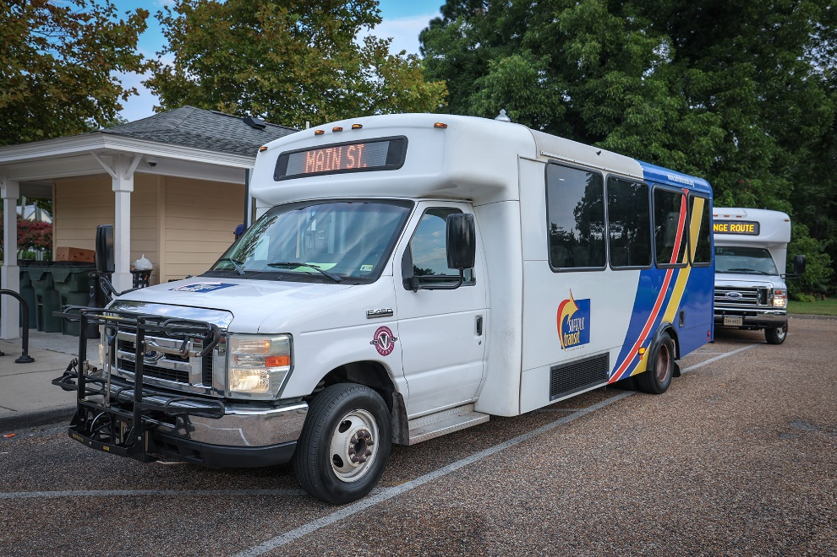

Suffolk Transit Operations
  Suffolk Transit was established on January 2, 2012
  Service is overseen by the Transit Manger for City of Suffolk
  Transit operations are provided by a contractor
  The City of Suffolk is the owner of the transit infrastructure

Slide 3
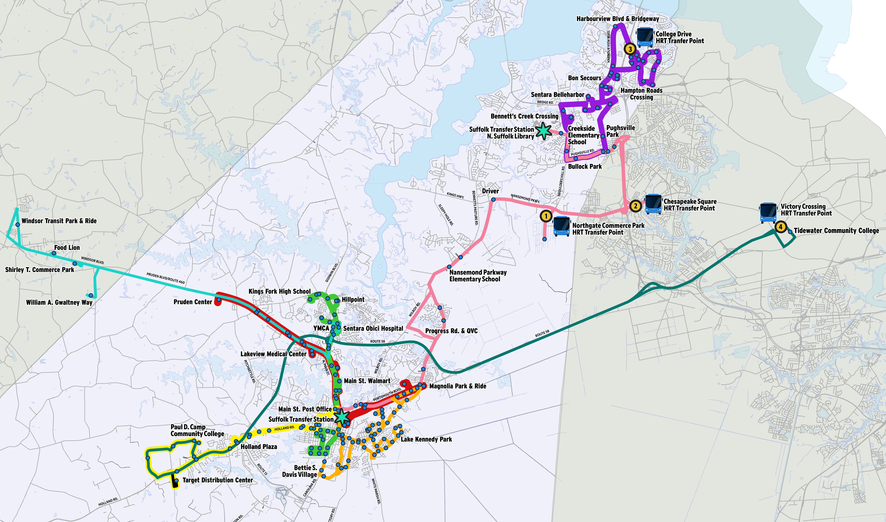
Suffolk Transit Operations
  Modes of Transit:
  Bus: 99,540
    $1.50 per trip
  Paratransit: 2,182
    $3.00 per trip
  101,722 passenger trips in FY26
  Increase of 16% in passenger trips
  between FY25 and FY26

Slide 4
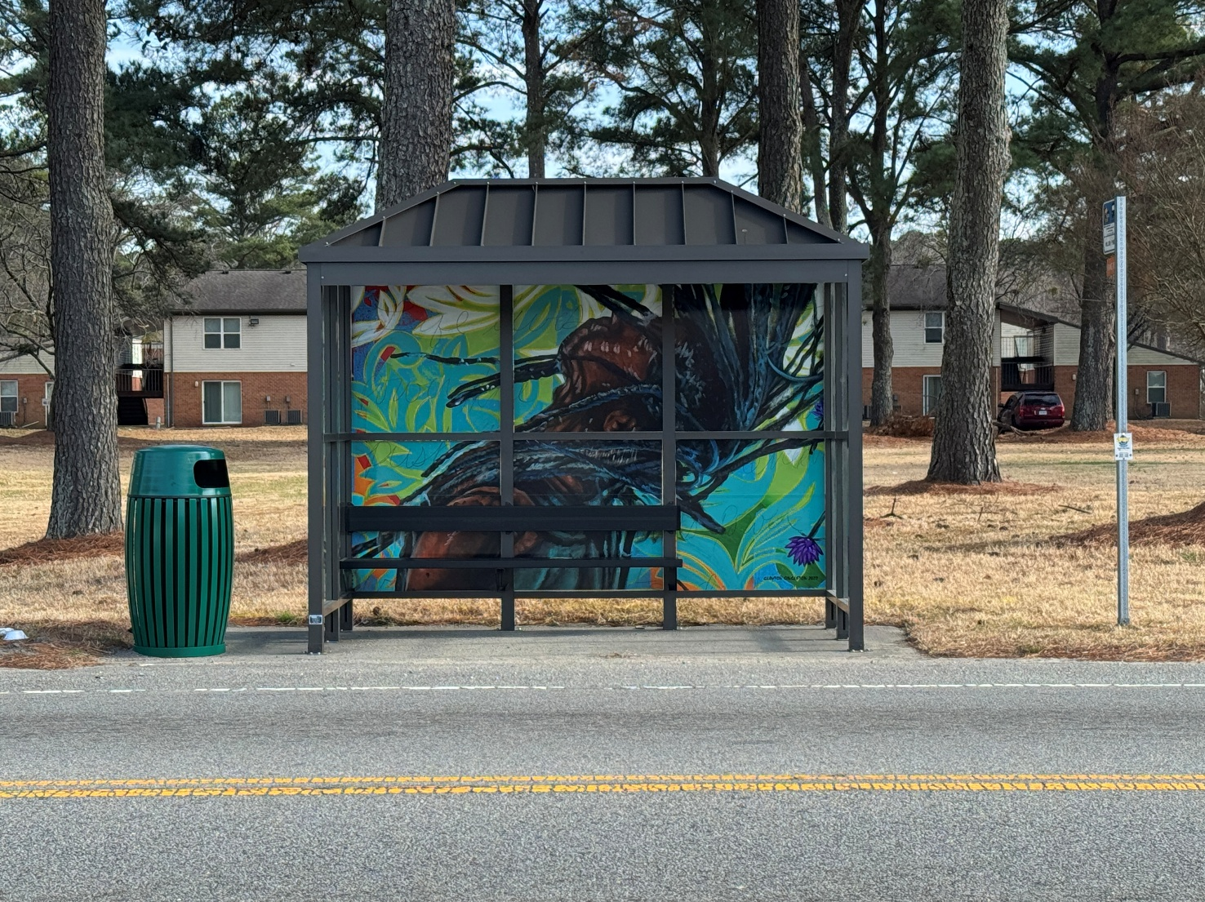
Suffolk Transit Operations
  Operate 8 fixed routes
  189 bus stops and 19 bus shelters
    Artwork has been installed on 5 bus shelters.
  Service Hours
    Monday – Friday – 6:30 am to 8:30 pm
    Saturday – 7:30 am to 4:30 pm

Slide 5
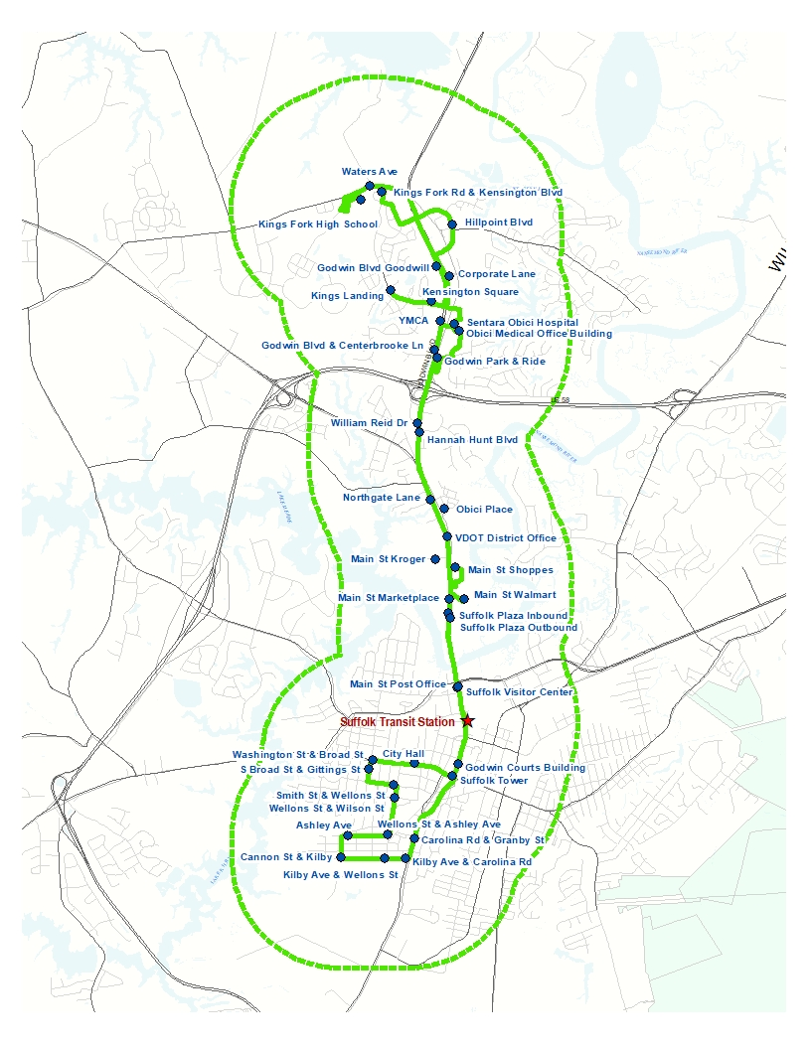
Suffolk Transit ADA Paratransit
  ADA Paratransit operates complimentary to the fixed route service
  ADA boundary is within ¾ of a mile of all the fixed routes
  Paratransit operates the same hours as the fixed route service.
  There is an application process to become ADA certified to utilize the service
  Fare is $3 each way
  Trips are scheduled

Slide 6
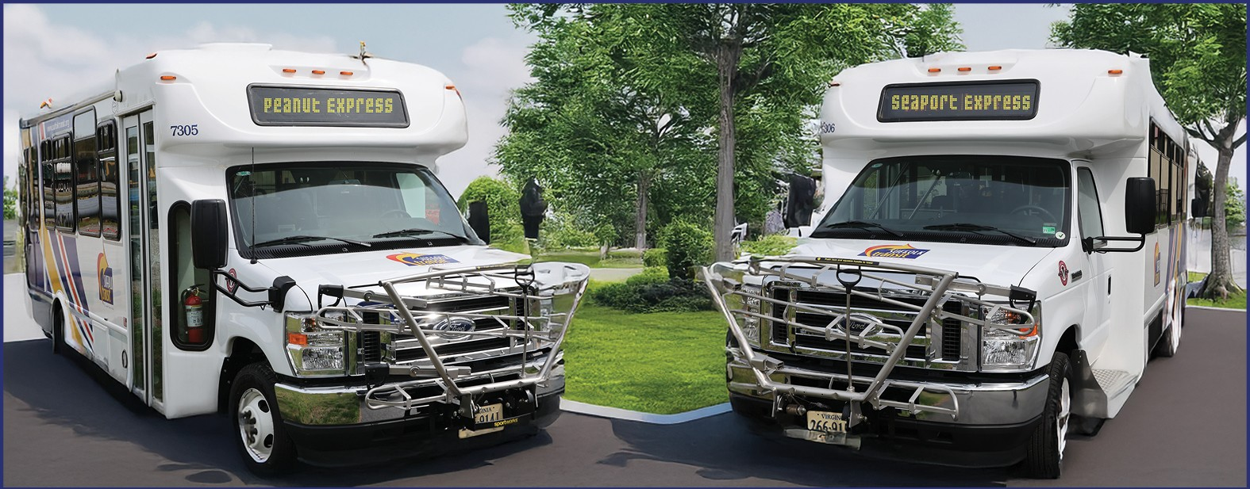
Suffolk Transit Vehicles
  Body-on-chassis buses that seat 19-24 passengers
    ADA Accessible with wheelchair lifts and can transport two wheelchairs at a time
    Bike rack in the front of the vehicle can transport three bikes at a time to assist with first mile/last mile connections
  Paratransit
    Wheelchair - accessible mini vans
    Two electric medium roof vans

Slide 7
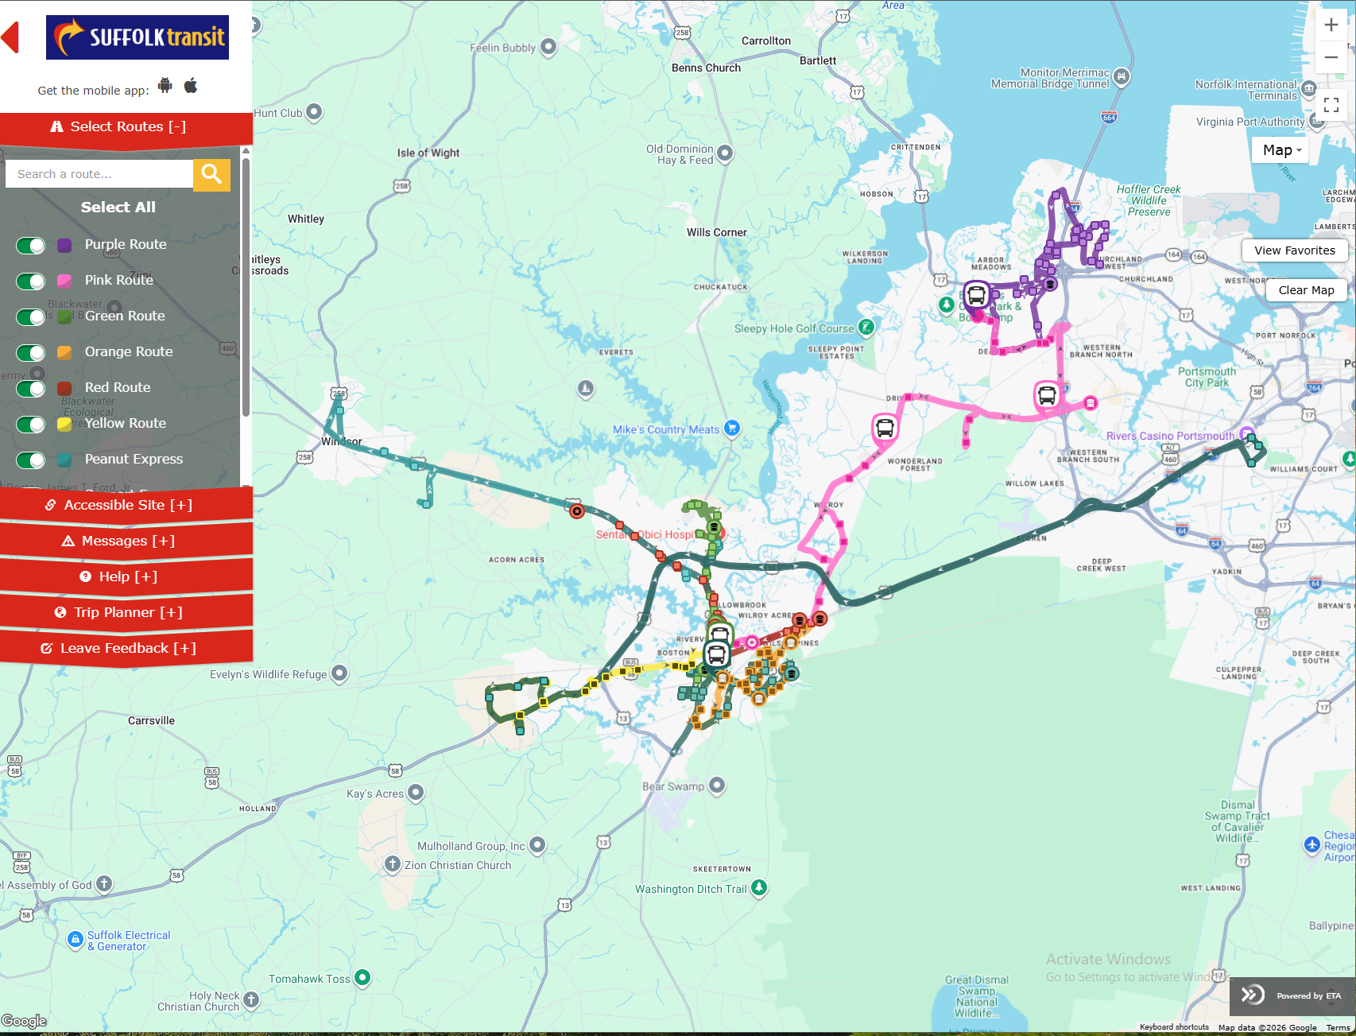
Suffolk Transit Technology
  ETA SPOT
  Since 2017, passengers have had the ability to track their bus through the ETA SPOT app on their phones or via a website
  Service alerts and announcements can be provided through SPOT
  SPOT can help with trip planning

Slide 8
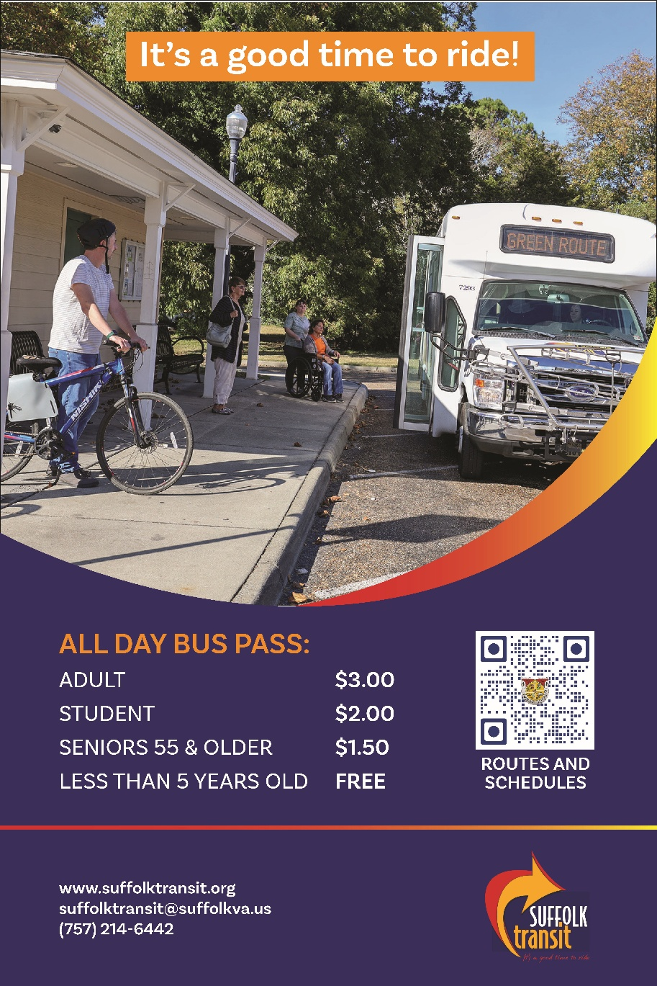
Our Riders
  Passengers seeking transportation to essential services like work, medical appointments, and school.
  Low-income households make up around 33% of our riders.

Slide 9
Suffolk Transit Funding
Suffolk Transit
Public Funding for Operating Budget | FY25 Budget | FY26 Budget | FY27 Budget
Federal Funding
Federal Section 5303 | $9,000 | $9,000 | $ 9,000
Federal Section 5307 | $761,203 | $474,639
Federal Sectin 5311 | $1,016 | $ 595,632 | $1,094,590
Total Federal Funding | $771,219 | $1,079,271 | $1,103,590
State and local
State | $434,023 | $373,177 | $456,282
Local | $984,952 | $1,079,173 | $1,095,590
Passenger Fares | $62,800 | $60,446 | $75,000
Total State & Local Funding | $1,481,775 | $1,512,796 | $1,626,872
Total Public Funding - Operating | $2,252,994 | $ 2,592,067 | $2,730,462
  Suffolk Transit receives funding from the federal, state and local governments and passenger fares.

Slide 10
Thank you for choosing Suffolk Transit –
It’s a good time to ride!
Suffolktransit.org

