Slide 1

WATA PRESENTATION TO HJ 28 JOINT SUBCOMMITTEE
SEPTEMBER 23, 2026

Slide 2
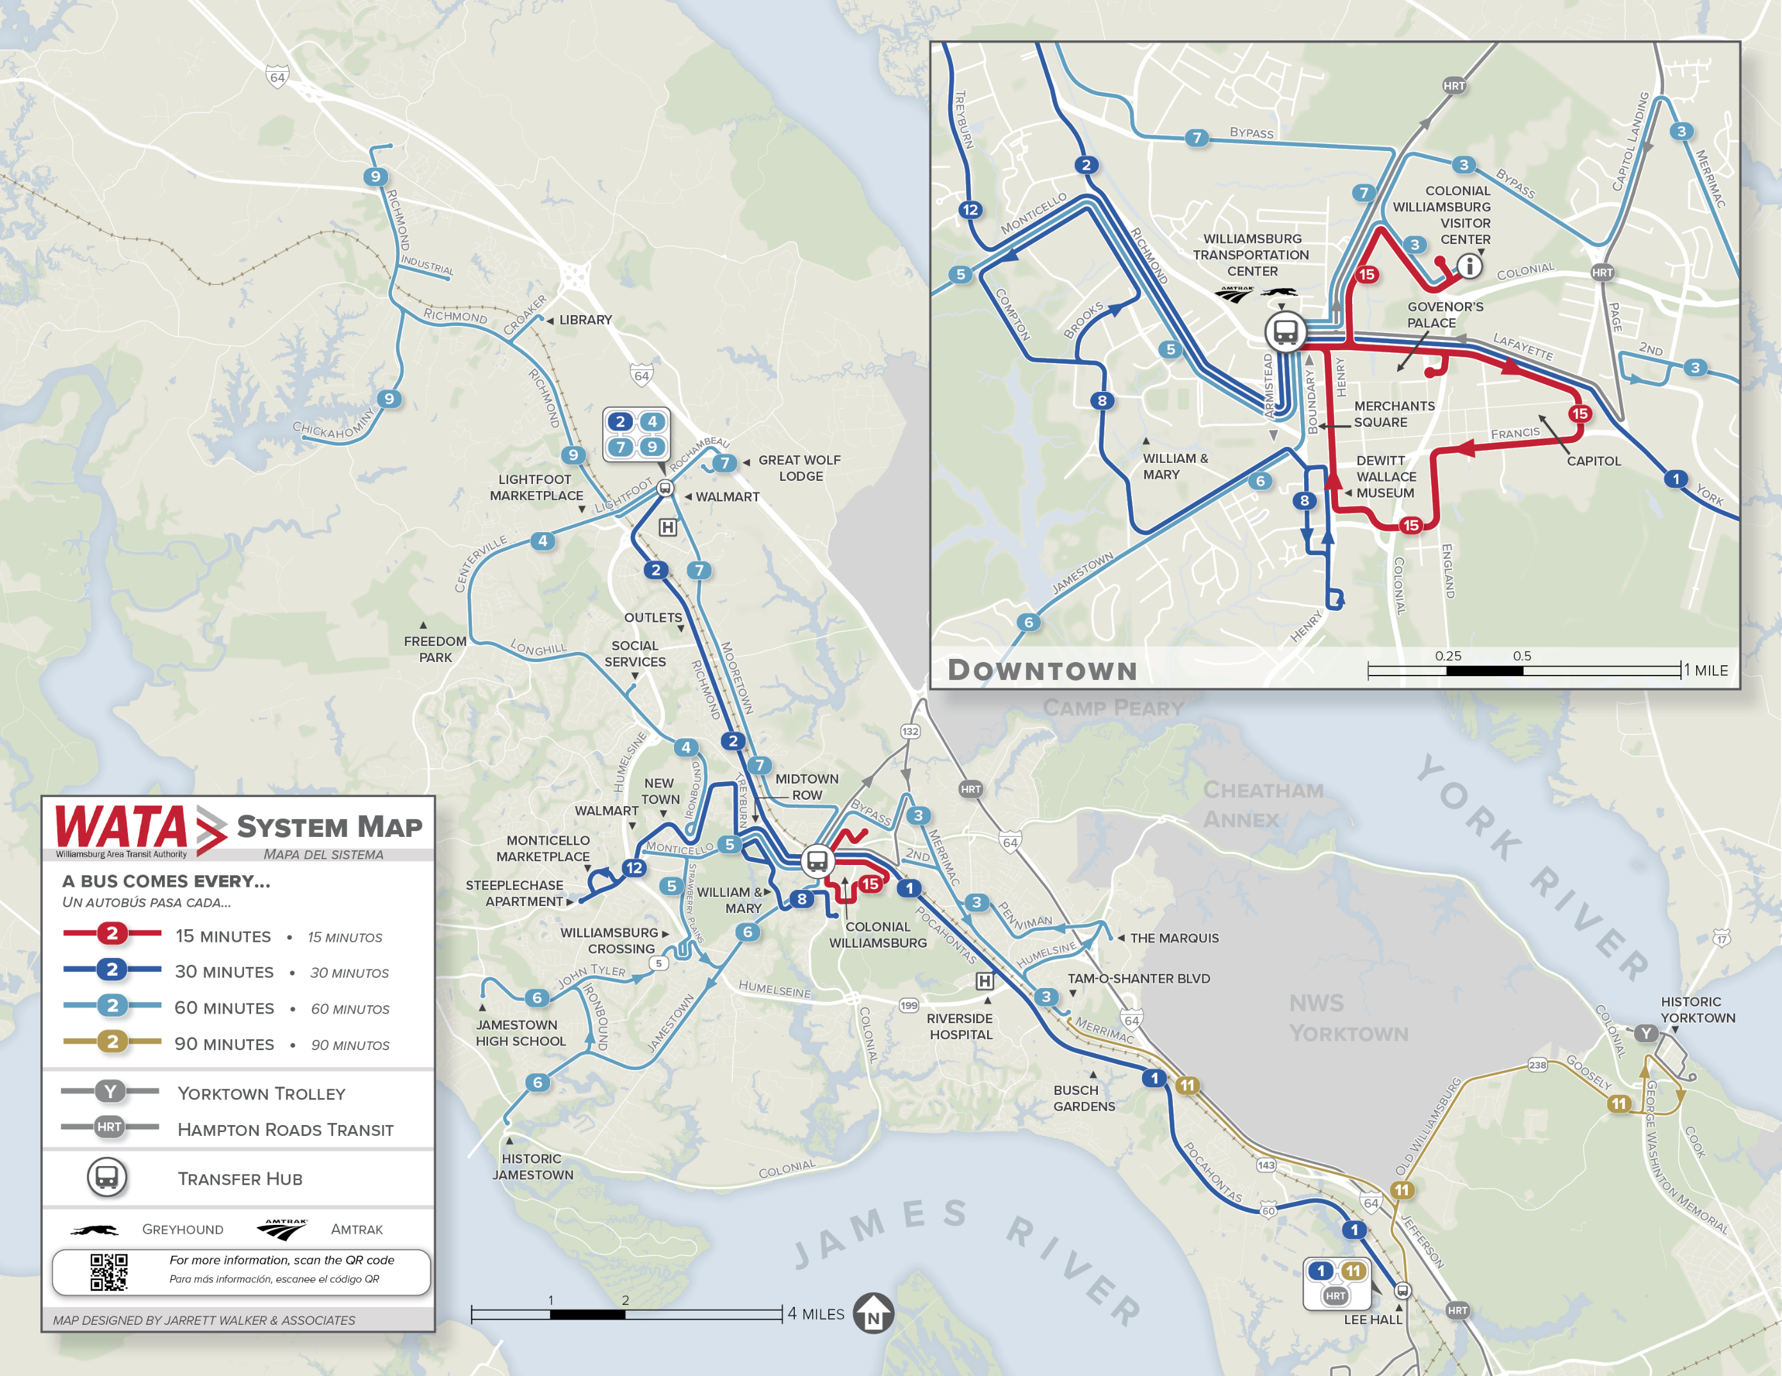
SERVICE
WATA provides service to residents and visitors of James City County, the City of Williamsburg, and the Bruton District of York County.
12 routes total
  10 core routes
  2 specialty routes
Paratransit Service (PTS)
  Within ¾ of a mile bus routes
288 Bus Stops
  53 Shelters
84 Employees
Fare:
  $1.50 per ride
  $3 all day
  $3 PTS per ride
  Student Liberty Fare
  Mobile Ticketing

Slide 3
RIDERSHIP
FY26 TOTAL RIDERSHIP:
1,500,626*
10 CORE FIXED ROUTES
ROUTE 15: COLONIAL
PARATRANSIT
FY26 863,877, 1% increase from FY25 (855,103)
FY26 618,380, 9% decrease from FY25 (677,379)
FY26 19,242, 19% increase from FY25 (16,221)
DATA SOURCE: UTA
*Unaudited

Slide 4
RIDERSHIP
Comparison of Key Routes
Routes 1 & 2, August 2025 vs. August 2026
FIXED ROUTES
Route 1 | Aug-25 | Aug-26 | Diff
Weekday Average | 382 | 425 | +11%
Saturday Average | 326 | 340 | +4%
Sunday Average | 214 | 214 | 0%
Weekly Average | 2450 | 2679 | +9%
Route 2 | Aug-25 | Aug-26 | Diff
Weekday Average | 501 | 554 | +11%
Saturday Average | 398 | 396 | 0%
Sunday Average | 288 | 271 | -6%
Weekly Average | 3191 | 3437 | +8%
DATA SOURCE: UTA

Slide 5
RIDERSHIP
Comparison of Key Routes
Routes 3 & 7, August 2025 vs. August 2026
FIXED ROUTES
Route 3 | Aug-25 | Aug-26 | Diff
Weekday Average | 304 | 355 | +17%
Saturday Average | 230 | 299 | +30%
Sunday Average | 138 | 179 | +30%
Weekly Average | 1888 | 2253 | +19%
Route 7 | Aug-25 | Aug-26 | Diff
Weekday Average | 242 | 267 | +10%
Saturday Average | 195 | 241 | +24%
Sunday Average | 102 | 156 | +3%
Weekly Average | 1507 | 1732 | +15%

Slide 6
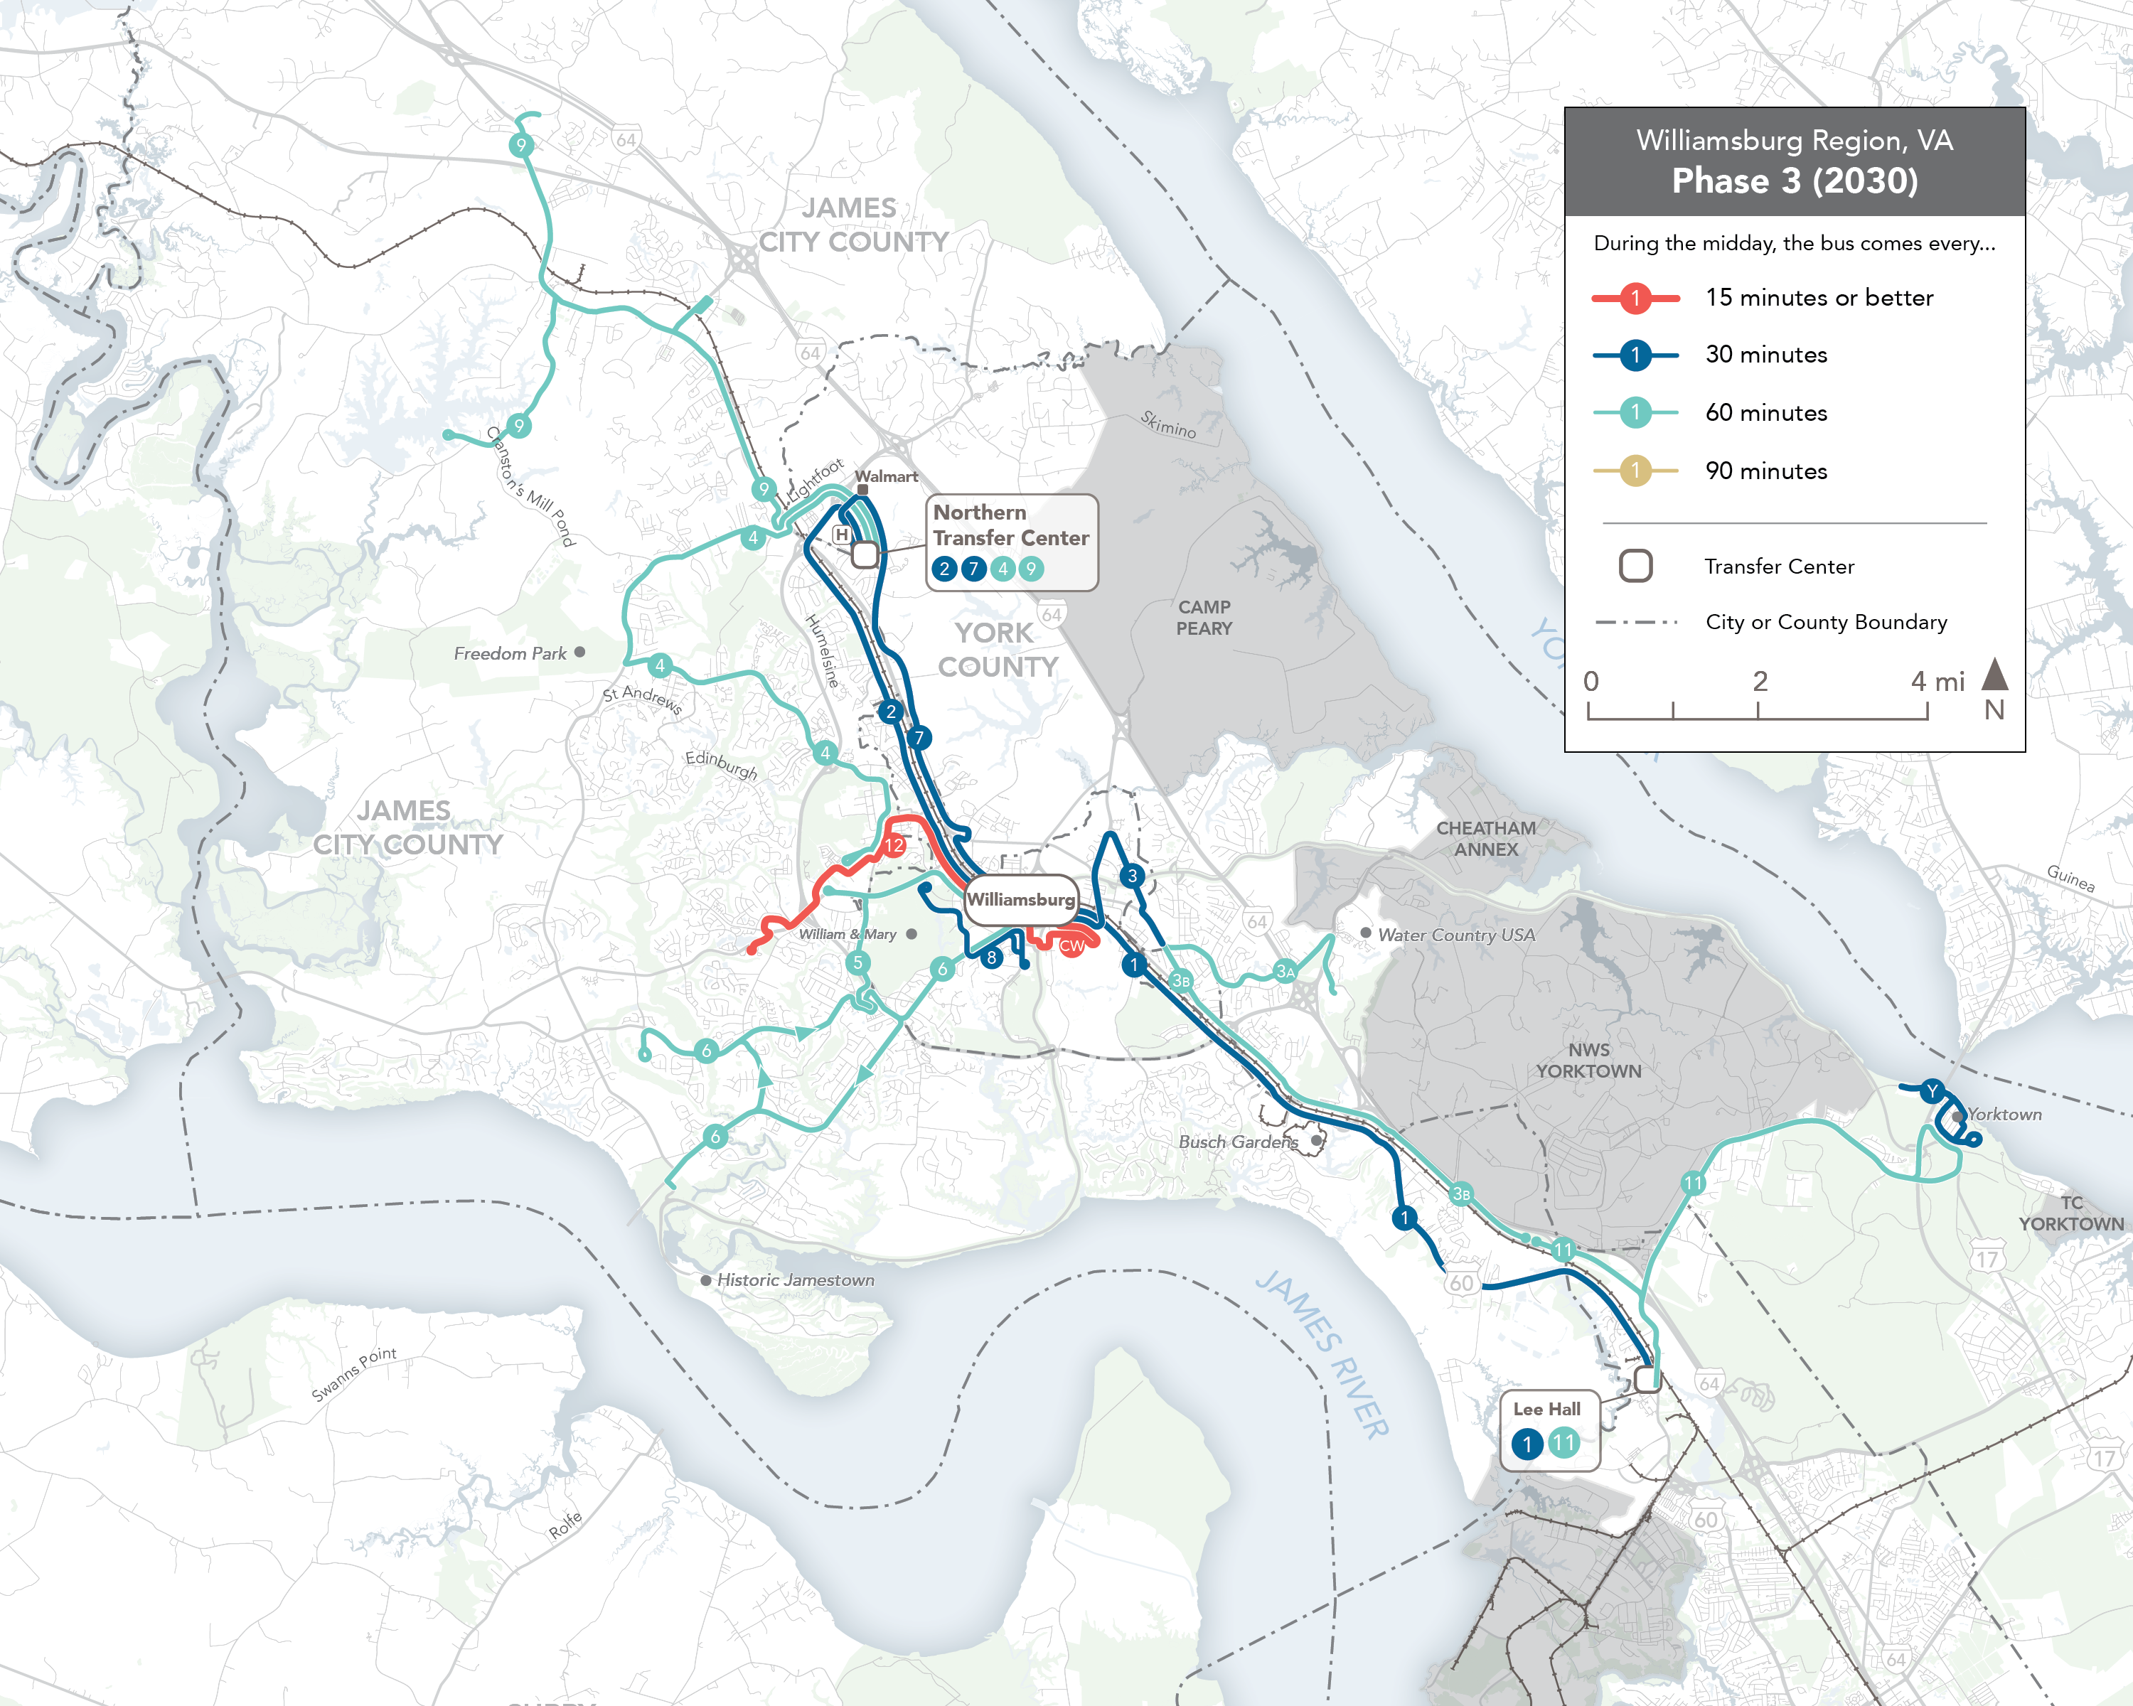
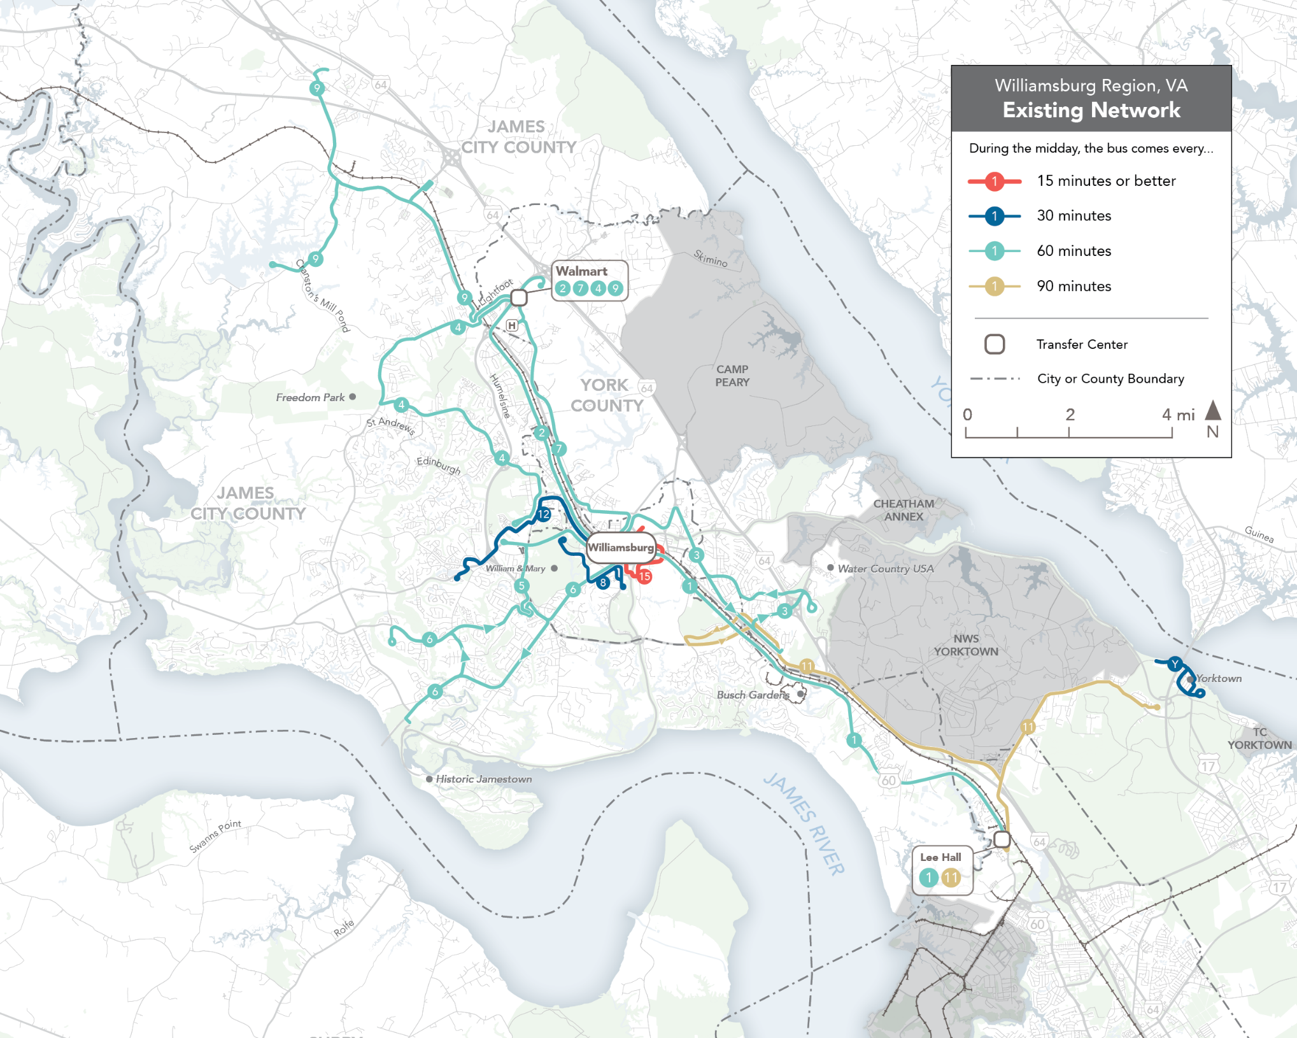
Future Network
TRANSIT STRATEGIC PLAN
3 Phases, 2027-2030
Previous Network
Details:
Increased frequency of 5 routes:
2 Routes of 15-min frequency (+1)
5 Routes of 30-min frequency (+3)
5 Routes of 60-min frequency (+1)
Benefits:
97% more jobs reached in 45 minutes
Frequency → Access → Expanded Opportunities → Ridership → Economic Stimulus

Slide 7
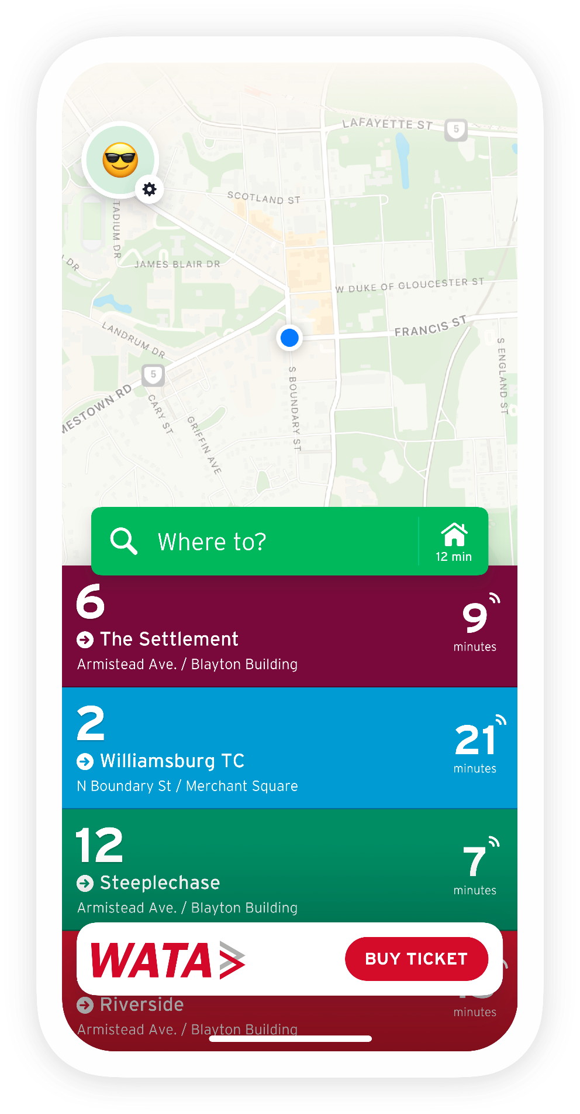
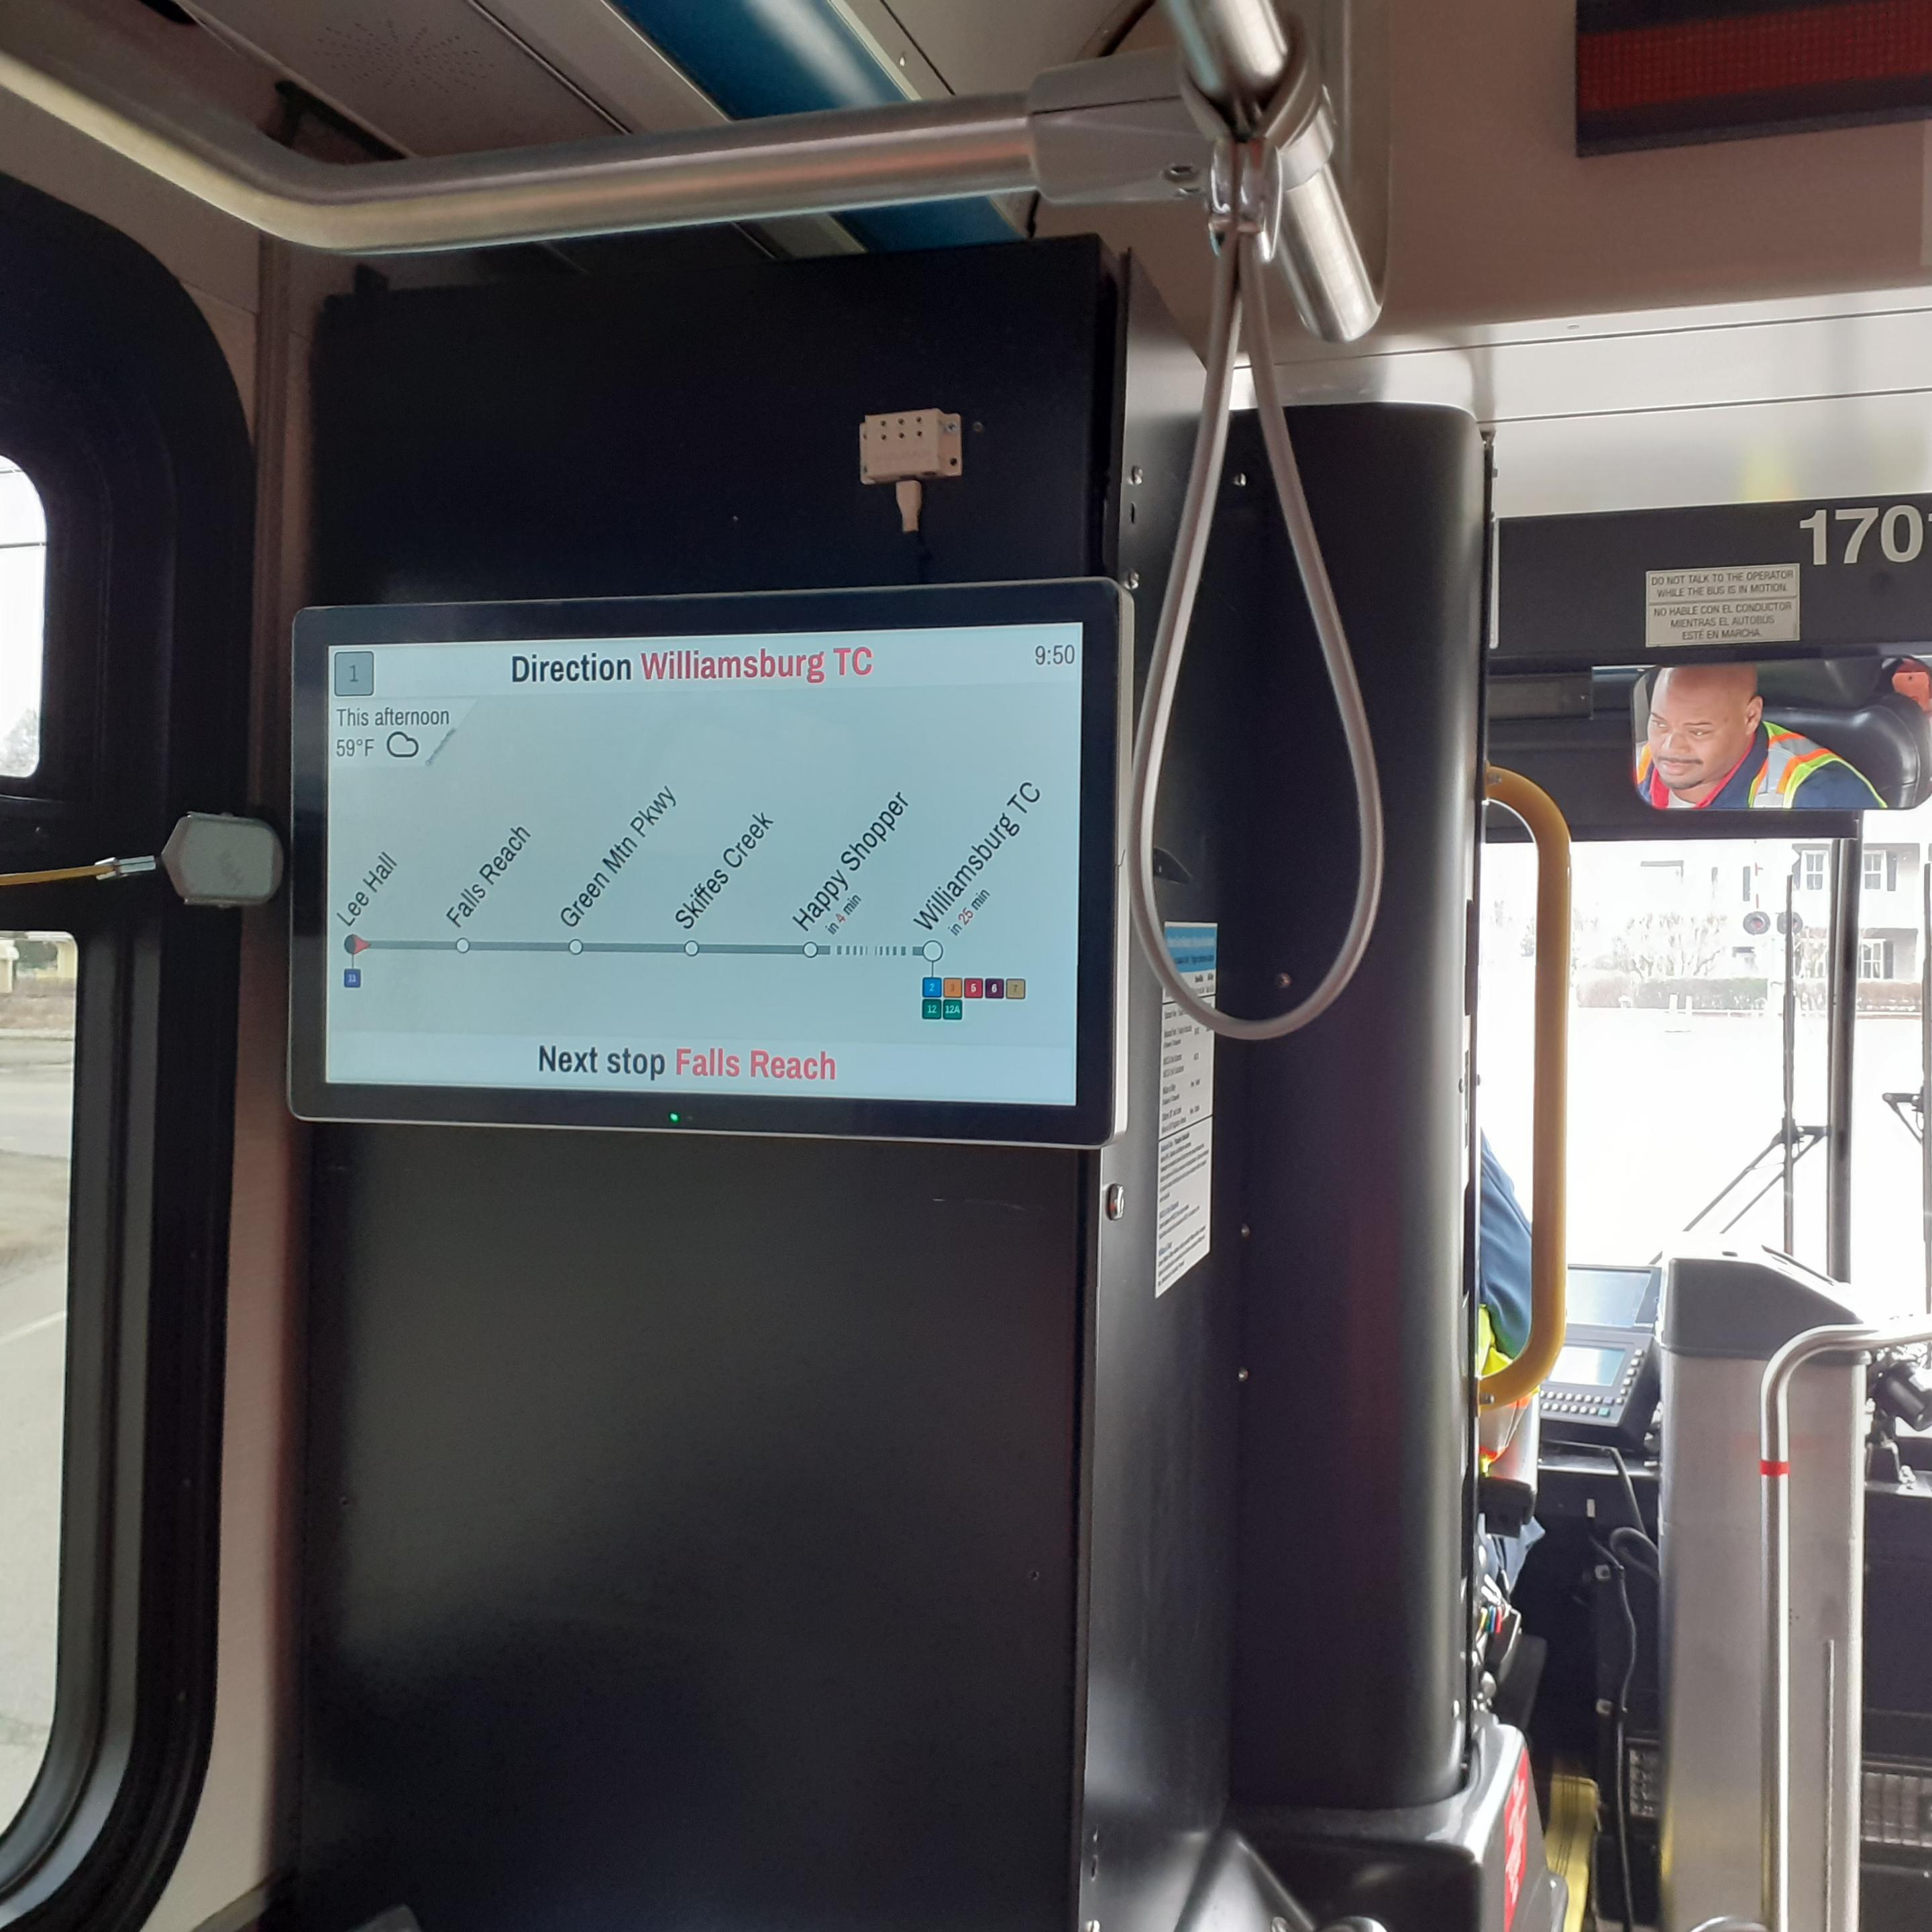
TECHNOLOGY
Transit App
Real-Time Bus Locations
Service Alerts
Step-by-Step Guidance
Mobile Ticketing
Infotainment Screens
Installed on all of WATA’s fixed-route fleet
Step-By-Step guidance on the bus
Service alerts

Slide 8
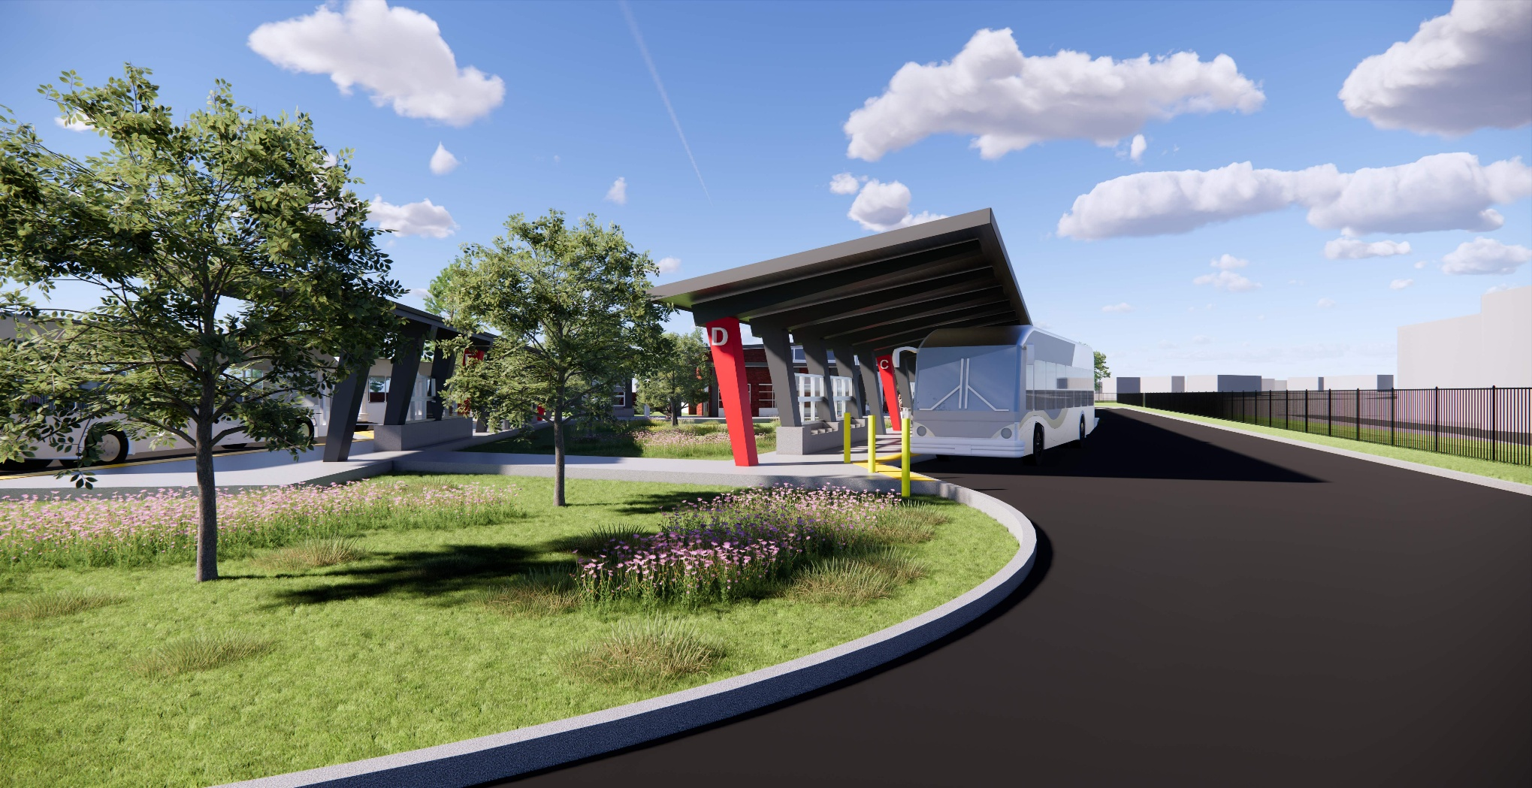
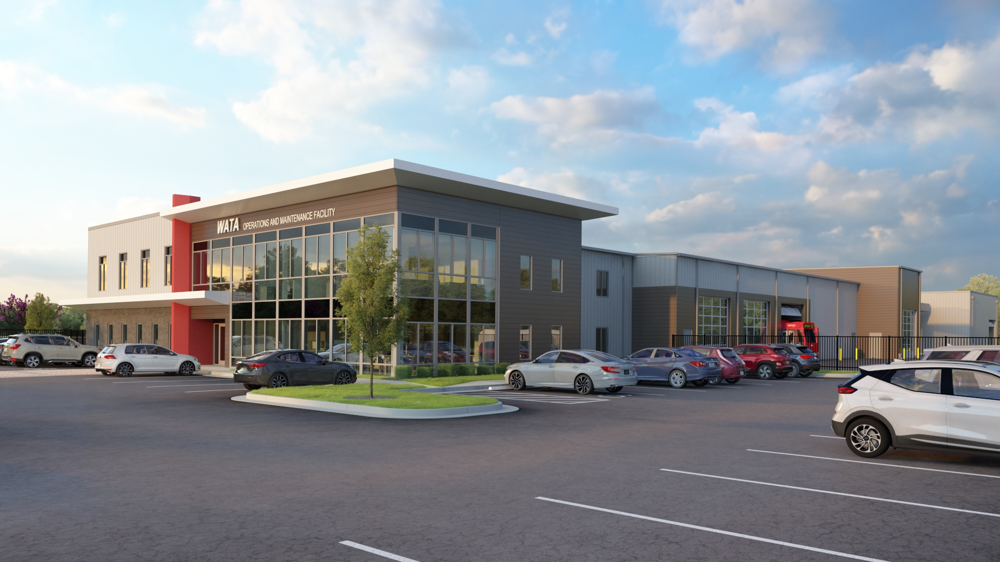
CONSTRUCTION PROJECTS
WATA North Transit Center
December 2026 Opening
$11M Project Cost
Dedicated transfer point for passengers, bathrooms, waiting area, safety
Operations & Maintenance Facility
Re-open Spring 2027
$25M Project Cost
New administrative and operator space, expanded maintenance bays, new bus wash facility

Slide 9
FUNDING
FY27 Revenues: $10,817,186
Description | FY25 Actual | FY26 Amended | FY27 Approved
Operating | $9,835,600 | $10,075,805 | $10,817,186
Other 20%
Federal 41%
Local 15%
Federal/State grants require a local match between 4-50%
State 24%

Slide 10
WATA PRESENTATION TO HJ 28 JOINT SUBCOMMITTEE
QUESTIONS / DISCUSSION

