Slide 1
Senate School Health Services Committee Meeting
School Based Mental Health Services
Kari Savage, M.S.
Director, Office of Child and Family Services

Slide 2
CC. Out of this appropriation, $15,000,000 the first year and $15,000,000 the second year from the general fund is provided for the Department of Behavioral Health and Developmental Services (DBHDS), in collaboration with the Department of Education, to (i) provide grants to contract with federally qualified health centers, or other healthcare organizations, to establish school-based health clinics, including mobile clinics, to serve students and their families, as well as school staff. These clinics shall provide mental health services, primary medical care, and other health services in schools; or (ii) to allow school districts to contract with a mental telehealth or in person provider or direct funding to cover costs of current contractual agreements with a mental telehealth provider. The departments shall ensure that contracted organizations have the capability to bill third party insurers or public programs for services provided. DBHDS shall report on grants awarded to the Chairs of the House Appropriations and Senate Finance and Appropriations Committees by December 1 of each year.
Budget Bill – Item 299

Slide 3
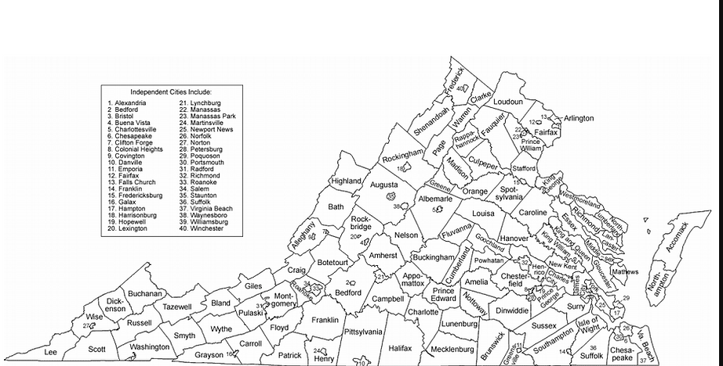
Locality Map
Colors show what year cities or counties became SBMH grantees*
Blue: FY 2023
Gold: FY 2024
Grey: FY 2025
Green: FY 2026
*This graphic shows when they division became a grantee. It does not indicate if the school division is still a recipient of funding
+ Green dots are recipients under the new telemental health budget language

Slide 4
School Based Mental Health Grantee Data
Current SBMH Grantees
From FY 2023 to FY 2024 SBMH grantees increased by 283%
From FY 2025 to Fy 2026 SBMH grantees increased by another 56%
*OCFS was able to incorporate a specialty project approved to address the mental health crisis of students during a natural disaster. “Project Helene”

Slide 5
School divisions partner with a provider (telehealth or in-person) for services delivered within the parameters of the school day
Youth are identified by the school or their guardian/caregiver
Services are delivered on a Multi-Tiered System of Support (MTSS) framework
Consent must be granted by the guardian to participate in services (at Tiers 2 and 3)
School divisions receive ongoing technical assistance from DBHDS
Federally Qualified Health Centers (FQHC) receive funding to establish or expand mental health services provided in schools and communities via clinics (mobile and standalone)
Notes:
Schools identifying youth for services:
Behavior has occurred, school implements screener, screener indicates need for services
MHFA trained staff identify a change in behavior, consults with school MH staff, staff connect with guardian to discuss participation in services

Slide 6
Youth Mental Health First Aid Initiative

Slide 7
The Office of Child and Family Services utilized a portion of the state general funds appropriated to provide Youth Mental Health First Aid (YMHFA) training to school personnel.
This initiative is separate from the community based Mental Health First Aid training that DBHDS offers through the Office of Mental Health, Wellness and Recovery Services.

Slide 8
Collaboration with Virginia Department of Education

Slide 9
Collaboration with Virginia Department of Education
  VDOE has been integral in:
    Development of request for applications (RFA)
    Messaging to school divisions about dates around RFA including submission deadline extensions
    Participation in pre-conference call with school divisions
    Participation in review of applications once received
  DBHDS has worked with VDOE on:
    Reviewing mental health first aid as a part of HB38 for inclusion on guidance to school divisions
    Participation in SB171 stakeholder meetings (discharge paperwork from facilities to schools)
    Providing consultation on HB355
    Contracted with ODU for training and technical assistance videos on School Based Mental Health

Slide 10
Next Steps
  DBHDS has requested a budget increase to further expand school based mental health services
  DBDHDS will continue to work with VDOE on the implementation of the school based mental health continuum
  Per budget language, VDOE is leading the charge on universal screeners in school for mental health
  To date, DBHDS has contributed the following information for guidance to VDOE on universal screeners for mental health in schools: screeners should be evidence based, culturally competent, developmentally appropriate, accessible in various modalities (languages, verbal and written administration, etc.).
  Questions to clarify: when should the screener be administered and what specific conditions or evens should prompt its administration?

