Slide 1
Joint Subcommittee Meeting on Recurring Flooding
October 21, 2026

Slide 2
Overview
Disaster Relief Process
Flooding Expenditures/Costs
Flood Intelligence Unit
Origin of Flooding

Slide 3
Disaster Relief Process
Assess Damage
  - Residential and Commercial Damage
  - Emergency Response and Debris Removal
  - Infrastructure Damage
Determine Potential Assistance Programs
  - Disaster assistance has criteria
Coordinate implementation of assistance programs
Notes:
Notes
Assistance Program Criteria
For State PA - $4 per capita
For Federal PA - $16.7M statewide damages
For IA – 6 factors, including uninsured damages
For SBA – 25 structures that are major/destroyed and uninsured
Wrapping up a revision to the Statewide Recovery Annex

Slide 4
Flood Specific Funding
VDEM administers the following federal grant programs to support local flooding projects
Flood Mitigation Assistance
Building Resilient Infrastructure and Communities
Pre-Disaster Mitigation (Congressional Directive)
Hazard Mitigation Grant Program
Safeguarding Tomorrow Revolving Loan Fund
Notes:
FMA – focused on insured properties with an emphasis on repetitive loss and severe repetitive loss
BRIC – large scale infrastructure projects
PDM – congressional directive spending
HMGP – authorized post-major disaster
STORM – revolving loan fund – working with DCR/VRA

Slide 5
VDEM State Flood Expenditures
VDEM administers the post-disaster Hazard Mitigation Grant Program, which utilizes state sum-sufficient authorized under a Governor’s Executive Order
State Fiscal Year | State Amount Reimbursed to Local Governments | Federal Amount Reimbursed to Local Governments
2026 | $561,153 | $3,883,565
2025 | $798,775 | $4,005,332
2024 | $794,128 | $1,748,284
2023 | $738,989 | $3,504,351
2022 | $203,332 | $1,355,789

Slide 6
Repetitive Loss
Virginia has
  5,849 repetitive loss properties (# mitigated)
  872 severe repetitive loss properties (# mitigated)
Fiscal Year | # of Claims | Cost of Claims
2022 | 240 | $2,553,586
2023 | 138 | $1,736,747
2024 | 144 | $954,255
2025 | 333 | $12,254,935
2026 | 128 | $2,750,681
From Hurricane Helene
Notes:
Talking Points
Repetitive loss properties are located in both coastal and riverine flood settings
Repetitive Loss Definition:
Severe Repetitive Loss Definition:

Slide 7
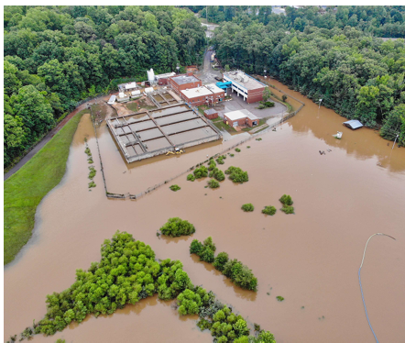
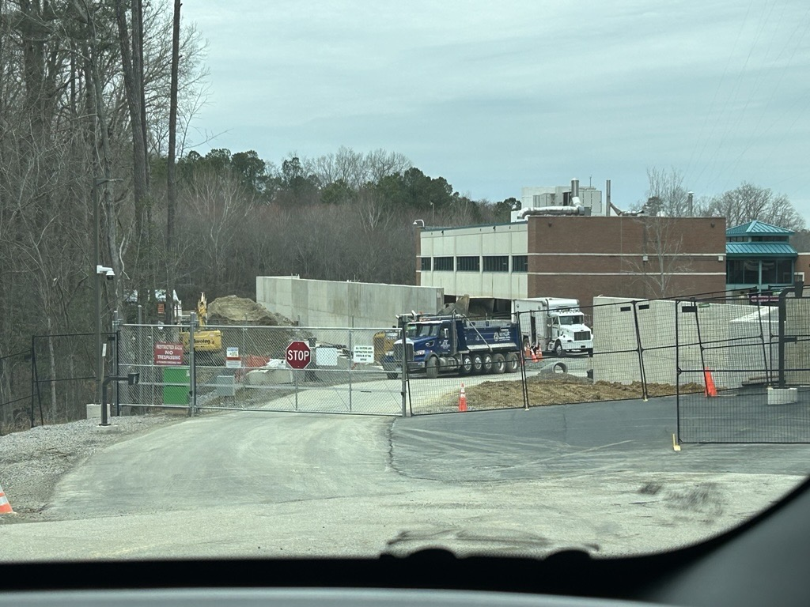
Flood Specific Projects
Project Type | Completed | In Progress
Elevations | 492 | 75
Acquisition/Demolition | 522 | 63
Drainage/Flood Control | 9 | 6

Slide 8
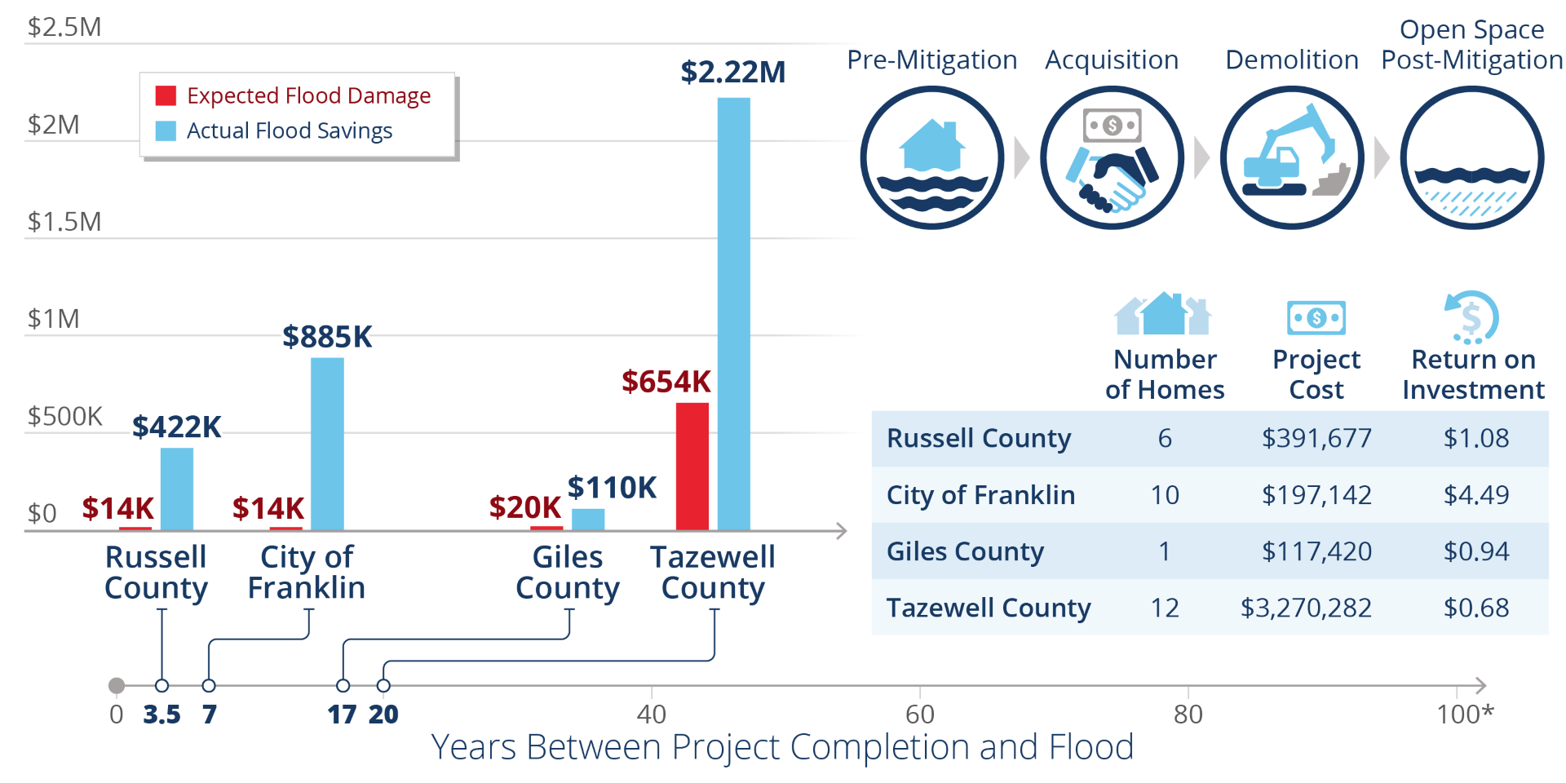
VDEM Tracks Return on Investment

Slide 9
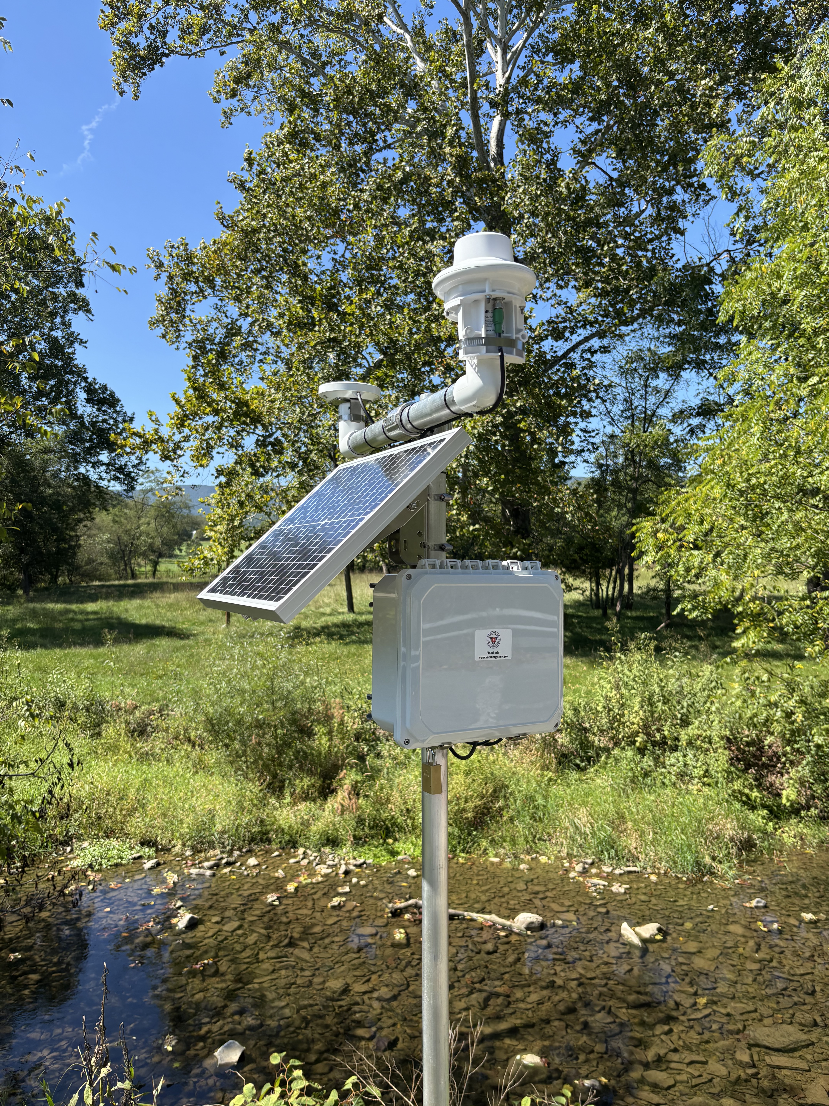
VA Flood Monitoring System
Statewide gauge network that collects precipitation and water level data
210 gauge stations + all data goes to NWS
Complements existing networks from NOAA, USGS, and localities
Data typically reports every 5-15 minutes
Provides quicker detection of heavy rainfall and flash flooding​
Also used for drought/water-supply monitoring

Slide 10
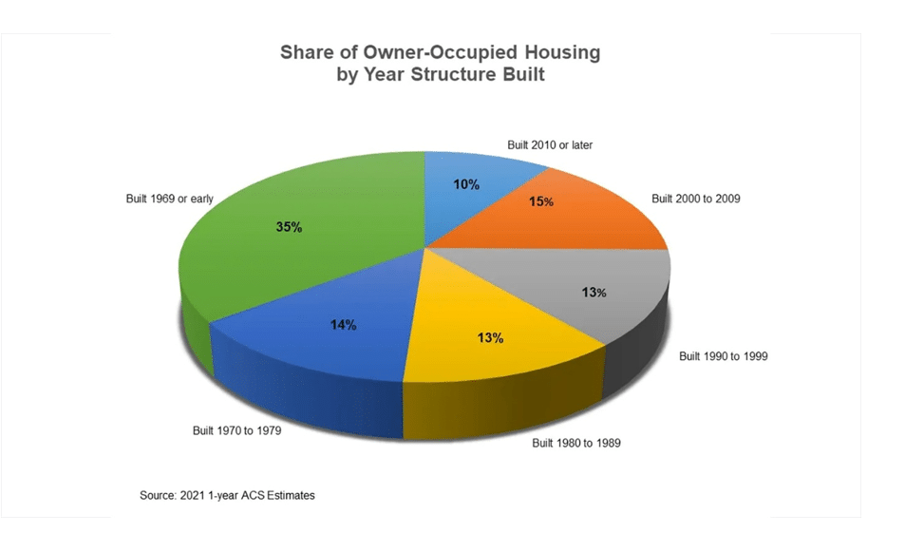
Origins of VA’s Flooding Issues
Earliest developed areas in Virginia are near a water source.
National Flood Insurance Program was not signed into law until 1968, and flood maps not widely available until the mid- 1980s
49% of Virginia’s Homes were built prior to 1980, and built prior to an understanding of flood risk
There are over 600,000 structures in the FEMA mapped floodplain totaling over $65B
Notes:
Talking Points
- VDEM understands the flaws around flood mapping, but prior to the NFIP there was no flood zone or regulatory requirements.

Slide 11
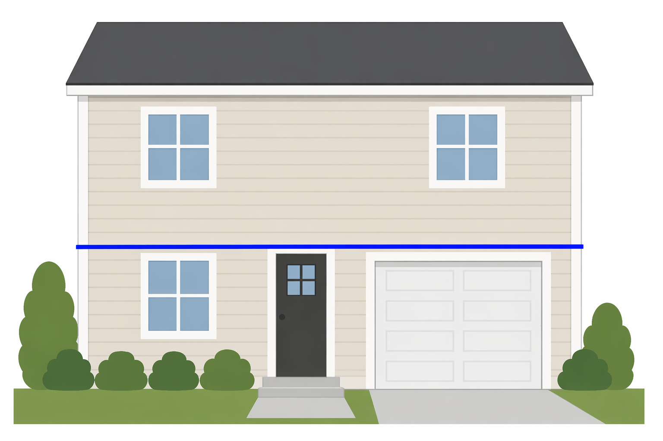
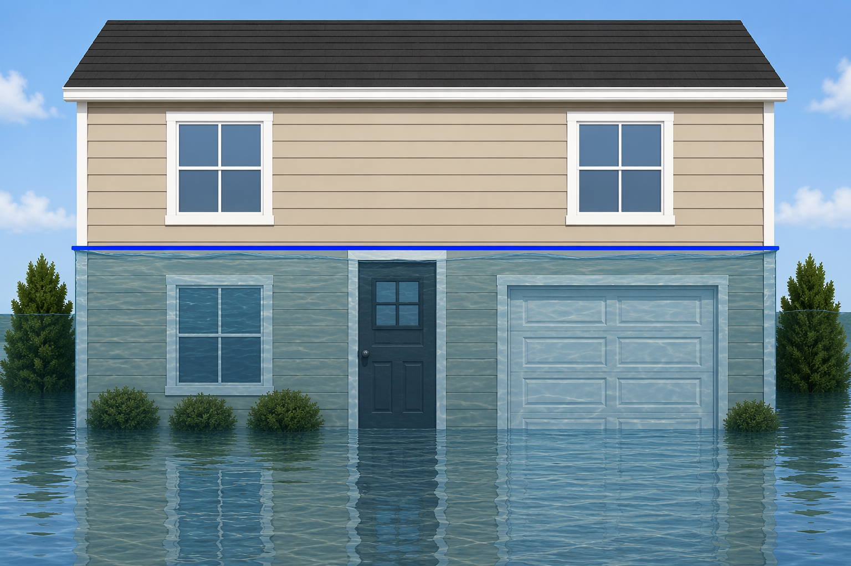
Disasters Amplify this Issue
Hypothetical Situation
House Built in 1974
Generational House, no mortgage
No Flood insurance
1% flood depth is above door frame
If a 1% flood or greater occurred
Home would sustain damage exceeding 50% of the home value
Local floodplain ordinances dictate that local government issues a substantial damage letter, requiring compliance with all current codes
There is no financial assistance to support
*If the President authorized an Individual Assistance Declaration, the maximum amount a homeowner would get is $46,400
Notes:
Talking Points
- If this property owner had flood insurance, they may get up to $30,000 in ICC to assist with the substantial damage code requirements

Slide 12
Contact Information
Phone Number
Email@VDEM.virginia.gov

