Slide 1
BRIEFING TO THE "GROWING IN GRACE" SUBCOMMITTEE
Advancing Brain Health Equity
Early Detection, Inclusive Registries, and Policy Solutions for Virginia’s Aging Women
Hamid Okhravi, M.D. | Medical Director, Richard Roberts Comprehensive Memory Center, ODU

Slide 2
Outline
Recent advancements in the field of Alzheimer’s treatment and diagnosis
Shirley & Richard Roberts Comprehensive Memory Center
Disproportionate dementia risks, diagnostic and therapeutic gaps in underrepresented populations
Health equity and brain health:
  Challenges and solutions

Slide 3
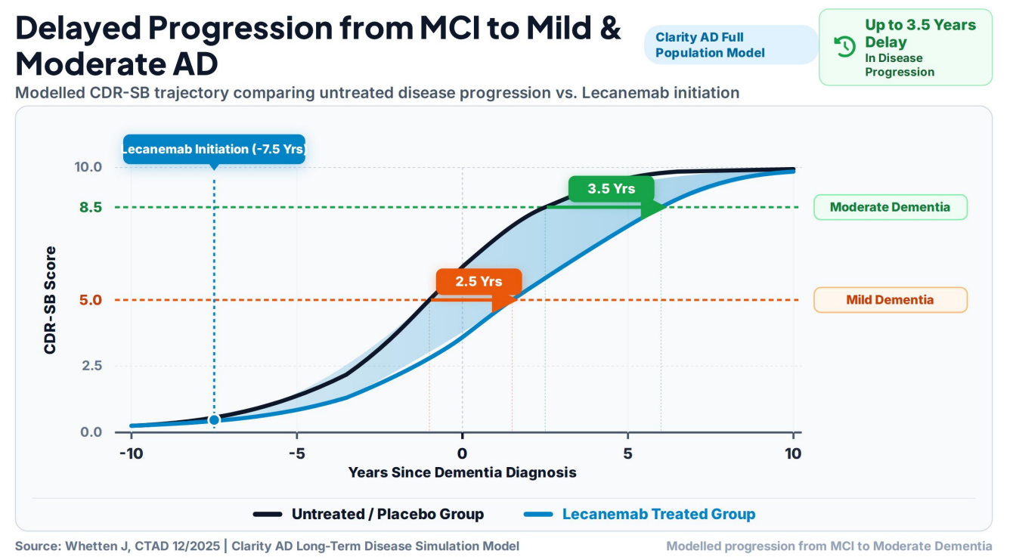

Slide 4
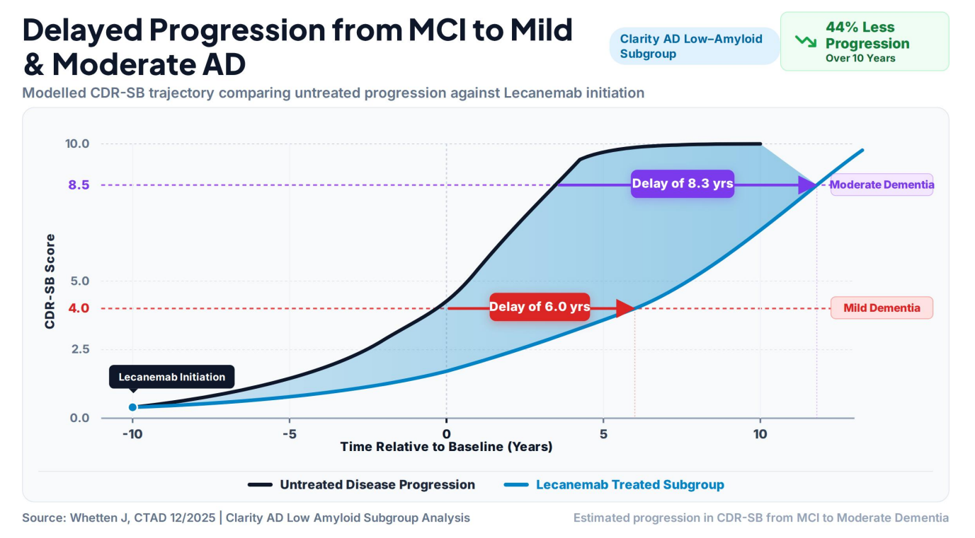

Slide 5
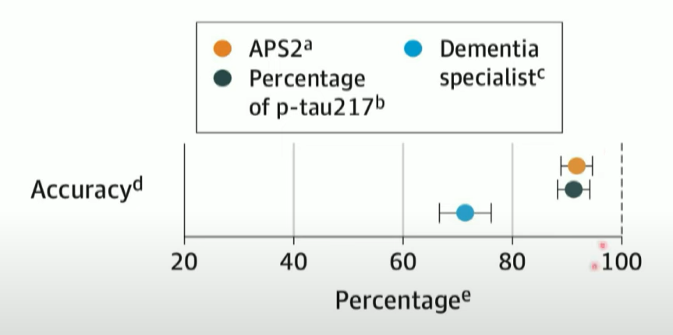
High Accuracy of Blood Tests for AD
Blood Test: 91%
Specialist
Specialists: 73%
Primary Care
Primary Care: 61%
Palmqvist S, JAMA 2024

Slide 6

CLINICAL CENTER OF EXCELLENCE
Institutional Foundation & Clinical Reach
3,500+ Annual Patients
Evaluated at the Richard Roberts Comprehensive Memory Center.
20 Active Research Studies
Includes cutting-edge clinical trials for patients & families to participate.
Regional Catchment
Serving Hampton Roads (75%), North Carolina, Williamsburg, & Richmond.
Novel Therapeutics
Active infusion program delivering novel disease-modifying therapies.

Slide 7

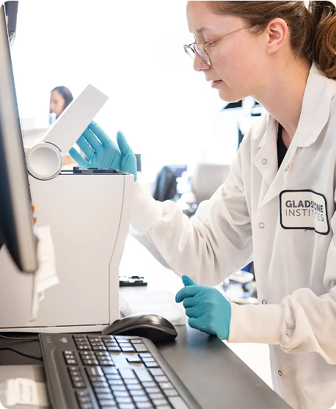
DATA-DRIVEN RESEARCH
The Memory Center Registry Project (MCRP)
Est. 2021 · Philanthropic Support
Largest non-federally funded memory registry in Virginia
5 Years
2,000+
Longitudinal Data
Data Points / Visit
600+ active participants (MCI, Alzheimer's, LBD, healthy controls)
Biomarkers, cognitive testing, genetics & SDOH
NATIONAL RECOGNITION
ACTC Site Member
Official Site Principal Investigator network member of the NIA-funded Alzheimer's Clinical Trials Consortium since July 2023.

Slide 8
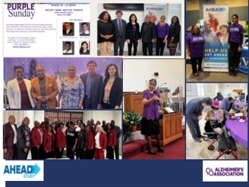



COMMUNITY ENGAGEMENT
Bridging Trust: "Purple Sundays"
Faith-Based Outreach
Partnering with pastors and the Ministerial Alliance for health education.
14,000+ Reached
Directly engaged at churches and community expos in under two years.
Community Advisory Board
Guiding respectful research and expanding clinical trial diversity.

Slide 9
PUBLIC HEALTH & NEUROPATHOLOGICAL DRIVERS
Disproportionate dementia risk: Women & African Americans
2 in 3
2x
Up to 40%
Women's Risk Profile
African American Risk Profile
Undiagnosed Due to Structural Barriers
Accounts for ~67% of Alzheimer's cases.
2x as likely to develop dementia vs. white peers.
110,000 of Virginia's 164,000 Alzheimer's patients are women.
Black Americans with Alzheimer's remain undiagnosed, missing early intervention windows.
Virginia Patient Impact:
•
USP11 Tau Accumulation: X-chromosome gene escape accelerates tau spread.
• Total Black Virginians with Alzheimer's: 44,000
$1.44B
•
Post-Menopausal Priming: Estrogen loss triggers microglial priming.
• Black Women with Alzheimer's: 30,000
•
Vascular Comorbidities: Hypertension & diabetes drive vascular dementia.
Medicaid Burden
•
APOE-ε4 Interaction: Escalates risk between ages 65–75.
Annual Virginia Medicaid cost for late-stage dementia care.
•
ABCA7 Risk Variants: Population-specific gene variants alter lipid processing.
•
Social Determinants: Environmental barriers & care access gaps.
Policy Target: Shift spending to early detection
Caregiving: 66% of family caregivers
Clinical Trials: <5% national participation
Compounded Risk for Black Women:
Highest overall risk due to systemic stressors and health inequities.

Slide 10



CLINICAL RESEARCH EQUITY
Diversity & Inclusion in Clinical Trials
Why Inclusion Matters
Underrepresentation
Aducanumab Phase 3 Clinical Trial
Critical Alzheimer's clinical trials demonstrate persistent underrepresentation of minority populations:
Differential Disease Experience
People may experience disease progression, biological markers, and treatment responses differently.
19 (0.6%)
African Americans
104 (3.2%)
Hispanic / Latinos
Universal Benefit from Science
Trial cohorts must reflect diverse lived experiences so that all communities benefit from scientific advances.
Out of 3,268 total participants in the study, minority representation remained strikingly low despite higher population risk.
The field needs participants of every race and ethnicity to find an Alzheimer's treatment that works for everyone.
Goal: Effective treatments developed for every race and ethnicity.

Slide 11
HEALTH EQUITY & BRAIN HEALTH IMPACT
Addressing Disparities in Diagnosis & Treatment Delays
The High-ADI Barrier in Norfolk, Portsmouth & Newport News
High Area Deprivation Index (ADI) census tracts across urban Hampton Roads create systemic barriers to routine cognitive screening, specialty care referrals, and early biomarker evaluations.
Diagnosis Delay
Treatment Delay
Brain Health Initiative Solution
Patients in high ADI areas present at significantly later stages due to limited specialty care access and screening rates.
Delays close the window for disease-modifying therapies (DMTs), which require early-stage intervention to slow disease.
Mobile community screening pipelines: Bringing early memory screening directly into high-ADI neighborhoods.
• Bridges early biomarker testing & clinical trial registries.
• Expands research access for Black women in urban corridors.

Slide 12
OVERCOMING EQUITY OBSTACLES
Barriers Facing Older Women in Care
Caregiver Strain
Travel & Cost Barriers
Trial Exclusion
Black women disproportionately serve as primary caregivers (>40 hrs/wk), limiting personal care time.
Transportation hurdles restrict access for low-income seniors in high-ADI areas.
Traditional trials often exclude patients with common comorbidities like hypertension.

Slide 13




STRATEGIC GROWTH
Brain Health Collaborative & Sub-Registries
Brain Health Registry
Central clinical registry driving participant engagement & population health research.
United Way Partner
Co-leading with United Way of South Hampton Roads for community reach.
African American Sub-Registry
Women's Sub-Registry
Hispanic / Latino Sub-Registry
Investigating biomarker variants and vascular risk factors in Black populations.
Evaluating reproductive history and hormone impacts on brain aging.
Addressing 1.5x higher dementia risk, metabolic links, and bilingual clinical access.

Slide 14
POLICY RECOMMENDATIONS
Policy Roadmap for General Assembly
01
State-Level Seed Funding
Support $500,000 launch funding to expand inclusive brain health sub-registries.
02
Community-Academic Partnerships
Formalize state frameworks connecting EVMS/ODU with civic leaders.
03
Geriatric Workforce Investment
Fund specialized memory care navigators and Community Health Workers.

Slide 15
THANK YOU
Building a Brain Healthier Commonwealth
Moving Virginia from late-stage dementia crisis care to proactive, equitable brain health solutions
Questions & Discussion

